Slide 1

Client Name
Notes:
This presentation is being presented by Mercer Marketplace 365+. My name is ____________ and I am happy to be here with you today!

Slide 2

Commuter benefits
Notes:
Thank you for joining us today to cover your company’s sponsored Commuter plan.

Slide 3

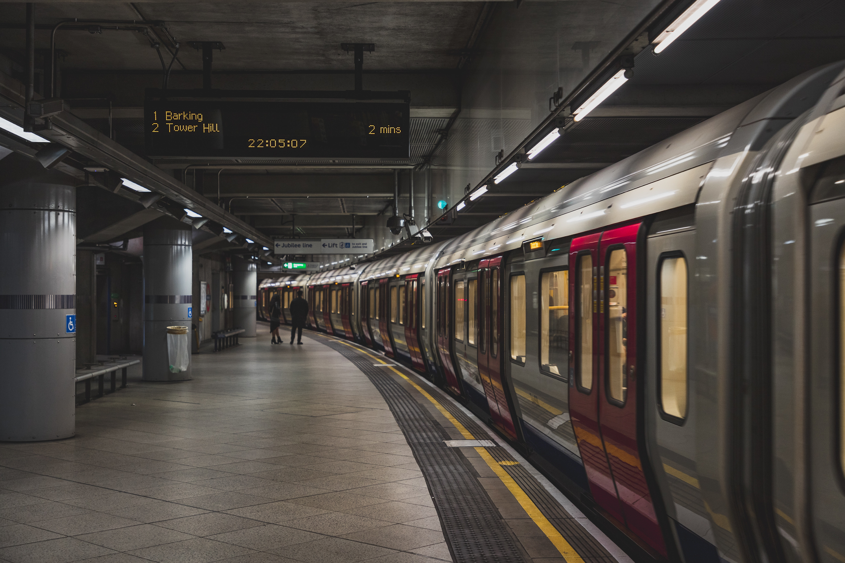
Benefits - Transit
Pay for transportation to and from work – tax free
  Contribute up to $315 a month (pre-tax)
  Make post-tax contributions at any time
  Public transportation such as train, bus, subway, vanpool (vehicle that seats six or more adults, excluding the driver), ferry, etc.
Notes:
Why should you choose commuter benefits?
Commuter benefits allow you to put money from your paycheck aside each month, before taxes are taken out, for qualified mass transit and parking expenses.
You will experience fast savings, you can save 40% or more on your costs commuting to and from work.
You will also get hours back in your day, the average one way commute to work is nearly 30 minutes! By using public transit, you can use that time to read news, text friends or family, or simply get a start on your day.
Studies have also shown that people who commute to and from work in a method other than a private vehicle are less stressed.
Enrolling in the commuter plan also makes an impact on the environment, doing your part to reduce traffic congestion and air pollution.

Slide 4

What does the plan cover?
Eligible modes of transportation include but are not limited to:
Train
Bus
Subway
Ferry
Vanpool (must seat at least six adults)
Parking or parking meter near your place of employment
Notes:
What does the commuter plan cover?
Commuter funds can be used on a variety of transportation and parking expenses that allow you to travel to and from work.
Eligible modes of transportation include but aren’t limited to:
Train
Bus
Subway
Ferry
Vanpool (must seat at least 6 adults)
Parking or parking meter near your place of employment

Slide 5

Annual contribution limit
2024 commuter benefit maximum per month:
$315
$315
Transit:
Parking:
Any money contributed to your transit or parking benefit rolls over every month until it’s used or you are no longer eligible.
Notes:
The IRS sets the maximum dollar amount you can elect and contribute to the commuter and parking plan.
The 2024 limit is $315 per month for both transit and parking.
We recommend reviewing how much you spend on eligible expenses every year to determine how much to elect.

Slide 6
Smart commute
Notes:
Now let’s talk about smart commute.

Slide 7



Smart commute
For those in Chicago, San Francisco, and Washington D.C.
^{Step 1}
^{Step 2}
^{Step 3}
^{Step 4}
^{Enroll in mass transit plan.}
Purchase a smart card from your transit authority in Atlanta*, Chicago, San Francisco, or Washington D.C.
Log in to your online account, go to the commuter page, and load your pre-tax dollars onto your smart card by clicking “New Order.” You must do this at least a month in advance.
Pre-tax dollars are available on the smart card on the 1st of the benefit month. You can begin spending!
*Not required for Atlanta; the smart card will be mailed to consumer after the first smart commute order is placed.
Notes:
Those eligible for Smart commute can load commuter funds onto transit cards through a commuter page in their online account each month. It’s easy! Just click the “Place Commuter Order” button to access Smart commute, click the “New Order” button and follow a few simple steps.
Smart commute orders must be placed by 11:59 p.m. Eastern time on the 10th of the month prior to the balance being used for commuter funds to be accessible on your transit cards. If this deadline isn’t met, funds won’t be loaded onto transit cards.

Slide 8
Accessing your funds
benefits card
Cash reimbursement available for parking
File the parking claims through your online account or mobile app
No documentation required
Notes:
You can access your commuter funds by using your benefits card or by filing a claim for reimbursement through your mobile app.

Slide 9
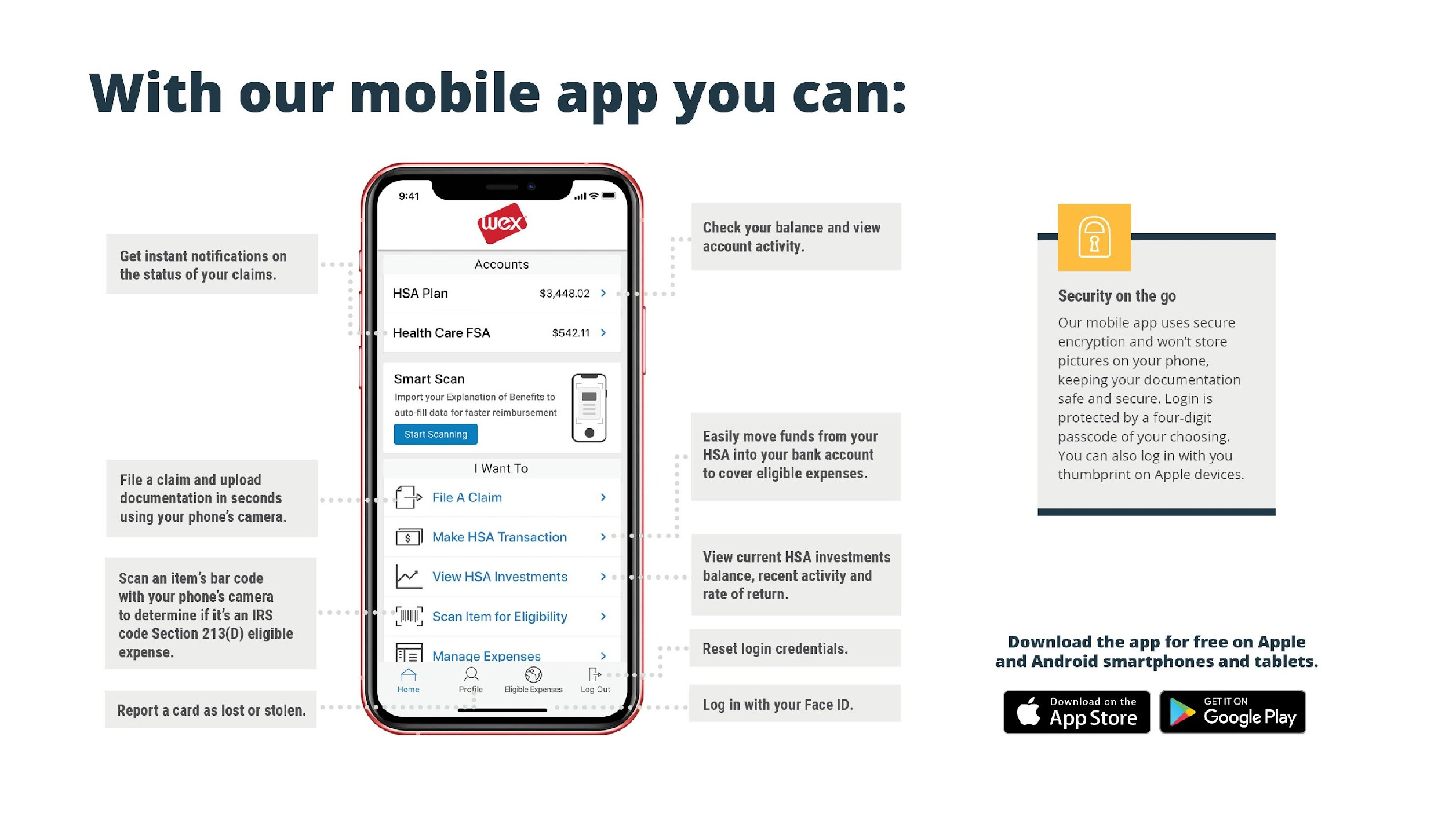
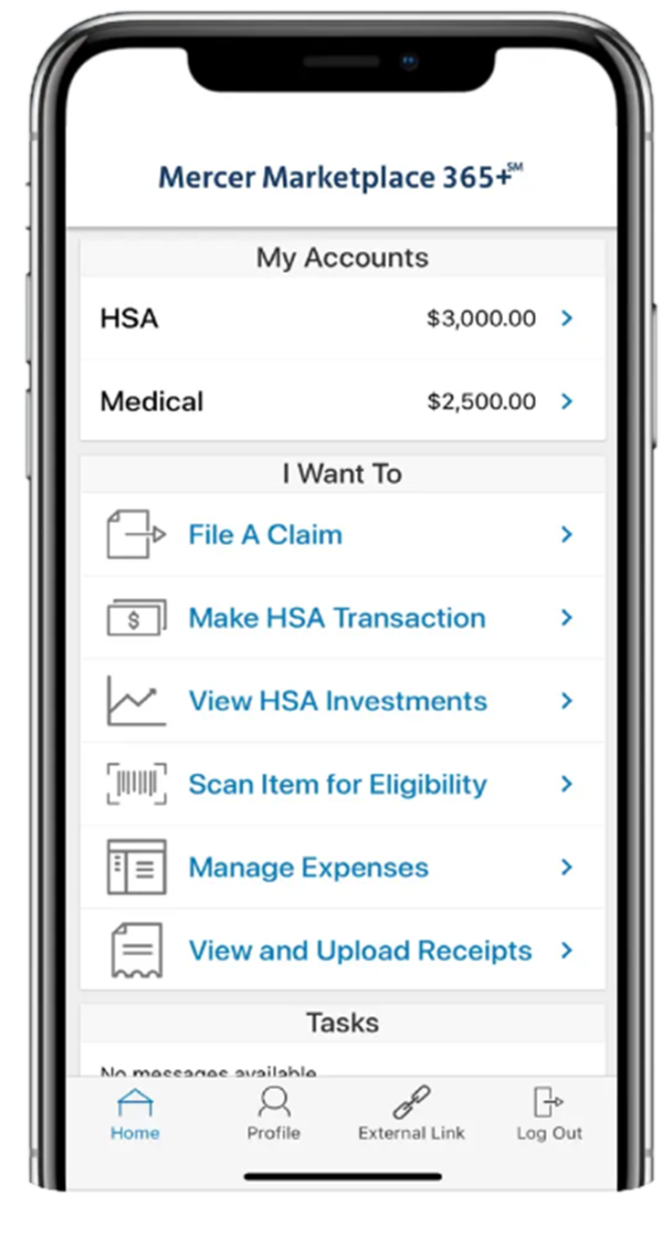
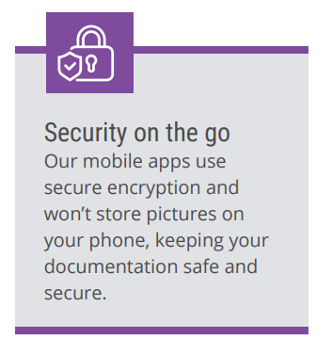

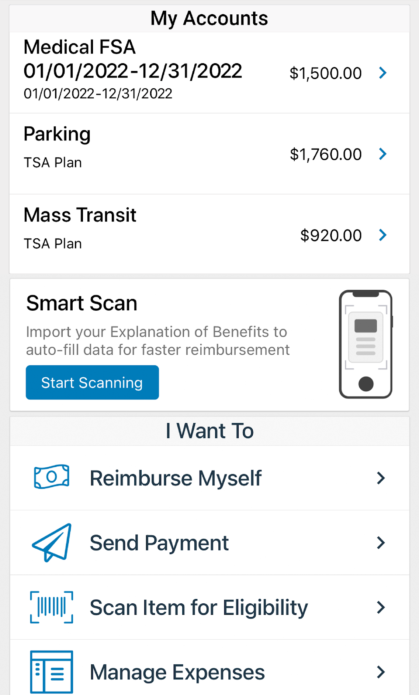






With our mobile app you can:
Notes:
The Mercer Marketplace Accounts Mobile App provides you with quick easy access to your online account. After logging in the first time, you can set up fingerprint access right from your phone.
Other great features include:
Take a photo of your explanation of benefits or itemized receipt in order to submit documentation for any outstanding claims. This saves a ton of time since you don’t have to scan an email receipt and upload it manually.
Easily check your account balance while standing in line at the store, making it easy to decide if you want to use your FSA dollars to cover a purchase.

Slide 10



Contact Participant Services
Our Participant Services team is available Monday through Friday, from 6 a.m. to 9 p.m. Central time, except holidays.
^{Live Chat}
^{Email}
^{Phone}
mercermarketplaceaccounts@serviceaccount.com
^{Toll-Free: 877-248-0510}
Notes:
Our participant services team is available to you Monday through Friday from 6 a.m. to 9 p.m. Central time.
You have a variety of options when contacting us.
You can use the CHAT feature from our website by logging into your online account.
You can email us or call us and check your balance using the automated system.

Slide 11

THANK YOU!

