Slide 1

Client Name
Notes:
This presentation is being presented by Mercer Marketplace 365+. My name is ____________ and I am happy to be here with you today!

Slide 2

Dependent care flexible spending account (dependent care FSA)
Notes:
Now let us cover your dependent care flexible spending account, what it is, and how you can leverage this tax free account.

Slide 3


Why choose a dependent care FSA
Pre-tax benefit
Save money
Save strategically
Notes:
A dependent care FSA is a benefit that allows you to put aside a portion of your paycheck before taxes for eligible dependent care expenses each year.
The dependent care FSA lets you pay for eligible dependent care expenses while you reap the benefits of additional tax savings. You are spending the money either way. This way, eligible childcare and other dependent care costs are a little less.
You can either use the funds as they are contributed to your dependent care account, OR choose to save strategically, and submit all of your dependent care expenses at the end of the plan year for one lump sum reimbursement to give yourself a hard-earned “bonus” at the end of the year.

Slide 4

Annual contribution limit
2025 dependent care FSA maximum:
$5,000 per household
$2,500 per person
(if married or filing separately)
Contribute and spend funds tax-free
Pay for qualified dependent care expenses
Recurring Dependent Care Form
Notes:
Your dependent care FSA can be used to pay for out-of-pocket daycare expenses, after-school programs, and day camp programs for dependents up to the age of 13. It also covers costs for disabled spouse or dependents of any age.
Your household can elect up to $5,000 annually through the Dependent Care FSA.
A household can be a single adult electing $5,000 or if you are married or have a domestic partner and elect $5,000 total together as a household.
If you are married but filing separately your total annual election can still not exceed $5,000.
You can contribute dollars to your dependent care FSA pre tax via your payroll dollars to help pay for qualified dependent care expenses.
We do offer a Recurring Dependent Care Request Form that makes utilizing your dependent care dollars really easy. Simply fill out the form once, submit it to us and if approved we will reimburse you every time you contribute to your dependent care account.

Slide 5

Meet Kenneth
Kenneth is a 36 year old single father with two children in daycare.
Without dependent care FSA
With dependent care FSA
GROSS ANNUAL PAY…………………… $60,000
TAX RATE (18%) ……………………..…… -$10,800
NET ANNUAL PAY …………………….… $49,200
DEPENDENT CARE EXPENSES …. -$5,000
FINAL TAKE-HOME PAY ………….…. $44,200
GROSS ANNUAL PAY…………….…… $60,000
ANNUAL FSA CONTRIBUTION ...-$5,000
ADJUSTED GROSS PAY …………..…..$55,000
TAX RATE (18%) ………………………...… -$9,900
FINAL TAKE-HOME PAY ………....…. $45,100
Take home this much more with a dependent care FSA
$900
All figures in this table are estimates and based on an annual salary of $60,000 and maximum contribution limits to the benefit account. Your salary, tax rate, healthcare expenses and tax savings may be different..
Notes:
Let us review a real life example of how having a dependent care FSA can save you money.
Meet Kenneth. Kenneth is a 36 year old single father with 2 children in daycare.
He is enrolled in an dependent care FSA and makes an annual contribution of $5,000
Since his dependent care FSA contributions are taken out pre-tax his actual taxable income is lowered which means he has more take-home pay then if he didn’t have an dependent care FSA.
For Kenneth this means an additional $900 dollars he gets to keep and take home.

Slide 6

Dependent care FSA grace period and run-out
January 1, 2025 – December 31, 2025
March 15, 2026 – deadline to incur claims
March 31, 2026 – deadline to submit claims
Notes:
Your dependent care plan year also runs from January 1st to December 31st --(remove if no grace period) with a grace period allowing you until March 15, 2026 to incur services.
March 31st of 2026 is your run out date, which means you have until this date to submit all paperwork for claims incurred during the plan year (remove if no grace period) and grace period.

Slide 7
Using dependent care flexible spending accounts
Notes:
Now that we have learned about dependent care FSAs, let’s talk about how you can using this plan and the multiple resources you have.

Slide 8

IRS regulations
Qualifying status changes include:
  Elections cannot be changed mid-year
  Qualifying status changes
  Marital status
  Number of dependents
  Job status
  Daycare cost/provider change
  30 days to make changes
Notes:
Once you elect a dependent care FSA you cannot change your election unless you have a qualifying event.
A qualifying event includes: change in marital status, number of dependents, or a job status change.
For dependent care FSA, another qualifying event includes any changes in daycare cost or a provider change.
You have 30 days from the date of your qualifying event to notify your employer to make any election changes.

Slide 9
Benefits card
Free benefits card
Minimize the amount of out-of-pocket spending
Valid for three+ years
Instant access to plan funds
Notes:
Your enrollment in an HSA includes our free benefits debit card. This allows you to easily access your HSA funds right from your wallet to help you minimize the amount of out of pocket spending.
If you already have our debit card, they are good for three years, so if you received one within the last two years you will not get a new one again next year. We will mail you a new debit card 90 days before the expiration date of your current debit card. All new cards will be good for 4 years.
Regardless if you are enrolled in an HSA, FSA, or dependent care FSA you will use the same card.
If your card is lost or stolen, you can order a new card free of charge from the benefits mobile app or by going through your online account.
You can request a debit card for your dependents and/or spouse. First ensure they are added to your online account. You can do that by going to the Profile section of your online account. Once they are added you can select Banking/Cards and request a card for each dependent. A dependent must be 18 years of age or older to receive a debit card.

Slide 10

Claim filing
The best form of documentation when submitting a claim is an itemized receipt from your provider
Any documentation provided must contain the following information:
  Name of the provider
  Date service was received
  Description of the service received
  The dollar amount of the service
Notes:
Let us talk a bit about documentation! (say jokingly) Everyone loves providing documentation, right?
The IRS requires you to provide documentation to make sure the expenses are eligible for reimbursement from your dependent care flexible spending account (dependent care FSA).
You can eliminate the need to submit substantiation or file claims throughout the year for dependent care expenses by enrolling in Recurring Dependent Care. This process requires you to submit one form per year for each daycare provider
used. The Recurring Dependent Care Request Form must be completed by you and by your daycare provider. The form can be submitted by fax or mail. You will automatically be reimbursed throughout the plan year once your form has been
processed.
Any documentation provided must contain the following information:
The name of the provider
The date the service was received
A description of the service received
And the dollar amount of the service received.

Slide 11


Claim filing options
^{Mobile app, online account}
^{or manual claims}
Processed within two business days
Choose direct deposit or paper check
^{Direct deposit – FREE}
^{$25 minimum reimbursement}
^{for paper checks}
Notes:
For anything you have paid out of pocket, you can also submit claims to be reimbursed by using your mobile app – simply login, select File a Claim and use the easy to follow steps. You can even take a picture itemized receipt right from your mobile phone!
And of course you can submit a claim through your online account by following similar steps and uploading your documentation or by submitting the Claim form.
All claims are processed within two business days. You can choose to be reimbursed through direct deposit right to your bank account or have a check mailed to you. Direct deposit is provided free of charge and is a quick and easy way to get your reimbursement!

Slide 12

Account access
^{Online account}
^{Mobile App}
Notes:
Now we are going to end with a highlight of how you can access all of your accounts with us.
You can get access to information about your account by logging into your online account, downloading the mobile app or calling our Participant Services department.

Slide 13
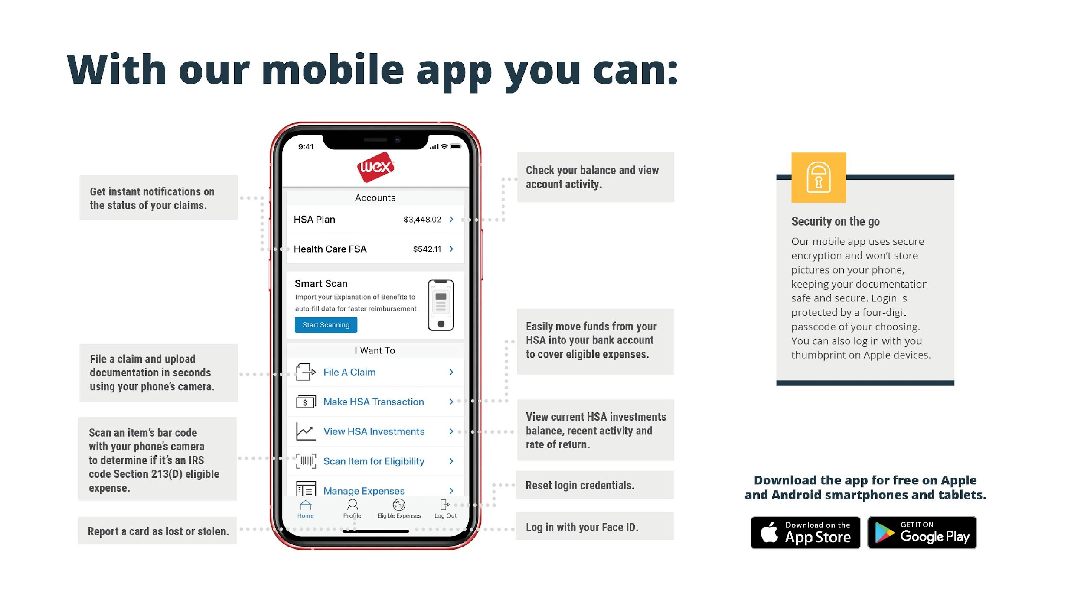
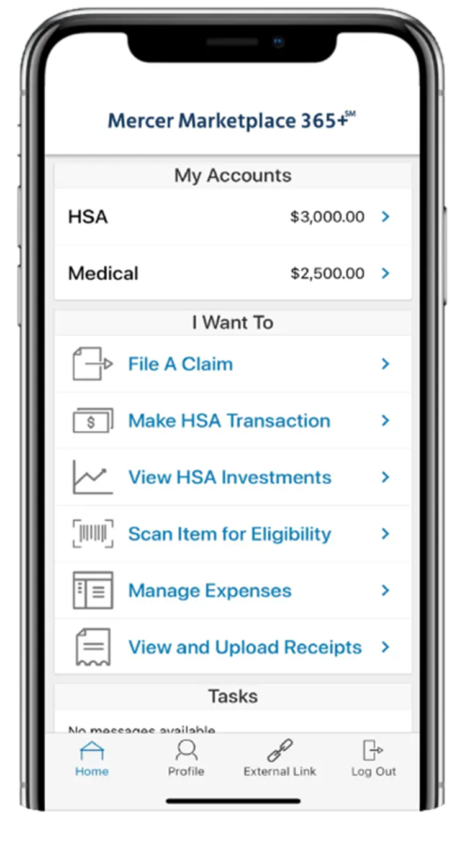
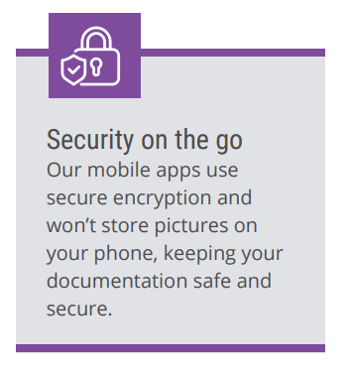

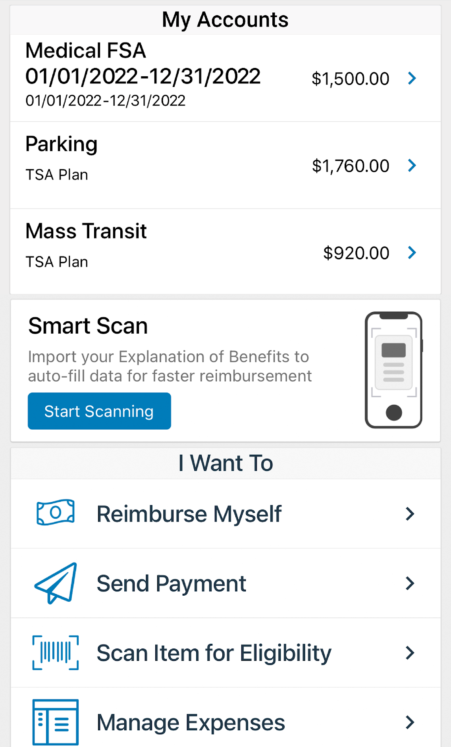






With our mobile app you can:
Notes:
The Mercer Marketplace Accounts Mobile App provides you with quick easy access to your online account. After logging in the first time, you can set up fingerprint access right from your phone.
Other great features include:
Take a photo of your explanation of benefits or itemized receipt in order to submit documentation for any outstanding claims. This saves a ton of time since you don’t have to scan an email receipt and upload it manually.
Easily check your account balance while standing in line at the store, making it easy to decide if you want to use your FSA dollars to cover a purchase.

Slide 14



Contact Participant Services
Our Participant Services team is available Monday through Friday, from 6 a.m. to 9 p.m. Central time, except holidays.
^{Live Chat}
^{Email}
^{Phone}
mercermarketplaceaccounts@serviceaccount.com
^{Toll-Free: 877-248-0510}
Notes:
Our participant services team is available to you Monday through Friday from 6 a.m. to 9 p.m. Central time.
You have a variety of options when contacting us.
You can use the CHAT feature from our website by logging into your online account.
You can email us or call us and check your balance using the automated system.

Slide 15

THANK YOU!

