Slide 1

Client Name
Notes:
This presentation is being presented by Mercer Marketplace 365+. My name is ____________ and I am happy to be here with you today!

Slide 2

Health savings account (HSA)
Notes:
During our presentation today, I will be reviewing what a health savings account, or HSA, is and why you should consider enrolling in an HSA.

Slide 3


What is a health savings account?
Individually owned account
Funds rollover every year
Grow account through investments
Notes:
A health savings account is a benefit that allows you to choose how much of your paycheck you’d like to set aside, before taxes are taken out, for healthcare expenses or use as a retirement savings tool.
This plan offers more tax savings than a traditional Roth 401(k) and IRA, making it a powerful option for diversifying your retirement portfolio.

Slide 4

Eligibility
Must be enrolled in a high-deductible health plan (HDHP)
Cannot be enrolled in a PPT or HMO health plan
Can be enrolled/covered by:
Limited FSA or combination FSA
Dependent care FSA
Notes:
Now, to cover the nuts and bolts of HSA eligibility. In order to be eligible for an HSA you must be enrolled in a high-deductible health plan (HDHP).
This means they cannot be covered by a PPO or HMO health plan regardless if you are enrolled in the plan or you are covered by your spouse’s or guardian’s PPO or HMO health plan.
For reference a PPO or HMO plan would have co-pays. In order to qualify as a HDHP - the health plan must have a deductible of $1350 for individual coverage and $2750 for family coverage.
Did you know you can enroll in an HSA and still enroll in a dependent care FSA? [or Limited or Combo FSA?]

Slide 5
Benefits after age 65
You are eligible to contribute to an HSA after you turn 65 if you meet the following criteria:
You remain enrolled in a qualified high-deductible health plan (HDHP)
You do not enroll in Medicare
Note: if you sign up for Social Security, you are automatically enrolled in Medicare Part A.
Notes:
When you reach age 65, you can withdraw money (without penalty) and use it for anything, including non-healthcare expenses. You are eligible to contribute to an HSA after you turn 65 if you meet the following criteria:
You remain enrolled in a qualified high-deductible health plan (HDHP).
You do not enroll in Medicare.
Note: If you sign up for Social Security, you are automatically enrolled in Medicare Part A.
If you are enrolled in Medicare, you are not eligible to contribute to your HSA. However, you may continue to withdraw funds from your HSA without penalty. Distributions remain tax deductible if they are used to pay for qualified medical expenses.
Your spouse’s enrollment in Medicare doesn’t provide coverage for you, so you remain eligible to contribute to your HSA as long as you are not covered by a non-high-deductible health plan (non-HDHP). Your spouse’s qualified medical expenses are still eligible for reimbursement from your HSA even though your spouse is enrolled in Medicare.

Slide 6

What does an HSA cover?
The list includes but is not limited to:
Copays, coinsurance, insurance premiums
Doctor visits and surgeries
Over-the-counter medications (first-aid, allergy, asthma, cold/flu, heartburn, etc.)
Prescription drugs
Birthing and Lamaze classes
Dental and orthodontia
Vision expenses, such as frames, contacts, prescription sunglasses, etc.
Notes:
There are thousands of eligible items. The list includes but is not limited to:
Copays, coinsurance, insurance premiums
Doctor visits and surgeries
Over-the-counter medications (first-aid, allergy, asthma, cold/flu, heartburn, etc.)
Prescription drugs
Birthing and lamaze classes
Dental and orthodontia
Vision expenses, such as frames, contacts, prescription sunglasses, etc

Slide 7
Tax advantages
Since 2003
Tax-deductible contributions
Tax-free accumulation of interest & dividends
Tax-free distributions for qualified medical expenses
Notes:
Now let us go over some of the benefits of the HSA.
It is yours, think of your HSA as a personal savings account. Any unspent money in your HSA remains yours, allowing you to grow your balance over time. When you reach age 65, you can withdraw money (without penalty) and use it for anything, including non-healthcare expenses.
It is flexible and helps you save for a rainy day, Invest for your future retirement, Or simply spend your funds on qualified expenses, penalty free.
The HSA’s unique, triple-tax savings means the money you contribute, earnings from investments and withdrawals for eligible expenses are all tax-free, making it a powerful savings and retirement tool.
You also have investment options, You can invest your HSA funds in an interest-bearing account or our standard mutual fund lineup. Savvy investors may opt for a health savings brokerage account powered by Charles Schwab, giving you access to more than 8,500 mutual funds, stocks and bonds.

Slide 8


Meet Angela
Angela is a 38 year old mother of three kids with a full-time career
Without HSA
With HSA
GROSS ANNUAL PAY….……… $60,000
TAX RATE (18%) ………..…..… -$10,800
NET ANNUAL PAY ………….… $49,200
HEALTHCARE EXPENSES …… -$6,750
FINAL TAKE-HOME PAY ……... $42,450
GROSS ANNUAL PAY…………… $60,000
ANNUAL HSA CONTRIBUTION ….-$6,750
ADJUSTED GROSS PAY …….…..$53,250
TAX RATE (18%) ……………..…… -$9,585
FINAL TAKE-HOME PAY ….....…. $43,665
Take home this much more with a health savings account
$1,215
All figures in this table are estimates and based on an annual salary of $60,000 and maximum contribution limits to the benefit account. Your salary, tax rate, healthcare expenses and tax savings may be different..
Notes:
Let us review a real life example of how having an HSA can save you money.
Meet Angela. Angela is a 38 year old mother of 3 kids and has a full time career.
She is enrolled in an HSA and makes an annual contribution of $6,750
Since her HSA contributions are taken out pre-tax her actual taxable income is lowered which means she has more take-home pay then if she didn’t have an HSA.
For Angela this means an additional $1,215 dollars to use for expenses or maybe even for a fun trip with her family.

Slide 9
FSA
HSA
Control
Owned by the employer
Owned by the employee
Funding
Employer and/or employee funded
Employer and/or employee funded
Contribution limits
2025: $4,300 (Single) $8,550 (Family)
2025: $3,200 (Medical FSA)
Health plan eligibility
Must be offered a group health plan by employer
Must be enrolled in a high deductible health plan
Can participants invest funds?
No
Yes
Can participants roll over funds?
No
Yes
Notes:
To help demonstrate what an HSA is, let us compare it to a standard flexible spending account.
FSA – an FSA is employer owned and you forfeit any unused money back at the end of a plan year vs. an HSA – that is employee owned and you can take all money in the account with you even if you leave the company.
Both can receive Employer and Employee contributions.
To be eligible for the FSA –a group health plan must be offered by the Employer
Where as with the HSA – an individual must be enrolled in a high deductible health plan to be considered eligible.
And, only the HSA provides participants with investment options

Slide 10
Annual contribution limit
Single maximum contribution limits
Family maximum contribution limits
$4,300
$8,550
Catch-up for over age 55:
$1,000
Can make pre-tax contributions:
    Pre-tax employer contribution, employee payroll contribution
    Post-tax employee contributes outside of payroll deductions post-tax
Notes:
This slide represents the 2025 HSA annual contribution limits
Your annual contributions should not exceed the annual limits or you may be fined by the IRS.
We will alert you via email if you contribute more than the IRS maximum. You can also set up text alerts so you receive a notification once you meet an established contribution threshold.
Any individual age 55 or older, who is currently enrolled and eligible for the HSA may contribute the additional $1000 annually to their account.
Ways to contribute: you can contribute pretax and post tax contributions. Contributions can be changed at any time throughout the year.
Studies are showing that Americans appreciate their benefits even more now and are in fact contributing more. Encourage you to sit down and run your numbers. Set savings goals. If you are just starting off, some will contribute just enough to cover their deductible. Then, if a healthcare expense comes out of left-field, it does not weigh you down. You can use your HSA. Then, save whenever you can. Some of those smaller items can be paid for out-of-pocket so that you can save your HSA instead. Down the road, you could always pull the HSA funds out if you really need them. Remember it is a health savings account, not a health spending account.

Slide 11

Accessing your HSA funds
Submit a distribution request online at any time
Pay your provider from your online account/mobile app – check issued from your HSA to your provider
Distribution request to you via free direct deposit or paper check!
Notes:
In addition to using your debit card you can also submit a distribution request from your HSA at anytime.
You can login to your online account or use your mobile app to request a payment to be sent directly to your provider or request a distribution directly to yourself for an expense you paid out of pocket.
And do not forget about direct deposit! You can set up direct deposit directly from your online account allowing us to automatically distribute funds directly to your bank account!

Slide 12
Your role
Ensure funds are used for eligible health care expenses
No documentation required for the HSA
  Recommend you save these contributions and distributions for tax purposes
We will provide HSA participants with the necessary tax forms, it will remain your responsibility to report these contributions on your taxes
Notes:
So what do you need to do when it comes to your HSA?
We will make it easy for you to manager your HSA with an online account, free benefits mobile app as well as text and email alerts.
All you have to do is make sure you use your HSA for eligible health care expenses.
We recommend saving your documentation such as itemized receipts and EOBs for tax purposes.
Then at the end of the year we will provide you with the necessary tax forms for you to file your taxes. But it is still your responsibility to report your HSA contributions and distributions at tax time.

Slide 13
Investment options
Interest earned on all funds
Cash account – low threshold
Money Market savings
Mutual funds
  30 different investment options
  Single-sign-on to view and manage investments
Notes:
So let us talk a little more about investment options.
After you have met your minimum cash balance you can start investing your HSA funds.
We have 30 different investment options for you to choose from – and now you can even keep track of your HSA portfolio right from your benefits mobile app!

Slide 14

Financial wellness through your HSA
Investment Guidance Tool
HSA Goal Calculator
Notes:
We also provide you with a variety of tools to help you manage your health care expenses including:
Your online account has an investment guidance tool – just follow the series of questions about your HSA goals and we will provide you with recommendations
We also have an HSA calculator to help you estimate how much to contribute into your HSA each year.

Slide 15
Benefits card
Free benefits card
Minimize the amount of out-of-pocket spending
Valid for three+ years
Instant access to plan funds
Notes:
Your enrollment in an HSA includes our free benefits debit card. This allows you to easily access your HSA funds right from your wallet to help you minimize the amount of out of pocket spending.
If you already have our debit card, they are good for three years, so if you received one within the last two years you will not get a new one again next year. We will mail you a new debit card 90 days before the expiration date of your current debit card. All new cards will be good for 4 years.
Regardless if you are enrolled in an HSA, FSA, or dependent care FSA you will use the same card.
If your card is lost or stolen, you can order a new card free of charge from the benefits mobile app or by going through your online account.
You can request a debit card for your dependents and/or spouse. First ensure they are added to your online account. You can do that by going to the Profile section of your online account. Once they are added you can select Banking/Cards and request a card for each dependent. A dependent must be 18 years of age or older to receive a debit card.

Slide 16
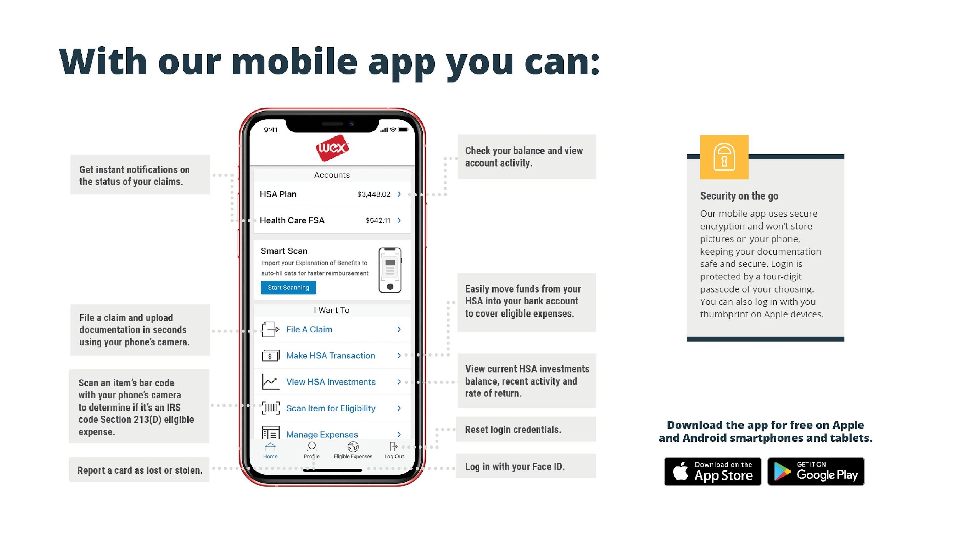
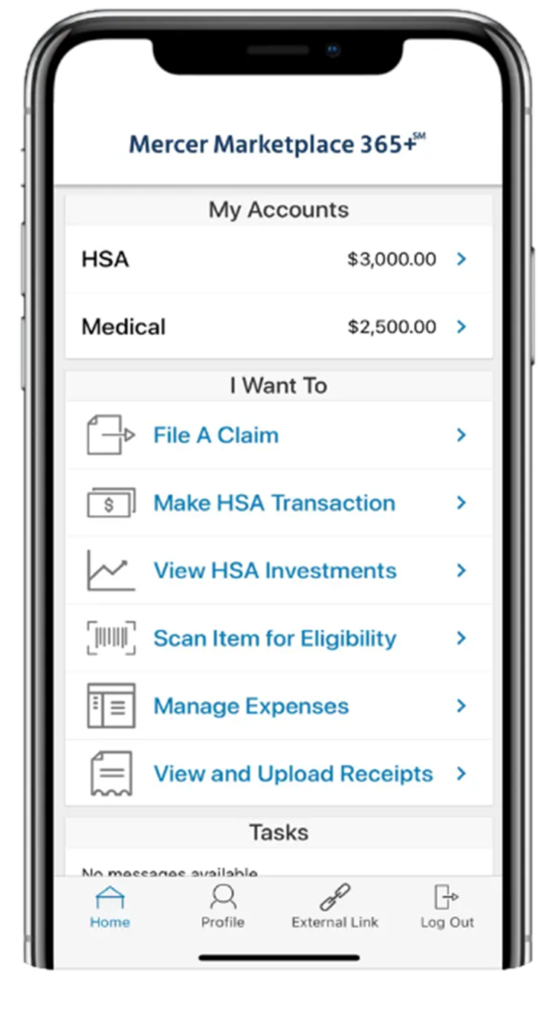
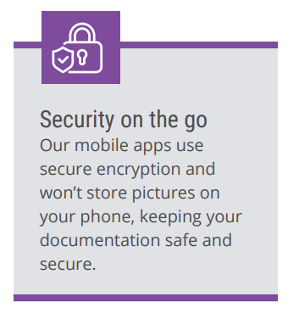

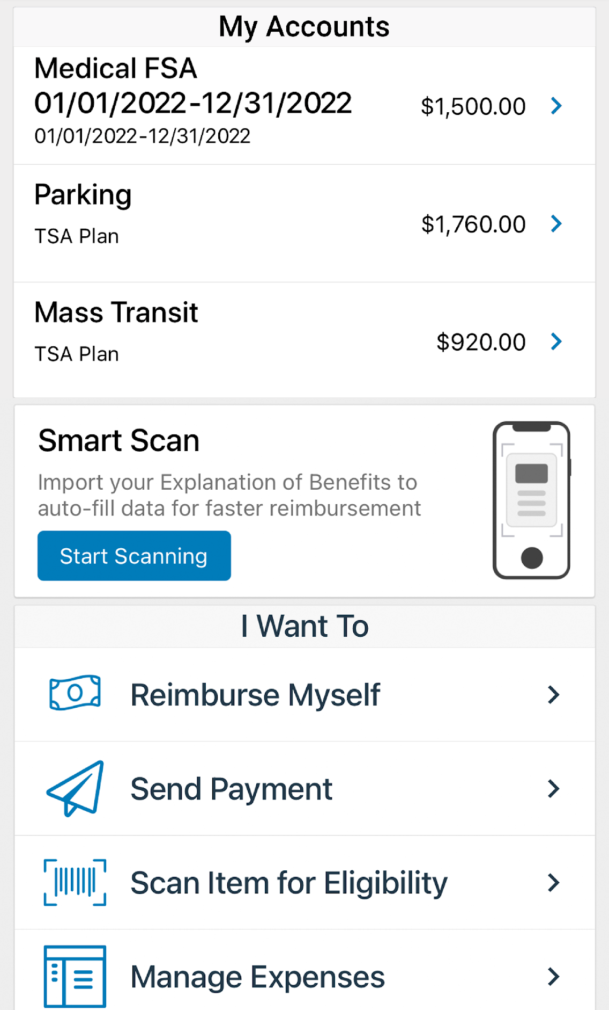






With our mobile app you can:
Notes:
The Mercer Marketplace Accounts Mobile App provides you with quick easy access to your online account. After logging in the first time, you can set up fingerprint access right from your phone.
Other great features include:
Take a photo of your explanation of benefits or itemized receipt in order to submit documentation for any outstanding claims. This saves a ton of time since you don’t have to scan an email receipt and upload it manually.
Easily check your account balance while standing in line at the store, making it easy to decide if you want to use your FSA dollars to cover a purchase.

Slide 17


Contact Participant Services
Our Participant Services team is available Monday through Friday, from 6 a.m. to 9 p.m. Central time, except holidays.
^{Live Chat}
^{Email}
^{Phone}
mercermarketplaceaccounts@serviceaccount.com
^{Toll-Free: 877-248-0510}
Notes:
Our participant services team is available to you Monday through Friday from 6 a.m. to 9 p.m. Central time.
You have a variety of options when contacting us.
You can use the CHAT feature from our website by logging into your online account.
You can email us or call us and check your balance using the automated system.

Slide 18

THANK YOU!

