Slide 1

Client Name
Notes:
This presentation is being presented by Mercer Marketplace 365+. My name is ____________ and I am happy to be here with you today!

Slide 2

Medical f lexible spending account (FSA)
Notes:
Now let us start out by covering your medical flexible spending account (FSA), what it is, and how you can leverage this tax free account.

Slide 3




Medical flexible spending account
Funds on day 1
Discount
Plan ahead
Notes:
A Medical FSA is a benefit that allows you to choose how much of your paycheck you’d like to set aside, before taxes are taken out, for qualified Medical, Dental, Vision and Preventative healthcare expenses. This saves you money by reducing your taxable income.
Funds on Day 1: All of your FSA funds are available to spend right away
Think of it like a discount on healthcare expenses at stores such as Amazon, Target, CVS, Walmart, Walgreens and more. Dollars you contribute are taken out of your paycheck before tax which means a $100 purchase could actually cost you over $130 without a Medical FSA.*
Think about the money you spent on your Medical, Dental, Vision and Preventative care expenses last year. Plan ahead and set those funds aside in a Medical FSA and save!

Slide 4

Annual contribution limit
2024 Medical FSA Maximum:
$3,200
Contribute and spend funds tax-free
Pay for eligible out-of-pocket healthcare expenses
Employer contribution (if applicable)
Notes:
The IRS sets the maximum dollar amount you can elect and contribute to a Flexible Spending Account (FSA) and Dependent Care FSA.
The 2024 FSA annual contribution limit is: $3,200.
We recommend reviewing how much you spend on eligible expenses every year to determine how much to elect.
Once you elect an FSA, all of your FSA dollars are available for you to use the very first day of the plan year. For example, if you elect to contribute $1,200 to your FSA, your contributions will be deducted evenly across all of your paychecks for the year, but you have access to all $1,200 on day one! You can use your funds for expenses incurred by you, your spouse or eligible dependents.

Slide 5

Meet Ashley
Ashley is a 33 year old college graduate working in Marketing.
Without Healthcare FSA
With Healthcare FSA
GROSS ANNUAL PAY………… $60,000
TAX RATE (18%) ………..…… -$10,800
NET ANNUAL PAY ………..… $49,200
HEALTHCARE EXPENSES …… -$3,200
FINAL TAKE-HOME PAY ……. $46,000
GROSS ANNUAL PAY…………… $60,000
ANNUAL FSA CONTRIBUTION -$3,200
ADJUSTED GROSS PAY …….…..$56,800
TAX RATE (18%) ……………..… -$10,224
FINAL TAKE-HOME PAY …...…. $46,576
Take home this much more with a Healthcare FSA
$576
All figures in this table are estimates and based on an annual salary of $60,000 and maximum contribution limits to the benefit account. Your salary, tax rate, healthcare expenses and tax savings may be different..
Notes:
Let us review a real life example of how having an FSA can save you money.
Meet Ashley. Ashley is a 33 year old college graduate working in marketing.
She is enrolled in an FSA and makes an annual contribution of $3,200
Since her FSA contributions are taken out pre-tax her actual taxable income is lowered which means she has more take-home pay then if she did not have an FSA.
For Ashley this means an additional $576 dollars she gets to keep and take home.

Slide 6

Medical FSA grace period and run-out
January 1, 2025 – December 31, 2025
March 15, 2026 – deadline to incur claims
March 31, 2026 – deadline to submit claims
Notes:
Your dependent care plan year also runs from January 1st to December 31st --(remove if no grace period) with a grace period allowing you until March 15, 2026 to incur services.
March 31st of 2026 is your run out date, which means you have until this date to submit all paperwork for claims incurred during the plan year (remove if no grace period) and grace period.

Slide 7


Medical FSA carryover
The carryover allows you to roll over up to $640 to the next plan year
Funds are available after the end of the run-out period – April 2026
Allowed to elect full maximum regardless of carryover amount
Only available for medical FSA funds
Notes:
(remove slide if no carryover)
A carryover allows you to transfer up to $640 of your remaining balance at the end of the plan year into the following year. Think of it like a safety net for your FSA. If you end up spending less than you anticipate when making your elections during open enrollment, you can tap into those funds next year.
Carryover funds become available to you after the run-out (claim filing) period.
You are able to carry over up to $640 while still electing the full maximum annual election in the new plan year.
If you have the benefits debit card, it will continue to work as normal, using your carryover funds first.
[IF APPLICABLE] The FSA carry over is only available for medical FSA funds and not for the dependent care account.

Slide 8
Combination f lexible spending account (combo FSA)
Notes:
Let’s talk about combination flexible spending accounts.

Slide 9
Combination FSA
Funds on day 1
Discount
Plan ahead
Notes:
First let’s talk about why you should choose a combination FSA: it’s a benefit that allows you to choose how much of your paycheck you’d like to set aside, before taxes are taken out, for qualified dental, vision and preventative care expenses.
Once you reach the IRS statutory deductible for the year, your combination FSA can also be used for any eligible healthcare and prescription costs.
Enjoy funds from day one, buy those eyeglasses or finally get those braces. All of your FSA funds are available to spend right away. Use your benefits debit card at the point of purchase.
Think of it like a discount on qualified expenses at stores such as Amazon, Target, CVS, Walmart, Walgreens and more. Dollars you contribute are taken out of your paycheck before tax which means a $100 purchase could actually cost you over $130 without a Combination FSA.*
Don’t know how much to elect? Think about the money you spent on healthcare expenses last year. Plan ahead and set those funds aside in a Limited FSA and save!

Slide 10



What does a combination FSA cover?
Use in combination with your health savings account (HSA) to cover:
Dental
Vision
Preventative
After you hit the IRS deductible, your combination FSA can cover eligible out of pocket medical expenses
Notes:
What does the Combination FSA cover before you meet your deductible?
Procedures and products deemed necessary by the IRS include but are not limited to:
Prescription sunglasses
Contact lenses
Orthodontia
Root canals/fillings
What does it cover after you meet your deductible?
All of the above, plus IRS-approved health care expenses, which include:
Emergency room visits and ambulance expenses
First Aid kits and supplies
Chiropractic treatments
Copays
As you can tell there are a lot of options to consider. By maximizing your benefits and enrolling in other health care benefits you can maximize your tax free contributions and grow your HSA balance for retirement! (Remove if HSA not offered)

Slide 11
Limited medical flexible spending account (limited FSA)
Notes:
Let’s talk about limited medical flexible spending accounts.

Slide 12
Limited FSA
Dental
Vision
Preventative
Notes:
A limited FSA is a benefit that allows you to choose how much of your paycheck you would like to set aside, before taxes are taken out, for qualified dental, vision and preventative care expenses. It pairs well with a Health Savings Account (HSA). (Remove if you don’t offer an HSA)
This plan offers instant access to funds for expenses you incur throughout the year. And saves you money by reducing your taxable income.
Enjoy funds on day one, you can buy those eyeglasses or finally get those braces. All of your FSA funds are available to spend right away. Use your benefits debit card at the point of purchase.
Think of it like a discount on qualified expenses at stores such as Amazon, Target, CVS, Walmart, Walgreens and more. Dollars you contribute are taken out of your paycheck before tax which means a $100 purchase could actually cost you over $130 without a Limited FSA.*
Don’t know how much to elect? Think about the money you spent on healthcare expenses last year. Plan ahead and set those funds aside in a Limited FSA and save!

Slide 13
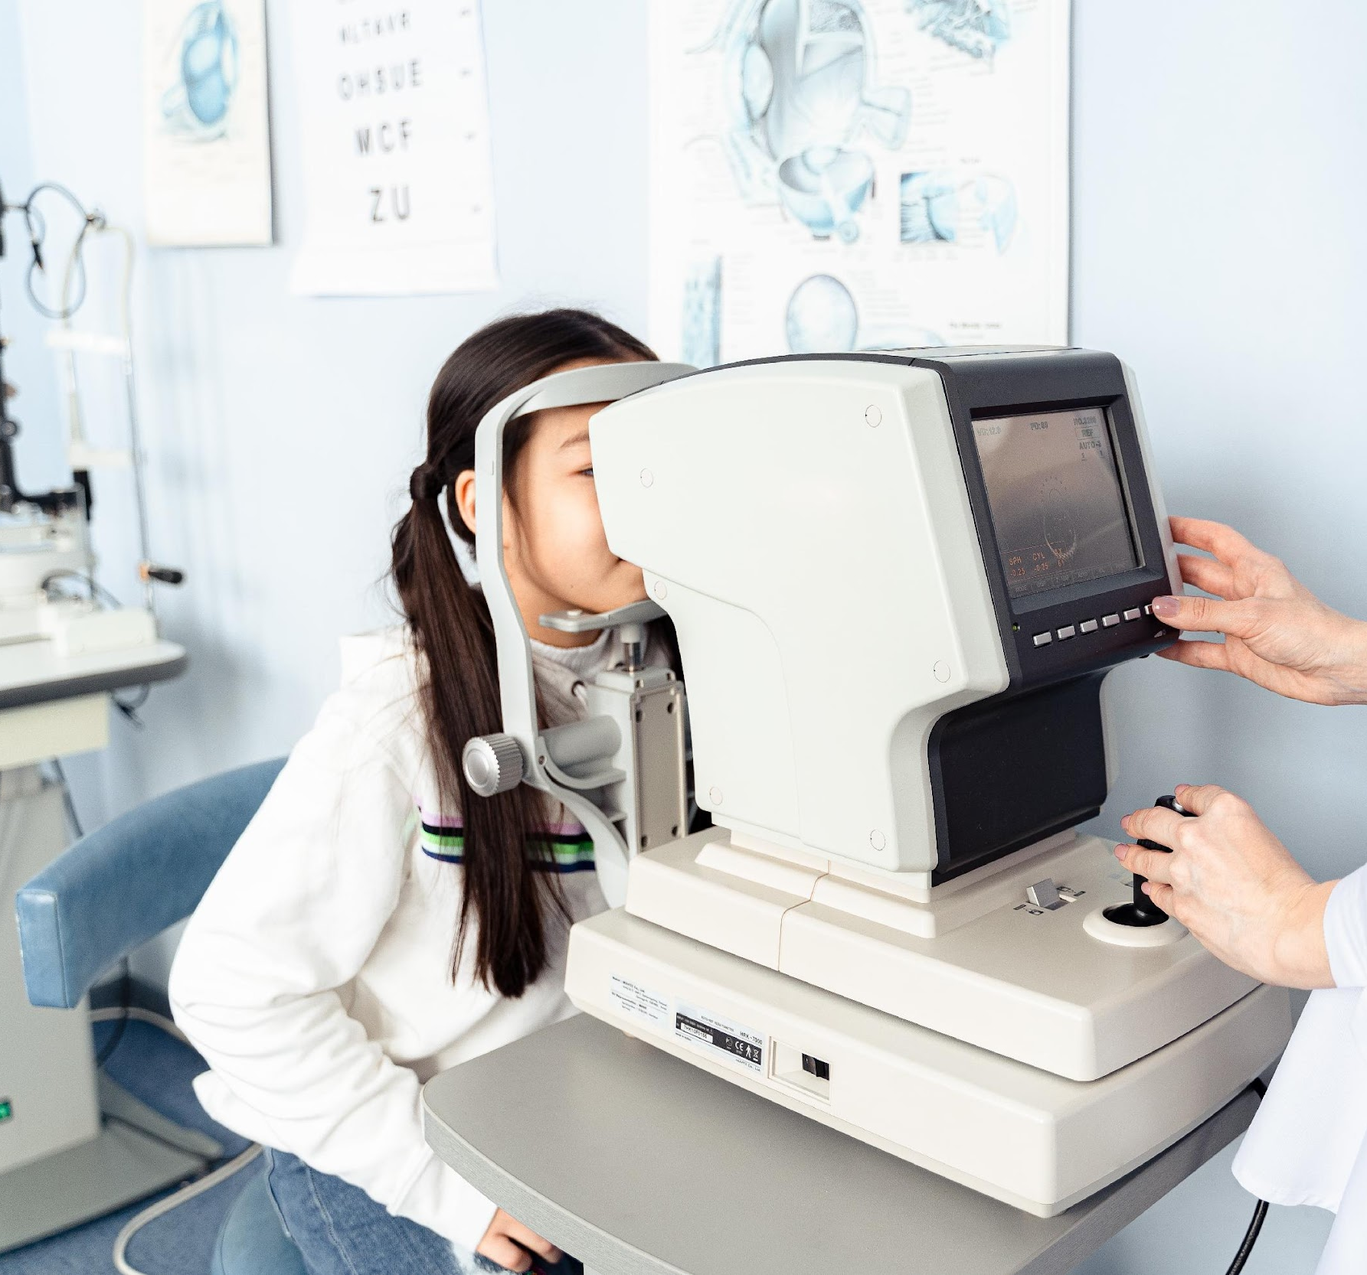
What does a limited FSA cover?
There are thousands of eligible items, including:
  Dental and orthodontia office visits and expenses
  Dental implants, dentures and bridges
  Optometrist and ophthalmologist visits and expenses
  Eyeglasses, contacts, prescription sunglasses, solutions and drops
  Laser eye surgery
Notes:
What does it cover?
There are thousands of eligible items, including:
Dental and orthodontia office visits and expenses
Dental implants, dentures and bridges
Optometrist and ophthalmologist visits and expenses
Eye glasses, contacts, prescription sunglasses, solutions and drops
Laser eye surgery
If you are wondering if you can enroll, anyone is eligible to enroll as long as you are not already enrolled in a Full Medical FSA. The Limited FSA pairs nicely with a Health Savings Account (HSA). Pairing these plans allows you to spend your Limited FSA dollars on eligible expenses while saving or investing your HSA dollars. (Remove if you don’t offer HSA)

Slide 14
Utilizing flexible spending accounts
Notes:
Now that we have learned about the Medical, Combination and Limited Flexible Spending Accounts, let’s talk about how you can utilize these plans and the multiple resources you have.

Slide 15

IRS regulations
Qualifying status changes include:
  Elections cannot be changed mid-year
  Qualifying status changes
  Marital status
  Number of dependents
  Job status
  Daycare cost/provider change
  30 days to make changes
Notes:
Once you elect a Healthcare FSA you cannot change your election unless you have a qualifying event.
A qualifying event includes: change in marital status, number of dependents, or a job status change.
You have 30 days from the date of your qualifying event to notify your employer to make any election changes.

Slide 16
Benefits card
Free benefits card
Minimize the amount of out-of-pocket spending
Valid for three+ years
Instant access to plan funds
Notes:
Your enrollment in an HSA includes our free benefits debit card. This allows you to easily access your HSA funds right from your wallet to help you minimize the amount of out of pocket spending.
If you already have our debit card, they are good for three years, so if you received one within the last two years you will not get a new one again next year. We will mail you a new debit card 90 days before the expiration date of your current debit card. All new cards will be good for 4 years.
Regardless if you are enrolled in an HSA, FSA, or dependent care FSA you will use the same card.
If your card is lost or stolen, you can order a new card free of charge from the benefits mobile app or by going through your online account.
You can request a debit card for your dependents and/or spouse. First ensure they are added to your online account. You can do that by going to the Profile section of your online account. Once they are added you can select Banking/Cards and request a card for each dependent. A dependent must be 18 years of age or older to receive a debit card.

Slide 17

Claim filing
The best form of documentation when submitting a claim is an itemized receipt from your provider
Any documentation provided must contain the following information:
  Name of the provider
  Date service was received
  Description of the service received
  The dollar amount of the service
Notes:
Lets talk a bit about documentation! (say jokingly) Everyone loves providing documentation, right?
Now, there are instances where we will reach out to you requesting documentation for your debit card purchase. This isn’t because we want to keep bothering you, it is because it is an IRS regulation. Before we get into what is needed specifically for substantiation, lets talk about when you may be asked to provide it.
We truly try to minimize the amount of times we have to ask for documentation or substantiation and this is because we completely understand that keeping track of your documentation or substantiation can be a hassle. We want this to be easy for you so our debit card has a couple of great features:
First, our debit card works with what is called an IIAS system. This means that if the merchant allows (typically big box stores like target and cvs will have this feature) our debit card can read what each product being purchased is and can approve and auto-substantiate your transaction if it is FSA eligible. For example, say you are at target and you’re purchasing a box of band aides, sunblock and a soda. If you swipe your FSA card, it will automatically approve and substantiate the band aides and sunblock, as these are FSA eligible, but you would be asked to use a different form of payment for the Soda. In this instance, we will not reach out to you!
Next, our debit card allows recurring transactions. For example, if you go to the chiropractor and you have a copay. The first time you use your debit card to pay for that service, we will ask for substantiation. Once properly substantiated, our debit card will assume that if the card is used for the same dollar amount as the same merchant, it is for your copay and will auto substantiate. This means we won’t ask you for further documentation.
Lastly, there are going to places that we will ask you for substantiation, an example would be the dentist office. As the dentist office does not have an IIAS system and offers services that are NOT FSA eligible, we will as you to substantiate your transactions there so we can tell if you got a teeth cleaning which is 100% FSA eligible, or if you got a teeth whitening, which is NOT an eligible expense.
Also, if you are submitting a claim via your mobile app, your online account or manually via the mail the best form of receipt or documentation is an Explanation of Benefits as it contains all of the necessary information for us to approve your claim. You receive your explanation of benefits (or EOB) from your medical, dental or vision carriers.
Any documentation provided must contain the following information:
When the service was received
Where the service was received
What service was received
The amount/cost of the service received
Who received the service

Slide 18


Claim filing options
^{Mobile app, online account}
^{or manual claims}
Processed within two business days
Choose direct deposit or paper check
^{Direct deposit – FREE}
^{$25 minimum reimbursement}
^{for paper checks}
Notes:
For anything you’ve paid out of pocket, you can also submit claims to be reimbursed by using your mobile app – simply login, select File a Claim and use the easy to follow steps. You can even take a picture of your explanation of benefits or itemized receipt right from your mobile phone!
And of course you can submit a claim thru you online account by following similar steps and uploading your documentation or by submitting the Claim form.
All claims are processed within 2 business days. You can choose to be reimbursed thru direct deposit right to your bank account or have a check mailed to you. Direct deposit is provided free of charge and is a quick and easy way to get your reimbursement!

Slide 19

Account access
^{Online account}
^{Mobile App}
Notes:
Now let’s end with a highlight of how you can access all of your accounts with us–
You can get access to information about your account by logging into your online account, downloading the mobile app or calling our Participant Services department.

Slide 20
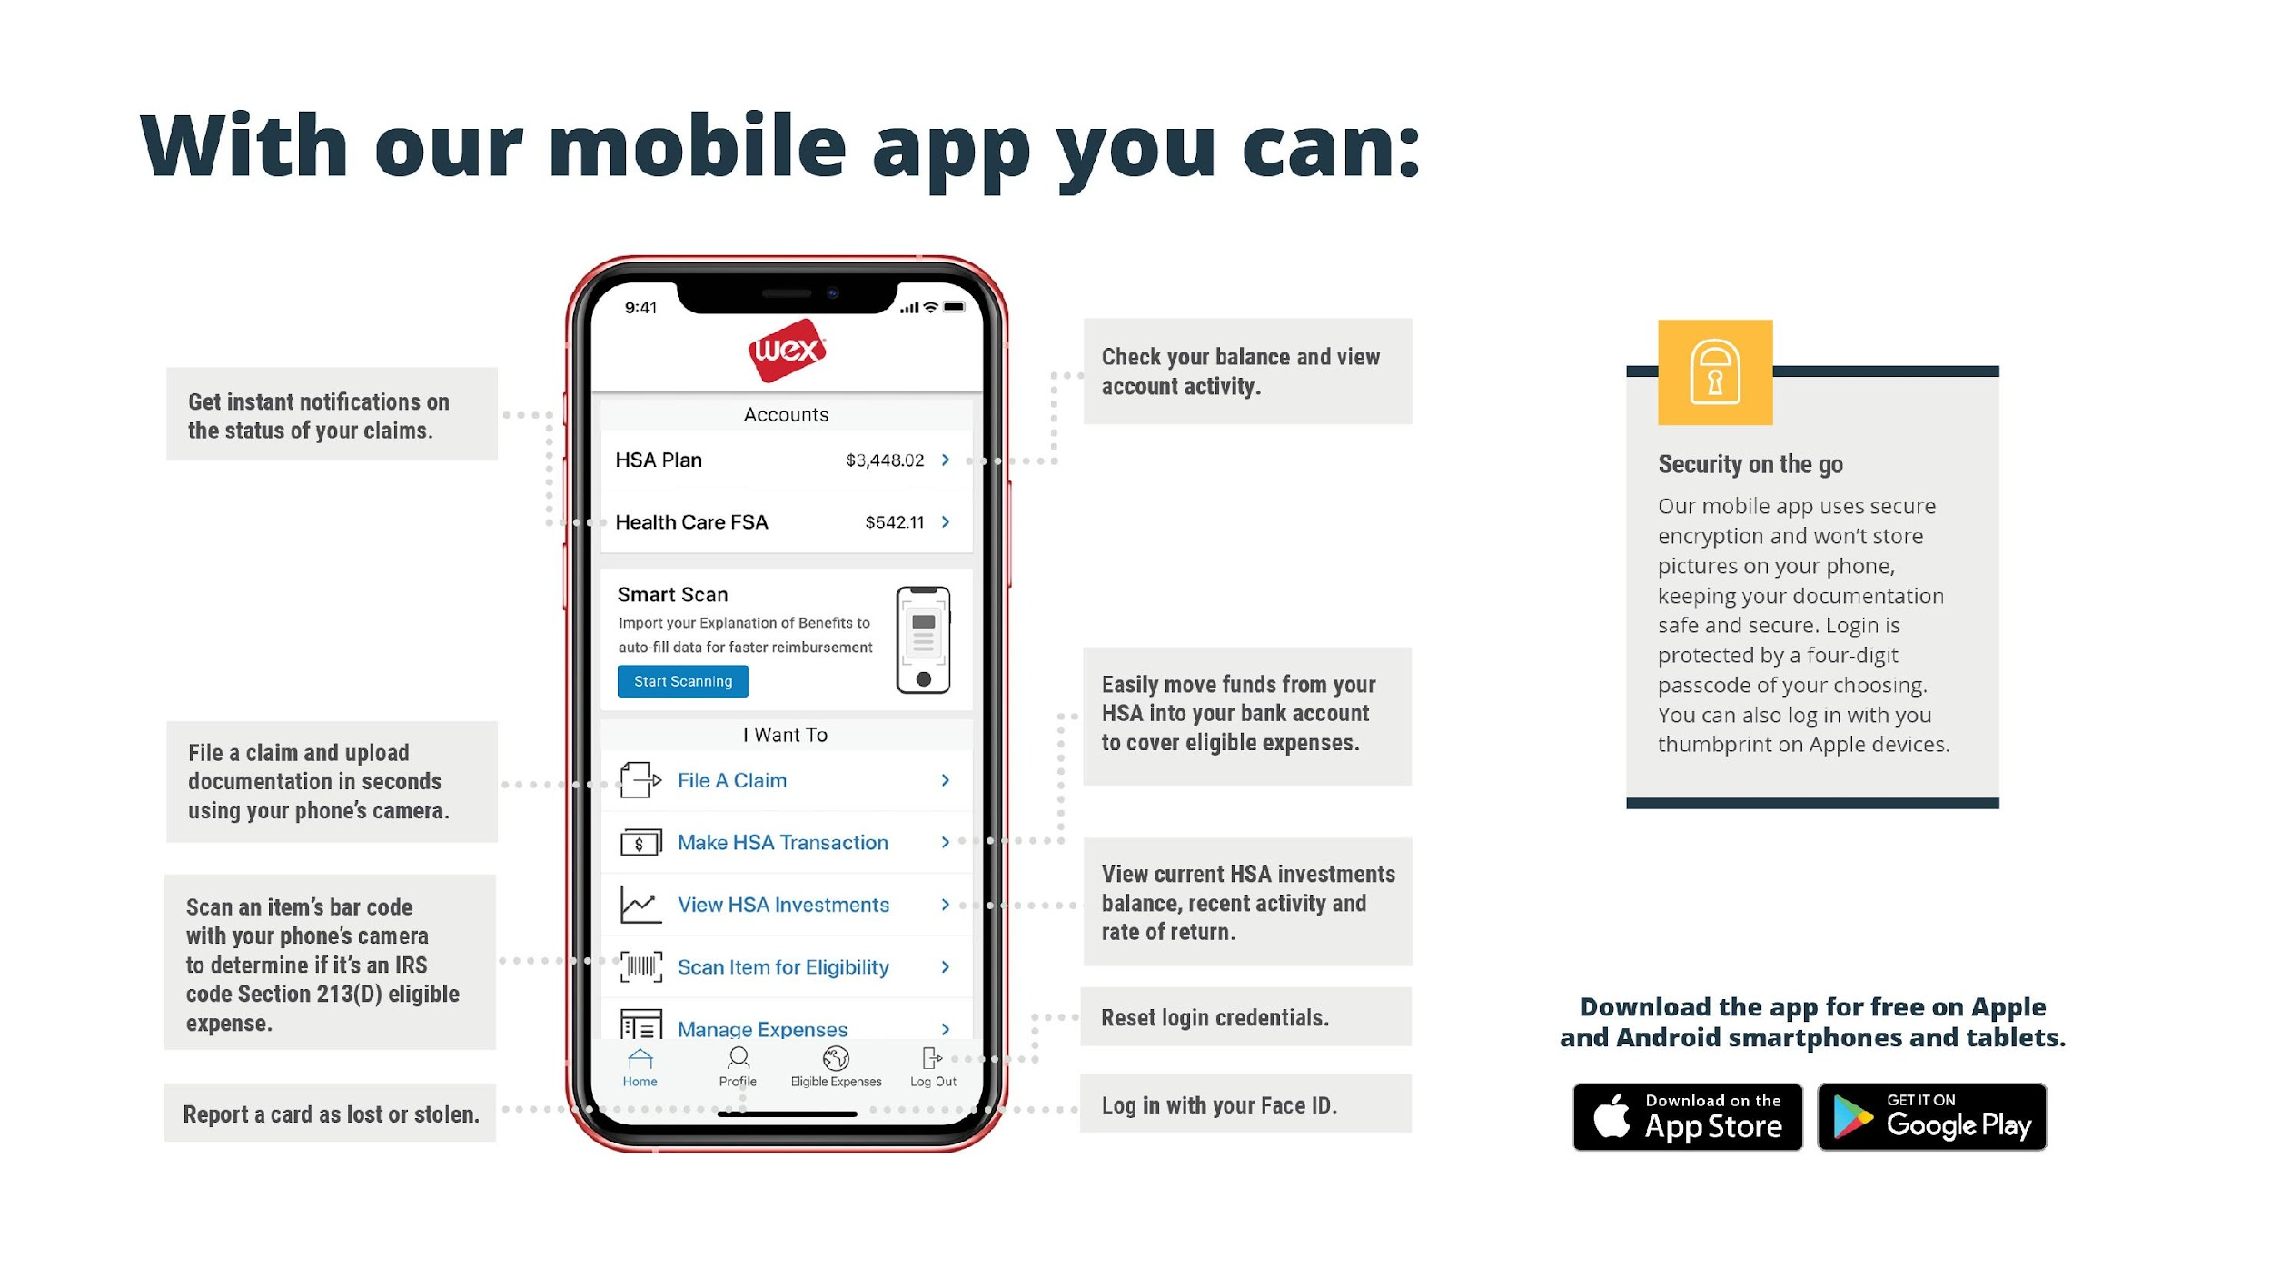
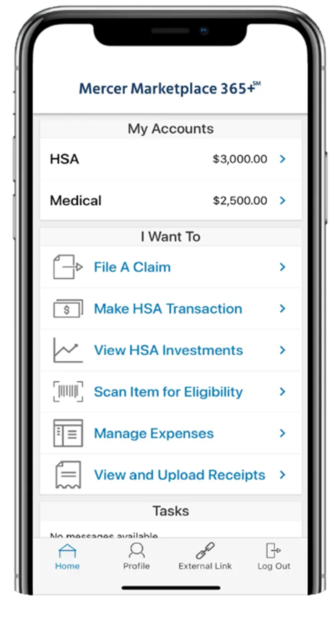
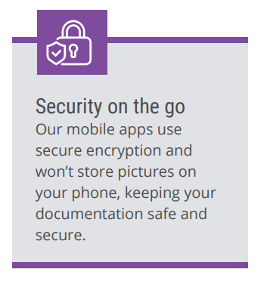

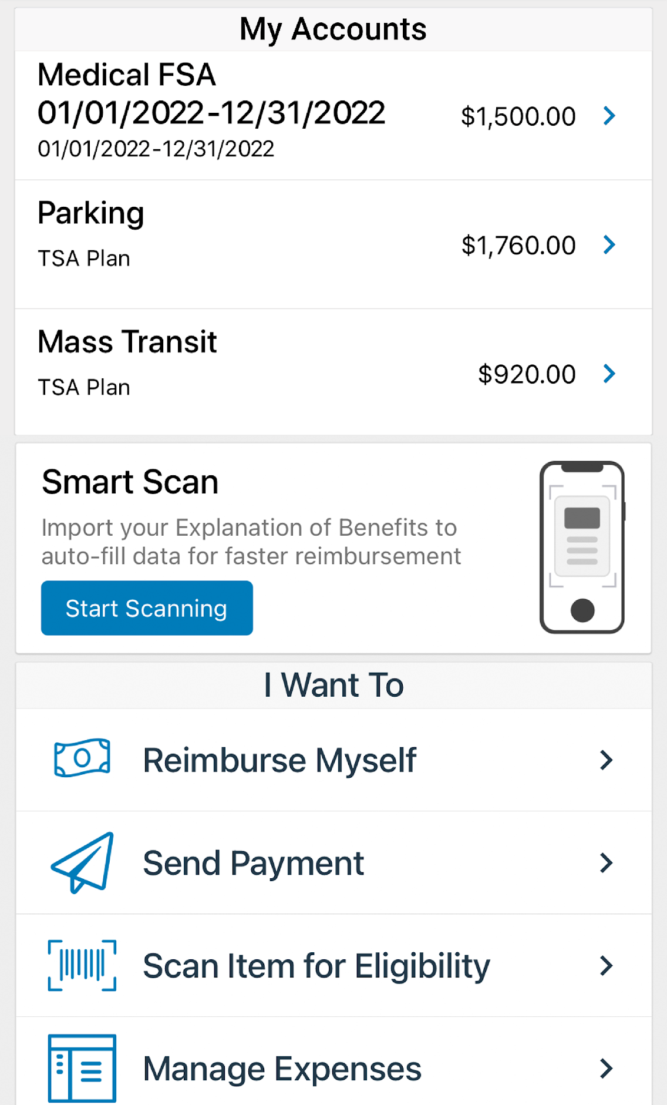






With our mobile app you can:
Notes:
The Mercer Marketplace Accounts Mobile App provides you with quick easy access to your online account. After logging in the first time, you can set up fingerprint access right from your phone.
Other great features include:
Take a photo of your explanation of benefits or itemized receipt in order to submit documentation for any outstanding claims. This saves a ton of time since you don’t have to scan an email receipt and upload it manually.
Easily check your account balance while standing in line at the store, making it easy to decide if you want to use your FSA dollars to cover a purchase.

Slide 21



Contact Participant Services
Our Participant Services team is available Monday through Friday, from 6 a.m. to 9 p.m. Central time, except holidays.
^{Live Chat}
^{Email}
^{Phone}
mercermarketplaceaccounts@serviceaccount.com
^{Toll-Free: 877-248-0510}
Notes:
Our participant services team is available to you Monday through Friday from 6 a.m. to 9 p.m. Central time.
You have a variety of options when contacting us.
You can use the CHAT feature from our website by logging into your online account.
You can email us or call us and check your balance using the automated system.

Slide 22

THANK YOU!

