Slide 1
Client Name
Notes:
Thank you for joining us as we cover your company’s Dependent Care Flexible Spending Account.
This presentation is being presented by WEX. My name is ____________ and I am happy to be here with you today!

Slide 2
Dependent care
flexible spending account
(dependent care FSA)
Notes:
Now let us cover your dependent care flexible spending account, what it is, and how you can leverage this tax free account.

Slide 3

Why choose a dependent care FSA
Pre-tax benefit
Save money
Save strategically
Notes:
A dependent care FSA is a benefit that allows you to put aside a portion of your paycheck before taxes for eligible dependent care expenses each year.
The dependent care FSA lets you pay for eligible dependent care expenses while you reap the benefits of additional tax savings. You are spending the money either way. This way, eligible childcare and other dependent care costs are a little less.
You can either use the funds as they are contributed to your dependent care account, OR choose to save strategically, and submit all of your dependent care expenses at the end of the plan year for one lump sum reimbursement to give yourself a hard-earned “bonus” at the end of the year.

Slide 4

Annual contribution limit
2026 dependent care FSA maximum:
$7,500
per household
Contribute and spend funds tax-free
Pay for qualified dependent care expenses
Recurring Dependent Care Form
Notes:
Your dependent care FSA can be used to pay for out-of-pocket daycare expenses, after-school programs, and day camp programs for dependents up to the age of 13. It also covers costs for disabled spouse or dependents of any age.
Your household can elect up to $7,500 maximum annually through the Dependent Care FSA in 2026.
A household can be a single adult electing $7,500 or if you are married or have a domestic partner and elect $7,500 total together as a household.
If you are married but filing separately your total annual election can still not exceed $7,500.
You can contribute dollars to your dependent care FSA pre tax via your payroll dollars to help pay for qualified dependent care expenses.
We do offer a Recurring Dependent Care Request Form that makes utilizing your dependent care dollars really easy. Simply fill out the form once, submit it to WEX and if approved we will reimburse you every time you contribute to your dependent care account.

Slide 5

Meet Kenneth
Kenneth is a 36 year old single father with two children in daycare.
Without dependent care FSA
––––
With dependent care FSA
––––
GROSS ANNUAL PAY…………..…… $60,000
TAX RATE (18%) ………………..…… -$10,800
NET ANNUAL PAY …………….....… $49,200
DEPENDENT CARE EXPENSES ... -$7,500
FINAL TAKE-HOME PAY ……..…... $41,700
GROSS ANNUAL PAY…………….… $60,000
ANNUAL FSA CONTRIBUTION ...-$7,500
ADJUSTED GROSS PAY ……...…...$52,500
TAX RATE (18%) …………………..… -$9,450
FINAL TAKE-HOME PAY …........…. $43,050
Take home this much more with a dependent care FSA
$1,350
All figures in this table are estimates and based on an annual salary of $60,000 and maximum contribution limits to the benefit account. Your salary, tax rate, dependent care expenses and tax savings may be different.
Notes:
Let us review a real life example of how having a dependent care FSA can save you money.
Meet Kenneth. Kenneth is a 36 year old single father with 2 children in daycare.
He is enrolled in an dependent care FSA and makes an annual contribution of $7,500
Since his dependent care FSA contributions are taken out pre-tax his actual taxable income is lowered which means he has more take-home pay then if he didn’t have an dependent care FSA.
For Kenneth this means an additional $1,350 dollars he gets to keep and take home.

Slide 6
Dependent care FSA grace period and run-out
January 1, 2026 – December 31, 2026
March 15, 2027 - Deadline to incur claims.
March 31, 2027 - Deadline to submit claims.
Notes:
(Remove slide if there is NO grace period)
Your plan year runs from January 1st to December 31st 2026 and your company offers a grace period, which means you have until March 15, 2027 to incur services.
March 31st of 2027 is your run out date, which means you have until this date to submit all paperwork for claims incurred during the plan year and grace period.

Slide 7
Dependent care FSA run-out
January 1, 2026 – December 31, 2026
March 31, 2027 - Deadline to submit claims.
Notes:
(Remove slide if there IS a grace period)
Your plan year runs from January 1st to December 31st 2026
March 31st of 2027 is your run out date, which means you have until this date to submit all paperwork for claims incurred during the plan year.

Slide 8

IRS Regulations
Qualifying status changes include:
Elections cannot be changed mid-year
Qualifying status changes
Marital status
Number of dependents
Job status
Daycare cost/ provider change
30 days to make changes
Notes:
Once you elect a dependent care FSA you cannot change your election unless you have a qualifying event.
A qualifying event includes: change in marital status, number of dependents, or a job status change.
For dependent care FSA, another qualifying event includes any changes in daycare cost or a provider change.
You have 30 days from the date of your qualifying event to notify your employer to make any election changes.

Slide 9
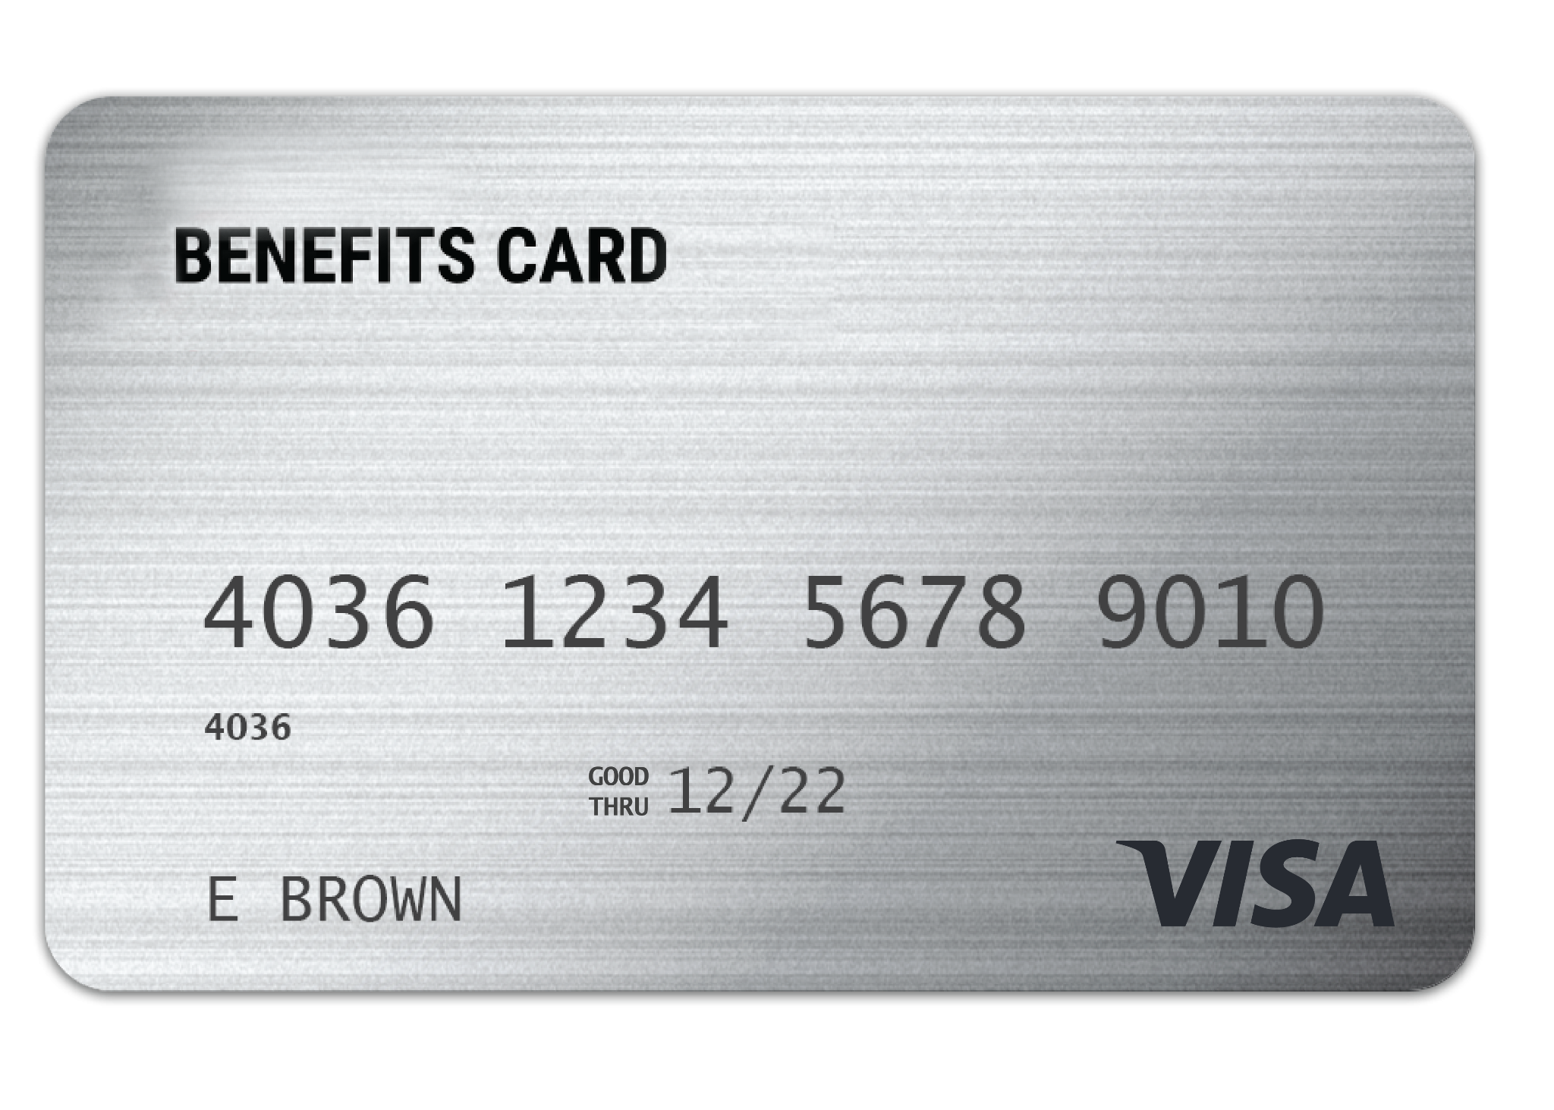
WEX benefits card
Free benefits card
Minimize the amount of out-of-pocket spending
Valid for three years
Instant access to plan funds
Notes:
Your enrollment in any of our plans includes our free benefits debit card. This allows you to easily access your funds right from your wallet to help you minimize the amount of out of pocket spending.
If you already have our debit card, they are good for 3 years, so if you received one within the last 2 years you will not get a new one again next year. We will mail you a new debit card 90 days before the expiration date of your current debit card. All new cards will be good for 4 years.
Regardless if you are enrolled in a DCA, or other WEX benefits you will use the same card.
If your card is lost or stolen, you can order a new card free of charge from the benefits mobile app or by going through your online account.

Slide 10
Claim filing
Any documentation provided must contain the following information:
  Name of the provider
  Date the service was received
  Description of the service received
  The amount/cost of the service received
The best form of documentation when submitting a claim is an itemized receipt from your provider
Notes:
Let us talk a bit about documentation! (say jokingly) Everyone loves providing documentation, right?
The IRS requires you to provide documentation to make sure the expenses are eligible for reimbursement from your dependent care flexible spending account (dependent care FSA).
You can eliminate the need to submit substantiation or file claims throughout the year for dependent care expenses by enrolling in Recurring Dependent Care. This process requires you to submit one form per year for each daycare provider
used. The Recurring Dependent Care Request Form must be completed by you and by your daycare provider. The form can be submitted by fax or mail. You will automatically be reimbursed throughout the plan year once your form has been
processed.
Any documentation provided must contain the following information:
The name of the provider
The date the service was received
A description of the service received
And the dollar amount of the service received.

Slide 11
Claim filing options
Mobile app, online account
or manual claims
Processed within two business days
Choose direct deposit or paper check
Direct deposit – FREE
$25 minimum reimbursement
for paper checks
Notes:
For anything you’ve paid out of pocket, you can also submit claims to be reimbursed by using your mobile app – simply login, select File a Claim and use the easy to follow steps. You can even take a picture of your itemized receipt right from your mobile phone!
And of course you can submit a claim thru you online account by following similar steps and uploading your documentation or by submitting the Claim form.
All claims are processed within 2 business days. You can choose to be reimbursed via check in the mail, or set up direct deposit and we’re able to send funds right to your bank account. Direct deposit is provided free of charge and is a quick and easy way to get your reimbursement!

Slide 12
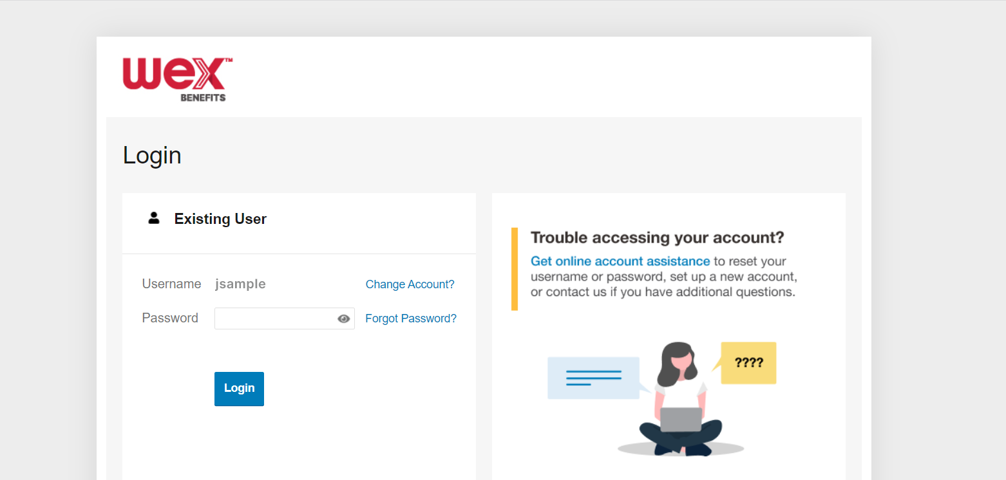

Account Access
Online account
Mobile app
Notes:
Now let’s end with a highlight of how you can access all of your accounts with us.
You can get access your account information by logging into your online account. Here you see details and balances of any accounts with us, transactions, and complete any tasks you’d like or need to take on your account. We also have the free WEX benefits mobile app.

Slide 13
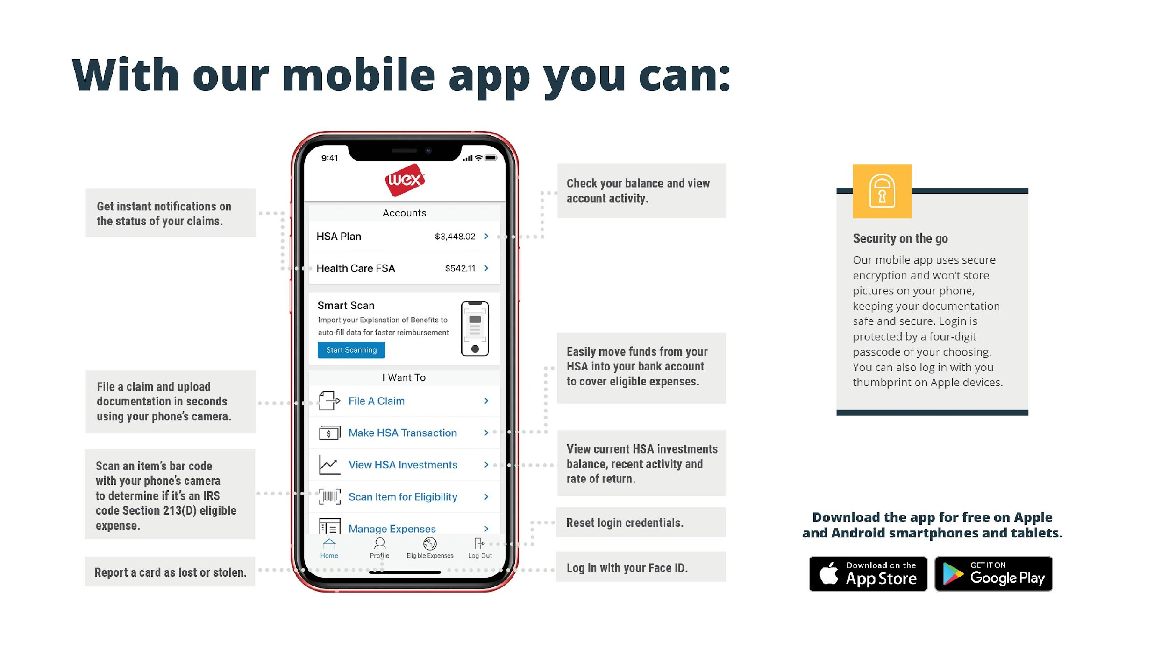

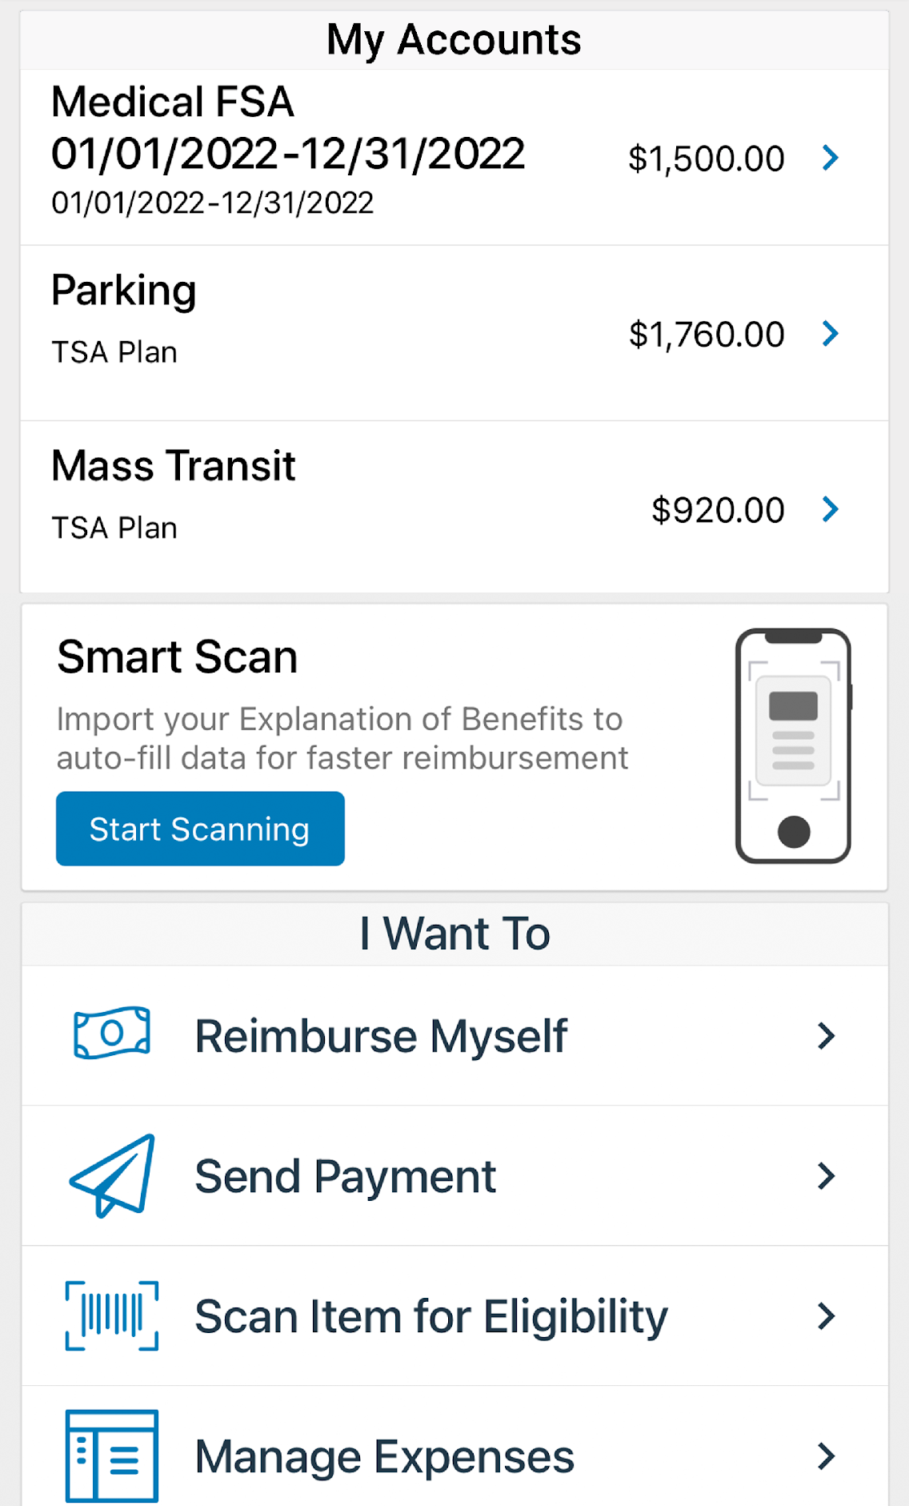

With our mobile app you can:
Check your balance and view your activity.
Get instant notifications on the status of your claims.
Security on the go
Easily move funds from your HSA into your bank account to cover eligible expenses.
Security on the go
Our mobile app uses secure encryption and won’t store pictures on your phone, keeping your documentation safe and secure. Login is protected by a four-digit passcode of your choosing. You can also log in with your thumbprint on Apple devices.
Our mobile app uses secure encryption and won’t store pictures on your phone, keeping your documentation safe and secure. Login is protected by a four digit passcode of your choosing. You can also log in with your thumbprint on Apple devices.
File a claim and upload documentation in seconds using your phone’s camera.
View current HSA investments balance, recent activity, and rate of return.
Scan an item’s barcode with your phone’s camera to determine if it is an IRS code 213(D) eligible expense.
Reset login credentials.
Login with your Face ID.
Report a card as lost or stolen.
Notes:
The WEX mobile app provides you with quick easy access to your online account. After logging in the first time, you can set up fingerprint access right from your phone.
Other great features include:
Take a photo of your explanation of benefits or itemized receipt in order to submit documentation for any outstanding claims. This saves a ton of time since you don’t have to scan an email receipt and upload it manually.
Easily check your account balance or activity at any time, anywhere.

Slide 14

Contact Participant Services
Our Participant Services team is available Monday through Friday, from 6 a.m. to 9 p.m. CT, except holidays.
Live Chat
––––
Log into your online account
Website
––––
www.wexinc.com
Phone
––––
Current WEX participants:
866-451-3399
New to WEX:
844-561-1337
Notes:
For any questions or assistance you may need, our participant services team is available to you Monday through Friday from 6 am to 9 pm Central time.
You have a variety of options to contact us. You can use the live chat feature by logging into your online account, get support on our website at www.wexinc.com, or call to speak to a participant services representative.
If participates ask for instructions…
Live Chat: from your online account, select Need Help? in the bottom right corner, which will open a virtual assistant window, then follow prompts.
Support on Website: To access the form, follow the below steps:
Navigate to www.wexinc.com > Support > Contact customer service team > Contact WEX benefits.
Select the following:
a. Type of Inquiry: Customer Service
b. I am a: Employee/Participant
Select “WEX Benefits Support Center”.
Complete the form.
A successful submission message will appear indicating that we'll be in touch.
The employee/participant will receive an email response with additional details or resolution to their inquiry.
Form URL: https://wexhealthinc.my.site.com/WEXbenefitscontactus/s/

