Slide 1



Minnesota Healthcare Consortium
OPEN ENROLLMENT PRESENTATION
Notes:
Thank you for joining us as we cover your company’s Flexible Spending Accounts.
This presentation is being presented by WEX. My name is ____________ and I am happy to be here with you today!

Slide 2
Medical flexible spending account
Medical FSA
Notes:
Now let us start out by covering your medical flexible spending account (or medical FSA), what it is, and how you can leverage this tax free account.

Slide 3
Medical flexible spending account
Funds on day 1
Discount
Plan ahead
Page 3
Notes:
A Medical FSA is a benefit that allows you to choose how much of your paycheck you’d like to set aside, before taxes are taken out, for qualified Medical, Dental, Vision and preventive healthcare expenses. This saves you money by reducing your taxable income.
Funds on Day 1: All of your FSA funds are available to spend right away
Think of it like a discount on healthcare expenses at stores such as Amazon, Target, CVS, Walmart, Walgreens and more. Dollars you contribute are taken out of your paycheck before tax which means a $100 purchase could actually cost you over $130 without a Medical FSA.*
Think about the money you spent on your Medical, Dental, Vision and preventive care expenses last year. Plan ahead and set those funds aside in a Medical FSA and save!

Slide 4
Medical FSA covers…
Eligible expenses include medical, dental, vision, and preventive care
Page 4
Notes:
What does the medical fsa cover?
To name just some of the many examples - medical expenses include things like ambulance services, coinsurance, copays, lab fees, prescriptions or over the counter medication.
Dental expenses include things like cleanings, coinsurance, copays, deductibles, dental treatments, fillings and orthodontics.
Vision expenses are similarly straightforward, covering contact lenses, eye drops, eye exams, prescription glasses and sunglasses, and vision correction procedures like Lasik.
Then there’s preventive care which includes services such as physicals, immunizations, and well child visits.

Slide 5

Annual contribution limit
2026 medical FSA maximum
$3,400
Contribute and spend funds tax-free
Pay for eligible out-of-pocket healthcare expenses
Page 5
Notes:
The IRS sets the maximum dollar amount you can elect and contribute to a Flexible Spending Accounts, and the 2026 FSA annual contribution limit is $3,400.
We recommend reviewing how much you spend on eligible expenses every year to determine how much to elect.
Once you elect an FSA, all of your FSA dollars are available for you to use the very first day of the plan year. For example, if you elect to contribute $1,200 to your FSA, your contributions will be deducted evenly across all of your paychecks for the year, but you have access to all $1,200 on day one! You can use your funds for expenses incurred by you, your spouse or eligible dependents.

Slide 6


Meet Ashley
Ashley is a 33 year old college graduate working in Marketing.
Without healthcare FSA
––––
With healthcare FSA
––––
GROSS ANNUAL PAY ……………….……. $60,000
TAX RATE (18%) …………………………..…. -$10,800
NET ANNUAL PAY ……………………....….. $49,200
HEALTHCARE EXPENSES ……….…….… -$3,400
FINAL TAKE-HOME PAY …………….….. $45,800
GROSS ANNUAL PAY ……………….……. $60,000
ANNUAL FSA CONTRIBUTION ….… -$3,400
ADJUSTED GROSS PAY ………….….... $56,600
TAX RATE (18%) …………………………....…. -$10,188
FINAL TAKE-HOME PAY ………….….….. $46,412
Take home this much more with a healthcare FSA.
$612
All figures in this table are estimates and based on an annual salary of $60,000 and maximum contribution limits to the benefit account. Your salary, tax rate, healthcare expenses, and tax savings may be different.
Page 6
Notes:
Let us review a real life example of how having an FSA can save you money.
Meet Ashley. Ashley is a 33 year old college graduate working in marketing.
She is enrolled in an FSA and makes an annual contribution of $3,400.
Since her FSA contributions are taken out pre-tax her actual taxable income is lowered which means she has more take-home pay then if she did not have an FSA.
For Ashley this means an additional $612 dollars she gets to keep and take home.

Slide 7
Medical FSA grace period and run-out
January 1, 2026 – December 31, 2026
March 15, 2027
Deadline to incur claims
March 31, 2027
Deadline to submit claims
Page 7
Notes:
(Remove slide if there is NO grace period)
Your plan year runs from January 1st to December 31st 2026 and your company offers a grace period, which means you have until March 15, 2027 to incur services.
March 31st of 2027 is your run out date, which means you have until this date to submit all paperwork for claims incurred during the plan year and grace period.

Slide 8
Medical FSA run-out
January 1, 2026 – December 31, 2026
March 31, 2027
Deadline to submit claims
Page 8
Notes:
(Remove slide if there IS a grace period)
Your plan year runs from January 1st to December 31st 2026
March 31st of 2027 is your run out date, which means you have until this date to submit all paperwork for claims incurred during the plan year.

Slide 9
Medical FSA carryover
The carryover allows you to roll over up to $680 to the next plan year
Funds are available after the end of the run-out period – April 2027
Allowed to elect full maximum regardless of carryover amount
Only available for medical FSA funds
Page 9
Notes:
(Remove slide if NO carryover)
A carryover allows you to transfer up to $680 of your remaining balance at the end of the plan year into the following year. Think of it like a safety net for your FSA. If you end up spending less than you anticipate when making your elections during open enrollment, you can tap into those funds next year.
Carryover funds become available to you after the run-out (claim filing) period.
You are able to carry over up to $680 while still electing the full maximum annual election in the new plan year.
If you have the benefits debit card, it will continue to work as normal, using your carryover funds first.
The FSA carry over is only available for medical FSA funds and not for the dependent care account. — (Remove if no DCA)

Slide 10
Combination flexible spending account
Combination FSA
Notes:
Combination flexible spending account (combo FSA)

Slide 11
Combination FSA
Funds on day 1
Discount
Plan ahead
Page 11
Notes:
First let’s talk about why you should choose a combination FSA: it’s a benefit that allows you to choose how much of your paycheck you’d like to set aside, before taxes are taken out, for qualified dental, vision and preventive care expenses.
Once you reach the IRS statutory deductible for the year, your combination FSA can also be used for any eligible healthcare and prescription costs.
Enjoy funds from day one, buy those eyeglasses or finally get those braces. All of your FSA funds are available to spend right away. Use your benefits debit card at the point of purchase.
Think of it like a discount on qualified expenses at stores such as Amazon, Target, CVS, Walmart, Walgreens and more. Dollars you contribute are taken out of your paycheck before tax which means a $100 purchase could actually cost you over $130 without a Combination FSA.*
Don’t know how much to elect? Think about the money you spent on healthcare expenses last year. Plan ahead and set those funds aside in a Limited FSA and save!

Slide 12
Combination FSA covers…
Use in combination with your health savings account (HSA) to cover:
Eligible expenses include dental, vision, and preventive care*
*Pre IRS statutory deductible
*After the IRS statutory deductible is met, the combination FSA can also cover medical expenses
Page 12
Notes:
What does the Combination FSA cover before you meet your deductible?
Procedures and products deemed necessary by the IRS include but are not limited to:
Prescription sunglasses
Contact lenses
Orthodontia
Root canals/fillings
What does it cover after you meet your deductible?
All of the above, plus IRS-approved health care expenses, which include:
Emergency room visits and ambulance expenses
First Aid kits and supplies
Chiropractic treatments
Copays
As you can tell there are a lot of options to consider. By maximizing your benefits and enrolling in other health care benefits you can maximize your tax free contributions and grow your HSA balance for retirement! (Remove if HSA not offered)

Slide 13
Limited flexible spending account
Limited FSA
Notes:
Limited flexible spending account (limited FSA)

Slide 14
Limited FSA
Dental
Vision
Preventive
Page 14
Notes:
A limited FSA is a benefit that allows you to choose how much of your paycheck you would like to set aside, before taxes are taken out, for qualified dental, vision and preventive care expenses. It pairs well with a Health Savings Account (HSA). — (Remove if you don’t offer an HSA)
This plan offers instant access to funds for expenses you incur throughout the year. And saves you money by reducing your taxable income.
Enjoy funds on day one, you can buy those eyeglasses or finally get those braces. All of your FSA funds are available to spend right away. Use your benefits debit card at the point of purchase.
Think of it like a discount on qualified expenses at stores such as Amazon, Target, CVS, Walmart, Walgreens and more. Dollars you contribute are taken out of your paycheck before tax which means a $100 purchase could actually cost you over $130 without a Limited FSA.*
Don’t know how much to elect? Think about the money you spent on healthcare expenses last year. Plan ahead and set those funds aside in a Limited FSA and save!

Slide 15

What does a limited FSA cover?
There are thousands of eligible items, including:
Dental and orthodontia office visits and expenses
Dental implants, dentures, and bridges
Optometrist and ophthalmologist visits and expenses
Eyeglasses, contacts, prescription sunglasses, solutions, and drops
Laser eye surgery
Page 15
Notes:
What does a limited FSA cover?
There are thousands of eligible items, including:
Dental and orthodontia office visits and expenses
Dental implants, dentures, and bridges
Optometrist and ophthalmologist visits and expenses
Eye glasses, contacts, prescription sunglasses, solutions and drops
Laser eye surgery
If you are wondering if you can enroll, anyone is eligible to enroll as long as you are not already enrolled in a Full Medical FSA.
The Limited FSA pairs nicely with a Health Savings Account (HSA). Pairing these plans allows you to spend your Limited FSA dollars on eligible expenses while saving or investing your HSA dollars. — (Remove if you don’t offer HSA)

Slide 16

IRS regulations
Elections cannot be changed mid-year without a qualifying life event
Qualifying status changes include:
        Marital status
    Number of dependents
    Job status
30 days to make changes
Page 16
Notes:
Once you elect an FSA you cannot change your election unless you have a qualifying event.
A qualifying event includes: change in marital status, number of dependents, or a job status change.
You have 30 days from the date of your qualifying event to notify your employer to make any election changes.

Slide 17
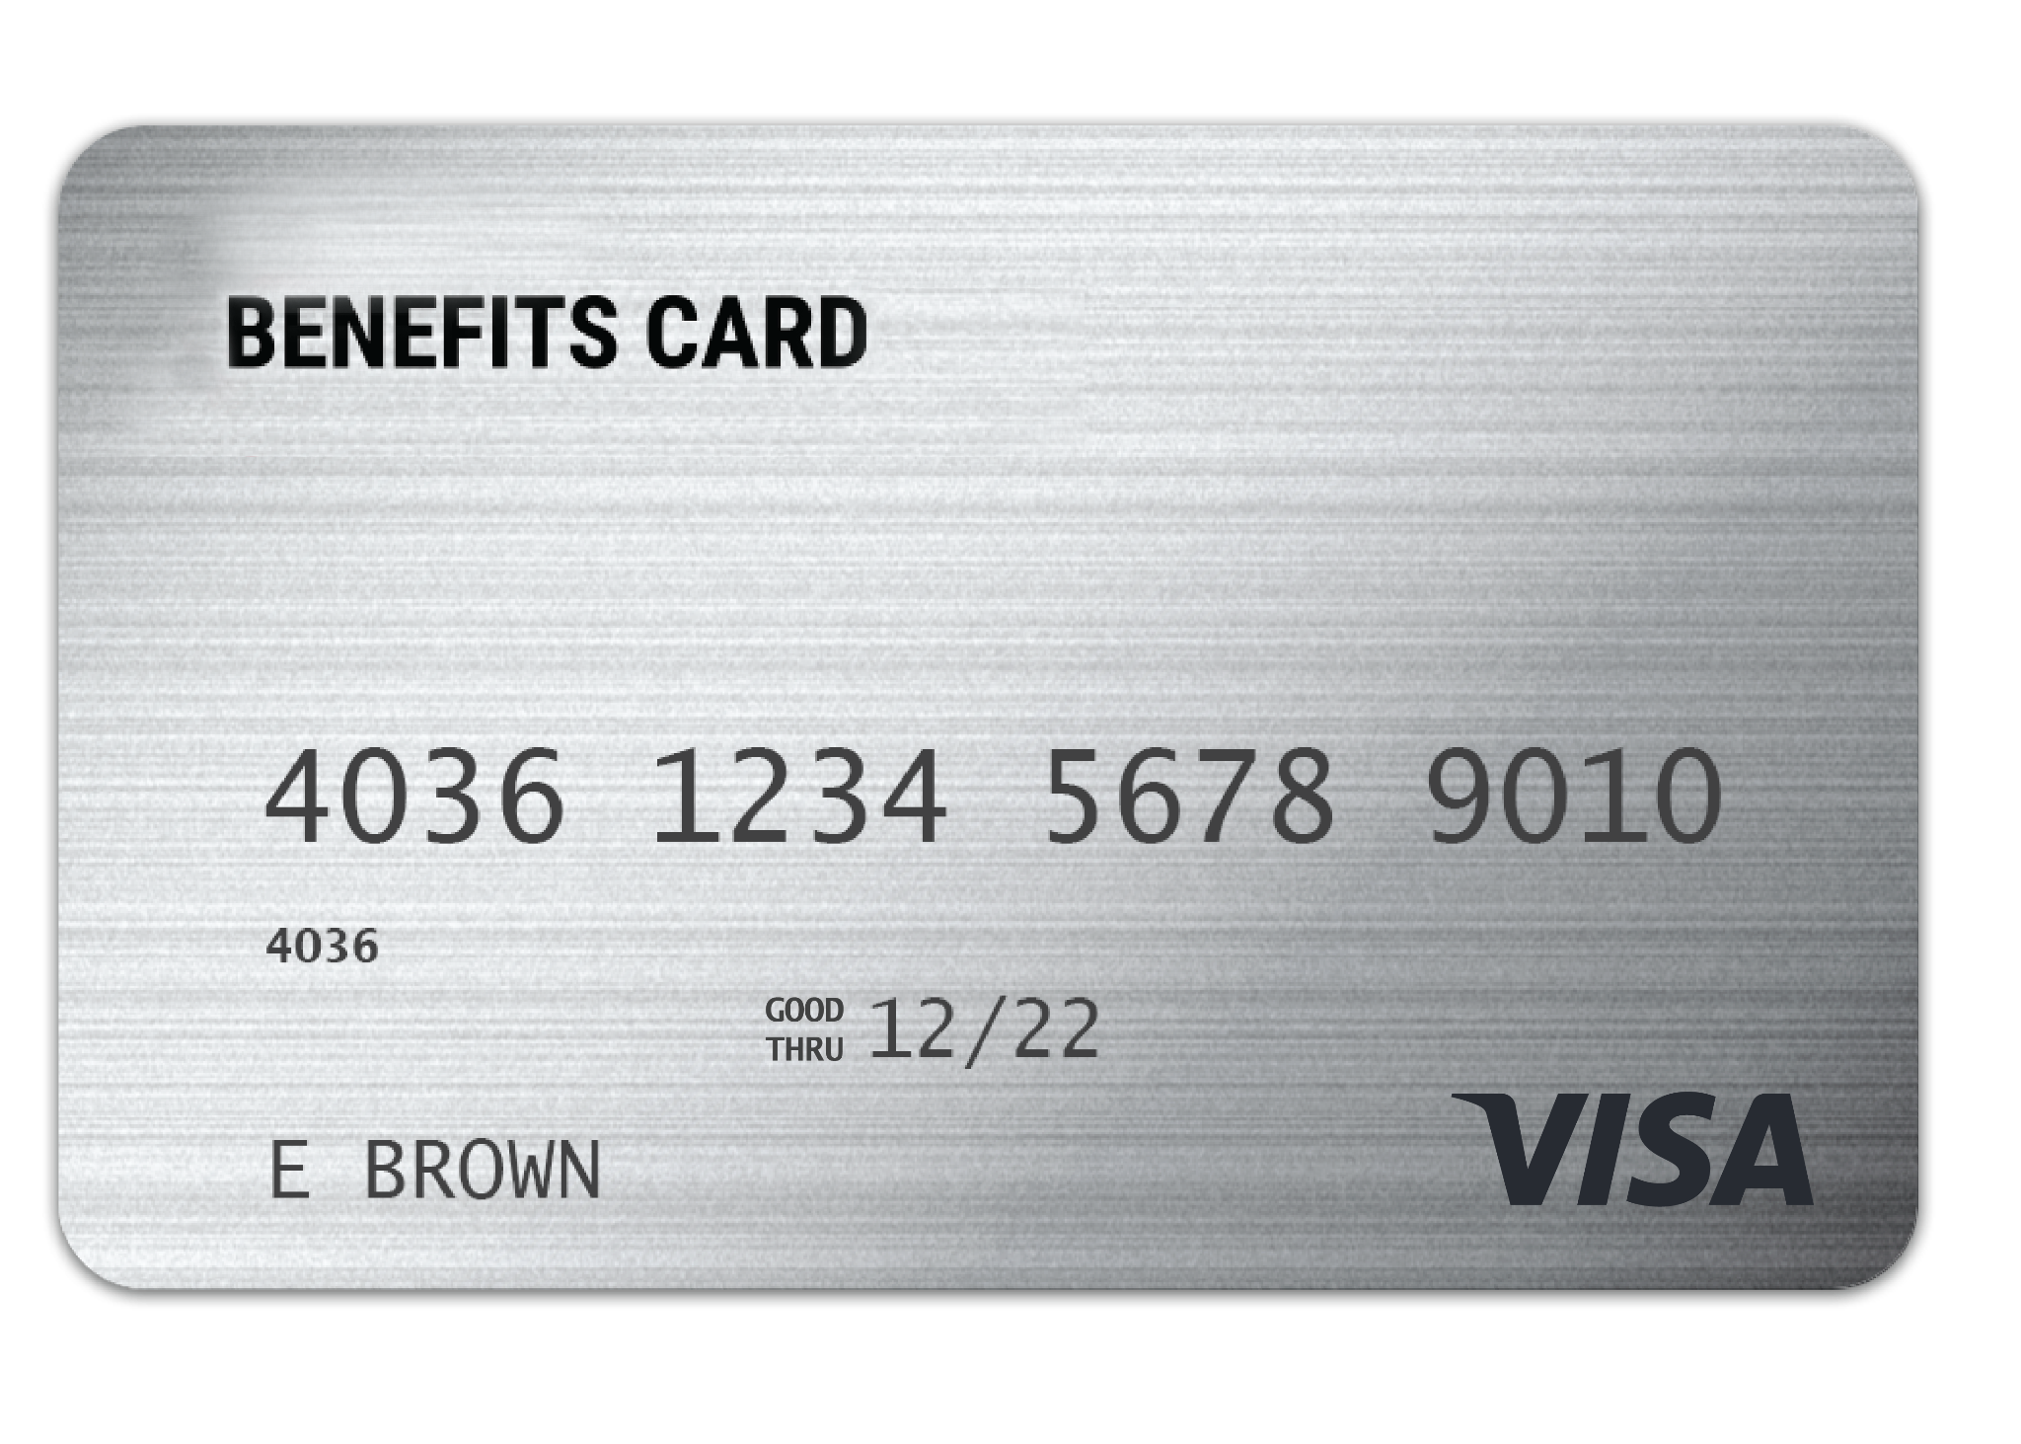
WEX
benefits card
One card to easily access your funds and pay for eligible expenses.
Free benefits card
Add to your mobile wallet for easy access on the go
Minimize the amount of out-of-pocket spending
Valid for three years
Instant access to plan funds
Page 17
Notes:
Your enrollment in any of our plans includes our free benefits debit card. This allows you to easily access your funds right from your wallet to help you minimize the amount of out of pocket spending.
You also have the option to add your benefits debit card to your mobile wallet, giving you convenient access on the go.
If you already have our debit card, they are good for 3 years, so if you received one within the last 2 years you will not get a new one again next year. We will mail you a new debit card 90 days before the expiration date of your current debit card. All new cards will be good for 4 years.
Regardless if you are enrolled in an FSA or other WEX benefits you will use the same card.
If your card is lost or stolen, you can order a new card free of charge from the benefits mobile app or by going through your online account.
The WEX Benefits Debit Card is the most common way that claims against your FSA are filed.

Slide 18
Any documentation provided must contain the following information:
When the service was received
Where the service was received
What service was received
The amount/cost of the service received
Who received the service
Claim filing
The best form of documentation when submitting a claim is an explanation of benefits (EOB) from your carrier, or an itemized receipt from your provider.
Page 18
Notes:
Let's talk a bit about documentation! (say jokingly) Everyone loves providing documentation, right?
Now, there are instances where we will reach out to you requesting documentation for your debit card purchase. This isn’t because we want to keep bothering you, it is because it is an IRS regulation. Before we get into what is needed specifically for substantiation, let's talk about when you may be asked to provide it.
We truly try to minimize the amount of times we have to ask for documentation or substantiation and this is because we completely understand that keeping track of your documentation or substantiation can be a hassle. We want this to be easy for you so our debit card has a couple of great features:
First, our debit card works with what is called an IIAS system. This means that if the merchant allows (typically big box stores like target and cvs will have this system) our debit card can read what each product being purchased is, will only allow eligible FSA items to be purchased on it, allowing it to auto substantiate (or verify) the card purchase. For example, say you are at target and you’re purchasing a box of band aides, sunblock and a soda. If you swipe your WEX benefits card, it will allow the band aides and sunblock to be purchased, as these are FSA eligible, but you would be asked to use a different form of payment for the Soda. In this instance, since the card could read and only allowed FSA eligible items to be purchased, it will auto substantiate and we will not reach out for you to ask for documentation to substantiate (or verify).
Next, our debit card recognizes recurring transactions. For example, if you go to the chiropractor and you have a copay. The first time you use your debit card to pay for that service, we will ask for substantiation. Once properly substantiated, our debit card will assume that if the card is used for the same dollar amount as the same merchant, it is for your already approved service or purchase and auto substantiate. Again, this means we won’t ask you for further documentation.
Lastly, there are going to places that we will ask you for documentation, and an example would be the dentist office. As the dentist office does not have an IIAS system and offers services that are NOT FSA eligible, we will as you to substantiate your transactions there so we can tell if you got a teeth cleaning which is 100% FSA eligible, or if you got a teeth whitening, which is NOT an eligible expense.
Now when you are asked to provide documentation, the best form of documentation to submit is an Explanation of Benefits (or EOB) as it contains all of the necessary information for WEX to approve your claim. You receive the EOB from your medical, dental or vision carriers.
An itemized receipt from a provider or merchant may work as well, but keep in mind any documentation provided must include the following information:
When the service was received
Where the service was received
What service was received
The amount/cost of the service received
Who received the service

Slide 19
Claim filing options
Mobile app, online
account, or manual claims
Choose direct deposit
or paper check
Processed within two business days
Direct deposit – FREE
$25 minimum reimbursement for paper checks
Page 19
Notes:
For anything you’ve paid out of pocket, you can also submit claims to be reimbursed by using your mobile app – simply login, select File a Claim and use the easy to follow steps. You can even take a picture of your explanation of benefits or itemized receipt right from your mobile phone!
And of course you can submit a claim thru you online account by following similar steps and uploading your documentation or by submitting the Claim form.
All claims are processed within 2 business days. You can choose to be reimbursed via check in the mail, or set up direct deposit and we’re able to send funds right to your bank account. Direct deposit is provided free of charge and is a quick and easy way to get your reimbursement!

Slide 20
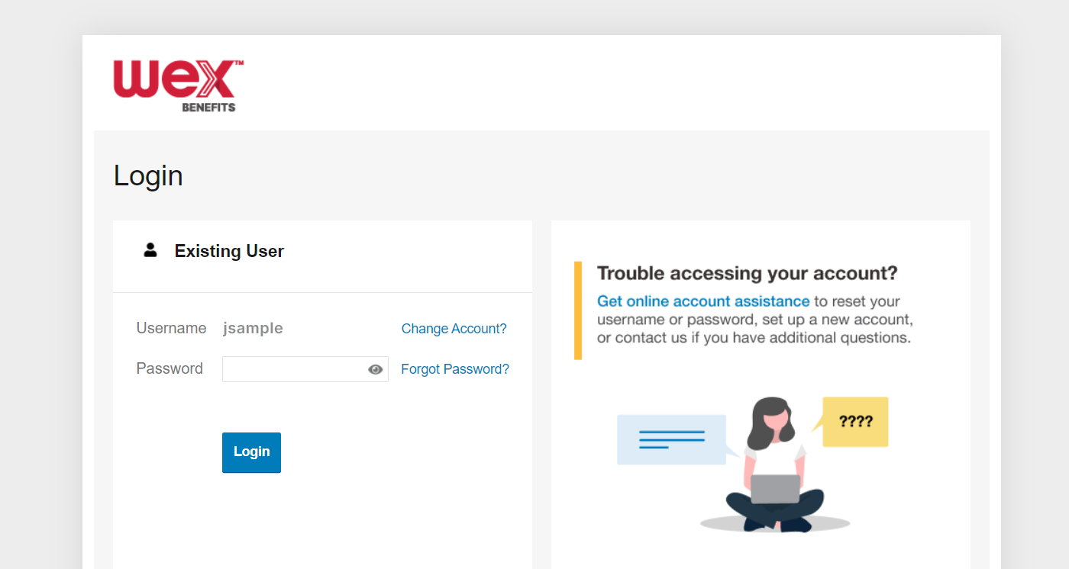

Account access
Online account
Mobile app
Page 20
Notes:
Now let’s end with a highlight of how you can access all of your accounts with us.
You can get access your account information by logging into your online account. Here you see details and balances of any accounts with us, transactions, and complete any tasks you’d like or need to take on your account. We also have the free WEX benefits mobile app.

Slide 21
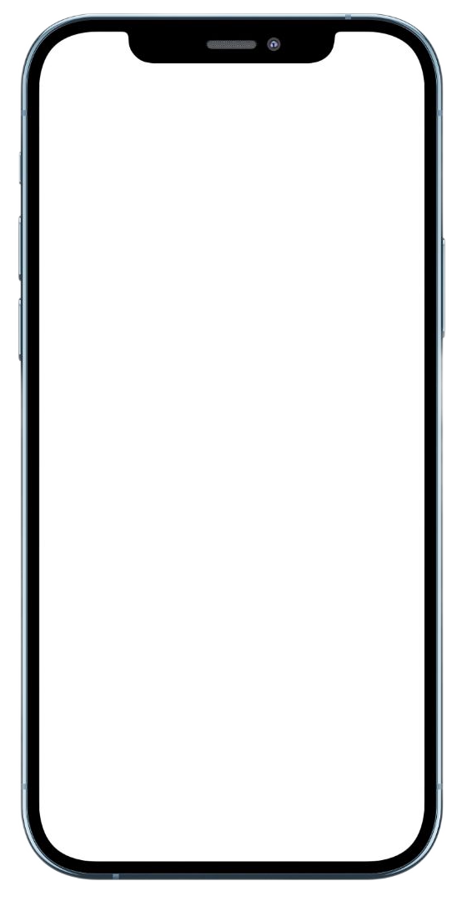
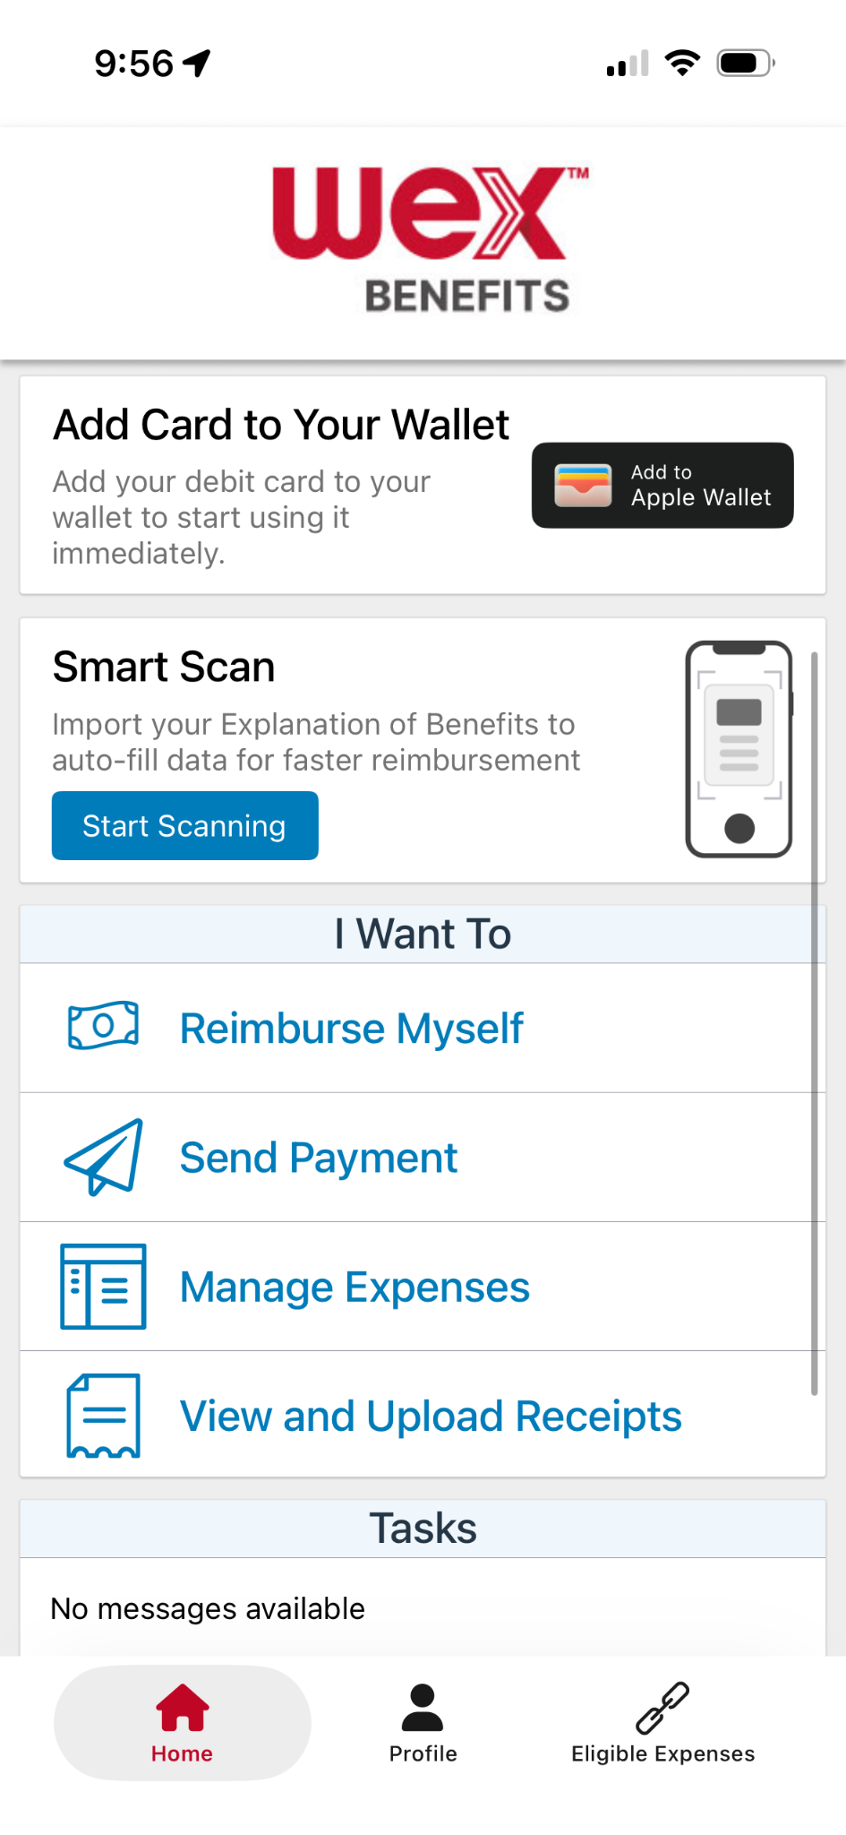
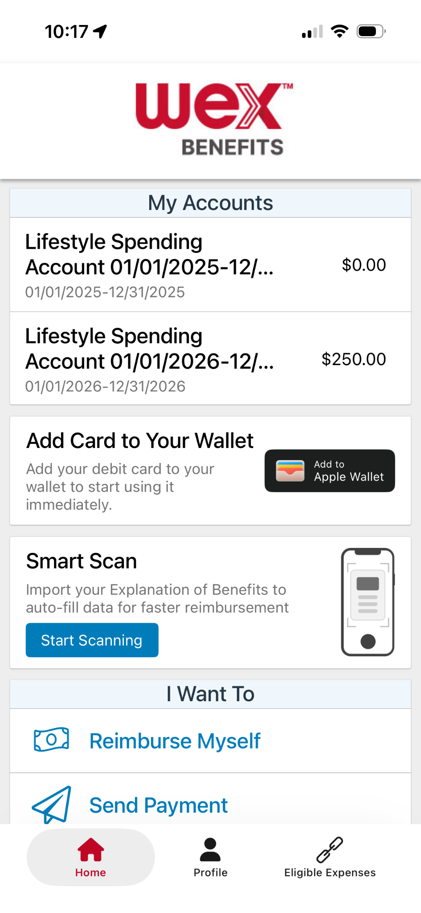
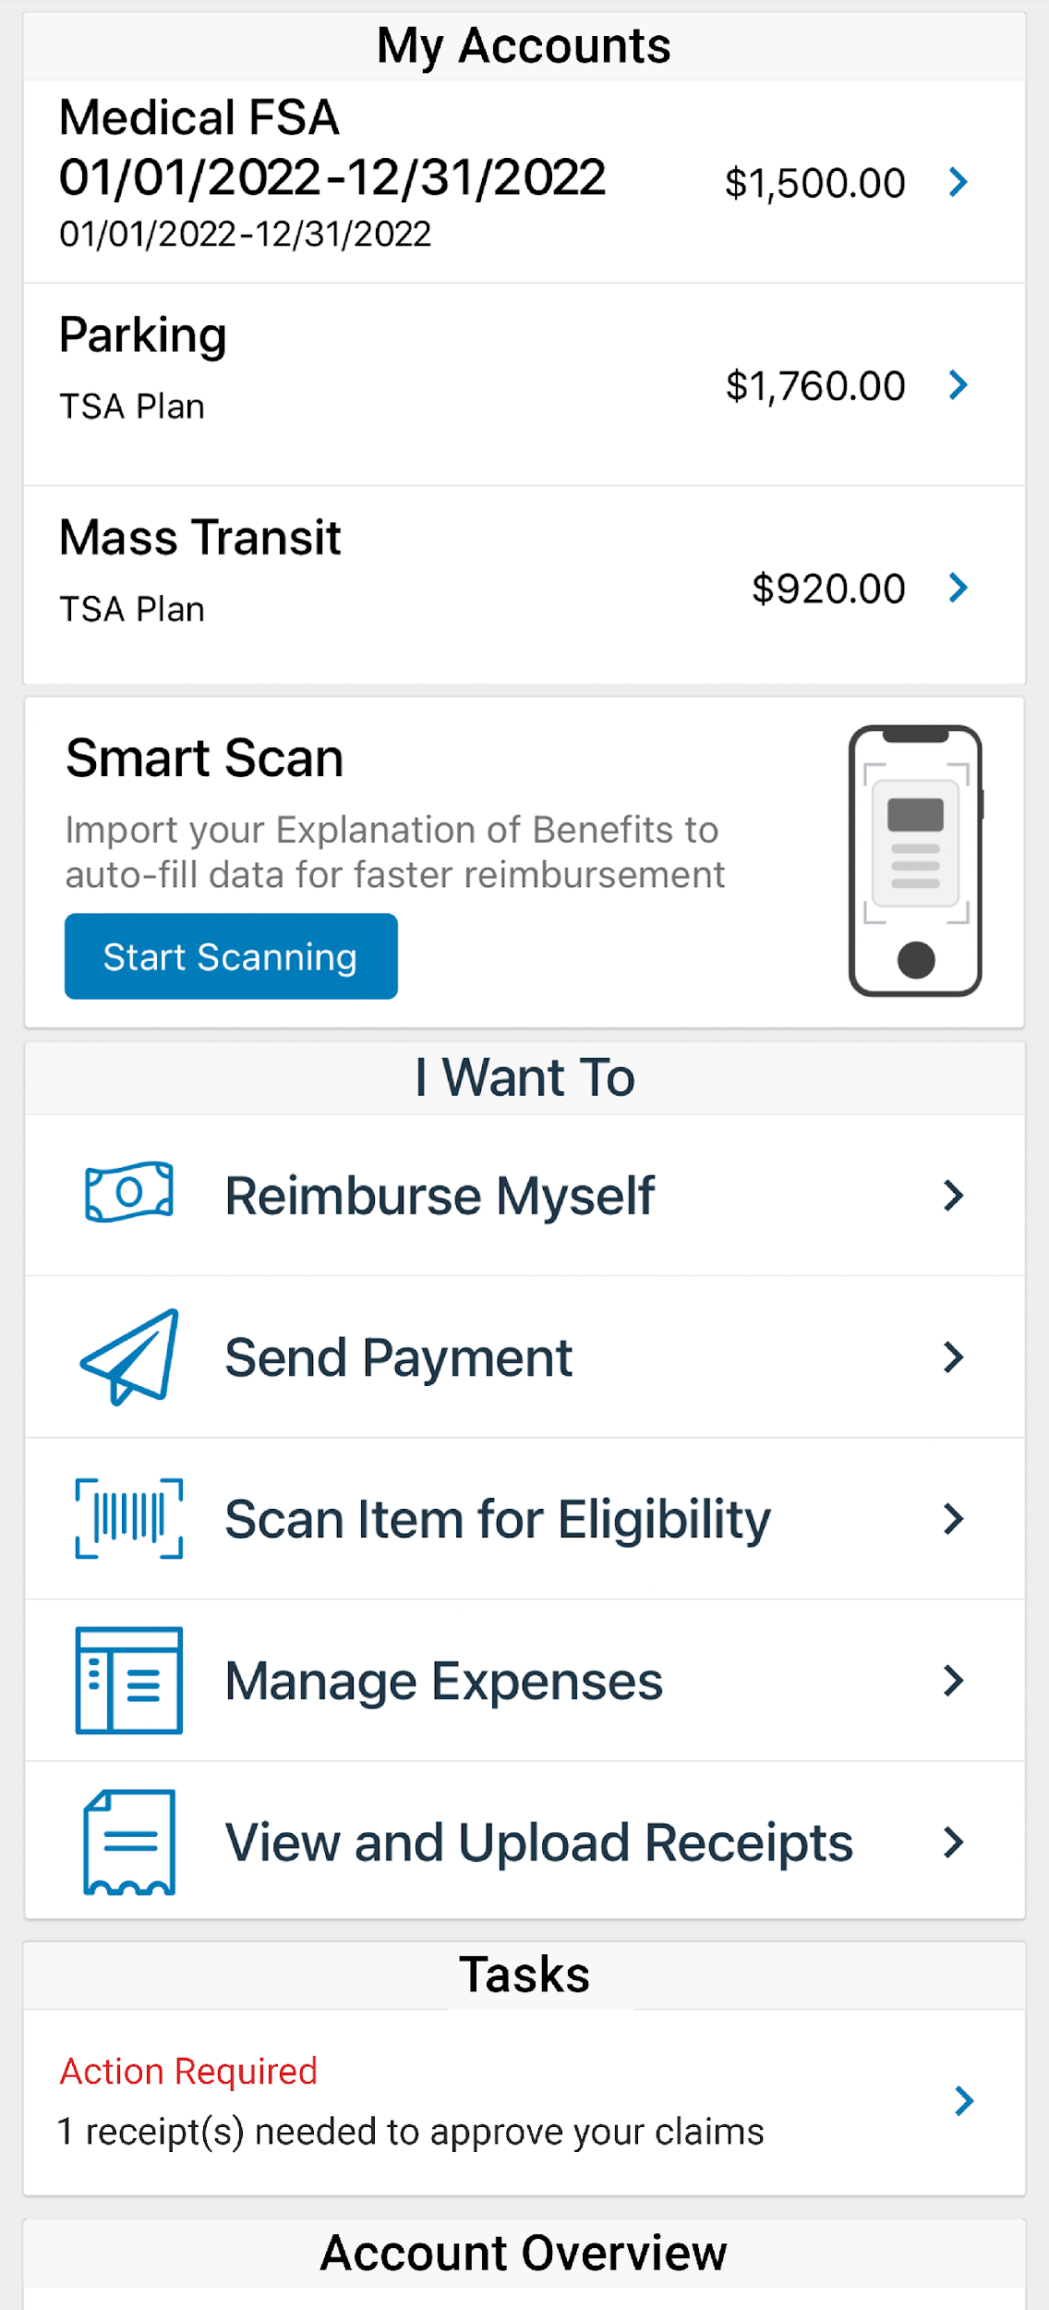
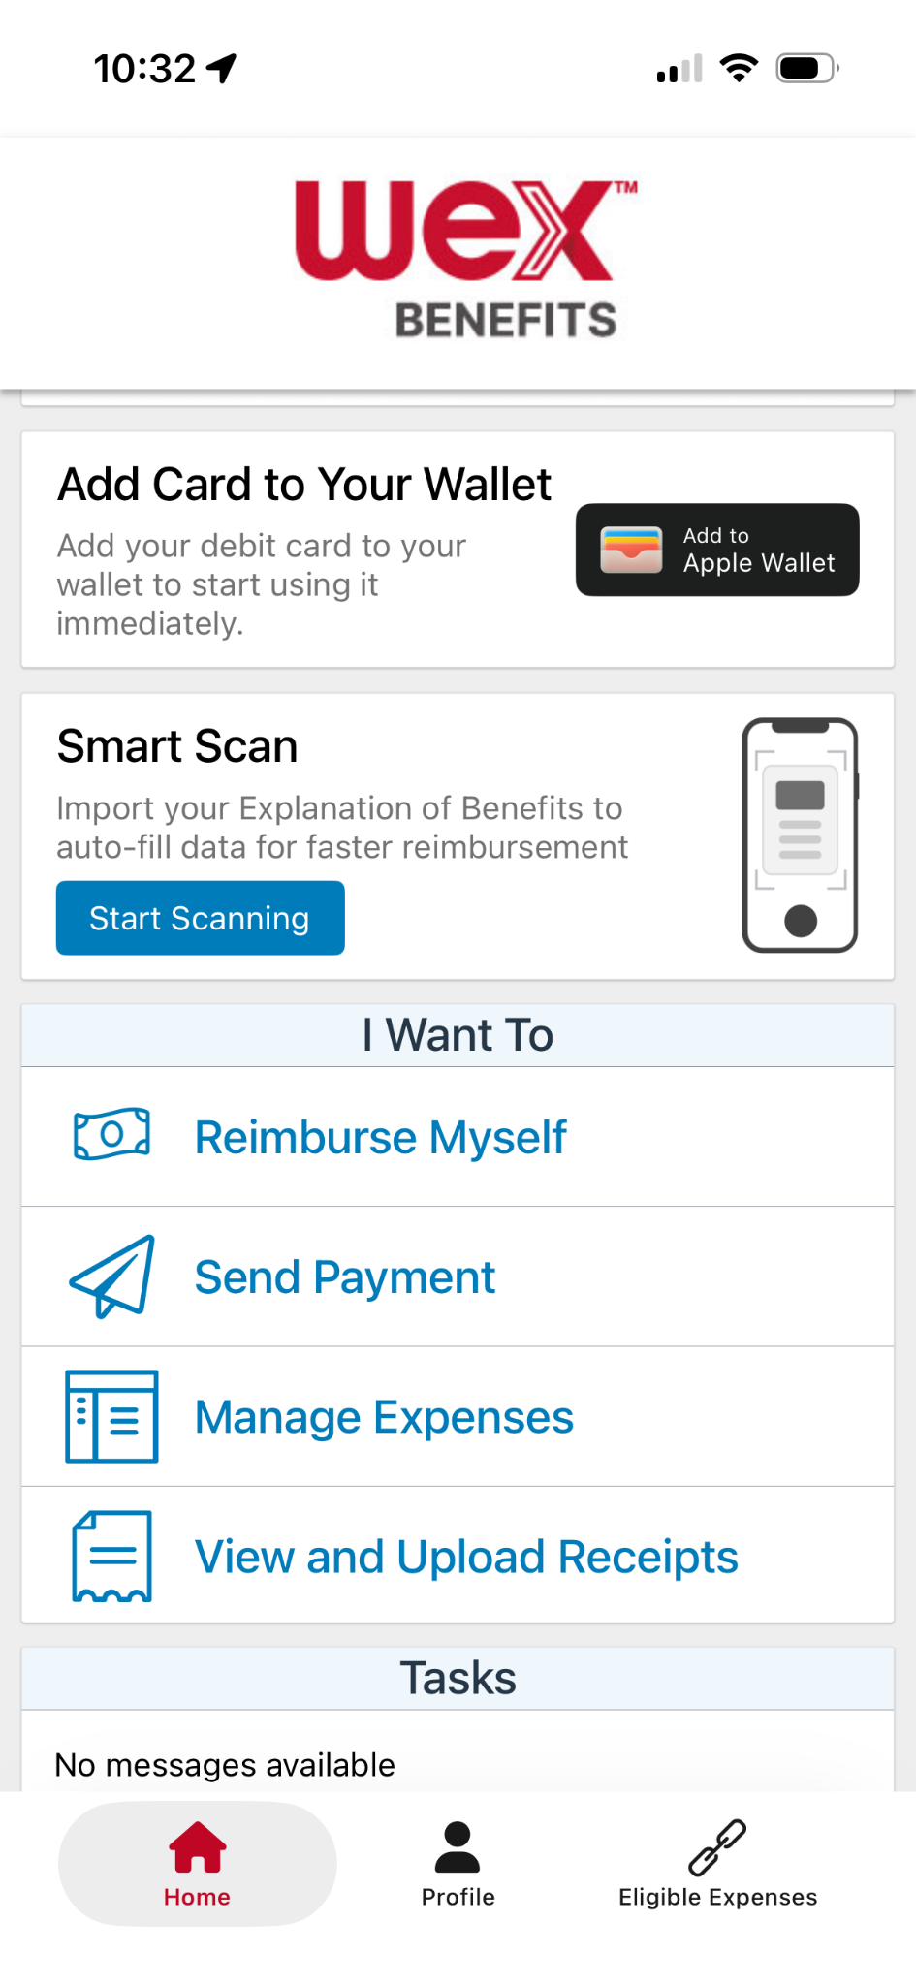

With our mobile app you can
Check your balance and view your activity.
Security on the go
Get instant notifications on the status of your claims.
01/01/2026-12/31/2026
01/01/2026 - 12/31/2026
Easily move funds from your HSA into your bank account to cover eligible expenses.
Our mobile app uses secure encryption and won’t store pictures on your phone, keeping your documentation safe and secure. Login is protected by a four digit passcode of your choosing. You can also log in with your thumbprint on Apple devices.
File a claim and upload documentation in seconds using your phone’s camera.
View current HSA investments balance, recent activity, and rate of return.
Scan an item’s barcode with your phone’s camera to determine if it is an IRS code 213(d) eligible expense.
Download the app for free on Apple and Android smartphones and tablets.
Scan Item for Eligibility
Reset login credentials.
Login with your Face ID.
Report a card as lost or stolen.
Page 21
Notes:
The WEX mobile app provides you with quick easy access to your online account. After logging in the first time, you can set up face ID access right from your phone.
Other great features include:
An eligible expense scanner – scan barcodes of items to see if they qualify as an eligible expense. — (Remove if not applicable)
Take a photo of your explanation of benefits or itemized receipt in order to submit documentation for any outstanding claims. This saves a ton of time since you don’t have to scan an email receipt and upload it manually.
Easily check your account balance while standing in line at the store, making it easy to decide if you want to use your FSA dollars to cover a purchase.

Slide 22


Contact Participant Services
Our Participant Services team is available Monday through Friday, from 6 a.m. to 9 p.m. CT, except holidays.
Website
www.wexinc.com
Current WEX participants
866-451-3399
New to WEX
844-561-1337
Page 22
Notes:
For any questions or assistance you may need, our participant services team is available to you Monday through Friday from 6 am to 9 pm Central time.
You have a variety of options to contact us. You can get support on our website at www.wexinc.com or call to speak to a participant services representative.
If participates ask for instructions…
Support on Website: To access the form, follow the below steps:
Navigate to www.wexinc.com > Support > Contact customer service team > Contact WEX benefits.
Select the following:
a. Type of Inquiry: Customer Service
b. I am a: Employee/Participant
Select “WEX Benefits Support Center”.
Complete the form.
A successful submission message will appear indicating that we'll be in touch.
The employee/participant will receive an email response with additional details or resolution to their inquiry.
Form URL: https://wexhealthinc.my.site.com/WEXbenefitscontactus/s/

Slide 23
Thank you!

