Slide 1



Minnesota Healthcare Consortium
OPEN ENROLLMENT PRESENTATION
Notes:
This presentation is being presented by WEX. My name is ____________ and I am happy to be here with you today!

Slide 2
Voluntary Employees’
Beneficiary Associations
VEBA
Notes:
During our presentation today, I’ll be reviewing what a VEBA is and why you should consider enrolling in an VEBA.

Slide 3

VEBA account
As soon as your employer funds the account, the money belongs to you! It is protected within a trust
Your dollars start earning interest right away, funds are automatically placed into the Lincoln Stable Value Fund with a 1.3% guaranteed rate of return
You have access to 30+ additional funds
No taxes on account contributions, interest or qualified withdrawals
Post employment, your money goes with you
Notes:
Some of you might be asking yourself, what is a VEBA. The goal of our time today have you leave today knowing the value a VEBA can bring to you. A VEBA is a Voluntary Employee Beneficiary Associations plan. It is a type of tax-exempt plan used by you and eligible dependents to pay for eligible medical expenses. It can only be funded by your employer.
VEBA’s are prevalent in the public sector space. When your employer puts money away for the future you need it to be safe. The VEBA offers that safety. A unique feature of a VEBA is that it doesn’t go into a bank account, it goes into a trust. I like to think of it as a one way trust. Meaning, your employer puts money in one way and you are the only one who can take the money out. Once the money goes into your VEBA it belongs to you forever.
The money in your VEBA earns interest, meaning it is consistently growing without you having to do anything. Dollar one starts investing in the Lincoln Stable Value Fund that has a guaranteed rate of 1.3%. You also have the option to move out of the stable value fund and move into any of the 30+ additional investment options available to you. The great news here is that there are no minimums to begin investing and there are no costs to invest. Our trust partner can assist you with investment fund specific guidance should you want assistance in exploring your options.
In addition to the benefits highlighted, there are no taxes on account contributions, interest or qualified withdrawals. Think of it like this, if your employer put a contribution on your paycheck directly, it would be subject to state FICA taxes. When your employer puts money into your VEBA state, federal or FICA tax do not apply.
This money belongs to you. Even if you part ways with your current employer or retire, it will always be in your employer trust to access.

Slide 4
VEBA expenses include…
Eligible expenses include 213(d) expenses, over-the-counter, co-pays, deductibles, co-insurance, as well as dependent expenses and post employment
Use your VEBA for medical expenses that your plan doesn’t cover, such as:
Page ‹#›
Notes:
Now that you understand the tax savings benefits of what a VEBA offers, what can you actually use it for? Your VEBA can be used medical, dental, vision expenses, 213d expenses and over the counter expenses. Over the counter expenses would be when you go into the pharmacy and buy products that do not require a prescription. Think of contact solution, Advil, etc. You can use your VEBA for all of those things!
One of the great features of a VEBA is that you are able to submit claims for your spouse or any children under the age of 26, regardless if they are covered by your insurance or not.
Imagine a day when you can stop working. Until you turn Medicare eligible at age 65, you most likely won’t be in a position to pay for your own health insurance. Here’s the good news about your VEBA. Once you are post employment you can pay for your premiums and you do not get taxed on it. This is huge! Many of your peers who have a VEBA today save their VEBA dollars for post employment. Something to think about!

Slide 5
Beneficiary protection through the MHC trust ensures that you control the designation of who retains your funds after you’re gone.
The death benefits would be paid out in the following order:
Spouse (tax free basis)
Medical dependent (up to age 26) (tax free basis)
Designated beneficiary (subject to state and/or federal taxes)
VEBA
beneficiary rules
Page ‹#›
Notes:
In addition to your 401k or HSA, you are also required to enter beneficiaries for your VEBA.
The rules I’m going to speak to now are specific to the VEBA and a great benefit. When I think about the future, I think about if I’m prepared. One of the many things I think about is, where will my money go, who will it go to?
For your VEBA, if you are married your funds will go to your spouse.
Maybe you aren’t married but have a medical dependent child under the age of 26, your VEBA funds would then go to that child.
If you don’t have a spouse, it automatically goes to your children who fall under the age of 26.
If you do not have a spouse or child under 26, you can name your beneficiary. You could say, I want Jane Doe to be the beneficiary of my VEBA funds. That is allowed with your VEBA.

Slide 6
Utilizing VEBA accounts
Notes:
Now that we have learned about the VEBA, let’s talk about how you can utilize these plans and the multiple resources you have.

Slide 7
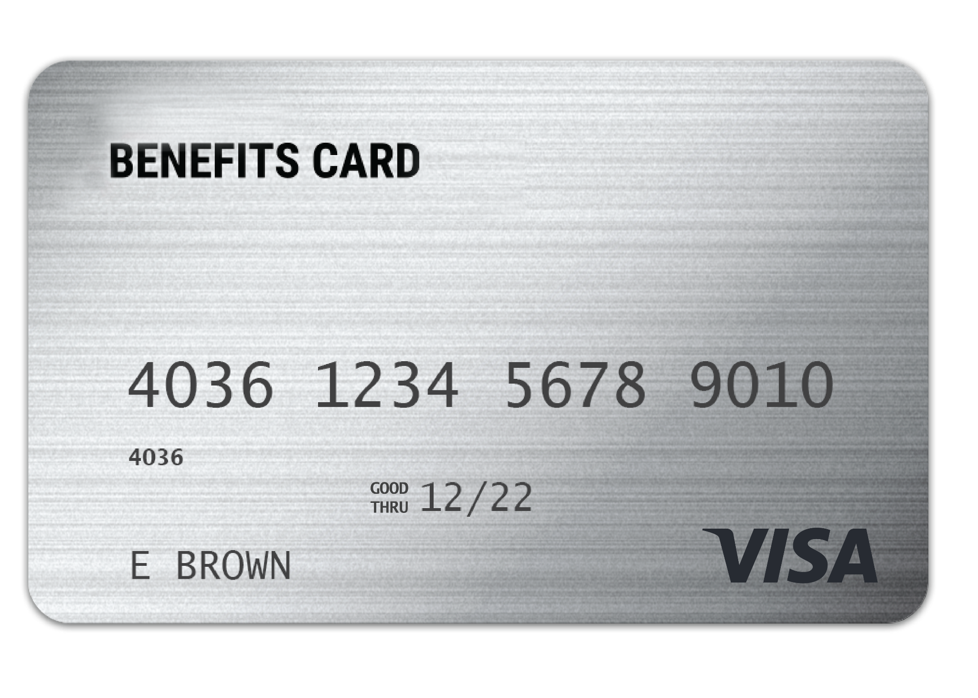
WEX
benefits card
One card to easily access your funds and pay for eligible expenses.
Free benefits card
Add to your mobile wallet for easy access on the go
Minimize the amount of out-of-pocket spending
Valid for four years
Instant access to plan funds
Page ‹#›
Notes:
Accessing your funds needs to be easy. The easiest way to get reimbursed is by using your WEX benefits debit card. Whether you are at the dentist whether you are picking up a prescription, the debit card allows you to easily access your VEBA funds along with any other plans you are enrolled in. Your enrollment in any of our plans includes our free benefits debit card. This allows you to easily access your funds right from your wallet to help you minimize the amount of out of pocket spending.
We will mail you a new debit card 90 days before the expiration date of your current debit card. All cards will be good for 4 years.
Regardless if you are enrolled in a VEBA or other WEX benefits you will use the same card.
If your card is lost or stolen, you can order a new card free of charge from the benefits mobile app or by going through your online account.
You can request a WEX benefits debit card for your dependents and/or spouse. First ensure they are added to your online account. You can do that by going to the Profile section of your online account. Once they are added you can select Banking/Cards and request a card for each dependent. A dependent must be 18 years of age or older to receive a debit card.
The WEX Benefits Debit Card is the most common way that claims against your VEBA are filed. The VEBA does have IRS regulations tied to it so don’t’ be surprised if WEX reaches out from time to time to ask for documentation.

Slide 8
Any documentation provided must contain the following information:
When the service was received
Where the service was received
What service was received
The amount/cost of the service received
Who received the service
Claim filing
The best form of documentation when submitting a claim is an explanation of benefits (EOB) from your carrier, or an itemized receipt from your provider.
Page ‹#›
Notes:
Lets talk a bit about documentation! (say jokingly) Everyone loves providing documentation, right?
Now, there are instances where we will reach out to you requesting documentation for your debit card purchase. This isn’t because we want to keep bothering you, it is because it is an IRS regulation. Before we get into what is needed specifically for substantiation, lets talk about when you may be asked to provide it.
We truly try to minimize the amount of times we have to ask for documentation or substantiation and this is because we completely understand that keeping track of your documentation or substantiation can be a hassle. We want this to be easy for you so our debit card has a couple of great features:
First, our debit card works with what is called an IIAS system. This means that if the merchant allows (typically big box stores like target and cvs will have this feature) our debit card can read what each product being purchased is and can approve and auto-substantiate your transaction if it is HRA eligible. For example, say you are at target and you’re purchasing a box of band aides, sunblock and a soda. If you swipe your HRA card, it will automatically approve and substantiate the band aides and sunblock, as these are HRA eligible, but you would be asked to use a different form of payment for the Soda. In this instance, we will not reach out to you!
Next, our debit card allows recurring transactions. For example, if you go to the chiropractor and you have a copay. The first time you use your debit card to pay for that service, we will ask for substantiation. Once properly substantiated, our debit card will assume that if the card is used for the same dollar amount as the same merchant, it is for your copay and will auto substantiate. This means we won’t ask you for further documentation.
Lastly, there are going to places that we will ask you for substantiation, an example would be the dentist office. As the dentist office does not have an IIAS system and offers services that are NOT HRA eligible, we will as you to substantiate your transactions there so we can tell if you got a teeth cleaning which is 100% HRA eligible, or if you got a teeth whitening, which is NOT an eligible expense.
Also, if you are submitting a claim via your mobile app, your online account or manually via the mail the best form of receipt or documentation is an Explanation of Benefits as it contains all of the necessary information for WEX to approve your claim. You receive your explanation of benefits (or EOB) from your medical, dental or vision carriers.
Any documentation provided must contain the following information:
When the service was received
Where the service was received
What service was received
The amount/cost of the service received
Who received the service

Slide 9
Claim filing options
Mobile app, online
account, or manual claims
Choose direct deposit
or paper check
Processed weekly
Direct deposit – FREE
$25 minimum reimbursement for paper checks
Page ‹#›
Notes:
For anything you’ve paid out of pocket, you can also submit claims to be reimbursed by using your mobile app – simply login, select File a Claim and use the easy to follow steps. You can even take a picture of your explanation of benefits or itemized receipt right from your mobile phone!
And of course you can submit a claim thru you online account by following similar steps and uploading your documentation or by submitting the Claim form.
Manual claims are processed weekly. You can choose to be reimbursed thru direct deposit right to your bank account or have a check mailed to you. Direct deposit is provided free of charge and is a quick and easy way to get your reimbursement!

Slide 10
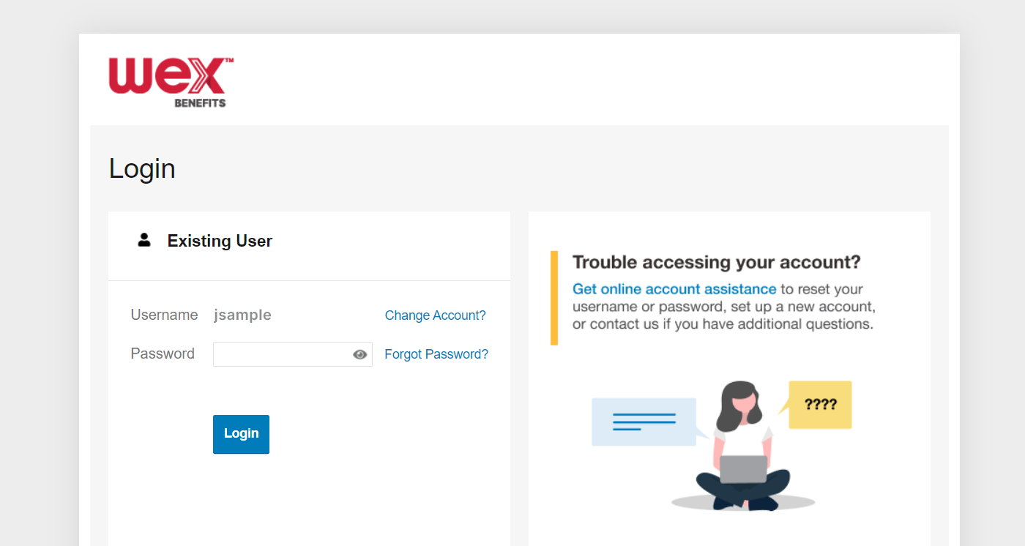

Account access
Online account
Mobile app
Page ‹#›
Notes:
Now let’s end with a highlight of how you can access all of your accounts with us–
You can get access to confirm your balances, file a claim, for investments for the VEBA and to make beneficiary updates by logging into your online account. You can also file claims by downloading the WEX Benefits mobile app.

Slide 11
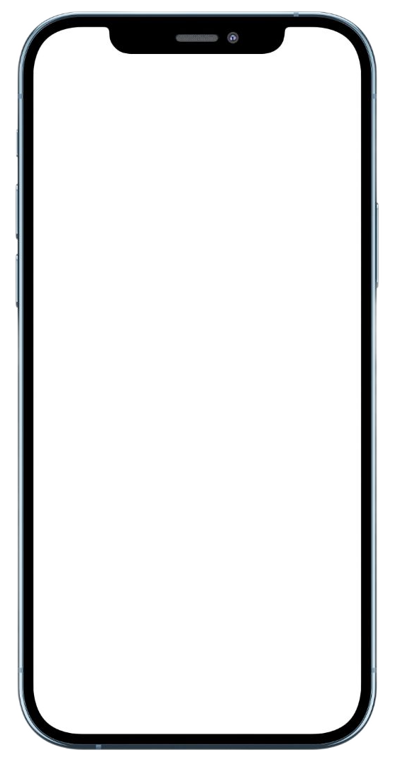
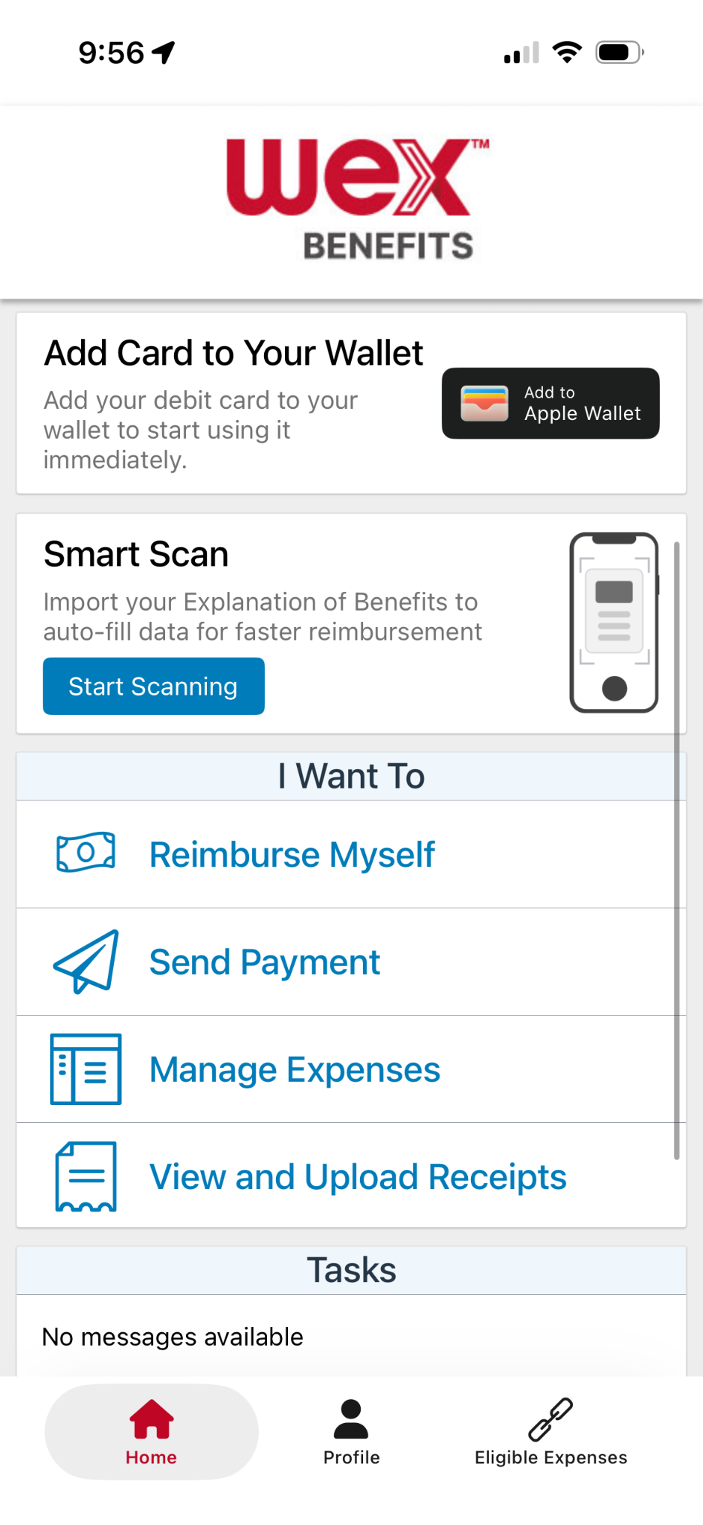
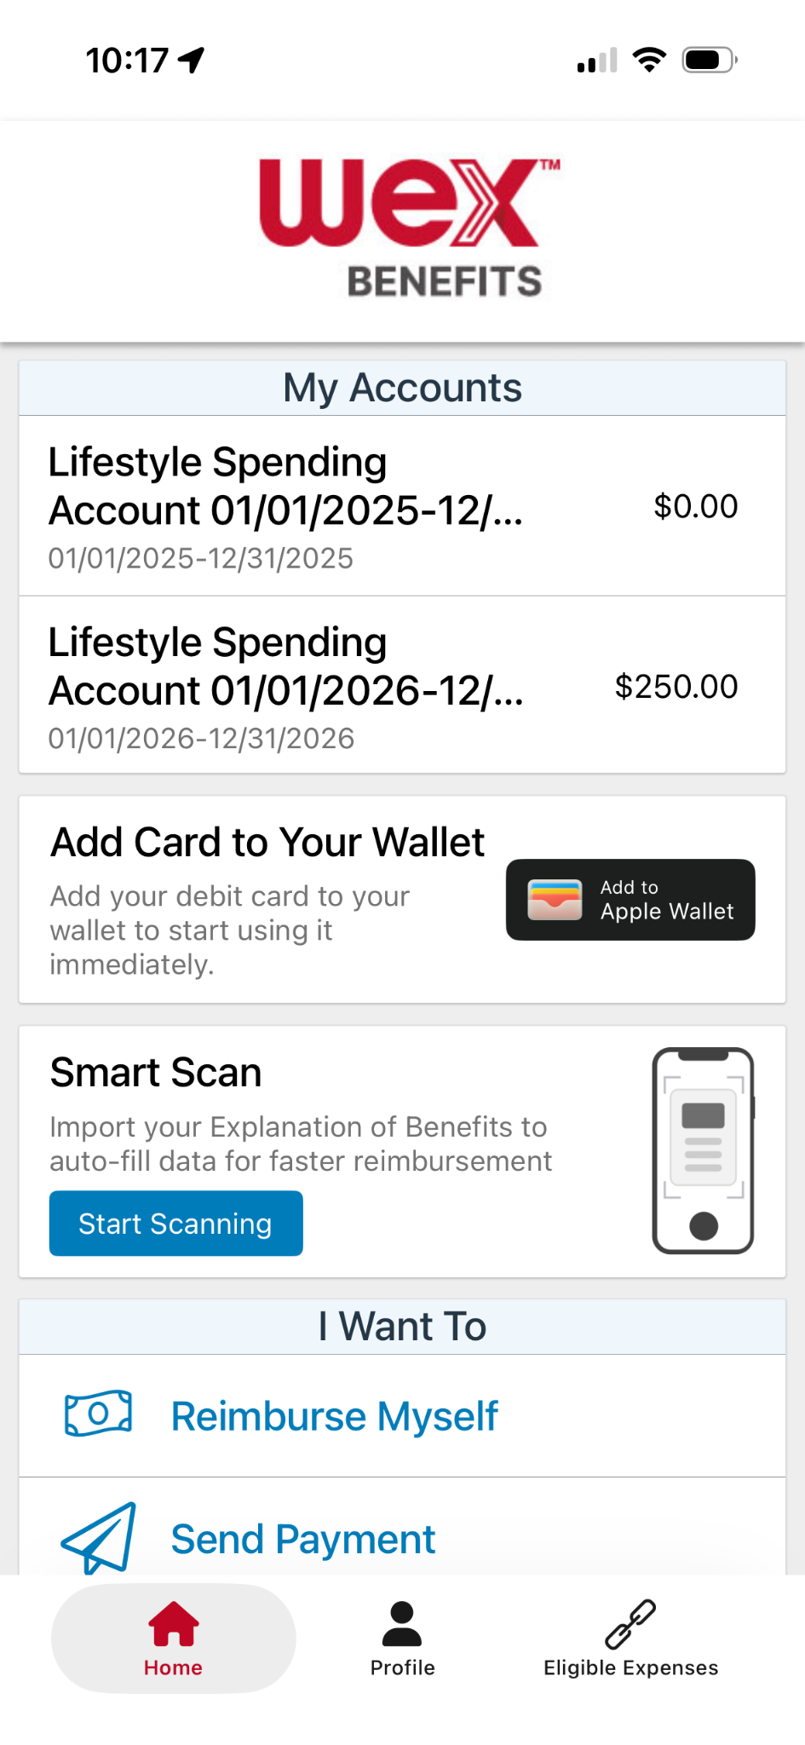
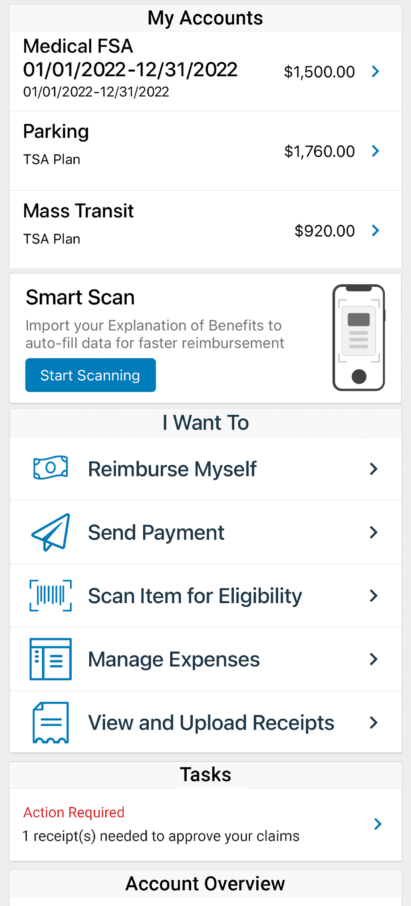
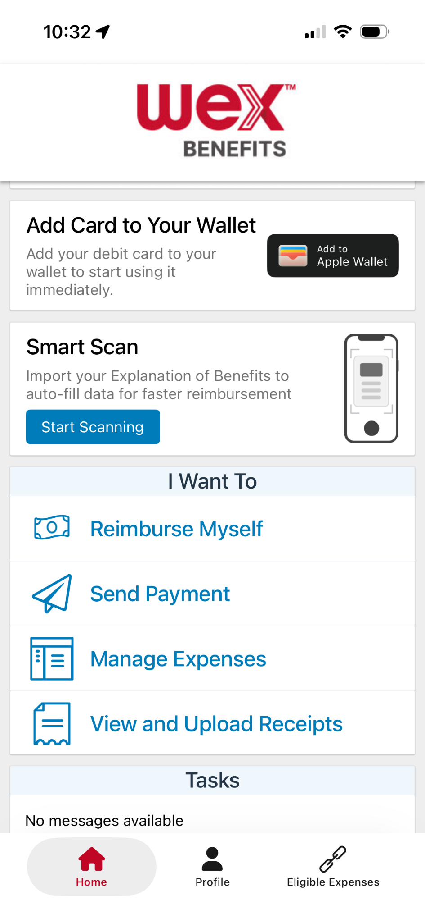

With our mobile app you can
Check your balance and view your activity.
Security on the go
Get instant notifications on the status of your claims.
01/01/2026-12/31/2026
01/01/2026 - 12/31/2026
Easily move funds from your HSA into your bank account to cover eligible expenses.
Our mobile app uses secure encryption and won’t store pictures on your phone, keeping your documentation safe and secure. Login is protected by a four digit passcode of your choosing. You can also log in with your thumbprint on Apple devices.
File a claim and upload documentation in seconds using your phone’s camera.
View current HSA investments balance, recent activity, and rate of return.
Scan an item’s barcode with your phone’s camera to determine if it is an IRS code 213(D) eligible expense.
Download the app for free on Apple and Android smartphones and tablets.
Scan Item for Eligibility
Reset login credentials.
Login with your Face ID.
Report a card as lost or stolen.
Page ‹#›
Notes:
The WEX mobile app provides you with quick easy access to your online account. After logging in the first time, you can set up fingerprint access right from your phone.
Other great features include:
An eligible expense scanner – scan barcodes of items to see if they qualify as an eligible expense.
Take a photo of your explanation of benefits or itemized receipt in order to submit documentation for any outstanding claims. This saves a ton of time since you don’t have to scan an email receipt and upload it manually.

Slide 12


Contact Participant Services
Our Participant Services team is available Monday through Friday, from 6 a.m. to 9 p.m. CT, except holidays.
Website
www.wexinc.com
Current WEX participants
866-451-3399
New to WEX
844-561-1337
Page ‹#›
Notes:
For any questions or assistance you may need, our participant services team is available to you Monday through Friday from 6 am to 9 pm Central time.
You have a variety of options to contact us. You can get support on our website at www.wexinc.com or call to speak to a participant services representative.
If participates ask for instructions…
Support on Website: To access the form, follow the below steps:
Navigate to www.wexinc.com > Support > Contact customer service team > Contact WEX benefits.
Select the following:
a. Type of Inquiry: Customer Service
b. I am a: Employee/Participant
Select “WEX Benefits Support Center”.
Complete the form.
A successful submission message will appear indicating that we'll be in touch.
The employee/participant will receive an email response with additional details or resolution to their inquiry.
Form URL: https://wexhealthinc.my.site.com/WEXbenefitscontactus/s/

Slide 13
Thank you!
Notes:
Thank you so much for your time today. We are looking forward to serving you and we hope you’ve learned more about your VEBA.

