Slide 1
Read, then delete this slide
Add/remove slides as needed to tailor your presentation
To share/email, click “File” in the top left of main menu above and then “Download.”
  Recommend downloading as a PDF for easy emailing and reading by the recipient
If are you looking for instructions or videos on the webinar subjects,
we have linked the participant articles and video of each topic.
How to set up your HSA investments in your online account Article | Video
How to manage HSA investments in your online account Article | Video
How to enroll in a Health Saving Brokerage Account (HSBA) Article | Video
My HSA Planner Article | Tool

Slide 2
Client name
Getting started with HSA investments
Notes:
Hello everyone, and welcome to your post-enrollment webinar, Getting started with Health Savings Account (or HSA) Investments , presented by WEX.
My name is ____________ and I am happy to be here with you today as we go through the basics of HSA investments.
Before we begin, I’d like to quickly mention- as we ask you to participate throughout the presentation, please keep in mind this is a live webinar in a group setting so we are unable to answer any questions regarding specific individual situations to protect your privacy. We are happy to answer any general questions you may have but are unable to provide any specific investment advice. Please reach out to your tax or financial advisor with any investment-related questions.
With that - let’s get started!

Slide 3
Getting started with HSA investments
Set up HSA investments in your online account
Manage HSA investments in your online account
Enroll in a Health Savings Brokerage Account
Utilize HSA Planner
Notes:
***If slides are removed from the deck, please remember to remove that task from this slide image and text***
During our time together, we will be covering how to :
Set up HSA investments in your online account
Manage HSA investments in your online account
Enroll in a Health Savings Brokerage Account
And how to utilize the HSA Planner through WEX
As we go through, you may notice your online account or mobile app looks slightly different than those showing on the screen, depending on the plan or plan(s) you’re enrolled in, OR slight platform updates.

Slide 4


How to set up HSA investments in your online account
Proprietary & Confidential
Notes:
To start out, let’s cover how to set up your HSA investments in your online account.

Slide 5
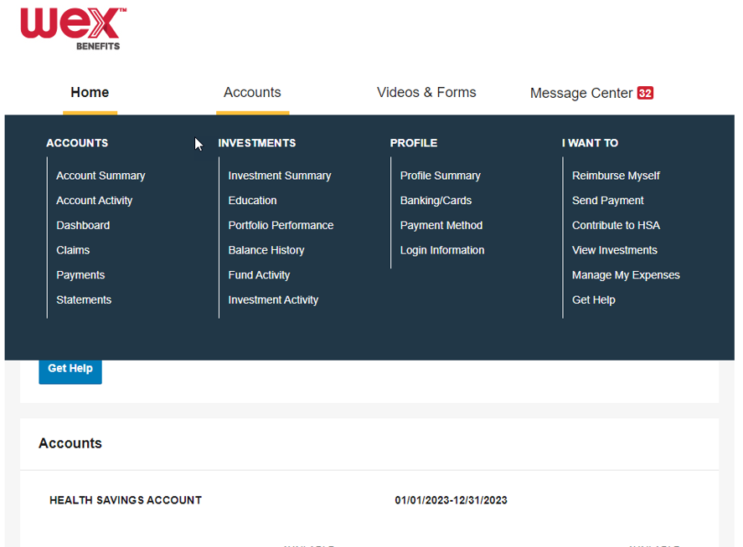
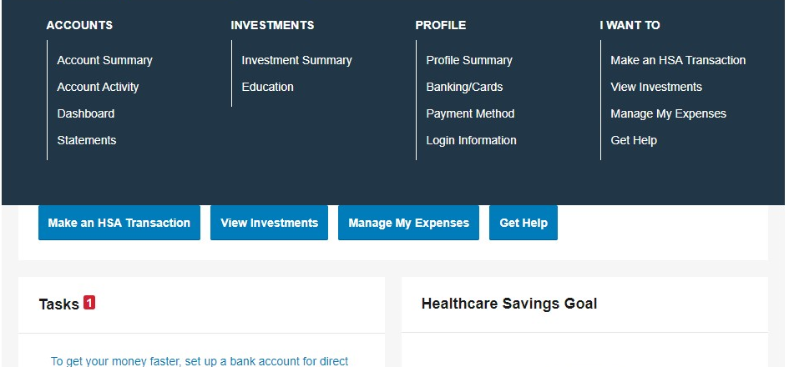
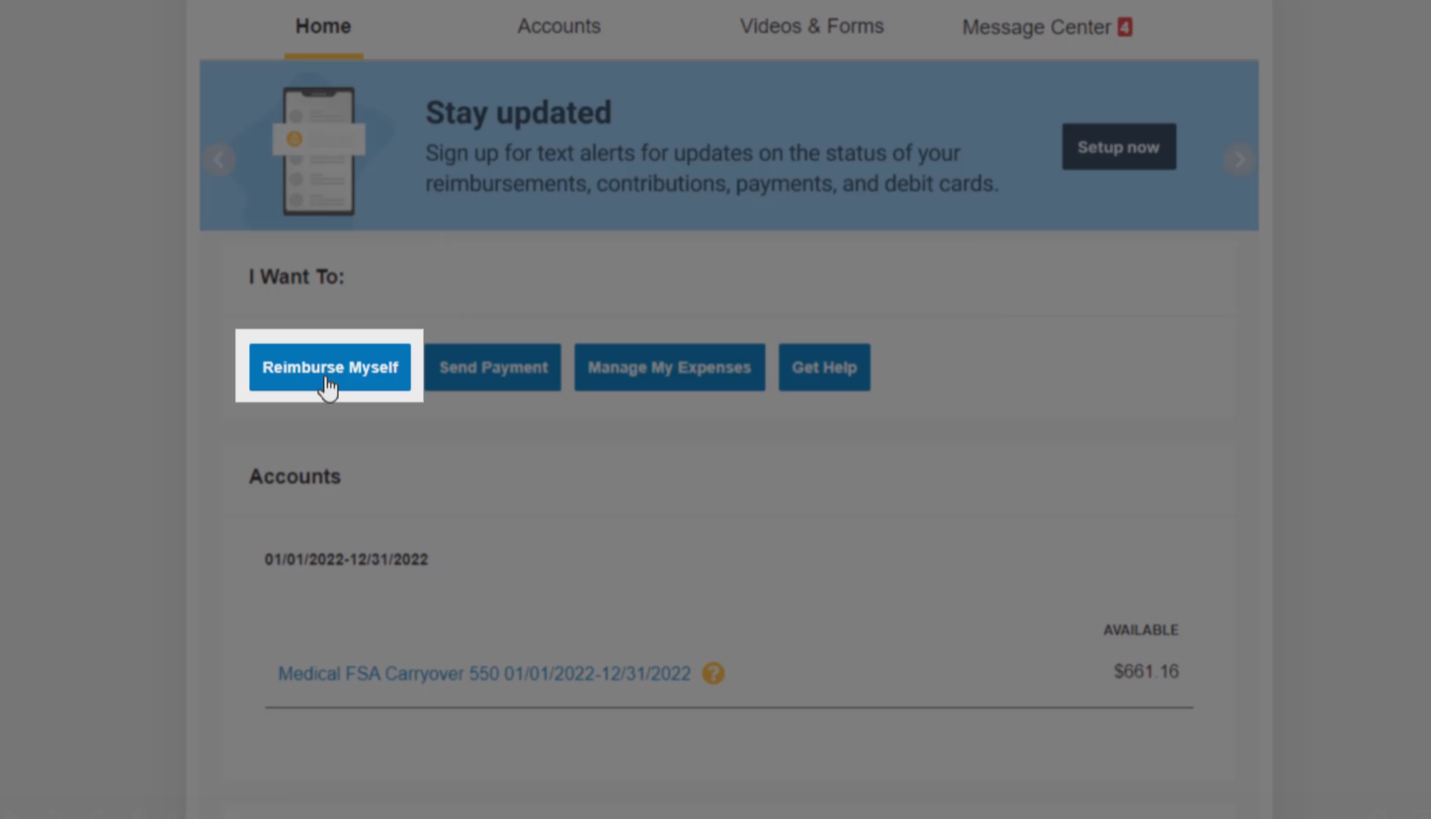
How to set up HSA investments in your online account
Notes:
You’ll first need to navigate to the “Accounts” tab, and under “Investments,” select “Investment Summary.”

Slide 6
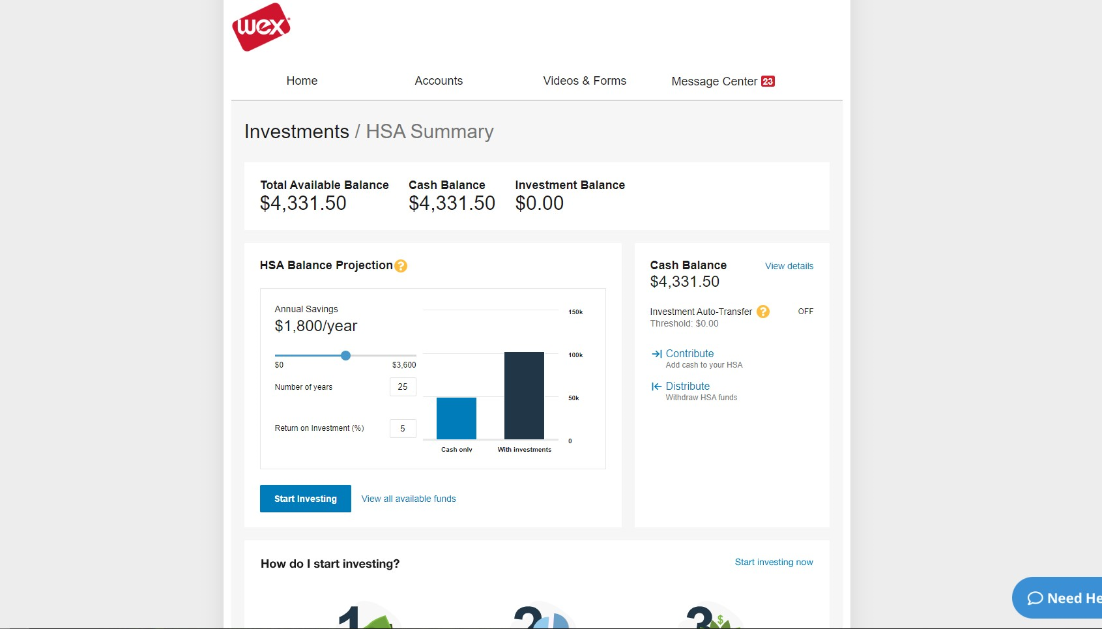
How to set up HSA investments in your online account
Notes:
This will route you to your “HSA Summary” page. Select “Start Investing.”

Slide 7
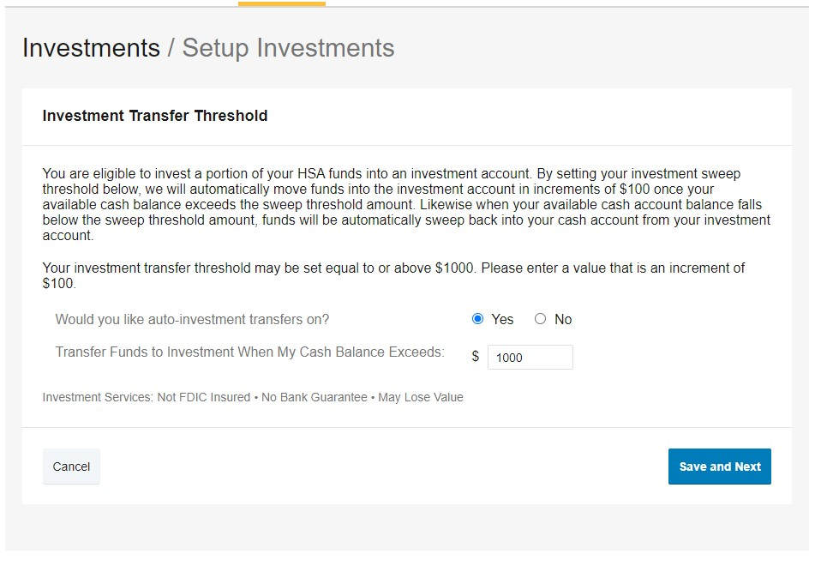
How to set up HSA investments in your online account
Notes:
On the next page, you will be asked to set up your desired transfer preferences.
Select “Yes” to turn on auto-investment transfers.

Slide 8
How to set up HSA investments in your online account
Notes:
Next, provide your desired transfer threshold amount in the available field.

Slide 9
How to set up HSA investments in your online account
Notes:
Then select “Save and Next.”

Slide 10
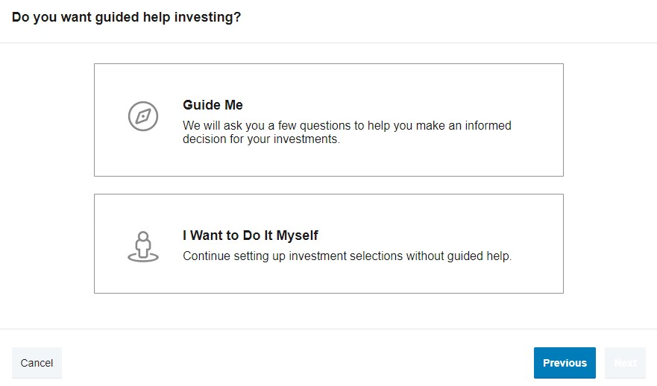
How to set up HSA investments in your online account
Notes:
You may either request help in choosing which funds to invest in, or you may do it yourself.

Slide 11
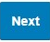
How to set up HSA investments in your online account
Notes:
Select the option you prefer.
Then, select “Next.”

Slide 12
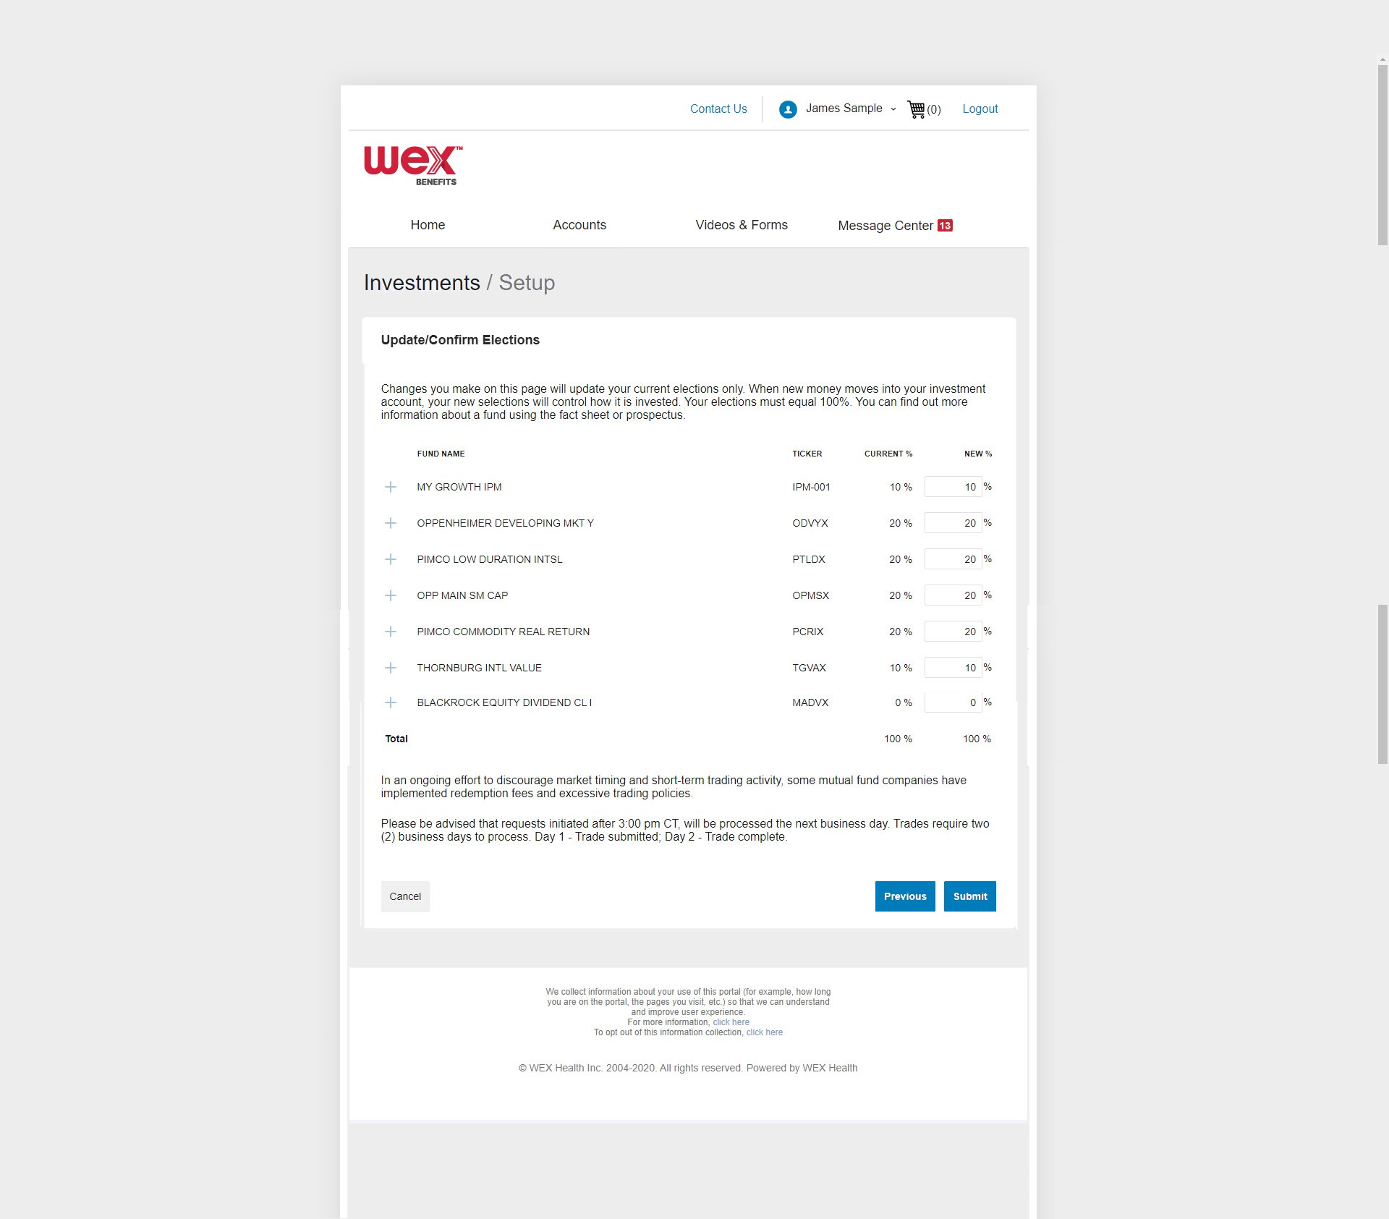
How to set up HSA investments in your online account
Notes:
Lastly, enter the amounts you’d like to allocate to your investment elections.
Then, select “Submit.”

Slide 13
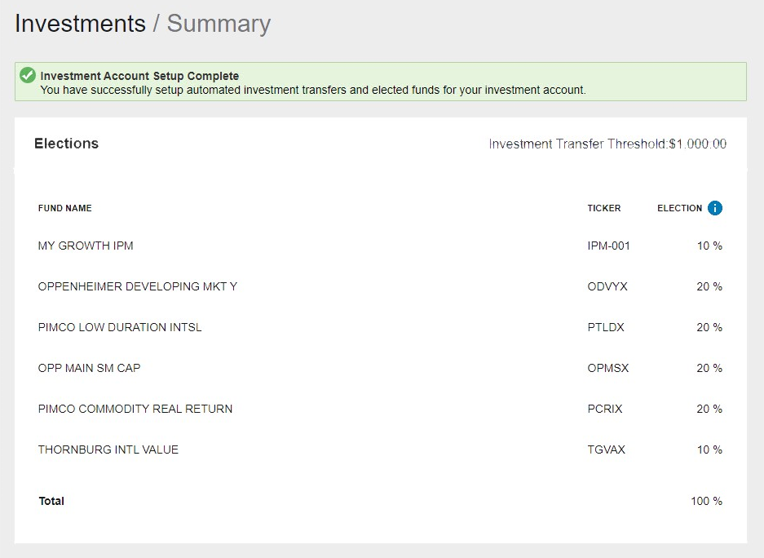
How to set up HSA investments in your online account
Notes:
You’ll receive a confirmation message indicating that you’ve successfully set up your HSA investments.

Slide 14

How to manage HSA investments in your online account
Proprietary & Confidential
Notes:
Now that you know how to set up HSA investments in your online account, let’s talk about how to manage them.

Slide 15
How to manage HSA investments in your online account
Notes:
To manage your HSA investments, first navigate to the “Accounts” tab in your online account, and under Investments, select “Investment Summary”.

Slide 16
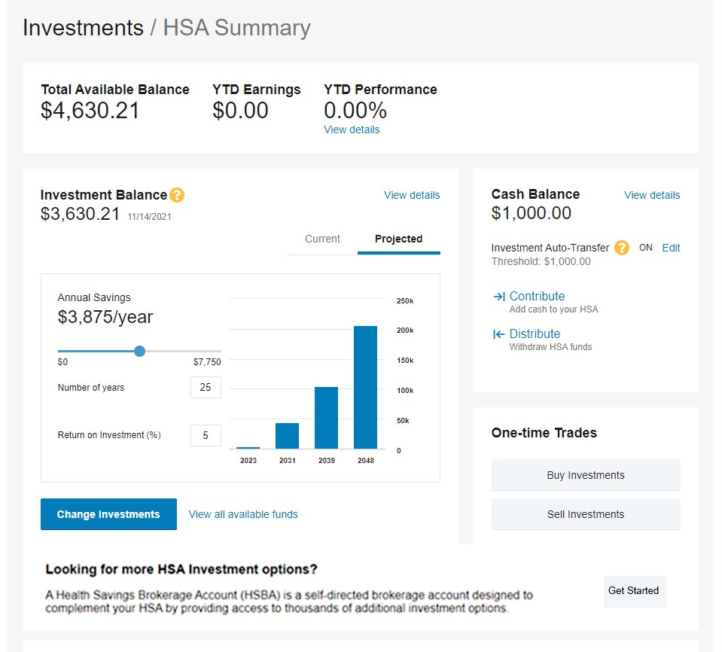
How to manage HSA investments in your online account
Notes:
This will route you to a page to manage your investments.
Select, “change investments.”

Slide 17
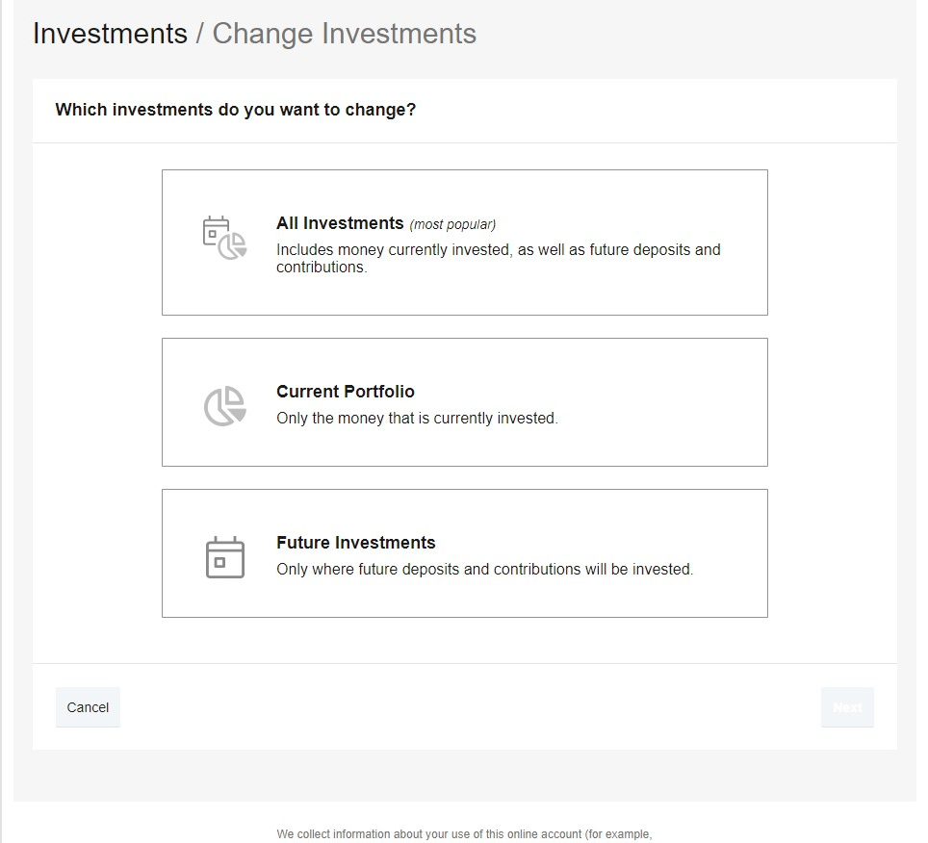
How to manage HSA investments in your online account
Notes:
You will see a list of actions you may take to manage your investments. Select the desired action. Once you’ve selected the appropriate action, follow the prompts to complete the remaining steps.

Slide 18
How to manage HSA investments in your online account
Request submitted after 3pm CST will be processed the next business day
Allow two business days for processing
Notes:
It’s important to note that requests submitted after 3pm CST will be processed the next business day.
Also note that any trades you make will require two business days for processing.

Slide 19

How to enroll in a Health Savings Brokerage Account (HSBA)
Proprietary & Confidential
Notes:
Now, what is a Health Savings Brokerage Account, or HSBA, and how can you enroll.

Slide 20
How to enroll in a Health Savings Brokerage Account (HSBA)
Allows you to purchase and trade investment assets that aren’t available as standard investment options.
Stocks
Bonds
Mutual funds
Notes:
A health savings brokerage account (or HSBA) allows you to purchase and trade investment assets that aren’t available as standard investment options.
Examples include: stocks, bonds, and mutual funds.

Slide 21
How to enroll in a Health Savings Brokerage Account (HSBA)
Establish your investment threshold.
Choose your investment allocations
Complete one standard investment transaction
Notes:
It’s important to note that before you can enroll in an HSBA, you must establish your investment threshold, choose your investment allocations, and complete at least one investment transaction from our standard investment options.

Slide 22
How to enroll in a Health Savings Brokerage Account (HSBA)
Notes:
To enroll in an HSBA, navigate to the “Accounts” tab in your online account.
Select “Accounts” to open the menu, and under “Investments,” select “Investment Summary.”

Slide 23
How to enroll in a Health Savings Brokerage Account (HSBA)
Notes:
This will route you to a page to manage your investments. Scroll down to “Looking for more HSA Investment options” and select “Get Started”.

Slide 24
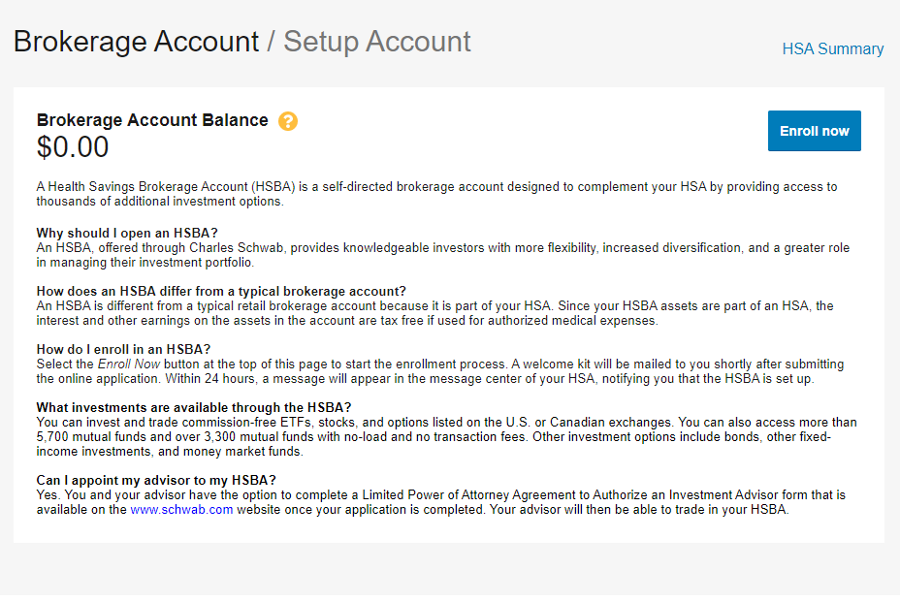
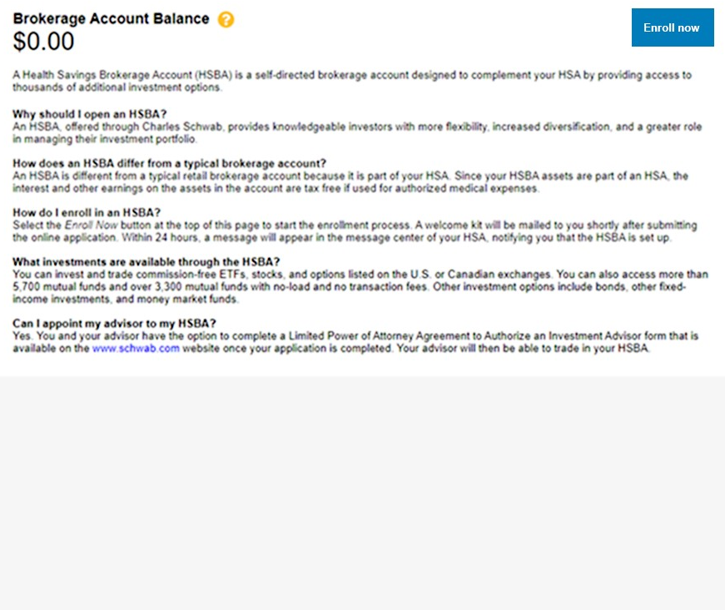
How to enroll in a Health Savings Brokerage Account (HSBA)
Notes:
Then select, “Enroll now .”

Slide 25
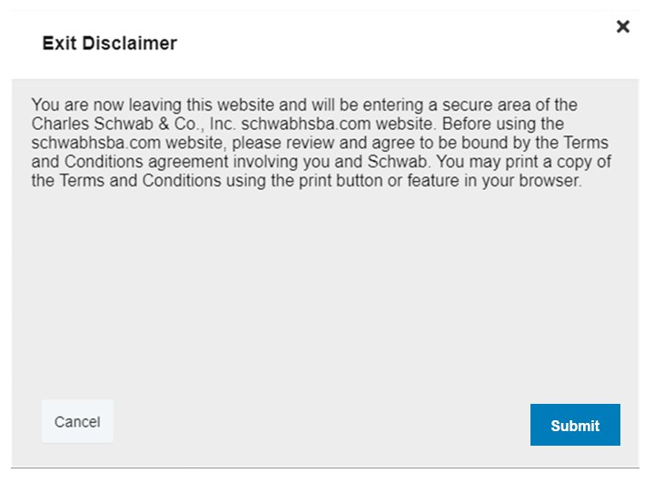
How to enroll in a Health Savings Brokerage Account (HSBA)
Notes:
This will pull up a window, notifying you that you’ll be opening a window to another website. Read the disclaimer, and select “Submit” to continue.
You’ll be redirected to the Charles Schwab website to complete your enrollment.

Slide 26

How to utilize the HSA planner
Proprietary & Confidential
Notes:
The HSA planner through WEX helps you learn how to benefit from your HSA.

Slide 27
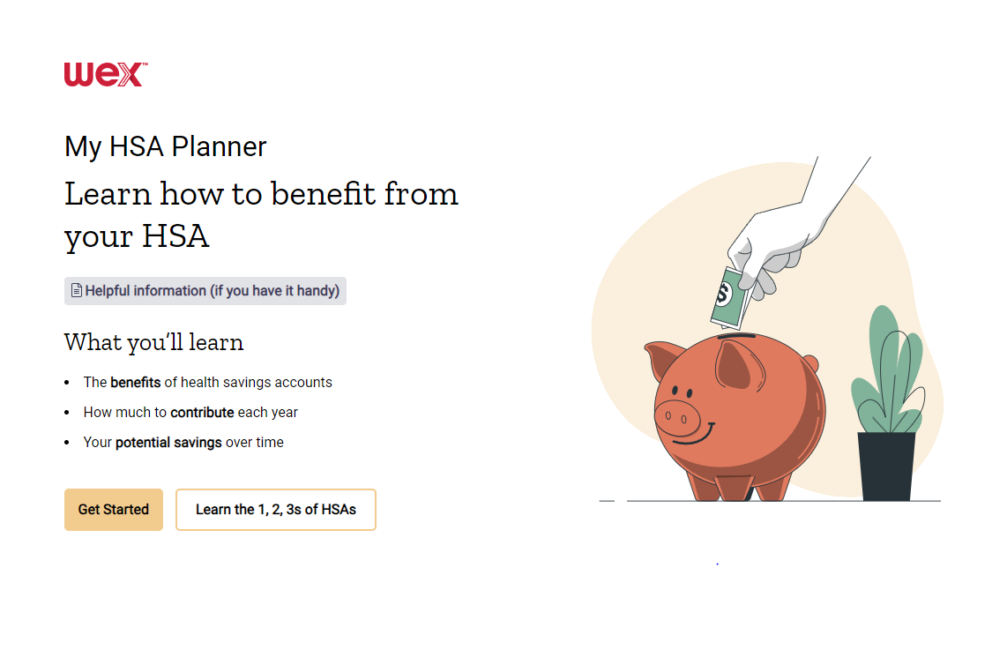
My HSA Planner
Notes:
You can find the HSA planner at https://myhsaplanner.com/GetStarted.
Selecting “Learn the 1, 2, 3s of HSAs” will bring you to a page breaking down the benefits of Health Savings Accounts.

Slide 28
My HSA Planner
Notes:
If you’d like help determining how much to contribute each year, and to see potential savings over time, select “Get started.”

Slide 29
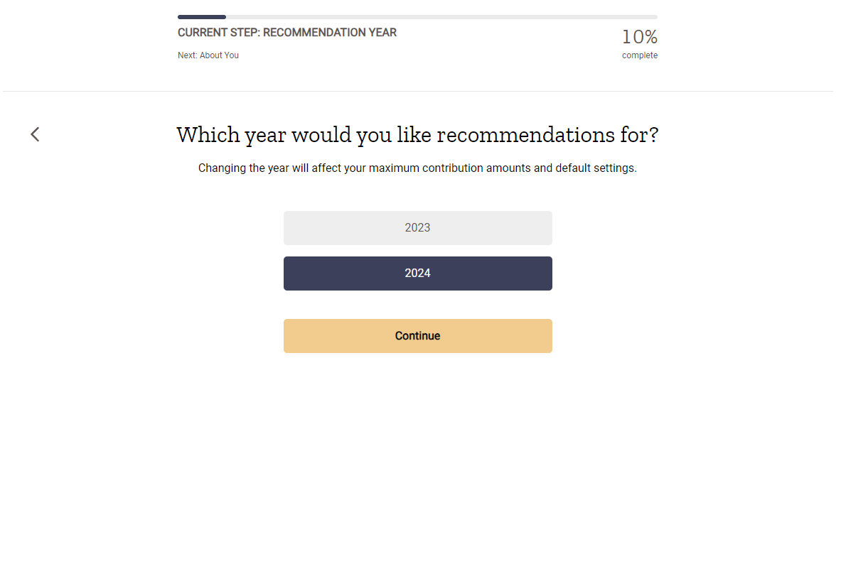
My HSA Planner
Notes:
My HSA Planner walks you through a series of questions to help provide a personalized HSA contribution amount based on your individual situation.

Slide 30
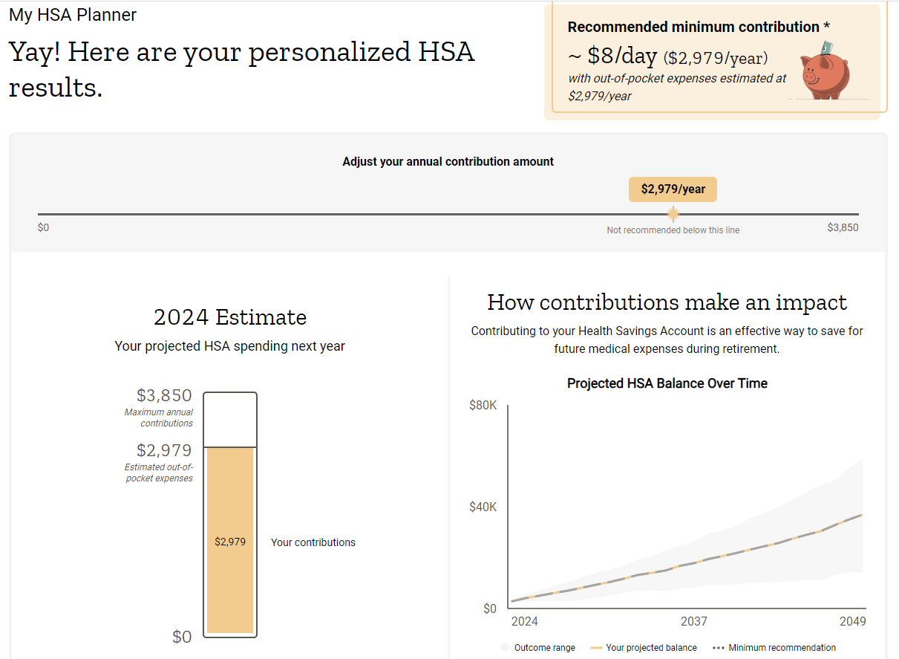
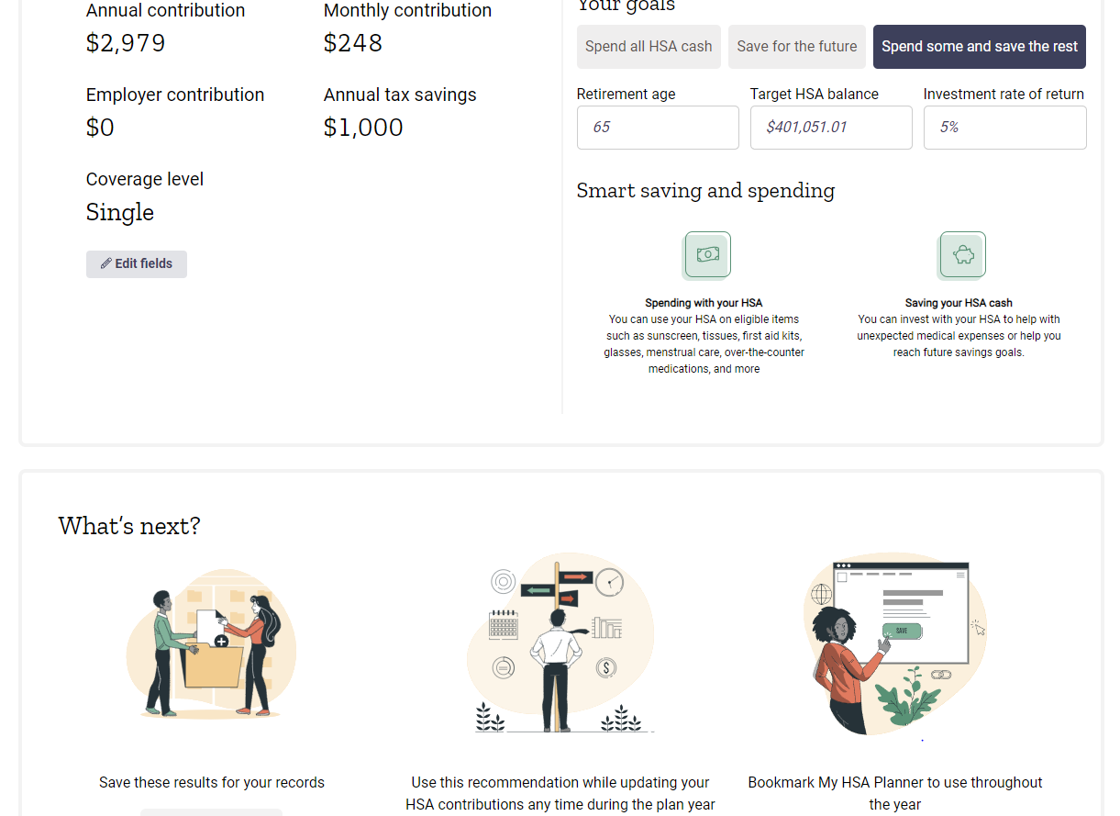
My HSA Planner
Notes:
After filling out the questions, the personalized results page will show you how much you should consider contributing, your tax savings, the long-term growth potential of your HSA based on how you use it, and more!
You can also easily adjust your contribution amount and watch how all of this information changes in real time.

Slide 31

Contact Participant Services
Our Participant Services team is available Monday through Friday, from 6 a.m. to 9 p.m. CT, except holidays.
Website
––––
www.wexinc.com
Phone
––––
Current WEX participants:
866-451-3399
New to WEX:
844-561-1337
Notes:
For any questions or assistance you may need, our participant services team is available to you Monday through Friday from 6 am to 9 pm Central time.
You have a variety of options to contact us. You can get support on our website at www.wexinc.com or call to speak to a participant services representative.
If participates ask for instructions…
Support on Website: To access the form, follow the below steps:
Navigate to www.wexinc.com > Support > Contact customer service team > Contact WEX benefits.
Select the following:
a. Type of Inquiry: Customer Service
b. I am a: Employee/Participant
Select “WEX Benefits Support Center”.
Complete the form.
A successful submission message will appear indicating that we'll be in touch.
The employee/participant will receive an email response with additional details or resolution to their inquiry.
Form URL: https://wexhealthinc.my.site.com/WEXbenefitscontactus/s/

Slide 32
Notes:
I want to thank you for taking the time to be with me today and I hope you found this presentation both educational and enjoyable.
We’ve got some time to open up for questions now. As a reminder, please keep in mind this is live in a group setting, so in order to protect your privacy, it’s best to contact Participant Services directly for any specific individual situations.

