Slide 1
Read, then delete this slide
Add/remove slides as needed to tailor your presentation to your prospect
To share/email, click “File” in the top left of main menu above and then “Download.”
Recommend downloading as a PDF for easy emailing and reading by the recipient
If are you looking for instructions or videos on the webinar subjects,
we have linked the participant articles and video of each topic.
How to file a claim in your online account Article | Video
How to file a claim in the the mobile app Article | Video
How to send a reimbursement check directly to a provider in your online account Article | Video
How to use the Explanation of Benefits (EOB) Smart Scan feature Article | Video
How to use the WEX benefits mobile app eligible expense scanner Article | Video

Slide 2
Client name
Getting started with claims
Notes:
Hello everyone, and welcome to your post-enrollment webinar, Getting started with Claims, presented by WEX.
My name is ____________ and I am happy to be here with you today as we go through the multiple ways you can file claims.
Before we begin, I’d like to quickly mention- as we ask you to participate throughout the presentation, please keep in mind this is a live webinar in a group setting so we are unable to answer any questions regarding specific individual situations to protect your privacy. We are happy to answer any general questions you may have, and will be sure to provide you with our Participant Services Team contact information as well, as they are able to dig in further and help you with any specific or more confidential questions you may have. With that - let’s get started!

Slide 3
Getting started with claims
File a claim in your online account
Send a reimbursement check
File a claim in the mobile app
Use the EOB Smart Scan feature
Use the mobile app eligible expense scanner
Submit a Recurring Dependent Care Form
Notes:
***If slides are removed from the deck, please remember to remove that task from this slide image and text***
During our time together, we will be covering:
How to file a claim in your online account
How to send a reimbursement check directly to a provider in your online account
How to file a claim in the mobile app
How to use the Explanation of Benefits (EOB) Smart Scan feature
How to use the benefits mobile app eligible expense scanner
How to submit a recurring dependent care claim form
As we go through, you may notice your online account or mobile app looks slightly different than those showing on the screen, depending on the plan or plan(s) you’re enrolled in, OR slight platform updates.

Slide 4

How to file a claim in your online account
Proprietary & Confidential
Notes:
First things first, how to file a claim in your online account.

Slide 5
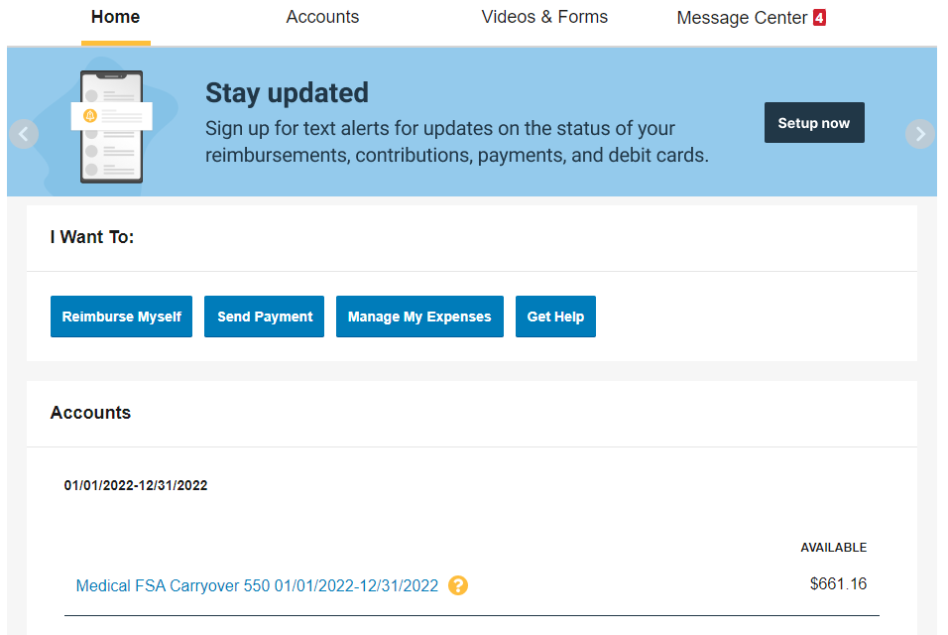
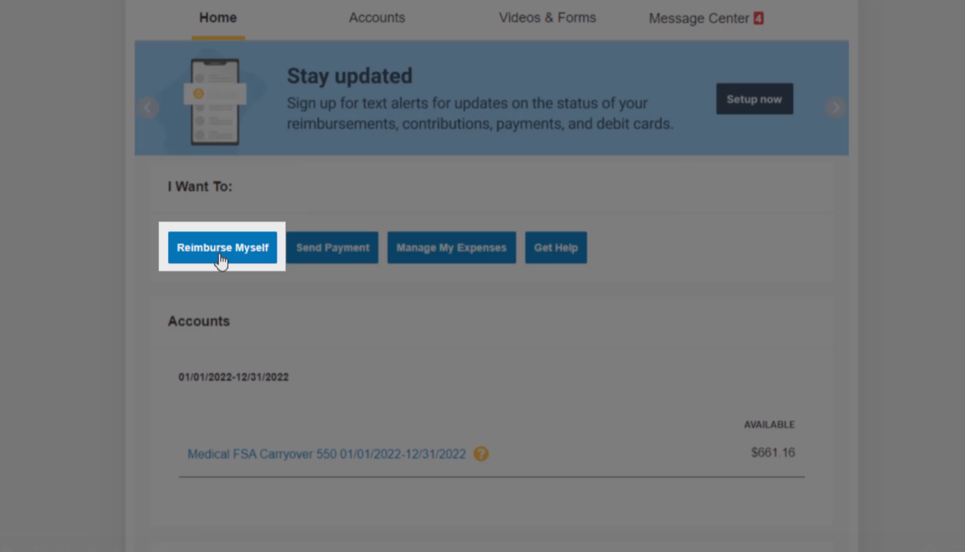
How to file a claim in your online account
Notes:
To file a claim in your online account, you’ll first need to select “Reimburse Myself.”
Be sure you’re not filing claims for expenses paid with your benefits debit card, as this could result in duplicate claim payments.

Slide 6
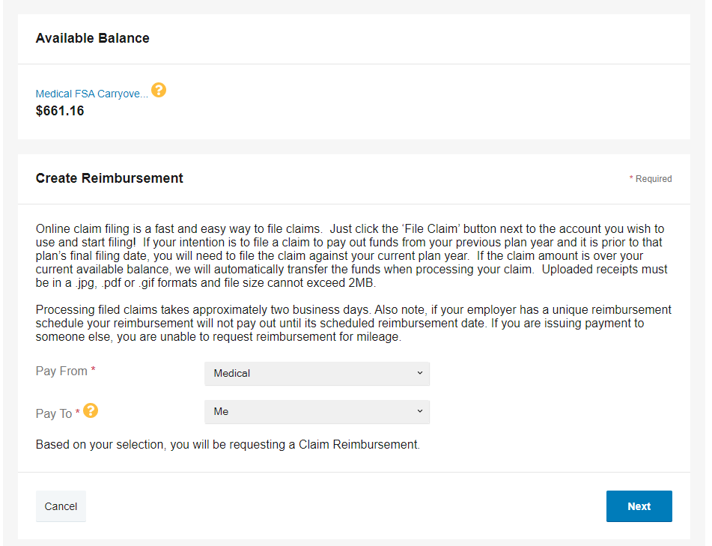
How to file a claim in your online account
Notes:
This will pull up a new page showing your available balance, as well as fields to enter your claim information. Here, you will need to complete the required fields.
In the “Pay To” field, open the drop-down menu and select “Me.”
Then, select “Next.”

Slide 7
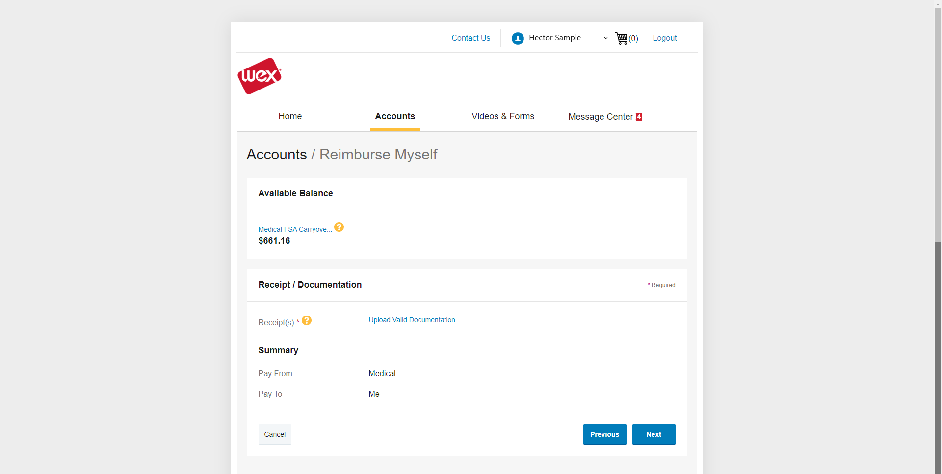
How to file a claim in your online account
Notes:
Under “Receipts and Documentation,” select “Upload Valid Documentation.”

Slide 8
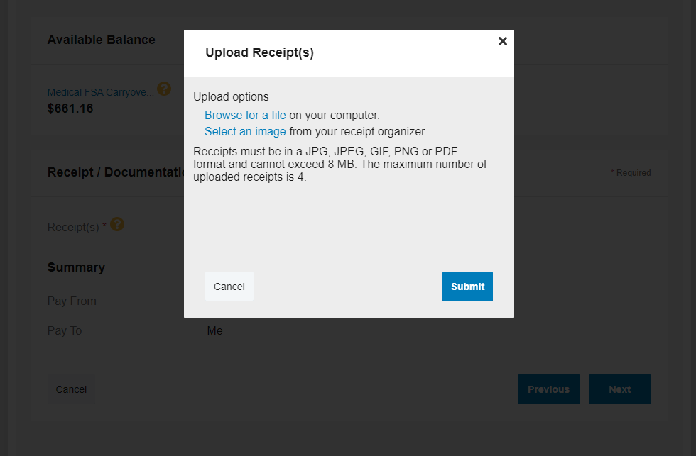
How to file a claim in your online account
Notes:
This will pull up a window requesting you to upload your documentation. Choose a receipt you’ve previously saved to your receipt organizer...

Slide 9
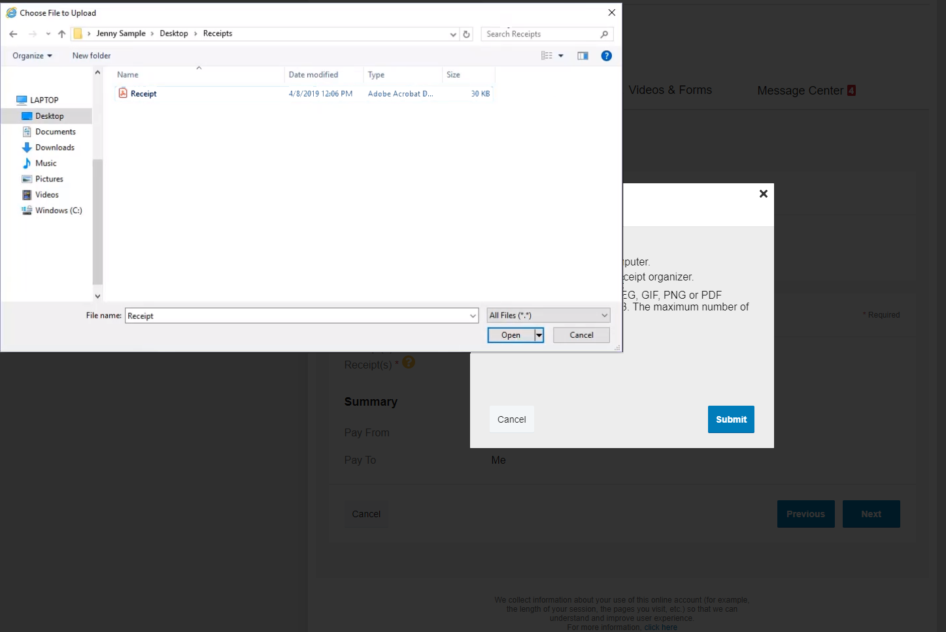
How to file a claim in your online account
Notes:
or select “Browse” and choose the file containing your receipt.

Slide 10
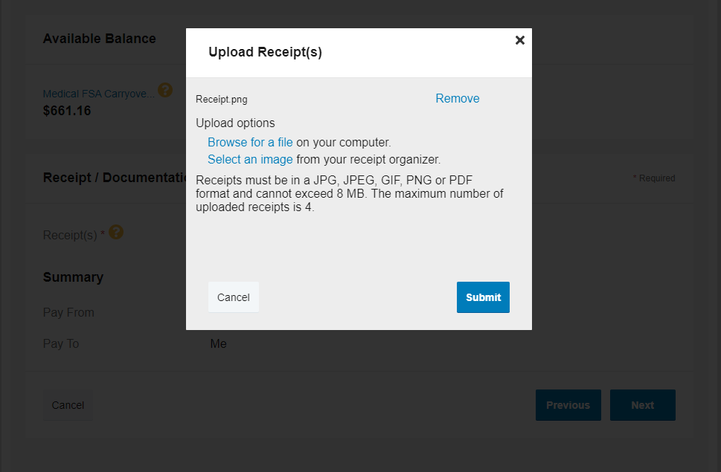
How to file a claim in your online account
Notes:
After all the documentation is uploaded, select “Submit.”

Slide 11
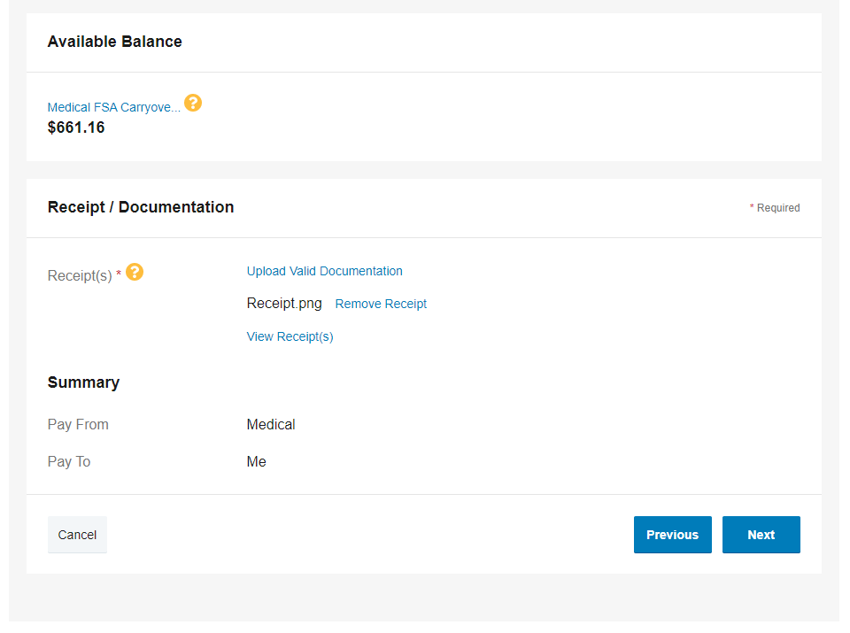
How to file a claim in your online account
Notes:
This will close the window. From here, select “Next.”

Slide 12
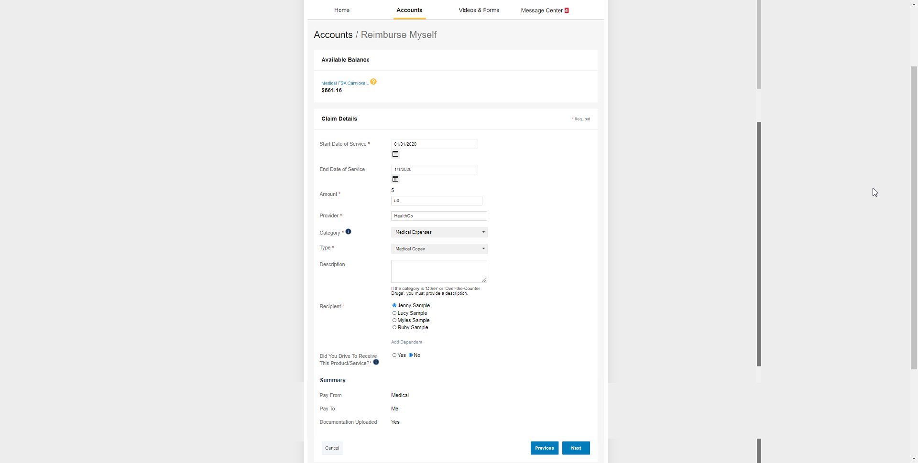
How to file a claim in your online account
Notes:
You will again need to complete the required fields, and once completed, select “Next” at the bottom of the page.

Slide 13
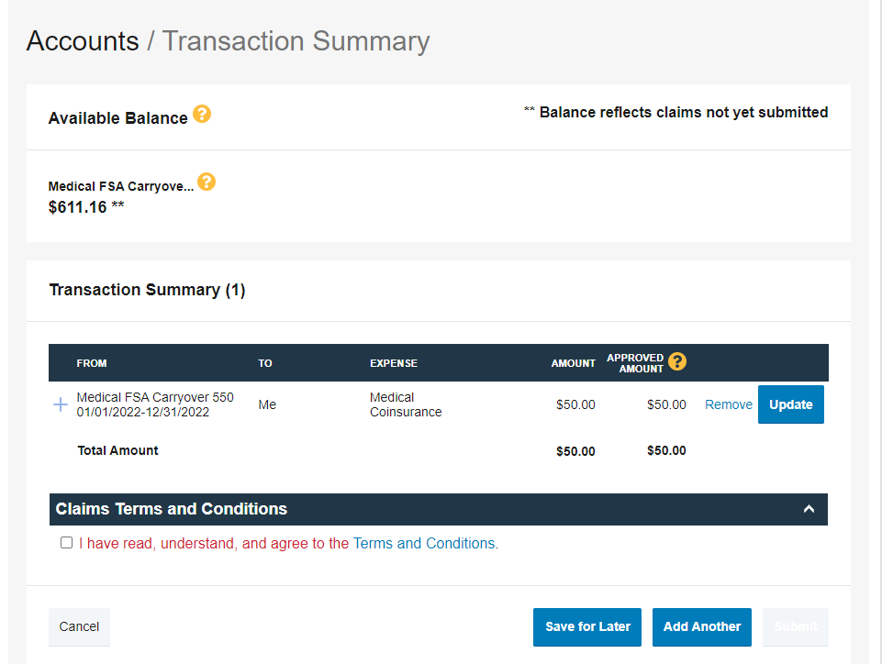
How to file a claim in your online account
Notes:
This will bring you to your transaction summary.
Review your transaction summary. If changes are needed, select “Update.”

Slide 14
How to file a claim in your online account
Notes:
If all the information is correct, review the claim’s terms and conditions and then check the box indicating you have read, understand, and agree to them.

Slide 15
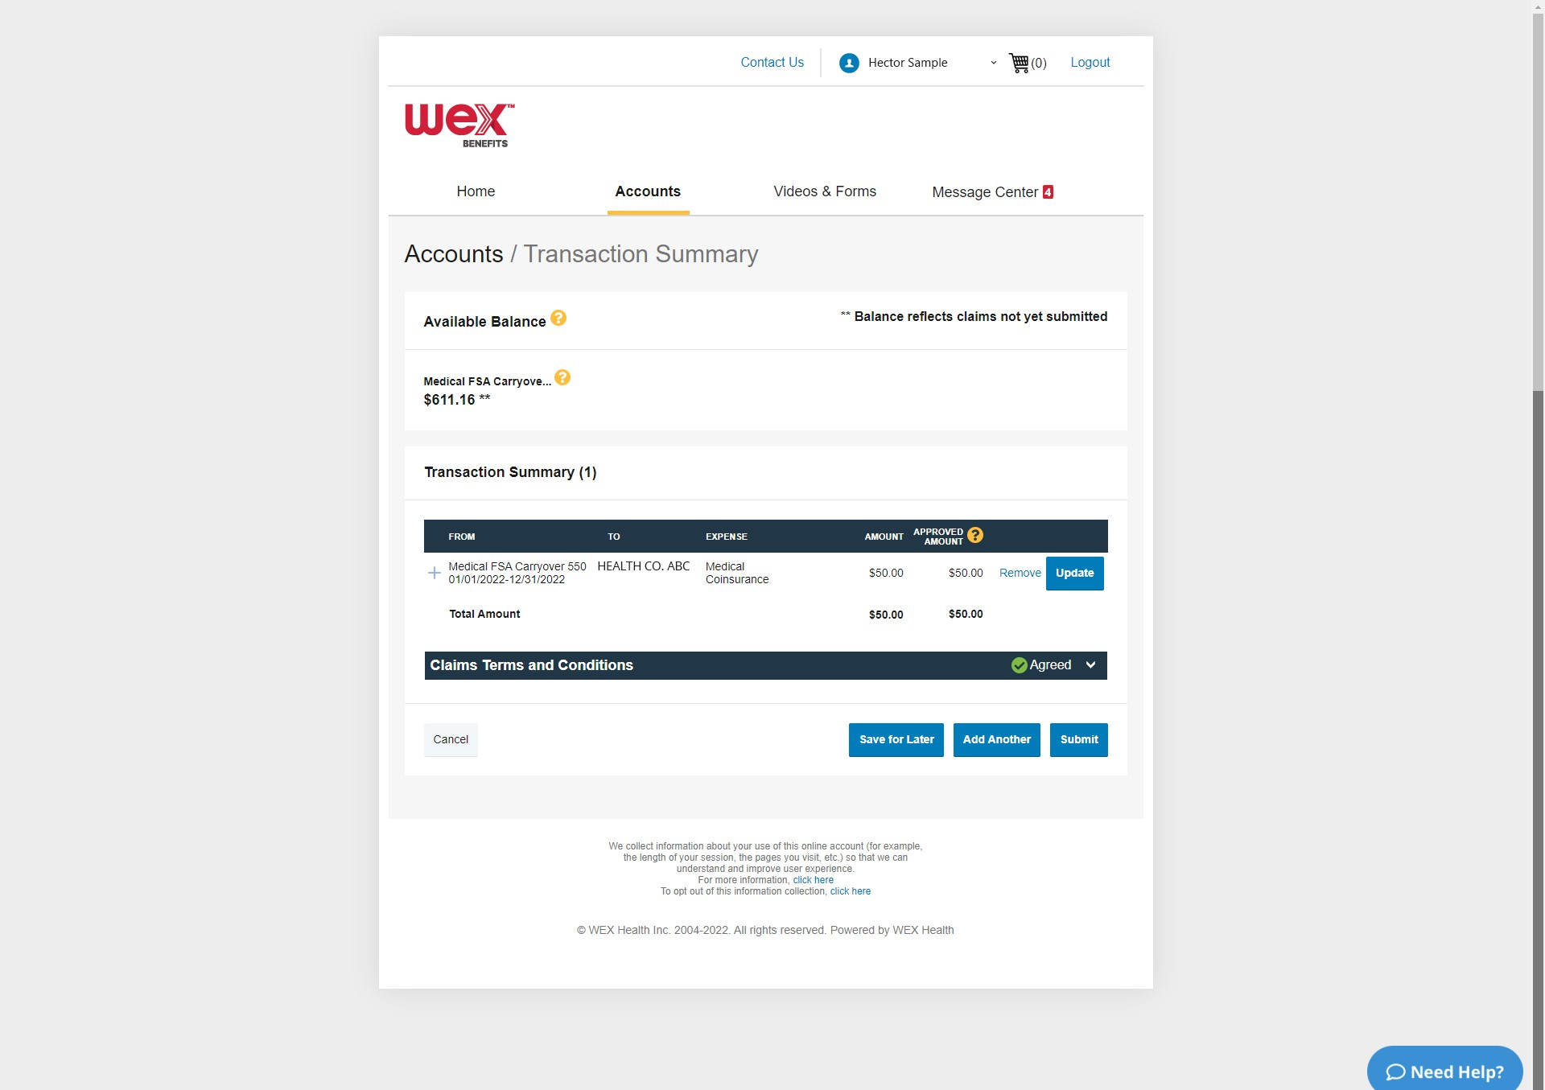
How to file a claim in your online account
Notes:
Then select “Submit.”
You'll receive a confirmation message that verifies the claim was successfully submitted. You’ll be notified if further documentation is needed. If you have an email address on file, you’ll be notified via email. Otherwise, you’ll be notified by mail.
Your documentation will typically be processed within two business days. Reimbursement will be issued as a direct deposit or mailed as a check, depending on your plan setup.

Slide 16


How to send a check directly to a provider
Proprietary & Confidential
Notes:
Now, what if you’d like to send a check directly to a provider?

Slide 17
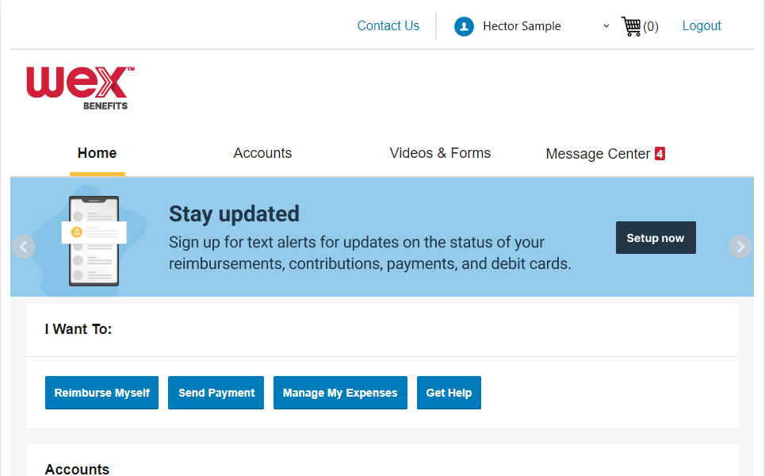
How to send a check directly to a provider
“I Want To:”
Send Payment
Select your name
along the bar at the top of the screen to open your profile menu
Notes:
To send a reimbursement check directly to a provider in your online account, scroll down to the “I Want To” section on the “Home” tab.
Under the “I Want To” section, select “Send Payment.”

Slide 18
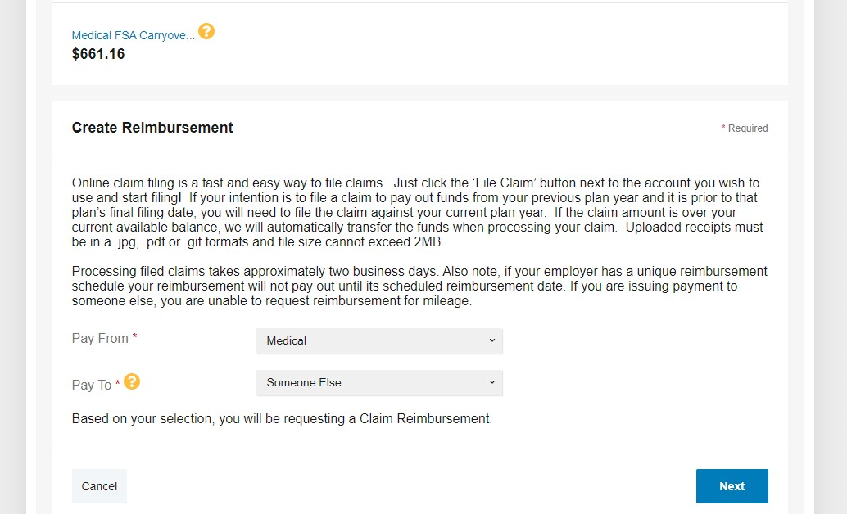
How to send a check directly to a provider
“Pay To”
Someone Else
Select your name
along the bar at the top of the screen to open your profile menu
Notes:
This will pull up a new page showing your available balance, as well as fields to enter your claim information. Complete the required fields.
In the “Pay To” field, open the drop-down menu and select “Someone Else.”
Once you’ve completed both fields, select “Next.”

Slide 19
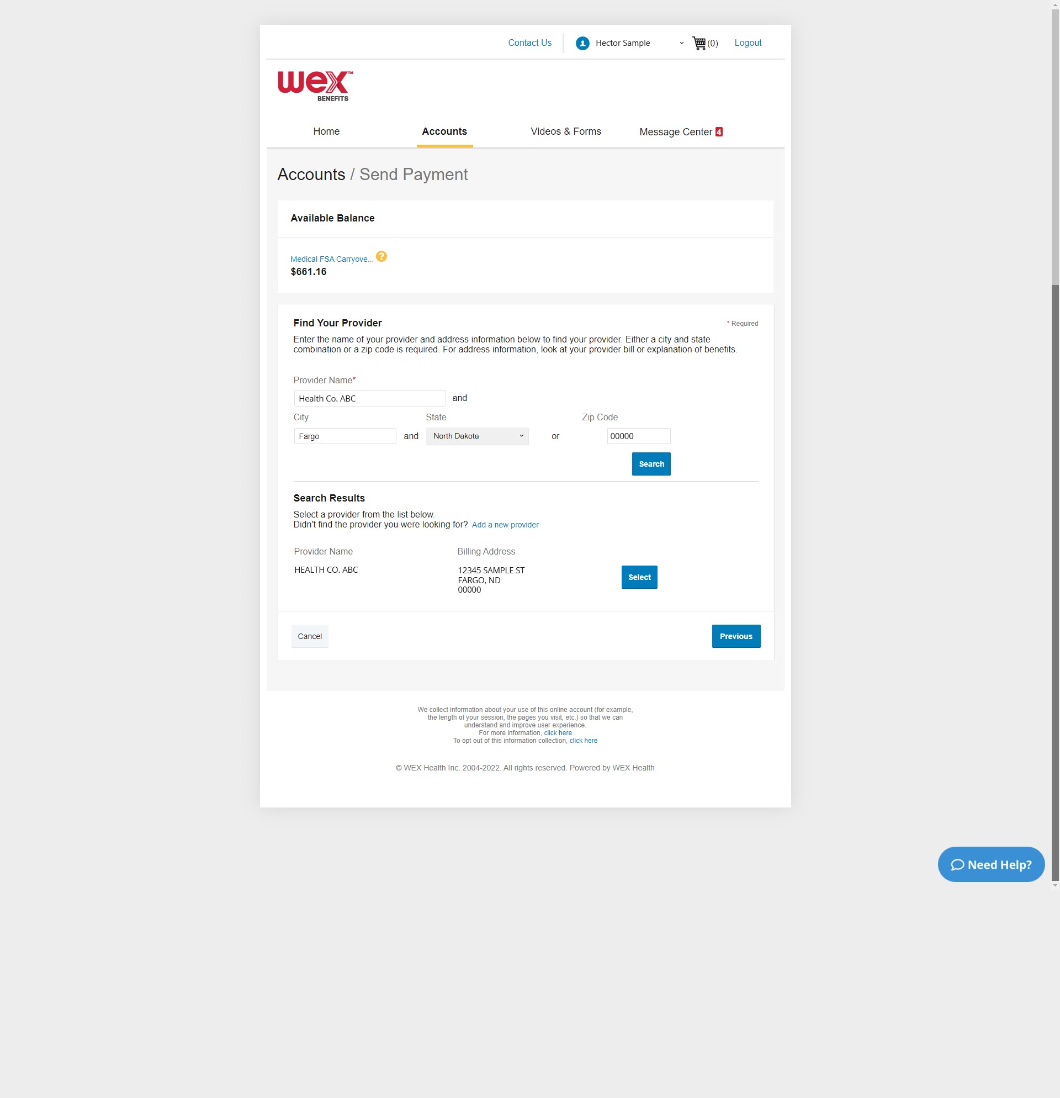
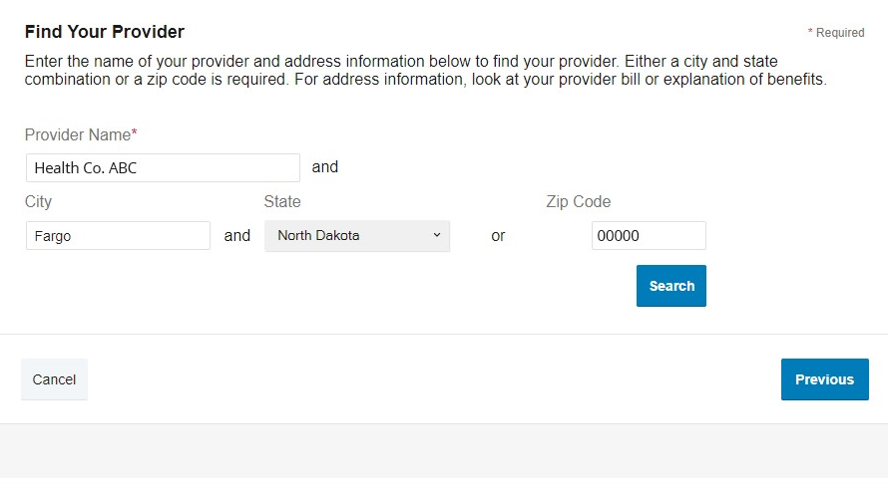
How to send a check directly to a provider
Enter provider information
Notes:
On the next page, you will be required to enter information on the provider you wish to pay.
Complete the required fields.

Slide 20
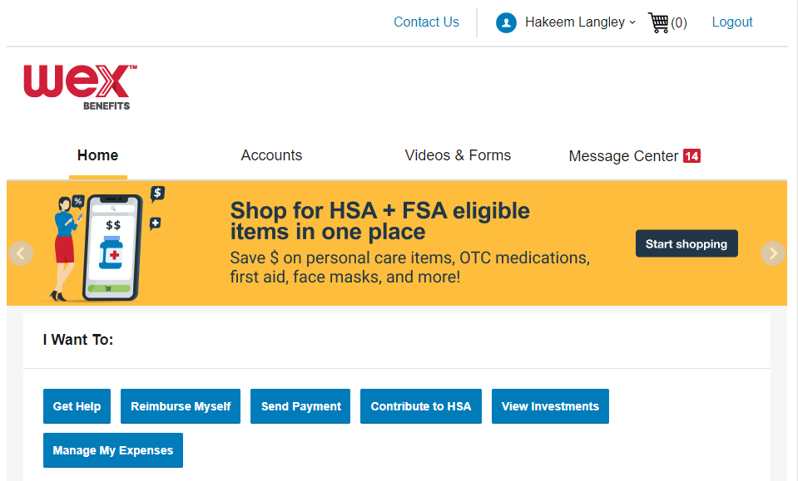
How to send a check directly to a provider
Search for your provider
and “Select”
This is a headline or statement about a feature or benefit
This is some body copy that supports the statement above. It should be typeset like this.
This is a headline or statement about a feature or benefit
This is some body copy that supports the statement above. It should be typeset like this.
Notes:
Next, search for your provider and select the appropriate option.

Slide 21
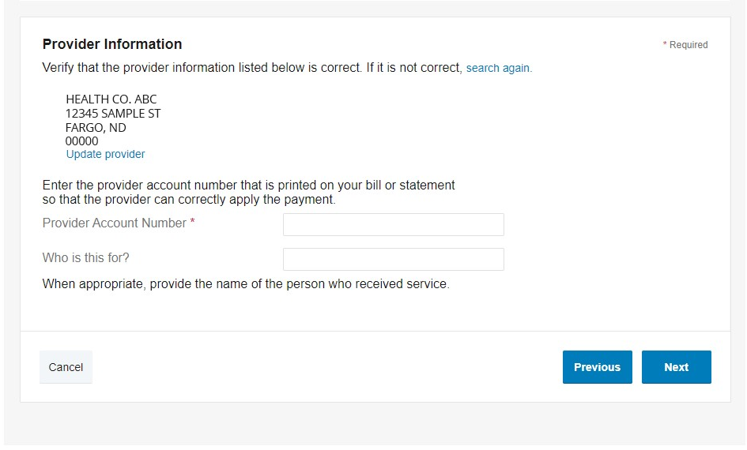
How to send a check directly to a provider
Complete required fields
This is a headline or statement about a feature or benefit
This is some body copy that supports the statement above. It should be typeset like this.
This is a headline or statement about a feature or benefit
This is some body copy that supports the statement above. It should be typeset like this.
Notes:
Complete the required fields.
Then select, “Next.”

Slide 22
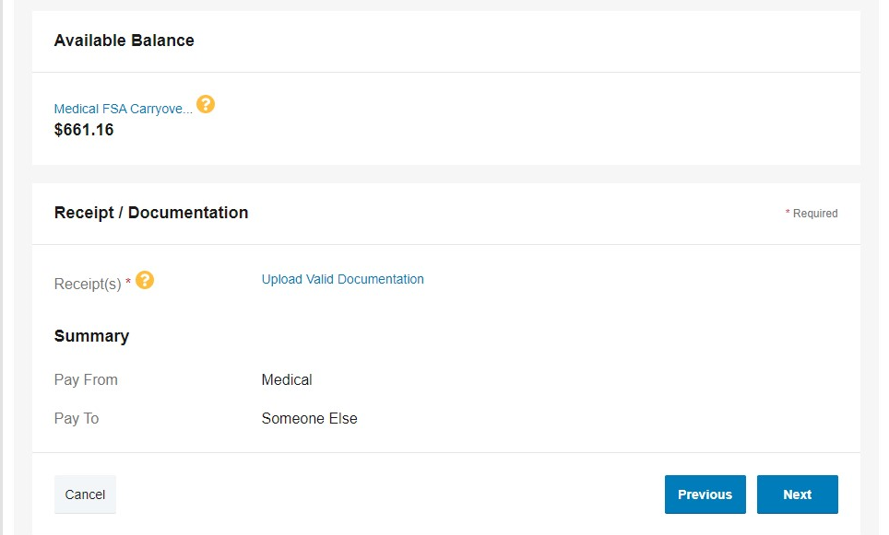
How to send a check directly to a provider
Upload Documentation
This is a headline or statement about a feature or benefit
This is some body copy that supports the statement above. It should be typeset like this.
This is a headline or statement about a feature or benefit
This is some body copy that supports the statement above. It should be typeset like this.
Notes:
You will need to provide receipt documentation for your claim. Under “Receipts and Documentation,” select “Upload Valid Documentation

Slide 23
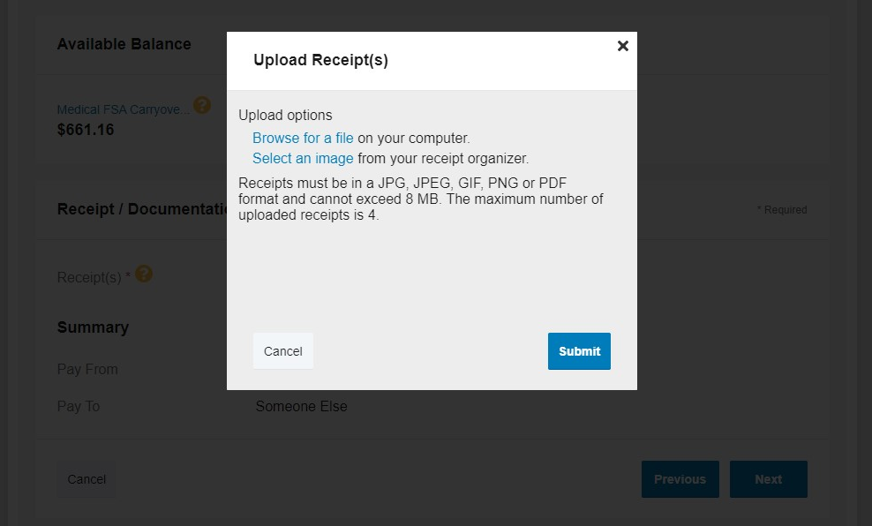
How to send a check directly to a provider
Upload receipt
by selecting image saved to receipt organizer
Notes:
This will open a window for you to upload your receipt. Select an image saved to your receipt organizer….

Slide 24
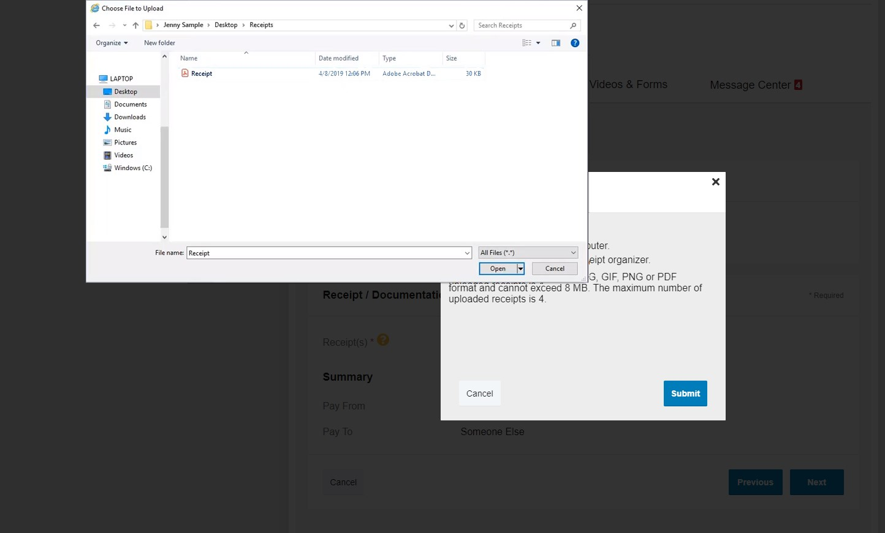
How to send a check directly to a provider
Upload receipt
by browsing for a file containing your receipt
This is a headline or statement about a feature or benefit
This is some body copy that supports the statement above. It should be typeset like this.
This is a headline or statement about a feature or benefit
This is some body copy that supports the statement above. It should be typeset like this.
Notes:
…or select “Browse for a file” and choose the file containing your receipt.

Slide 25

How to send a check directly to a provider
Select “Submit”
after documentation is uploaded
This is a headline or statement about a feature or benefit
This is some body copy that supports the statement above. It should be typeset like this.
This is a headline or statement about a feature or benefit
This is some body copy that supports the statement above. It should be typeset like this.
Notes:
After all the documentation is uploaded, select “Submit.”

Slide 26
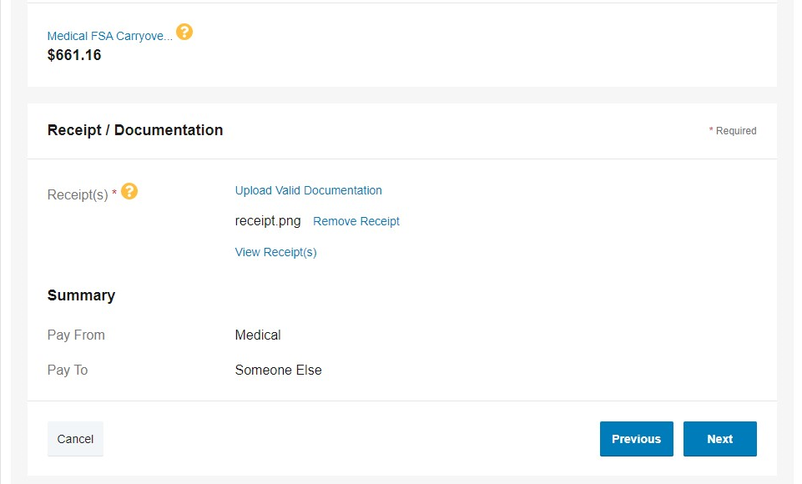
How to send a check directly to a provider
Select “Next”
This is a headline or statement about a feature or benefit
This is some body copy that supports the statement above. It should be typeset like this.
This is a headline or statement about a feature or benefit
This is some body copy that supports the statement above. It should be typeset like this.
Notes:
This will close the window. From here, select “Next.”

Slide 27
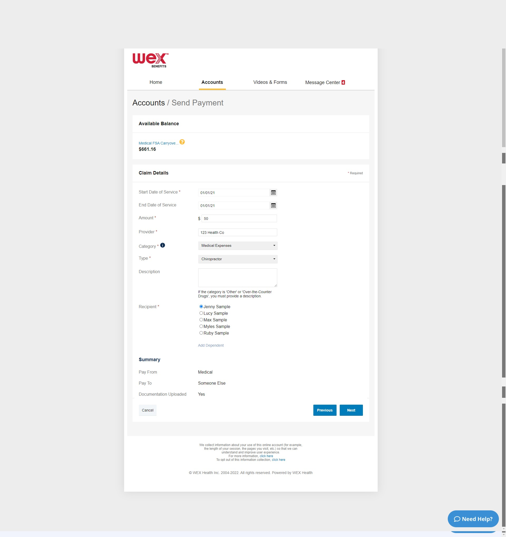
How to send a check directly to a provider
Provide claim details
This is a headline or statement about a feature or benefit
This is some body copy that supports the statement above. It should be typeset like this.
This is a headline or statement about a feature or benefit
This is some body copy that supports the statement above. It should be typeset like this.
Notes:
You will be asked to provide claim details. Enter the required fields and select, “Next.”

Slide 28
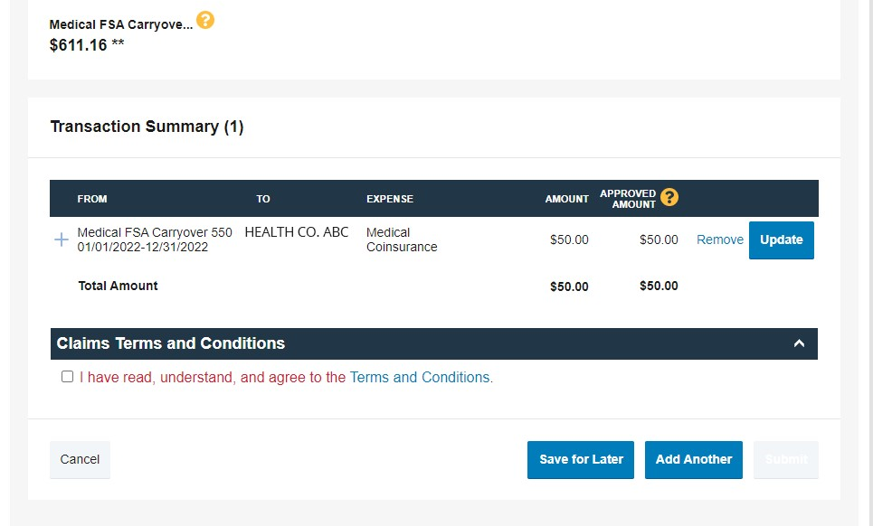
How to send a check directly to a provider
Update if needed
This is a headline or statement about a feature or benefit
This is some body copy that supports the statement above. It should be typeset like this.
This is a headline or statement about a feature or benefit
This is some body copy that supports the statement above. It should be typeset like this.
Notes:
Review your transaction summary. If changes are needed, select “Update.”

Slide 29
How to send a check directly to a provider
How to send a check directly to a provider
Select your name
along the bar at the top of the screen to open your profile menu
Review and Agree to Terms and Conditions
This is a headline or statement about a feature or benefit
This is some body copy that supports the statement above. It should be typeset like this.
This is a headline or statement about a feature or benefit
This is some body copy that supports the statement above. It should be typeset like this.
This is a headline or statement about a feature or benefit
This is some body copy that supports the statement above. It should be typeset like this.
This is a headline or statement about a feature or benefit
This is some body copy that supports the statement above. It should be typeset like this.
Notes:
If all the information is correct, review the claim’s terms and conditions, and then select the box indicating you have read, understand, and agree to them.

Slide 30
How to send a check directly to a provider
How to send a check directly to a provider
Select your name
along the bar at the top of the screen to open your profile menu
Submit claim
This is a headline or statement about a feature or benefit
This is some body copy that supports the statement above. It should be typeset like this.
This is a headline or statement about a feature or benefit
This is some body copy that supports the statement above. It should be typeset like this.
This is a headline or statement about a feature or benefit
This is some body copy that supports the statement above. It should be typeset like this.
This is a headline or statement about a feature or benefit
This is some body copy that supports the statement above. It should be typeset like this.
Notes:
Then select, “Submit.”

Slide 31
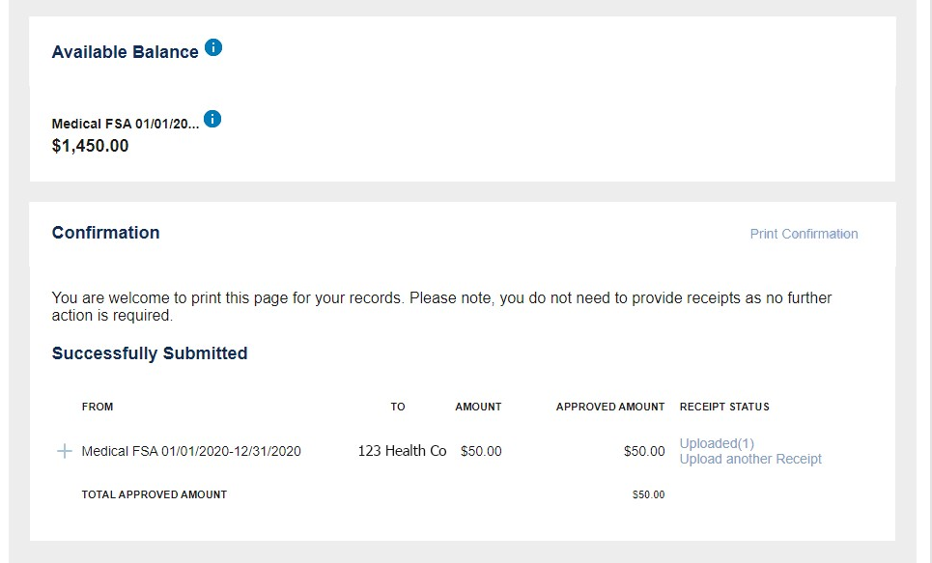
How to send a check directly to a provider
How to send a check directly to a provider
Select your name
along the bar at the top of the screen to open your profile menu
Documentation processed within two business days
This is a headline or statement about a feature or benefit
This is some body copy that supports the statement above. It should be typeset like this.
This is a headline or statement about a feature or benefit
This is some body copy that supports the statement above. It should be typeset like this.
This is a headline or statement about a feature or benefit
This is some body copy that supports the statement above. It should be typeset like this.
This is a headline or statement about a feature or benefit
This is some body copy that supports the statement above. It should be typeset like this.
Notes:
You will receive a confirmation message that verifies the claim was successfully submitted.
The documentation will typically be processed within two business days.

Slide 32

How to file a claim in the benefits mobile app
Proprietary & Confidential
Notes:
What about the mobile app?
There are two ways to file a claim in the WEX benefits mobile app, depending on how you want funds to be transferred.

Slide 33
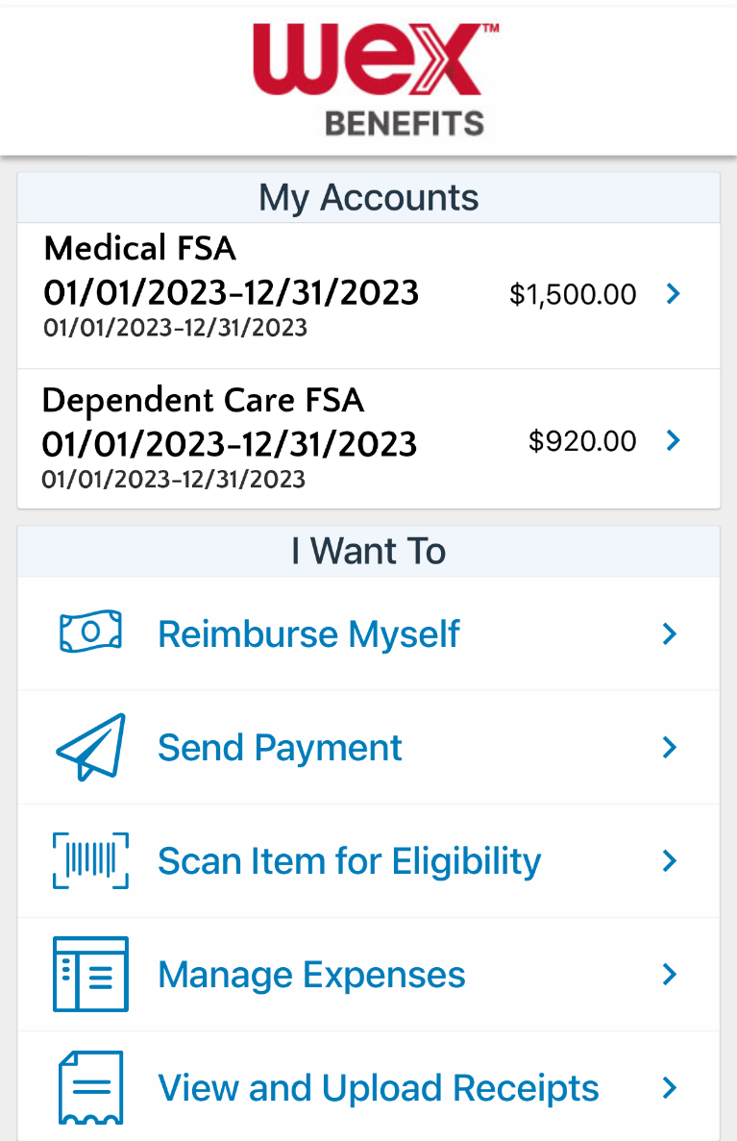
How to file a claim in the benefits mobile app
1
Select how you you like funds transferred
Reimburse Myself
Send Payment
Notes:
If you want to receive your benefit funds directly to make up for something you paid for out of pocket, select “Reimburse myself.”

Slide 34
How to file a claim in the benefits mobile app
1
Select how you you like funds transferred
Reimburse Myself
Send Payment
Notes:
If you want to send your benefit funds directly to a provider to pay for an eligible expense, select “Send Payment.”
Both processes are similar, so we will demonstrate with the “Send Payment” option.

Slide 35
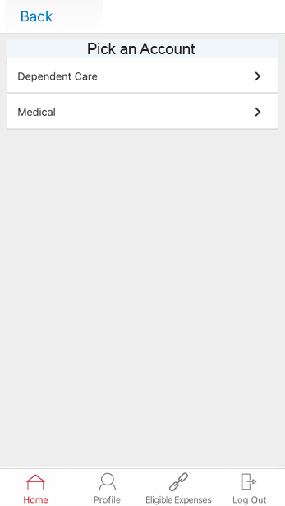
How to file a claim in the benefits mobile app
2
Select the plan from which you’d like reimbursement
Notes:
Select the plan from which you’re requesting reimbursement.

Slide 36
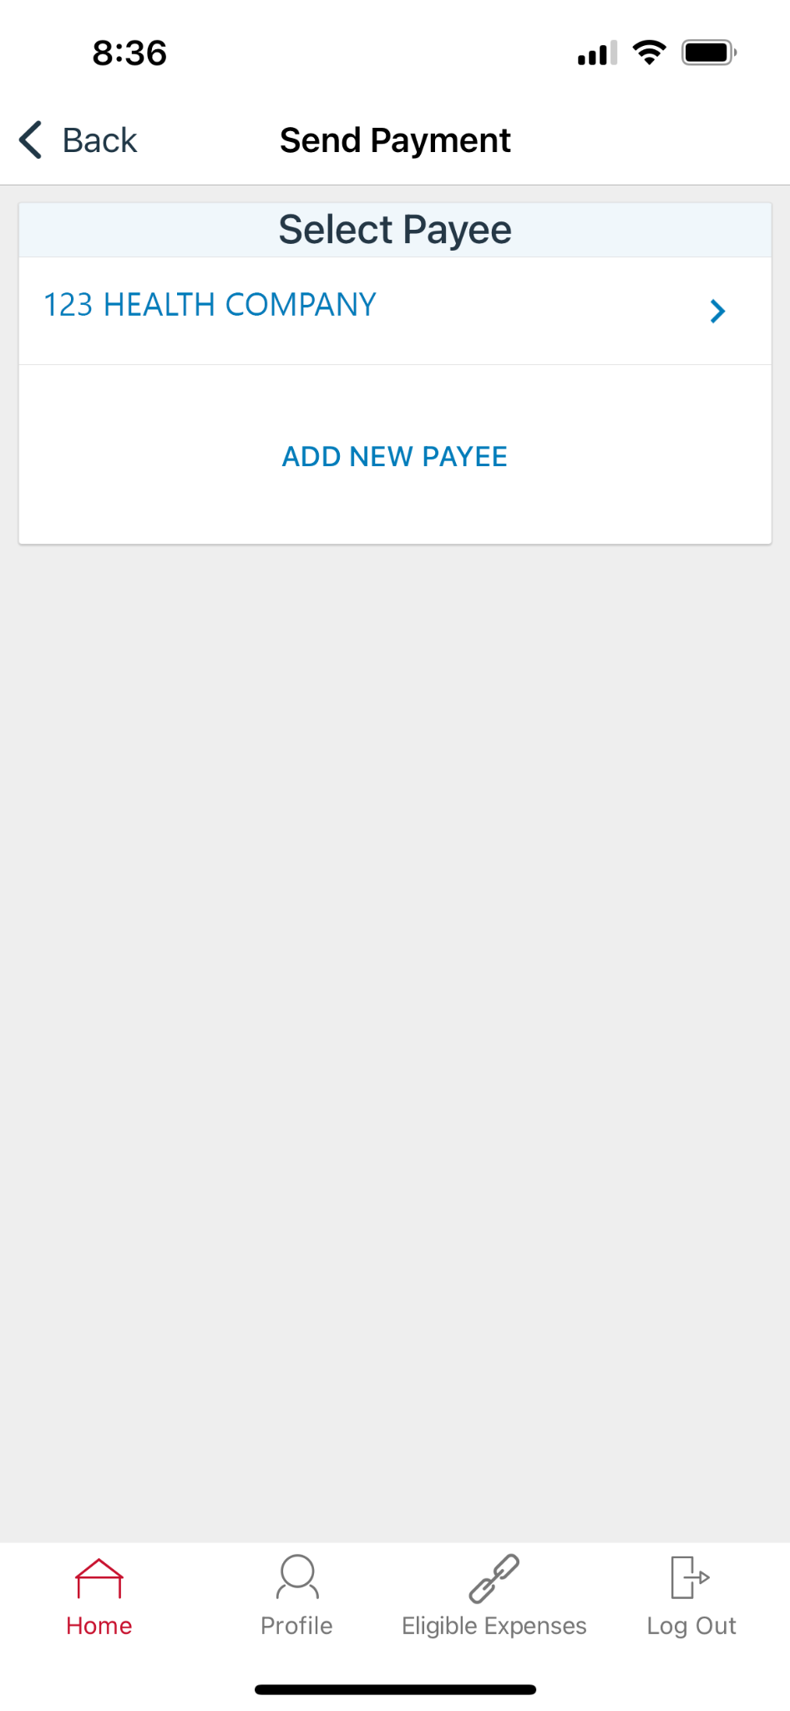
How to file a claim in the benefits mobile app
3
Select a payee for the claim
Add new payee
Choose existing payee
Notes:
You’ll need to select a payee for the claim. You can either add a new payee…

Slide 37
How to file a claim in the benefits mobile app
Select a payee for the claim
3
Select a payee for the claim
Add new payee
Choose existing payee
Notes:
…or choose an existing payee from the list.

Slide 38
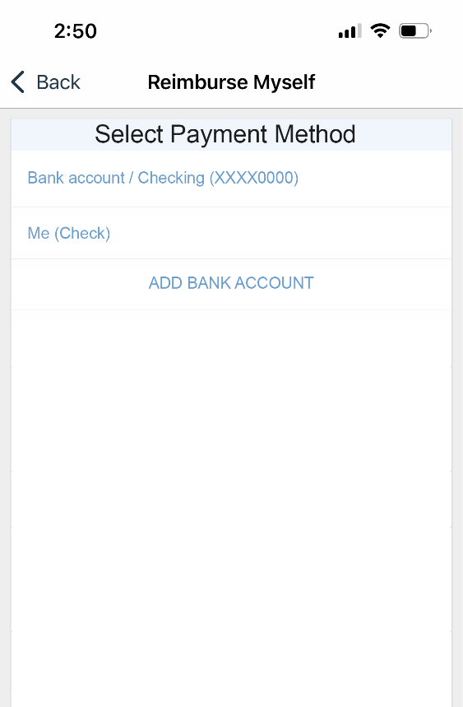
Reimburse self- select payment method
How to file a claim in the benefits mobile app
Direct Deposit
Check
Notes:
If you selected “Reimburse myself,” this screen will ask for your preferred payment method to receive the reimbursement.

Slide 39
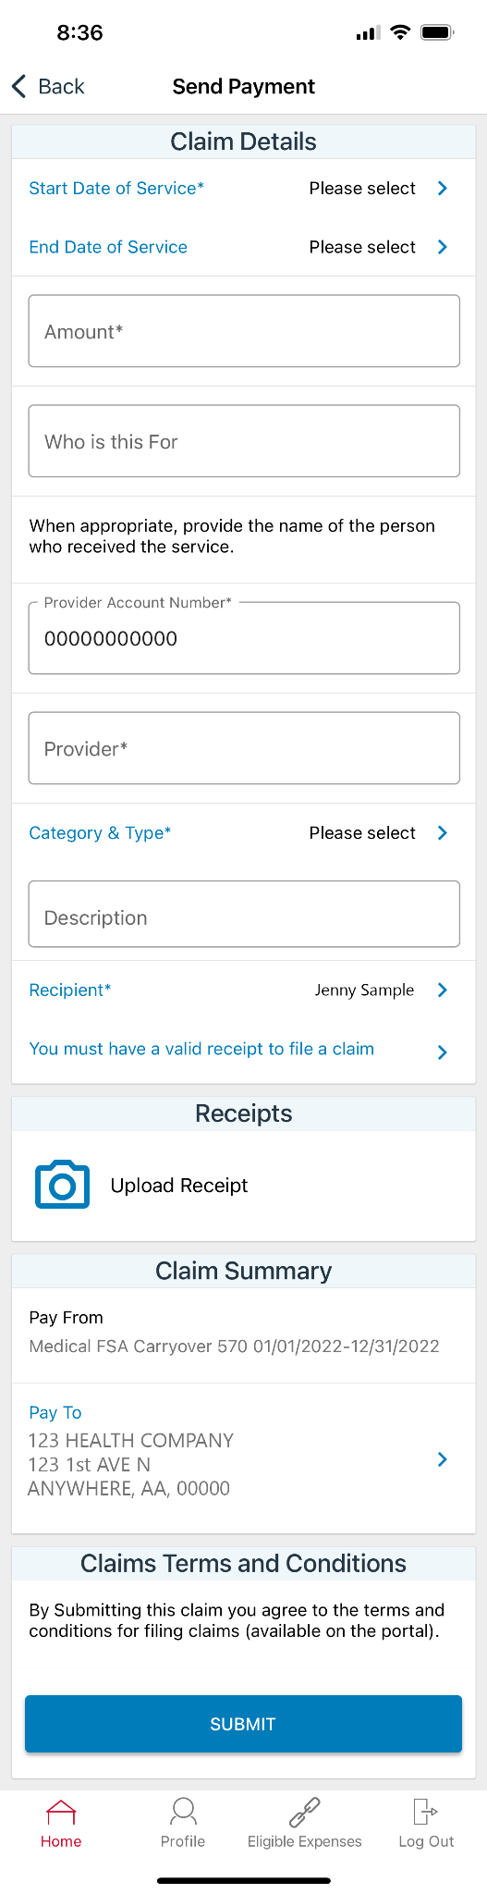
How to file a claim in the benefits mobile app
4
Provide claim details
Notes:
Next, provide the claim details in the required fields.

Slide 40
How to file a claim in the benefits mobile app
5
Scroll down to upload a receipt
Notes:
Then scroll down to the “Receipts” section and select “Upload Receipt.”

Slide 41
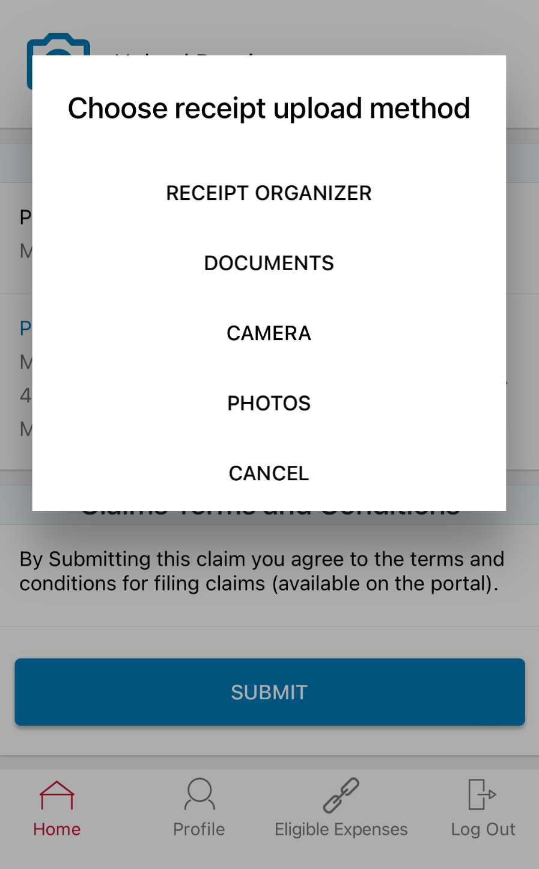
How to file a claim in the benefits mobile app
6
Select receipt upload method
Take a photo
Upload existing photo
Notes:
This will pull up a window for you to upload your receipt. You can either take a photo of the documentation, or upload an existing photo on your mobile device.

Slide 42
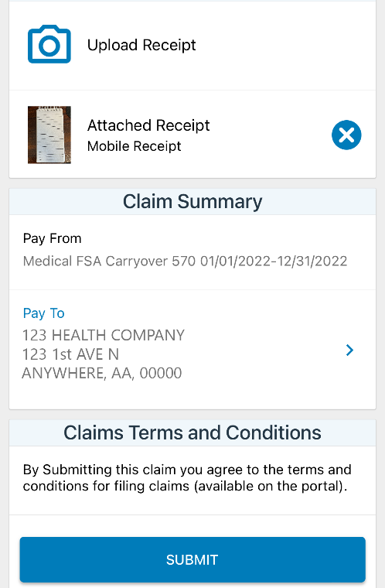
How to file a claim in the benefits mobile app
7
Select “Submit”
Notes:
Once you have uploaded your receipt, select “Submit.”

Slide 43
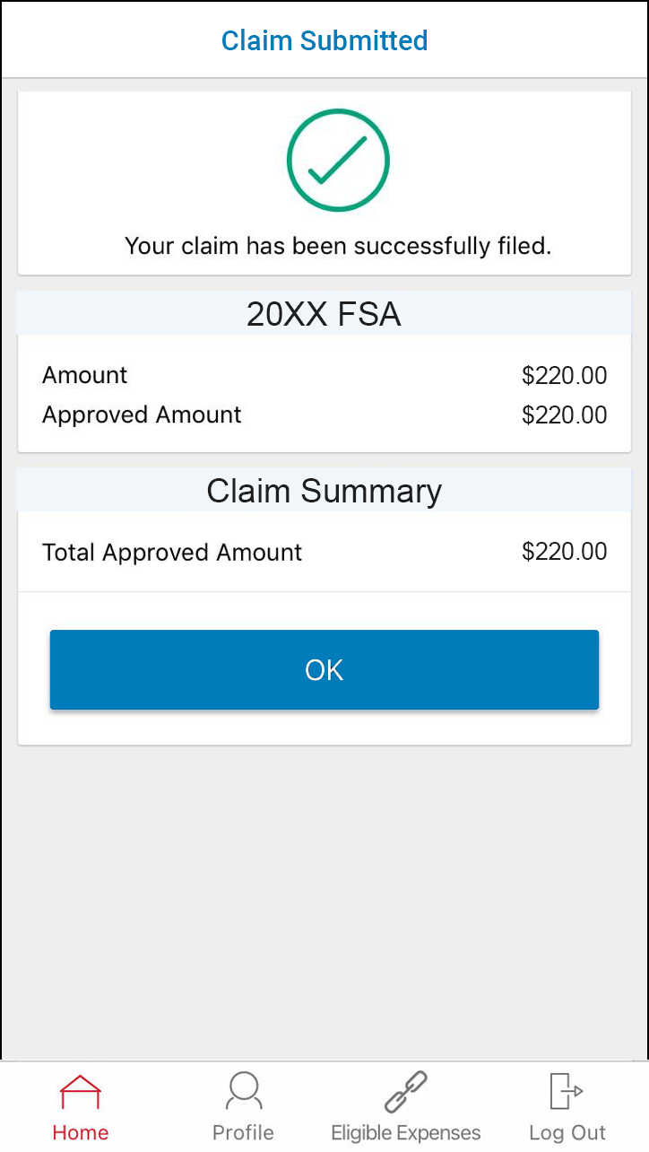
How to file a claim in the benefits mobile app
8
You’ll receive a confirmation message
Notes:
You’ll receive a confirmation once your claim has been successfully submitted.

Slide 44

How to use the EOB Smart Scan feature
Proprietary & Confidential
Notes:
Now let’s move on and look at how to use the Explanation of Benefits (or EOB) Smart Scan feature.

Slide 45
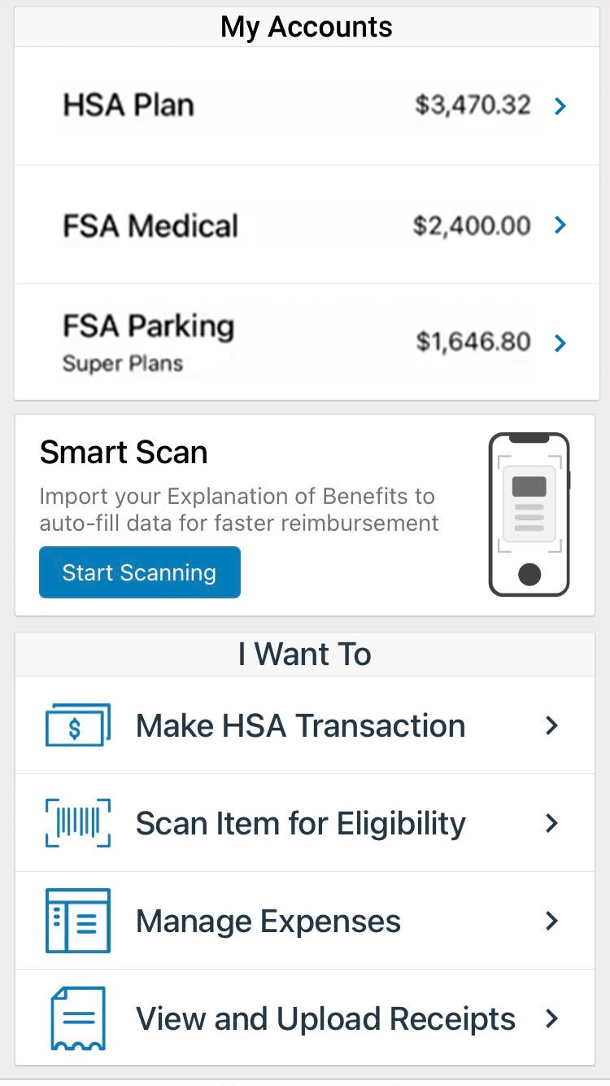
How to use the EOB Smart Scan feature
1
Select “Start Scanning”
Take a photo
Upload existing photo
Notes:
To begin using the explanation of benefits, or EOB, Smart Scan tool in the benefits mobile app, select “Start Scanning.”

Slide 46
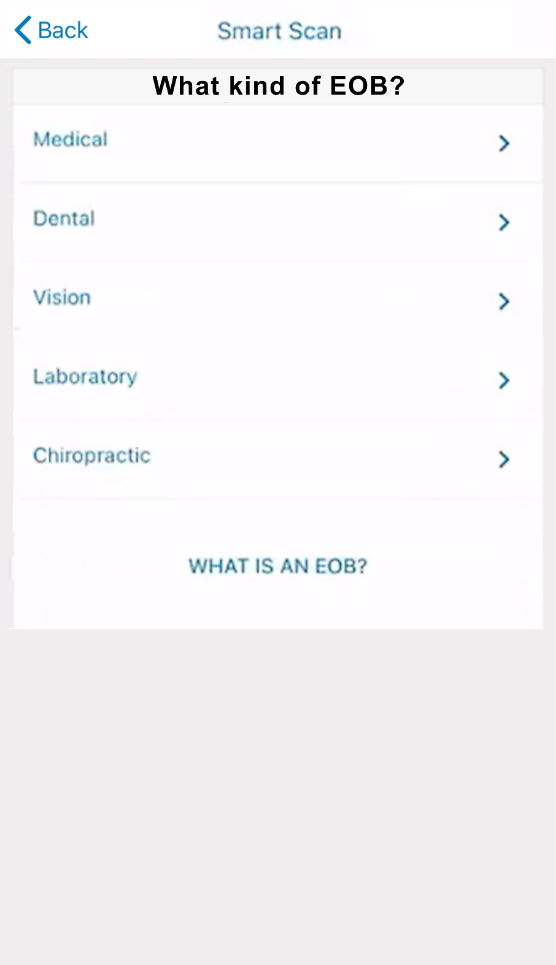
How to use the EOB Smart Scan feature
2
Select the type of EOB
Notes:
Select the type of EOB you will be scanning.

Slide 47
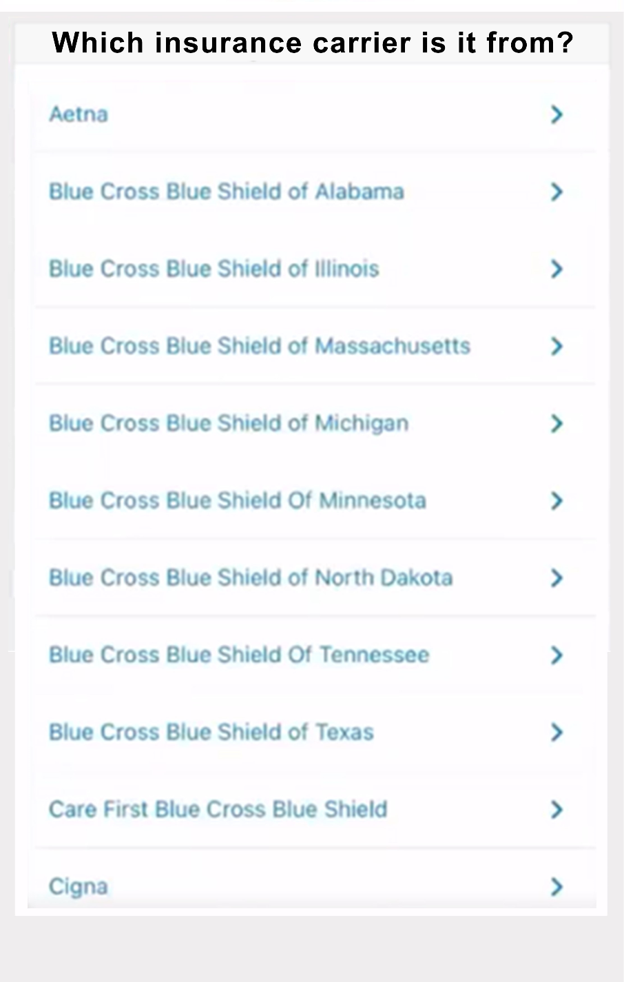
How to use the EOB Smart Scan feature
3
Select your insurance carrier
Notes:
Select your insurance carrier from the list.

Slide 48
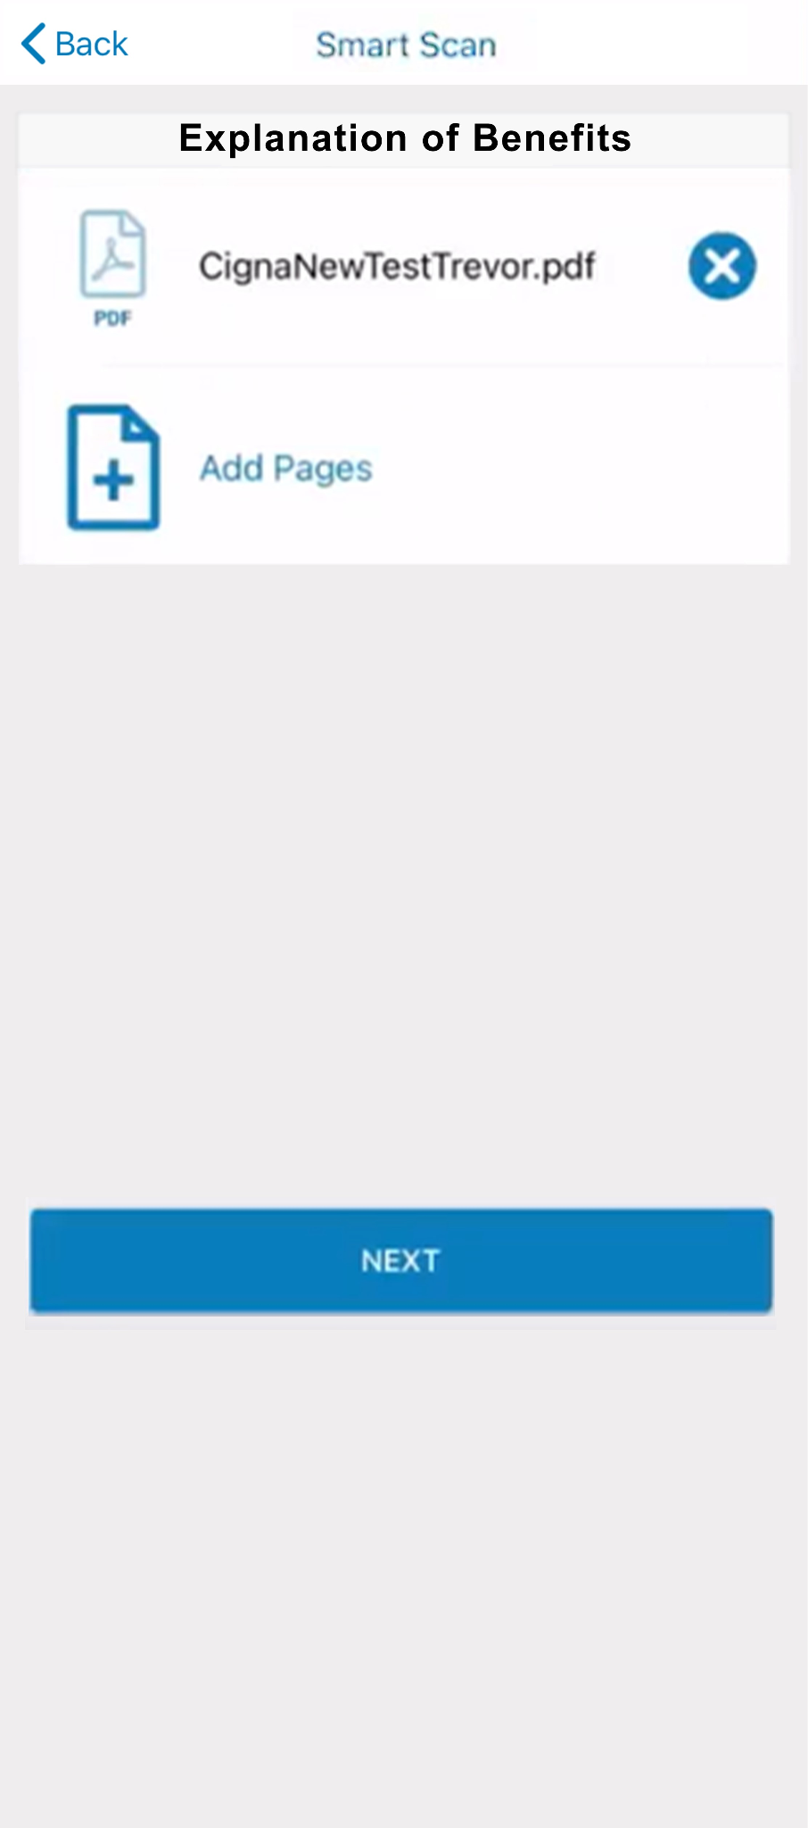
How to use the EOB Smart Scan feature
4
Select “Add Pages”
Notes:
To upload an image, select “Add Pages.”

Slide 49
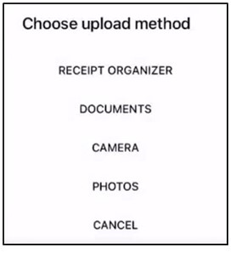
How to use the EOB Smart Scan feature
5
Choose upload method
Notes:
Then, choose the applicable upload method that contains your EOB image.

Slide 50
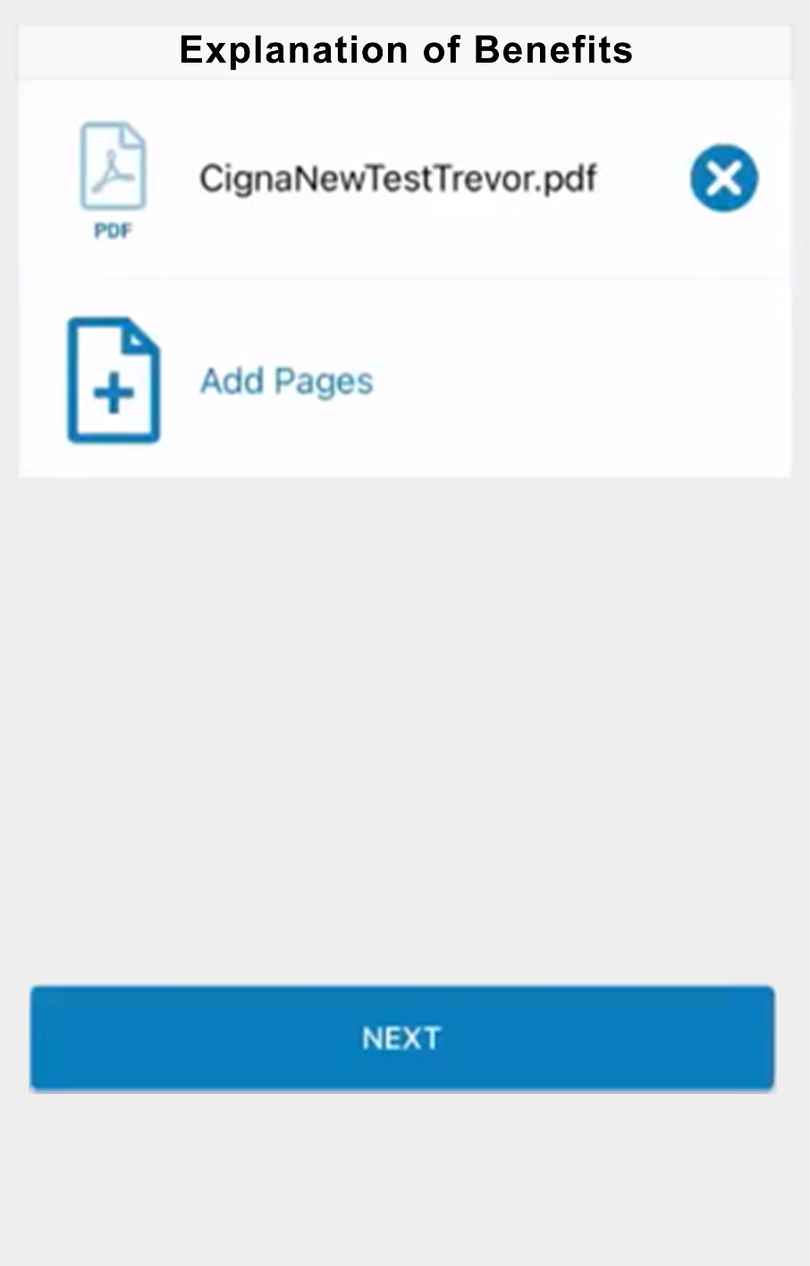
How to use the EOB Smart Scan feature
6
Select “Add Pages” if necessary
Repeat previous step
Notes:
You can add more pages by selecting “Add Pages” and repeating the previous step.

Slide 51
How to use the EOB Smart Scan feature
7
Select “Next”
Notes:
Otherwise, select “Next.”

Slide 52
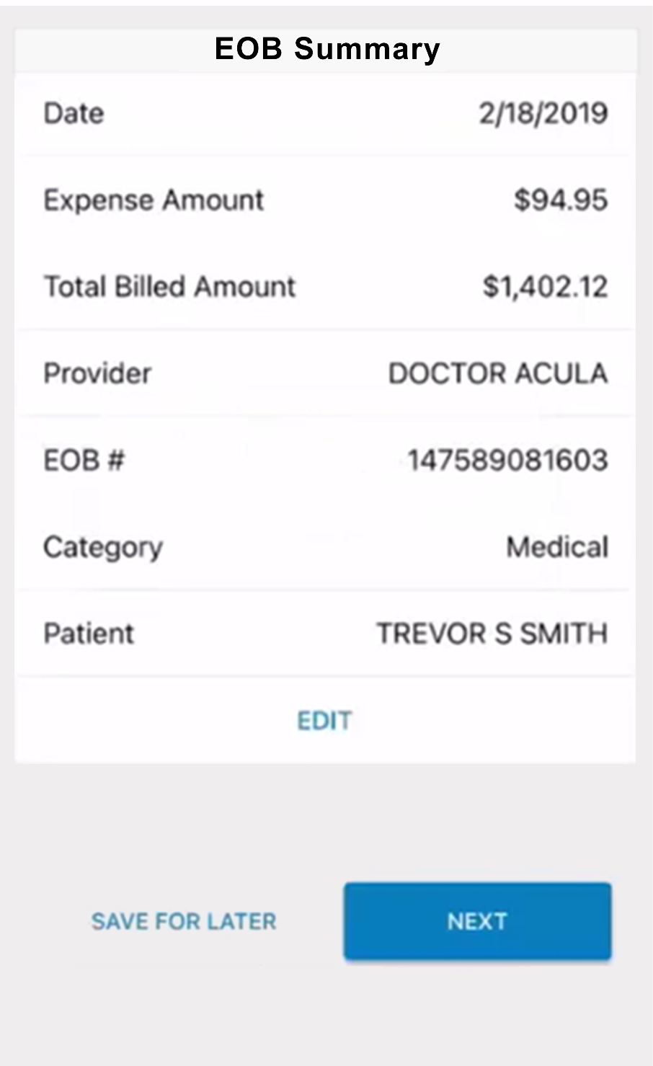
How to use the EOB Smart Scan feature
8
Review information
Select “Next”
Notes:
Review the information in the EOB summary section.
Then select “Next.”

Slide 53
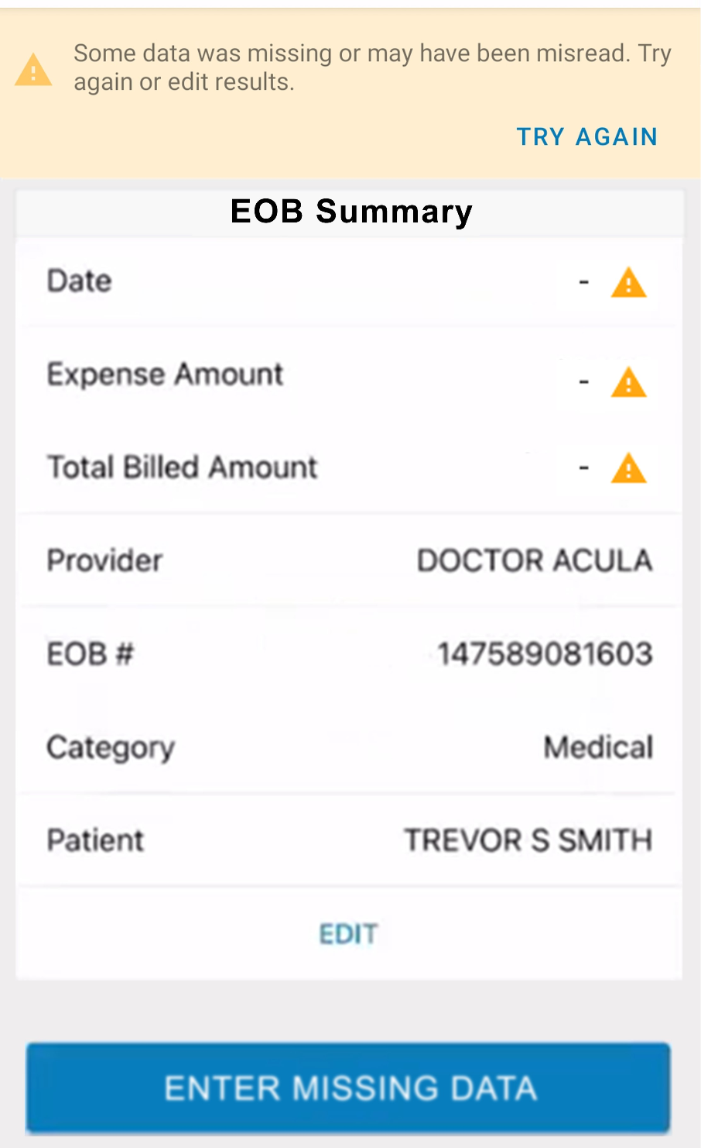
How to use the EOB Smart Scan feature
9
If information is missing an error icon will appear
Notes:
If the scan is misread or the EOB is missing data, an error icon will appear next to the field where the information is missing.

Slide 54
How to use the EOB Smart Scan feature
10
If
9
If information is missing an error icon will appear
Select “Try Again”
Select “Enter Missing Data”
Notes:
You can select “Try Again” at the top of the screen to upload a new image.

Slide 55
How to use the EOB Smart Scan feature
10
If
9
If information is missing an error icon will appear
Select “Try Again”
Select “Enter Missing Data”
Notes:
Or, manually enter the missing information yourself by selecting “Enter Missing Data.”

Slide 56
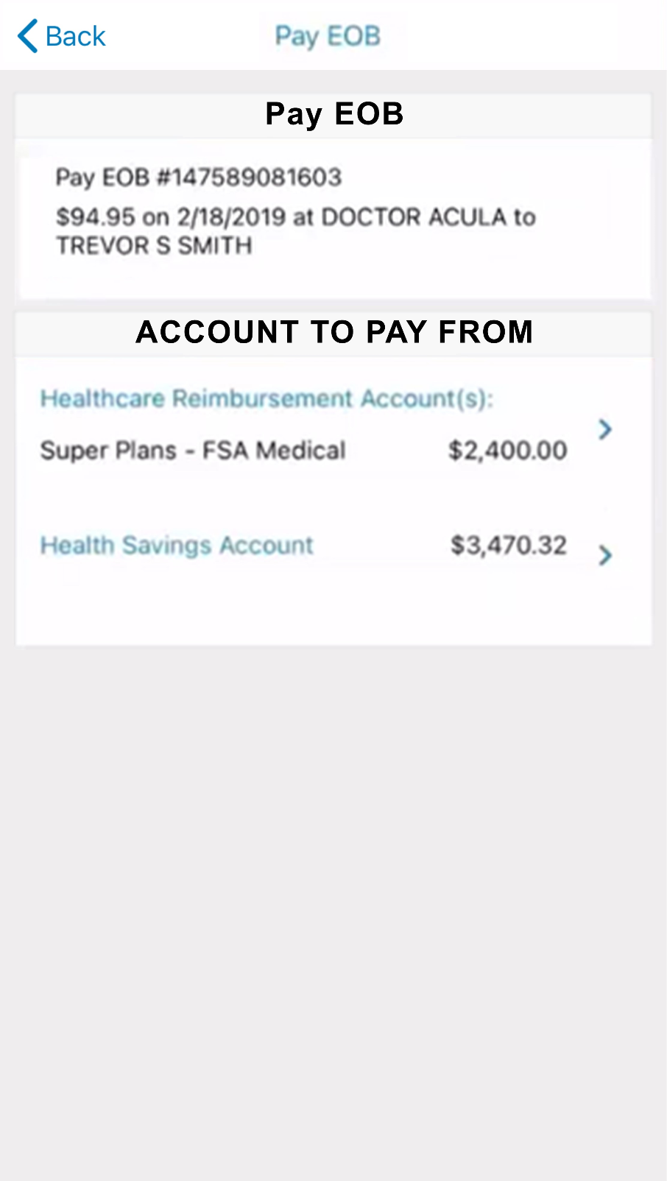
How to use the EOB Smart Scan feature
10
Select the account to pay from and complete remaining fields
Notes:
Once the information is confirmed, select the account from which you will pay and complete the remaining fields.

Slide 57

How to use the mobile app eligible expense scanner
Proprietary & Confidential
Notes:
Now let’s look at how to use the mobile app eligible expense scanner.

Slide 58
How to use the eligible expense scanner
1
Select “Scan Item for Eligibility”
Notes:
To use the benefits mobile app eligible expense scanner, select “Scan Item for Eligibility.”

Slide 59
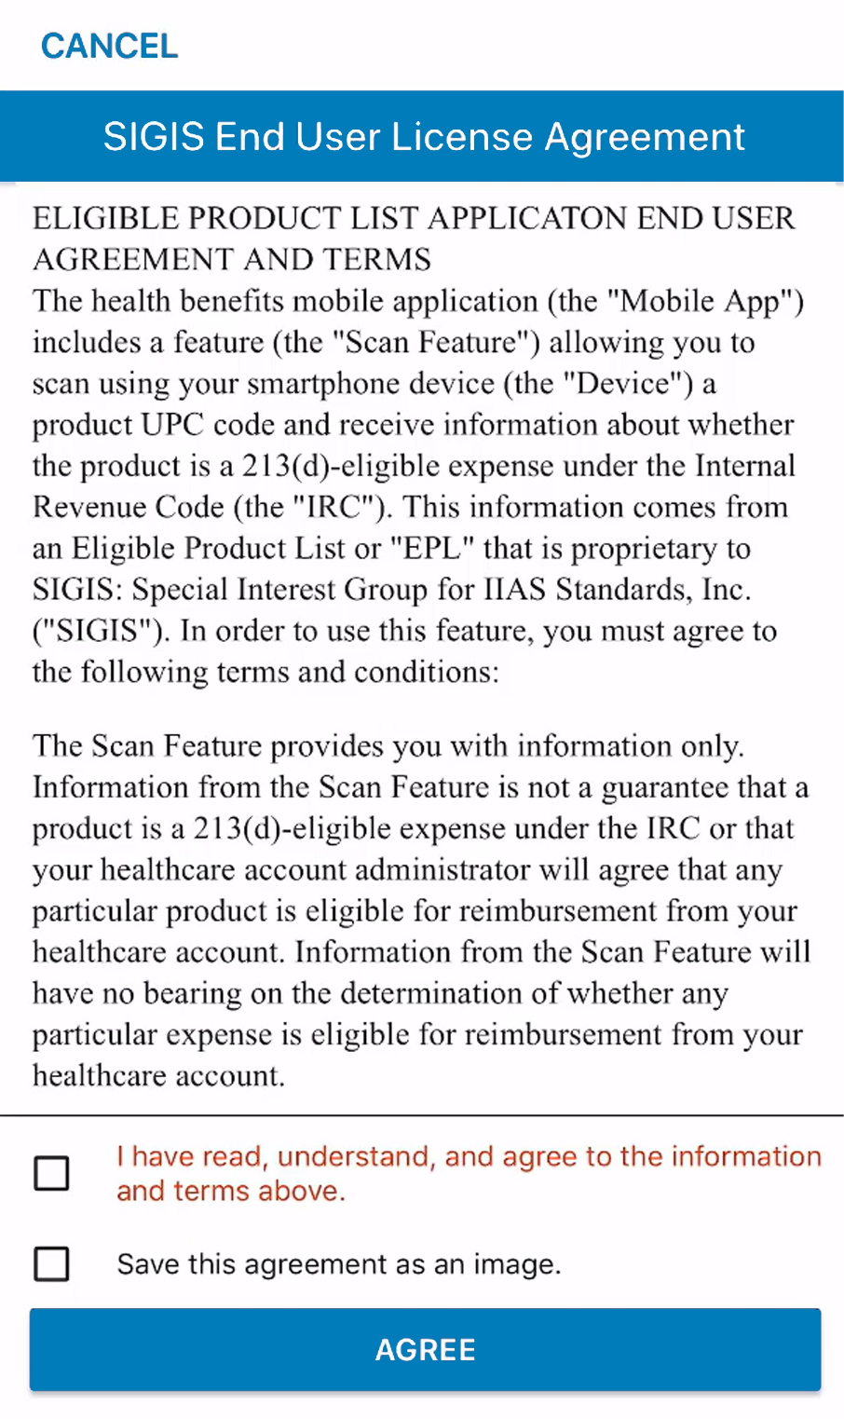
How to use the eligible expense scanner
2
Read terms and conditions
Select the box indicating you’ve read, understand and agree to them
Notes:
If it’s your first time using the scanner, you’ll be asked to review the terms and conditions for using the scanner.
Read the terms, and then select the box indicating that you’ve read, understand, and agree to them.

Slide 60
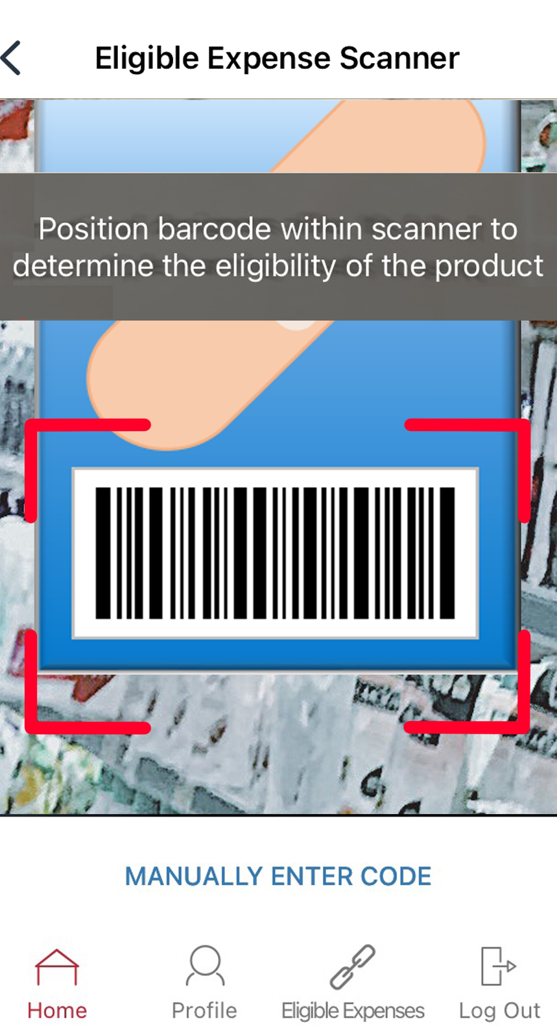
How to use the eligible expense scanner
3
Scan barcode
Notes:
When the scanner opens, use your phone’s camera to scan the product’s barcode.

Slide 61
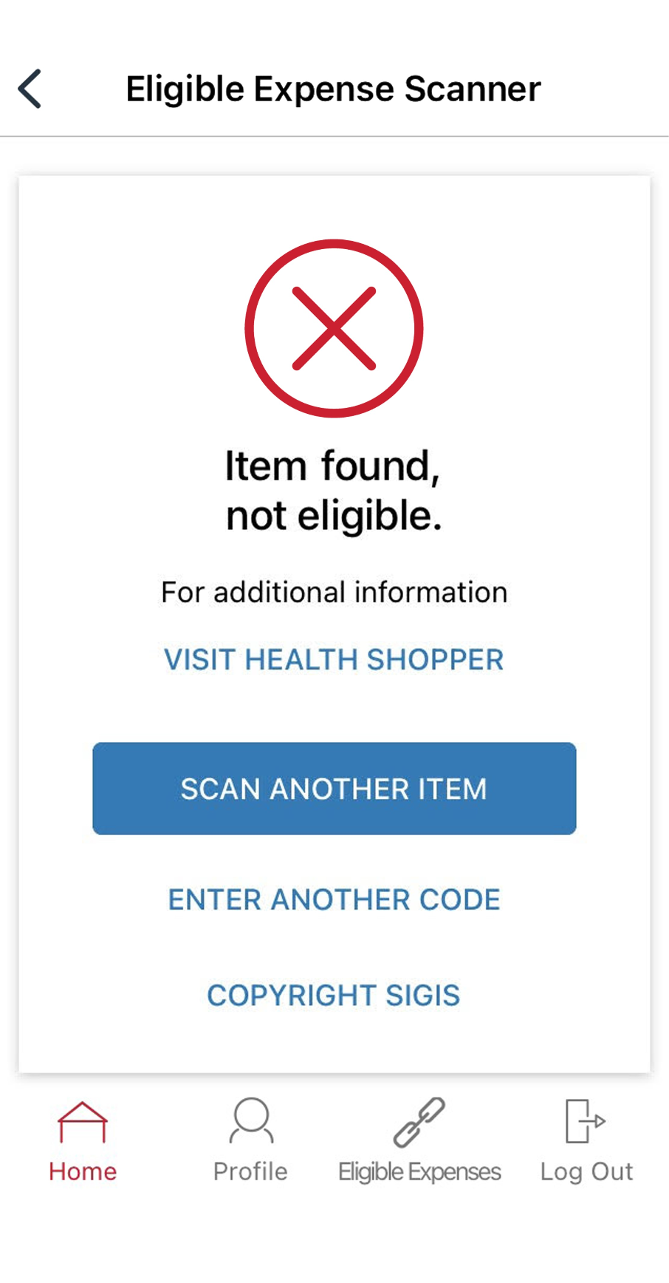
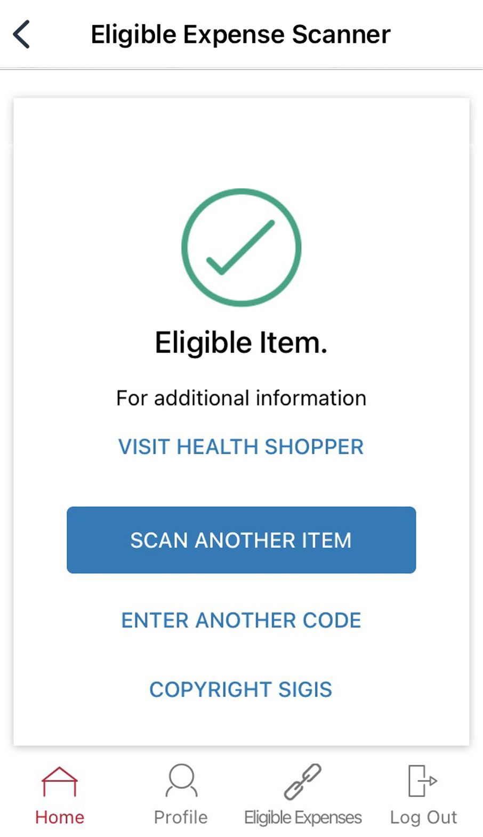
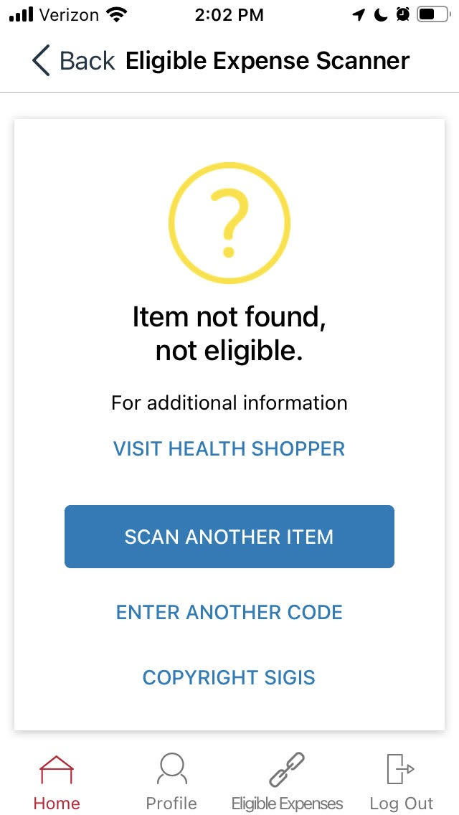
How to use the eligible expense scanner
4
View message to verify eligibility
Eligible Item
Item not found, not eligible
Item found, not eligible
Notes:
The scanner will display a message to verify whether or not the item is an eligible expense based on your plan.
You can scan up to one hundred barcodes per month.

Slide 62
How to set up recurring dependent care reimbursement
Proprietary & Confidential
Notes:
Now what can you do specifically for your dependent care account? Eliminate the need to file claims throughout the year for dependent care expenses by enrolling in recurring dependent care reimbursement.

Slide 63
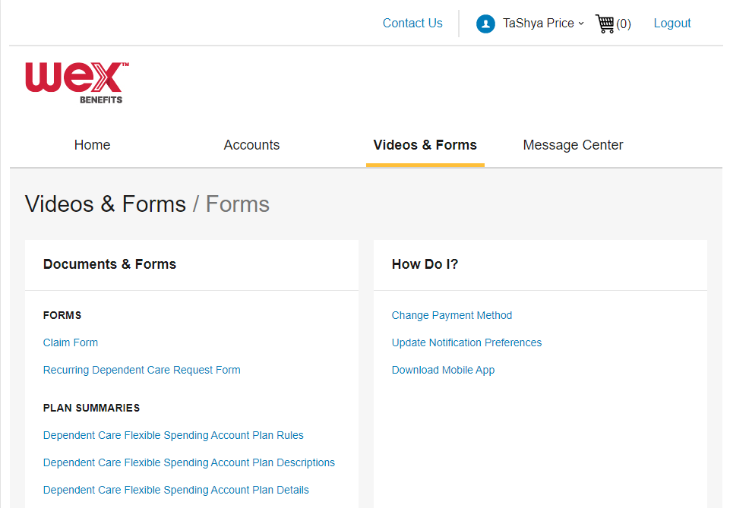
Recurring Dependent Care Request Form
Notes:
Using the Recurring Dependent Care Request form, which can be found in the Videos & Forms section of your online account, you are able to file for automatic recurring reimbursement for your eligible dependent care expenses.

Slide 64
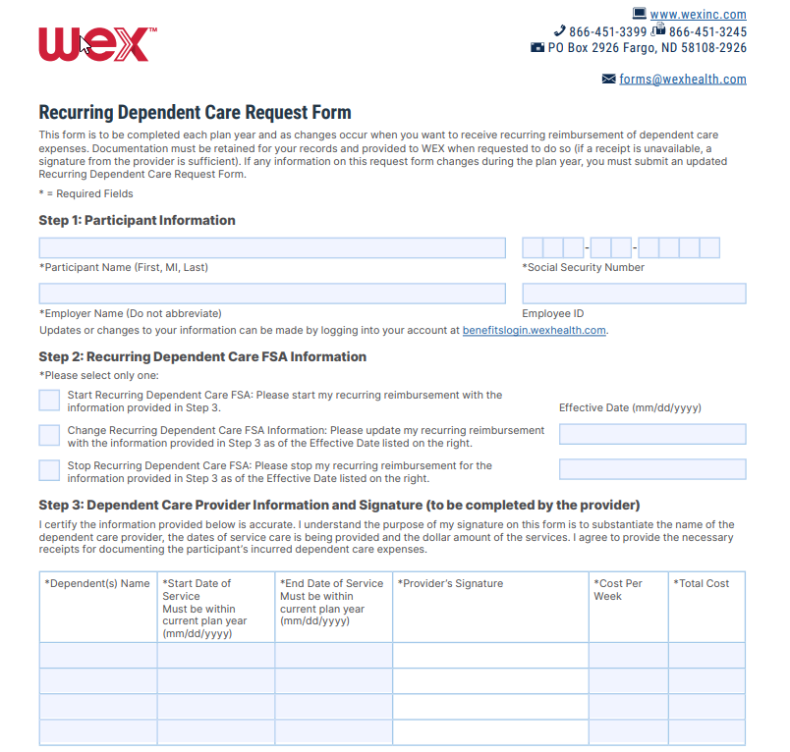
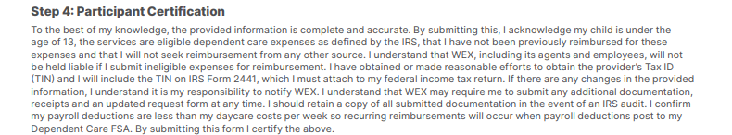
Recurring Dependent Care Request Form
Submit one form per year for automatic reimbursement
Mail
Fax
Email
Online Account
Notes:
This process requires you to submit one form per year for each daycare provider you use. You and your daycare provider will complete the Recurring Dependent Care Request Form. You can submit the form by email, fax, mail, or upload directly through your online account. Once your form is processed, you will be automatically reimbursed throughout the plan year.

Slide 65

Contact Participant Services
Our Participant Services team is available Monday through Friday, from 6 a.m. to 9 p.m. CT, except holidays.
Website
––––
www.wexinc.com
Phone
––––
Current WEX participants:
866-451-3399
New to WEX:
844-561-1337
Notes:
For any questions or assistance you may need, our participant services team is available to you Monday through Friday from 6 am to 9 pm Central time.
You have a variety of options to contact us. You can get support on our website at www.wexinc.com or call to speak to a participant services representative.
If participates ask for instructions…
Support on Website: To access the form, follow the below steps:
Navigate to www.wexinc.com > Support > Contact customer service team > Contact WEX benefits.
Select the following:
a. Type of Inquiry: Customer Service
b. I am a: Employee/Participant
Select “WEX Benefits Support Center”.
Complete the form.
A successful submission message will appear indicating that we'll be in touch.
The employee/participant will receive an email response with additional details or resolution to their inquiry.
Form URL: https://wexhealthinc.my.site.com/WEXbenefitscontactus/s/

Slide 66
Notes:
I want to thank you for taking the time to be with me today and I hope you found this presentation both educational and enjoyable.
We’ve got some time to open up for questions now. As a reminder, please keep in mind this is live in a group setting, so in order to protect your privacy, it’s best to contact Participant Services directly for any specific individual situations.

