Slide 1
Read, then delete this slide
Add/remove slides as needed to tailor your presentation
To share/email, click “File” in the top left of main menu above and then “Download.”
  Recommend downloading as a PDF for easy emailing and reading by the recipient
If are you looking for instructions or videos on the webinar subjects,
we have linked the participant articles and video of each topic.
How to upload documentation to an existing claim in your online account Article | Video
How to upload documentation to an existing claim in your benefits mobile app Article | Video
Eligible expenses for benefits plans Article | Video
How to substantiate medical flexible spending account (medical FSA) purchases of eligible expenses Article | Video
Dependent care flexible spending account (Dependent Care FSA) eligible expenses Article | Video
Substantiate Dependent Care Flexible Spending Accounts purchases of eligible expenses Article | Video

Slide 2
Client name
Getting started with substantiation
Notes:
Hello everyone, and welcome to your post-enrollment webinar, Getting started with Substantiation, presented by WEX.
My name is ____________ and I am happy to be here with you today as we go through the ins and outs of substantiation.
Before we begin, I’d like to quickly mention- as we ask you to participate throughout the presentation, please keep in mind this is a live webinar in a group setting so we are unable to answer any questions regarding specific individual situations to protect your privacy. We are happy to answer any general questions you may have, and will be sure to provide you with our Participant Services Team contact information as well, as they are able to dig in further and help you with any specific or more confidential questions you may have. With that - let’s get started!

Slide 3
Getting started with substantiation
Recognize eligible expenses for HSA and medical FSA plans
Substantiate medical FSA purchases of eligible expenses
Upload documentation to a claim in your online account
Upload documentation to a claim in your benefit mobile app
Recognize eligible expenses for dependent care FSA plan
Substantiate dependent care FSA purchases of eligible expenses
Notes:
***If slides are removed from the deck, please remember to remove that task from this slide image and text***
During our time together, we will be covering how to:
Recognize eligible expenses for Health Savings Accounts and medical flexible spending accounts
How to substantiate medical FSA purchases of eligible expenses
Upload documentation to an existing claim in your online account
…as well as in the benefit mobile app
Recognize eligible expenses for the Dependent Care Flexible Spending Account
and how to substantiate Dependent Care FSA purchases of eligible expenses
As we go through, you may notice your online account or mobile app looks slightly different than those showing on the screen, depending on the plan or plan(s) you’re enrolled in, OR slight platform updates.
Reminder, HSA distributions do not require third-party claim substantiation. It is the account holder's responsibility to maintain documents to show that a distribution was used for qualified medical expenses and provide the documentation in the event of a tax audit.

Slide 4

Eligible expenses for HSA and medical FSA benefits plans
Proprietary & Confidential
Notes:
First things first, eligible expenses. When you participate in a health savings account (or HSA), or in a medical flexible spending account (or Medical FSA), you’re able to contribute pre-tax funds for use on hundreds of eligible expenses.

Slide 5
Eligible expenses
Eligible expenses include: medical, dental, vision, and preventative
Notes:
The primary purpose of any expenses paid by an HSA or medical FSA must be to alleviate or prevent a physical or mental illness or limitation. Funds can be used to pay for the diagnosis, cure, prevention, or treatment of a disease and for treatments affecting any part or function of the body.
Eligible expenses include medical, dental, vision, and preventive care expenses as well as over-the-counter expenses.

Slide 6

Over-the-counter expenses
The list includes but is not limited to:
Pain relief medications
Over-the-counter cold and flu medicines
Allergy products
Heartburn medications
Menstrual products
Notes:
Many over-the-counter expenses are eligible without a prescription. Common eligible over-the-counter expenses include:
Pain relief medications, such as acetaminophen and nonsteroidal anti-inflammatory drugs
Over-the-counter cold and flu medicines which help with severe cough and congestion
Allergy products such as over-the-counter antihistamines and decongestants
Heartburn medications
And menstrual products such as pads and tampons

Slide 7
Medical expenses
Coinsurance
Copays
Prescription drugs
Medical deductibles
Medical services
Chiropractic adjustments
Hearing aids
Orthopedic goods and prosthetics
Ambulance services
Laboratory fees
Notes:
Common eligible medical expenses include:
Coinsurance, copays, prescription drugs, medical deductibles, medical services, chiropractic adjustments, hearing aids, orthopedic goods and prosthetics, ambulance services, and laboratory fees.

Slide 8
Dental expenses
Cleanings
Dentures
Denture adhesives and cleaners
Crowns
Fillings
Orthodontics
Copays
Coinsurance
Notes:
Common eligible dental expenses include:
Cleanings, dentures, denture adhesives and cleaners, crowns, fillings, orthodontics, copays, and coinsurance.

Slide 9
Vision expenses
Contact lenses
Contact solution and cleaning products
Prescription glasses and sunglasses
Eye exams
Vision screenings
Eye drops
Refractions
Vision correction procedures
Notes:
Eligible expenses related to vision care include:
Contact lenses, contact solution and cleaning products, prescription glasses and prescription sunglasses, eye exams, vision screenings, eye drops, refractions, and vision correction procedures such as Lasik surgery.

Slide 10
Preventative care expenses
Annual physicals
Screenings
Birth control products
Prenatal visits
Flu shots
Immunizations
Obesity and weight loss programs
Tobacco cessation programs
Well-child visits
Notes:
Preventive care may also be covered by an HSA or medical FSA. Some common eligible preventive care expenses include:
Annual physicals, screenings, birth control products, prenatal visits, flu shots, immunizations, obesity and weight loss programs, tobacco cessation programs, and well-child visits.
Preventive care generally doesn’t include any service or product intended to treat an existing illness, injury, or condition.

Slide 11
Ineligible expenses
X
Expenses solely for cosmetic reasons
Expenses that are merely beneficial to your general health
Notes:
It’s important to note that not all expenses are eligible under an HSA or medical FSA. Expenses that are solely for cosmetic reasons generally aren’t considered expenses for medical care, and therefore aren’t eligible. For example, teeth whitening is considered cosmetic and won’t be considered an eligible expense.
Expenses that are merely beneficial for general health, rather than preventive or alleviating, also typically aren’t eligible. An example of this would be a toothbrush. While a toothbrush is beneficial to dental health, it isn’t considered preventive or an alleviating treatment.

Slide 12

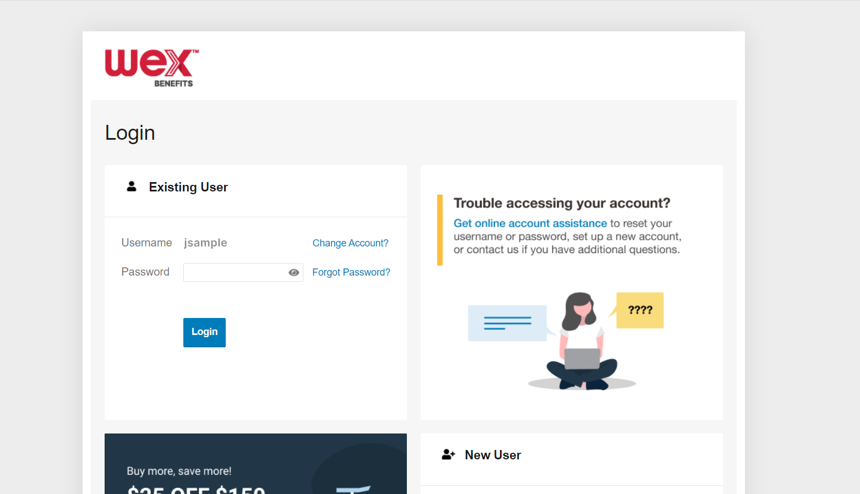
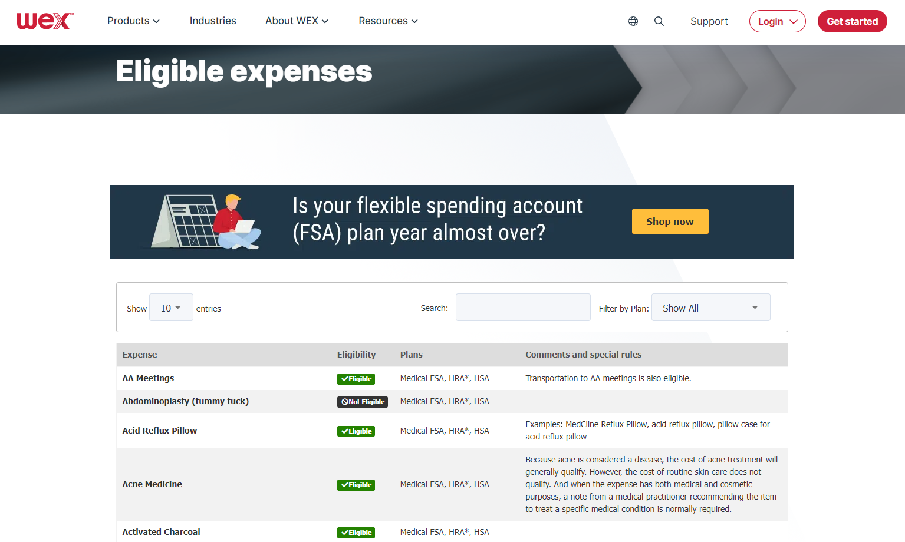
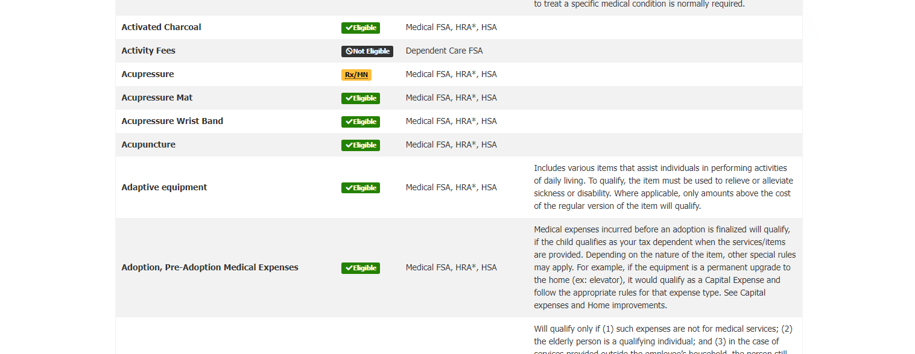
Additional resources
Online accoMobile app
unt
Mobile app - Eligible Expense Scanner
Online account - Interactive chart
Notes:
A great resource for determining the eligibility of an expense is our eligible expense scanner, available on our Benefits Mobile App. The eligible expense scanner allows you to easily maximise your savings by scanning an item’s barcode to determine its eligibility based on your plan.
For a complete list of eligible expenses, you can find an interactive chart on our website, wexinc.com. This chart allows you to filter eligible expenses by plan or search for specific expenses using keywords.

Slide 13


How to substantiate medical FSA purchases of eligible expenses
Proprietary & Confidential
Notes:
Let's talk a bit about documentation! (say jokingly) Everyone loves providing documentation, right?
Now, there are instances where we will reach out to you requesting documentation for your debit card purchase. This isn’t because we want to keep bothering you, it is because it is an IRS regulation. Before we get into what is needed specifically for substantiation, let's talk about when you may be asked to provide it.
We truly try to minimize the amount of times we have to ask for documentation or substantiation and this is because we completely understand that keeping track of your documentation or substantiation can be a hassle. We want this to be easy for you so our debit card has a couple of great features:
First, our debit card works with what is called an IIAS system. This means that if the merchant allows (typically big box stores like Target and CVS will have this system) our debit card can read what each product being purchased is, will only allow eligible FSA items to be purchased on it, allowing it to auto substantiate (or verify) the card purchase. For example, say you are at Target and you’re purchasing a box of band aides, sunblock and a soda. If you swipe your WEX benefits card, it will allow the band aides and sunblock to be purchased, as these are FSA eligible, but you would be asked to use a different form of payment for the soda. In this instance, since the card could read and only allowed FSA eligible items to be purchased, it will auto substantiate and we will not reach out for you to ask for documentation to substantiate (or verify).
Next, our debit card recognizes recurring transactions. For example, if you go to the chiropractor and you have a copay. The first time you use your debit card to pay for that service, we will ask for substantiation. Once properly substantiated, our debit card will assume that if the card is used for the same dollar amount as the same merchant, it is for your already approved service or purchase and auto substantiate. Again, this means we won’t ask you for further documentation.
Lastly, there are going to places that we will ask you for documentation, and an example would be the dentist office. As the dentist office does not have an IIAS system and offers services that are NOT FSA eligible, we will as you to substantiate your transactions there so we can tell if you got a teeth cleaning which is 100% FSA eligible, or if you got a teeth whitening, which is NOT an eligible expense.
Now when you are asked to provide documentation, the best form of documentation to submit is an Explanation of Benefits (or EOB) as it contains all of the necessary information for WEX to approve your claim. You receive the EOB from your medical, dental or vision carriers.

Slide 14
Details needed to substantiate
  Name of the provider or merchant
  Date of the service received or item purchased
  Description of the service received or item purchased
  Dollar Amount of the service received or item purchased
Notes:
If a transaction made with your benefits debit card can't be auto-substantiated, you'll receive one or more receipt reminders letting you know documentation is required. If you provide documentation but it's not sufficient to substantiate the claim, you'll receive a request for more information.
Documentation to substantiate claims for a medical FSA, limited medical FSA, or combination medical FSA must include the following details:
The name of the provider or merchant
The date of the service received or item purchased
The description of the service received or item purchased
And the dollar amount, after insurance, if applicable

Slide 15
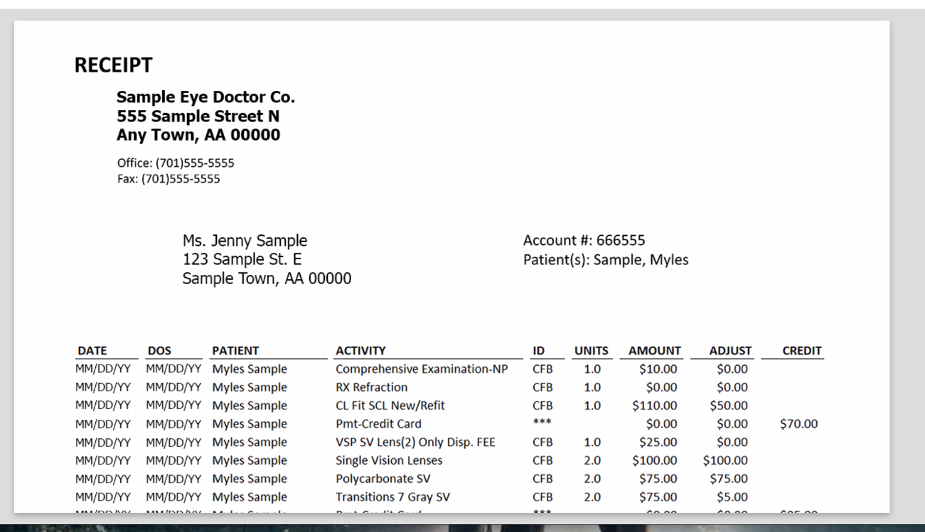
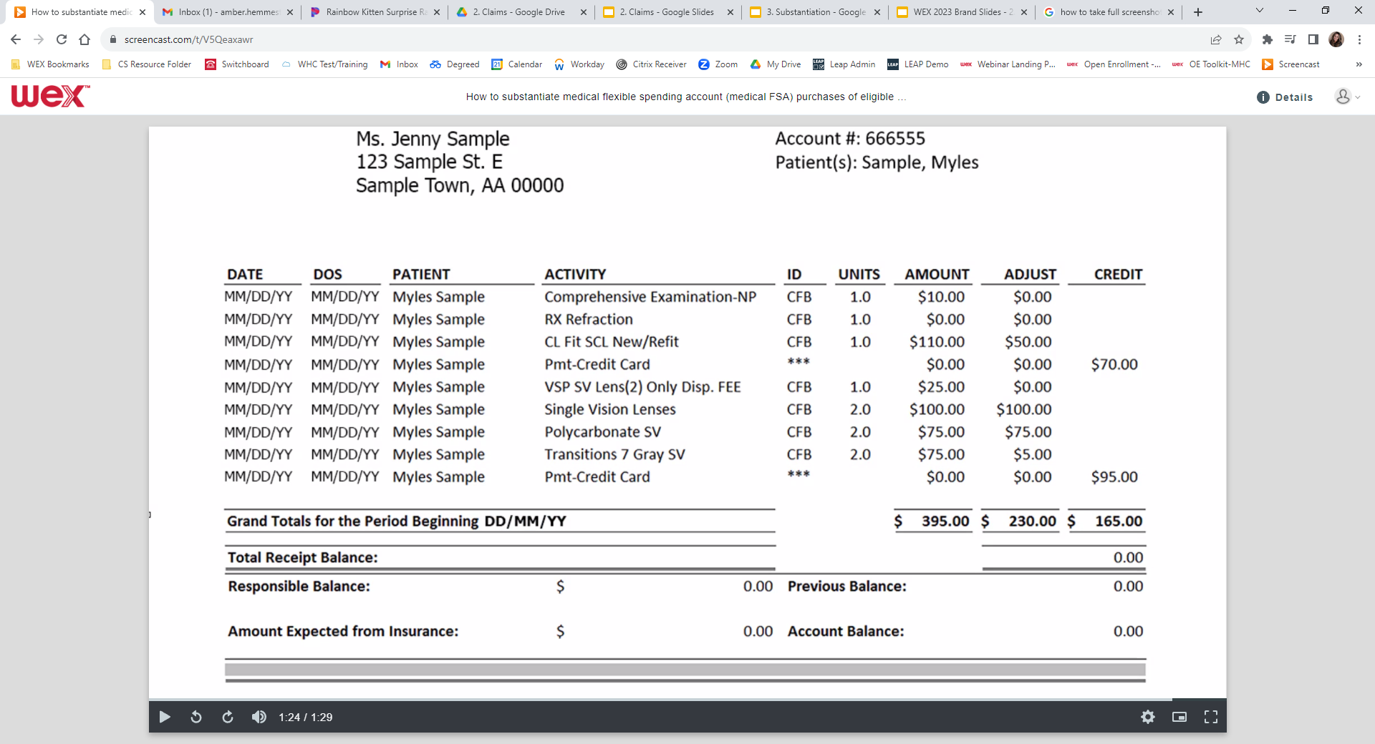
Details needed to substantiate
Notes:
Here is an example of a document with all the needed details to properly substantiate medical FSA purchases of eligible expenses.

Slide 16
Details needed to substantiate
Name of the provider or merchant
Notes:
Proper documentation will include the name of the provider or merchant.

Slide 17
Details needed to substantiate
Date of the service received or item purchased
Notes:
The date the service was received or the item was purchased.

Slide 18
Details needed to substantiate
Description of the service received or item purchased
Notes:
The description of the service received or the item purchased.

Slide 19
Details needed to substantiate
Dollar Amount of the service received or item purchased
Notes:
And the dollar amount, after insurance, if applicable.

Slide 20

How to upload documentation to an existing claim in your online account
Proprietary & Confidential
Notes:
Now how do you upload documentation to your online account for an existing claim?

Slide 21
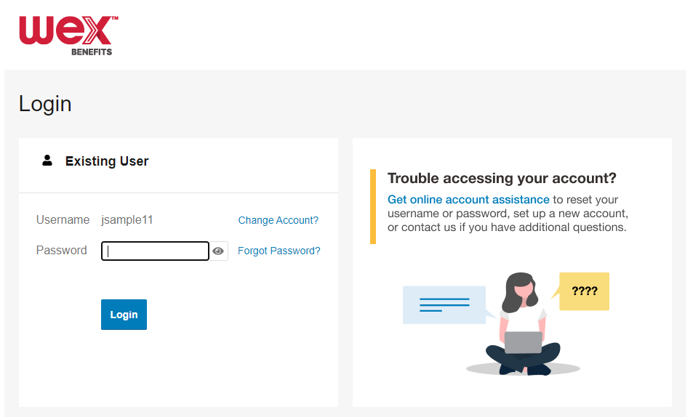
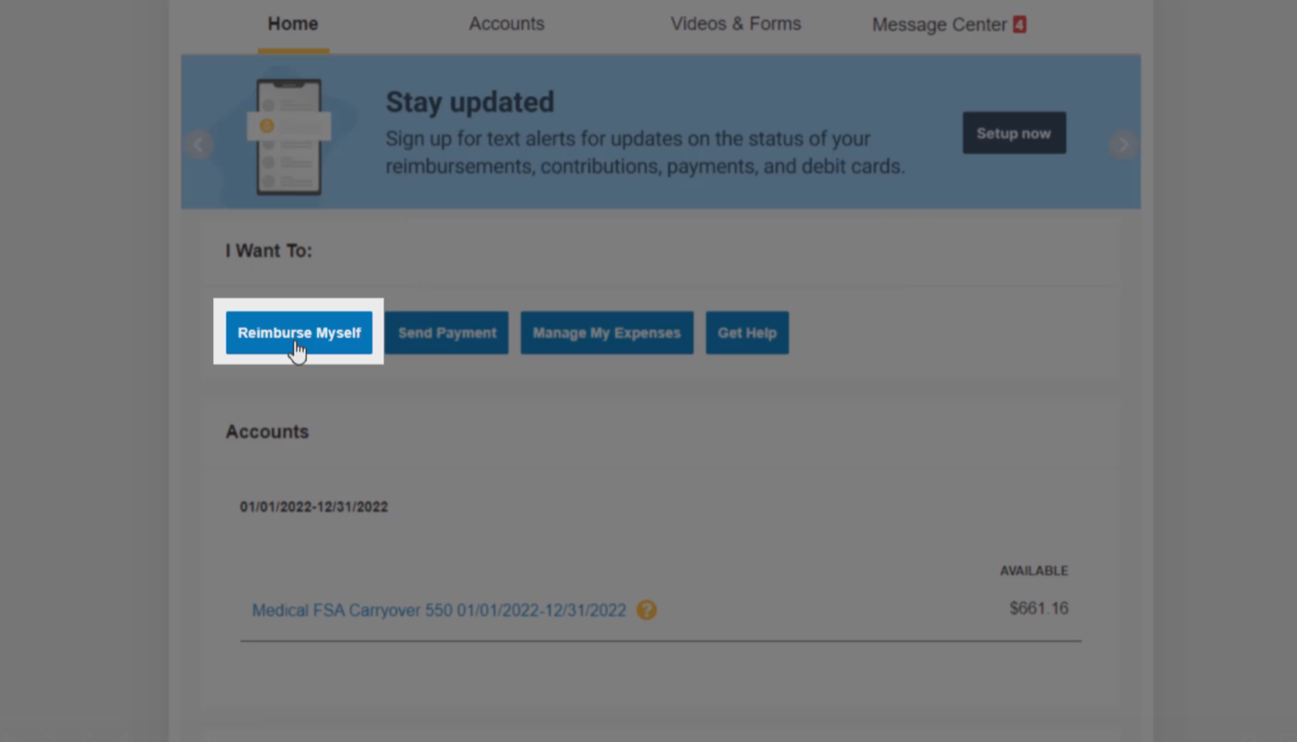
Upload documentation in your online account
Notes:
To upload documentation to an existing claim in your online account, you will first need to log in to your account.

Slide 22
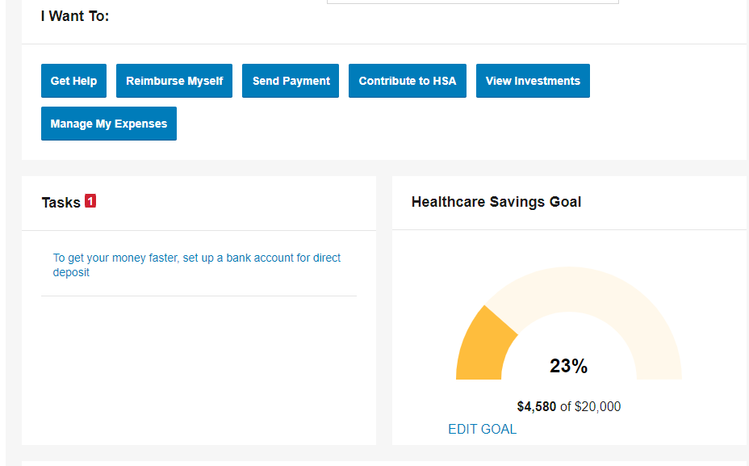
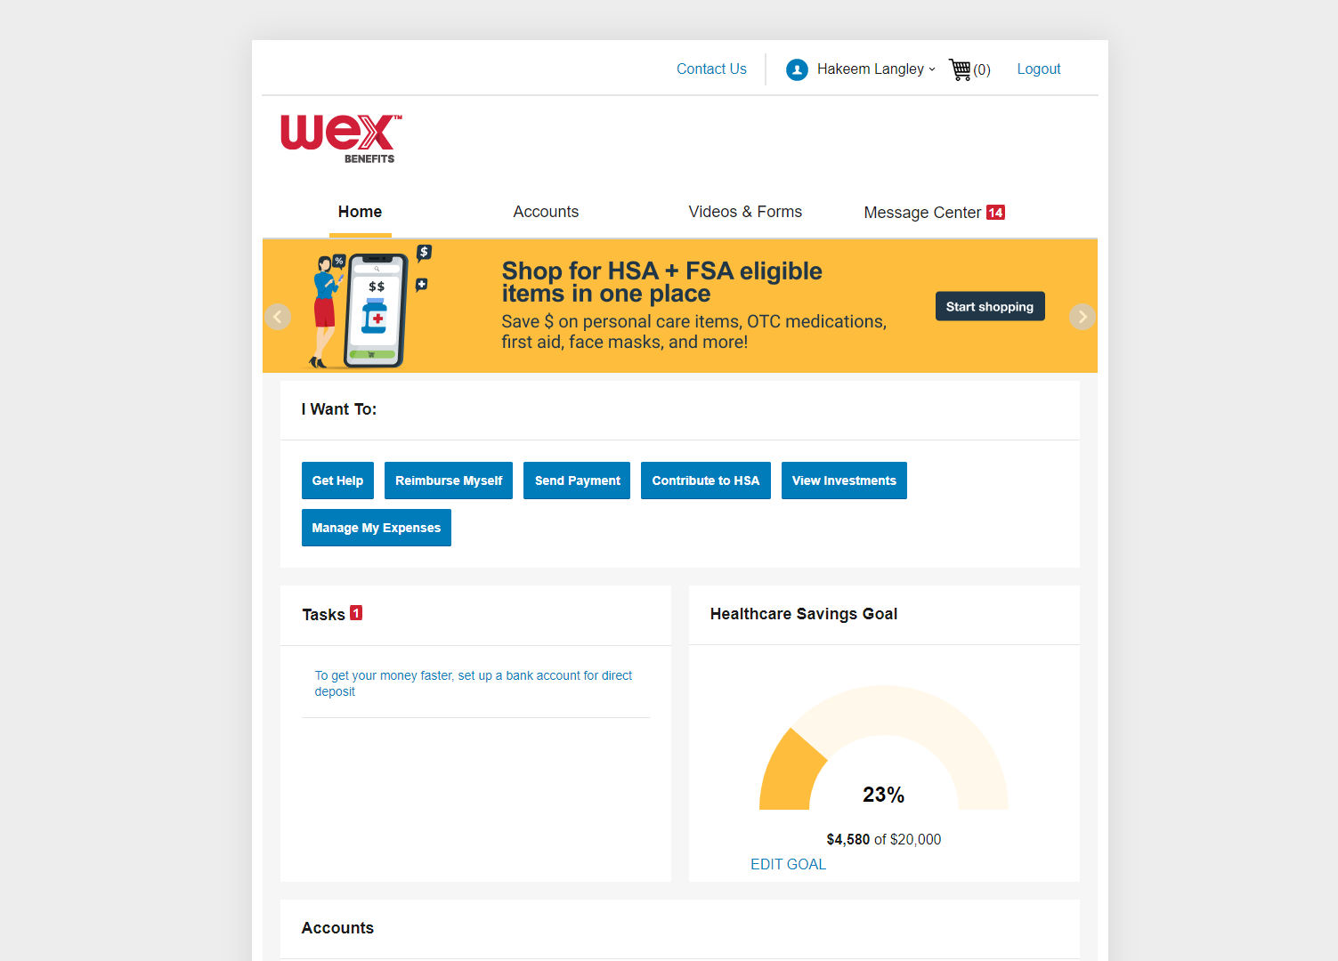
Upload documentation in your online account
! 1 receipt(s) needed to approve your claims
! 1 receipt(s) needed to approve your claims
Notes:
Once you are logged in, scroll down to the “Tasks” section of the “Home” tab.
Then select “receipt(s) needed.”

Slide 23
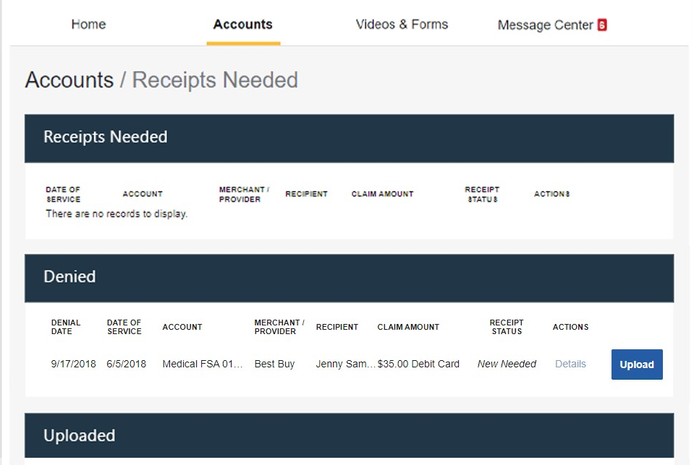
Upload documentation in your online account
Notes:
This will bring you to a page requesting you to upload your documentation.
You will see a “Receipts Needed” section to upload receipts that have not yet been uploaded and a “Denied” section to upload new receipts to claims that have been denied. Locate the claim that needs documentation.
“Select “Upload.”

Slide 24
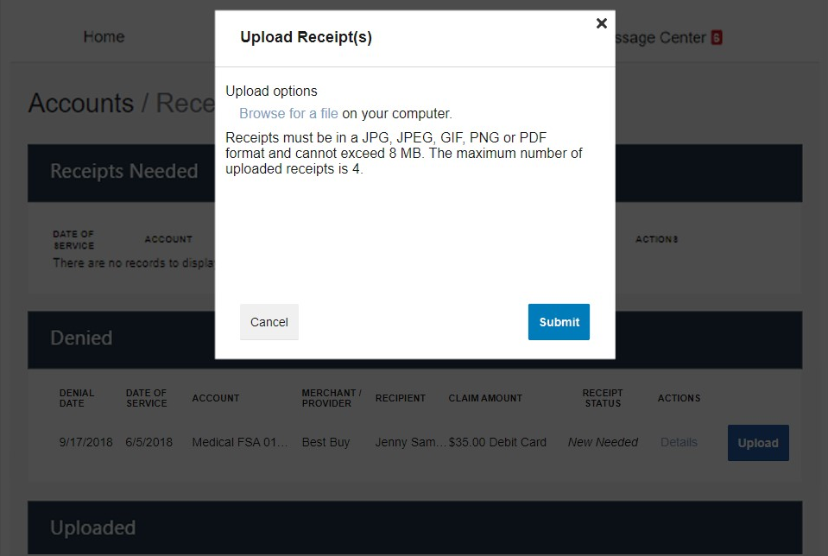
Upload documentation in your online account
Notes:
A window will appear to upload your receipt. Select “Browse” …

Slide 25
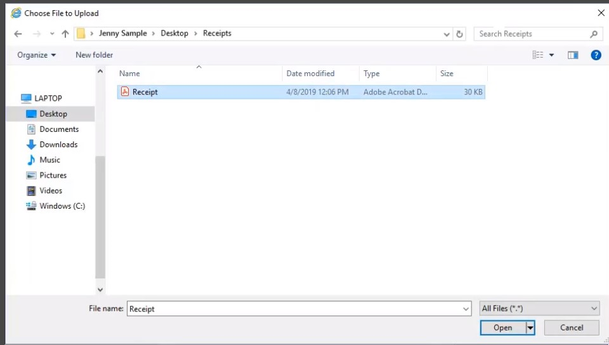
Upload documentation in your online account
Notes:
…and choose the file containing your receipt.

Slide 26
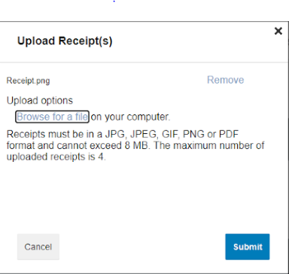
Upload documentation in your online account
Notes:
Then select, “Submit.”

Slide 27
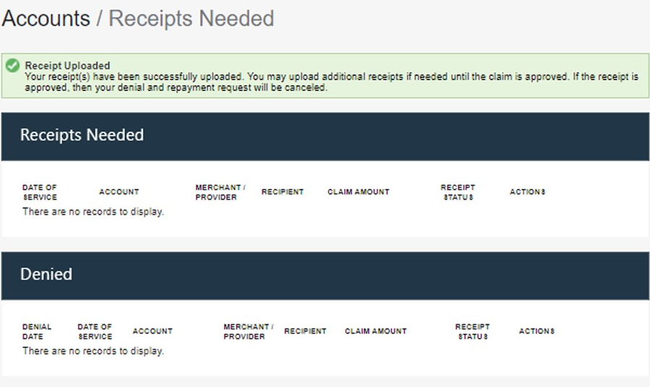
Upload documentation in your online account
Notes:
You’ll receive a confirmation message that verifies the receipt was successfully submitted…

Slide 28
Upload documentation in your online account
Notes:
…..and you’ll see an updated receipt status for that claim. Your documentation will typically be processed within two business days.
If further documentation is needed, you’ll be notified via email. If you don’t have an email address on file, you’ll be notified by mail.

Slide 29

How to upload documentation to an existing claim in the benefits mobile app
Proprietary & Confidential
Notes:
What about uploading documentation to an existing claim through your mobile app?

Slide 30
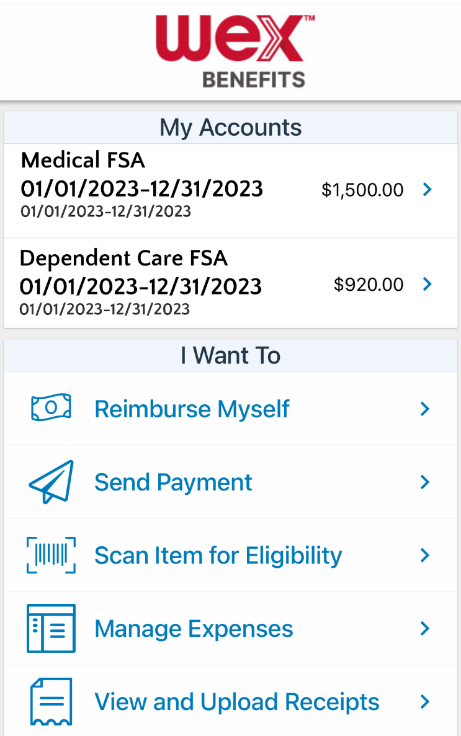
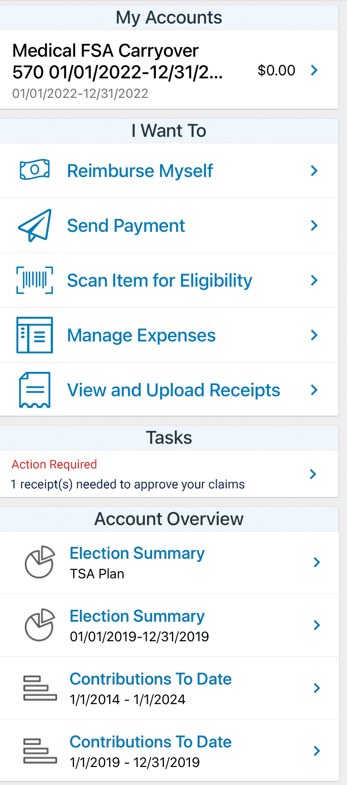
How to file a claim in the benefits mobile app
1
In the Tasks section, select the claim needing a receipt
Notes:
To upload documentation to an existing claim in the benefits mobile app, log in and scroll down to the “Tasks” section

Slide 31
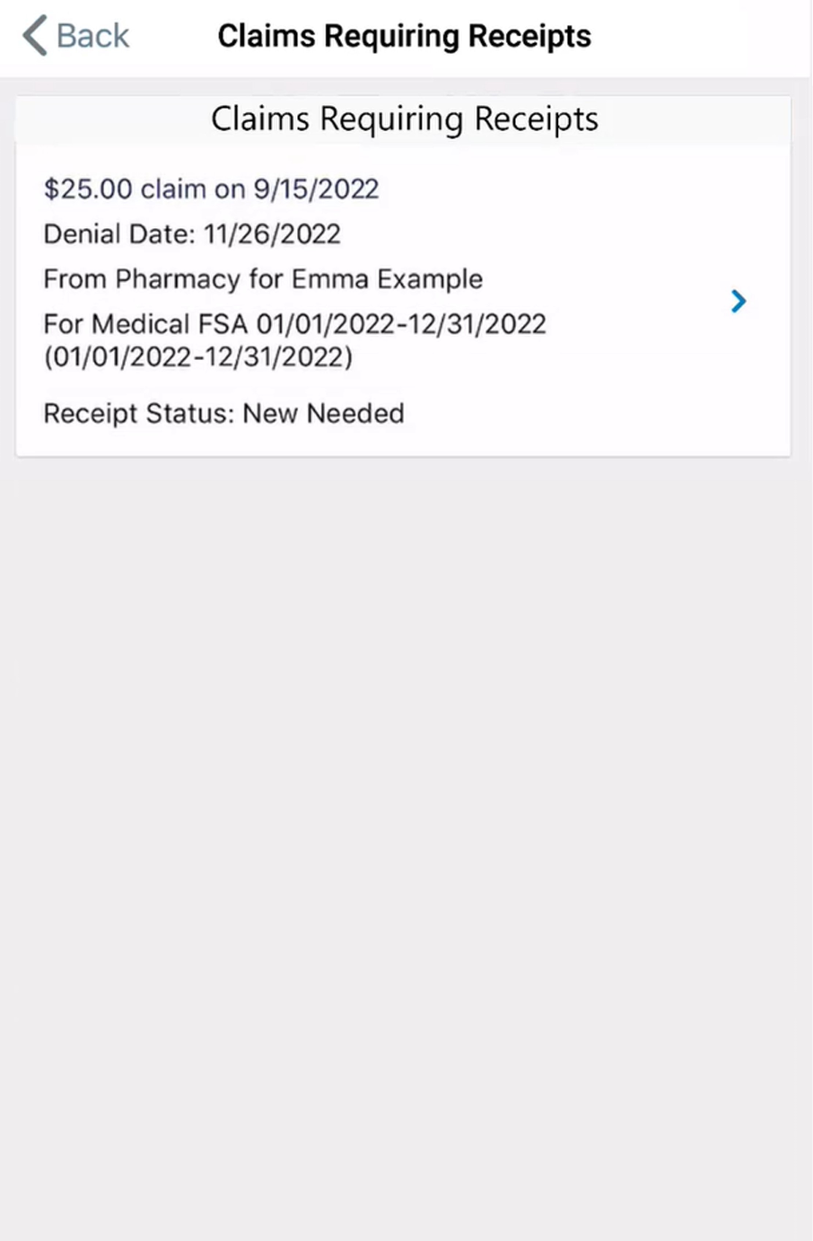
How to file a claim in the benefits mobile app
2
Select the claim needing a receipt
Notes:
You’ll be shown more details about the claim. Select the claim to upload a receipt.

Slide 32
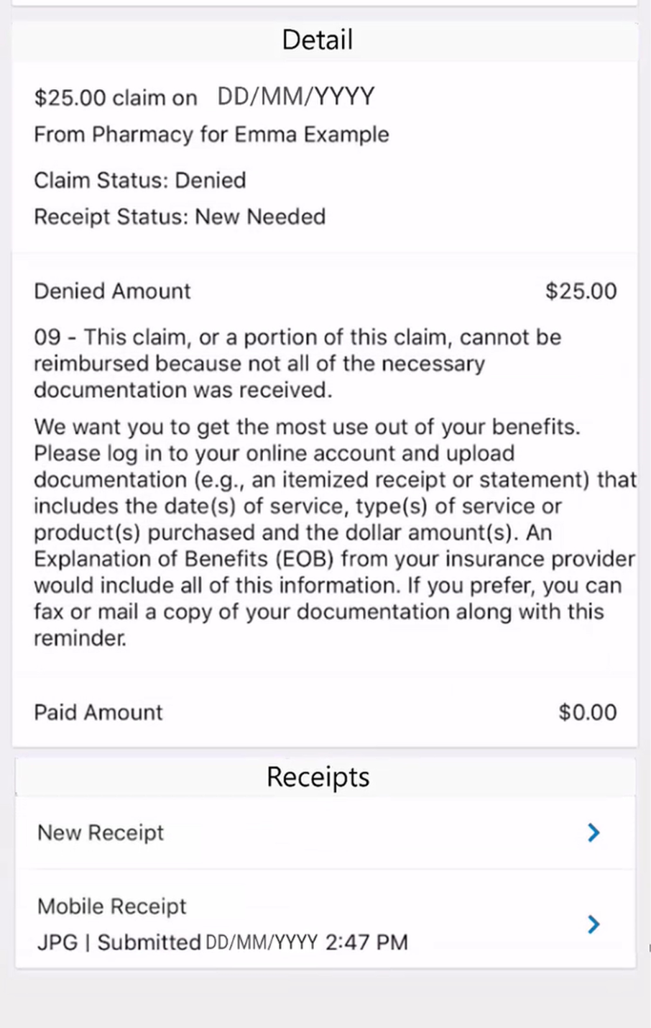
How to file a claim in the benefits mobile app
3
Select “New Receipt”
Notes:
Next, scroll down to the “Receipts” section and select “New Receipt.”

Slide 33
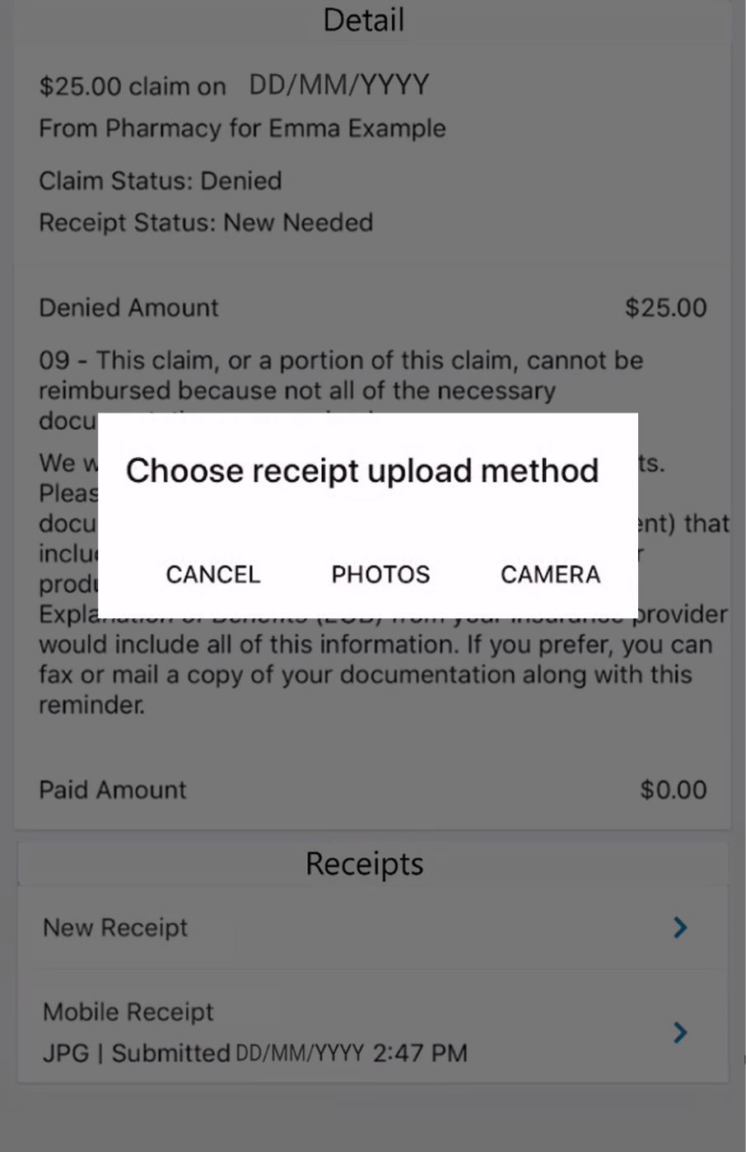
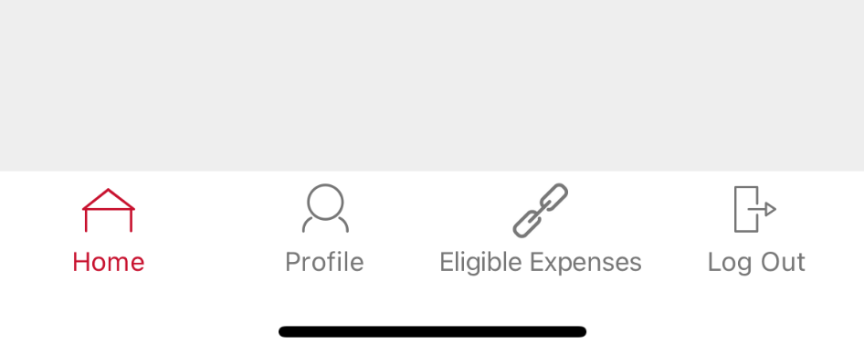
How to file a claim in the benefits mobile app
4
Select receipt upload method
Take a photo
Upload existing photo
Notes:
This will pull up a window prompting you to select your receipt upload method. You may take a photo of the documentation or upload an existing photo on your mobile device.

Slide 34
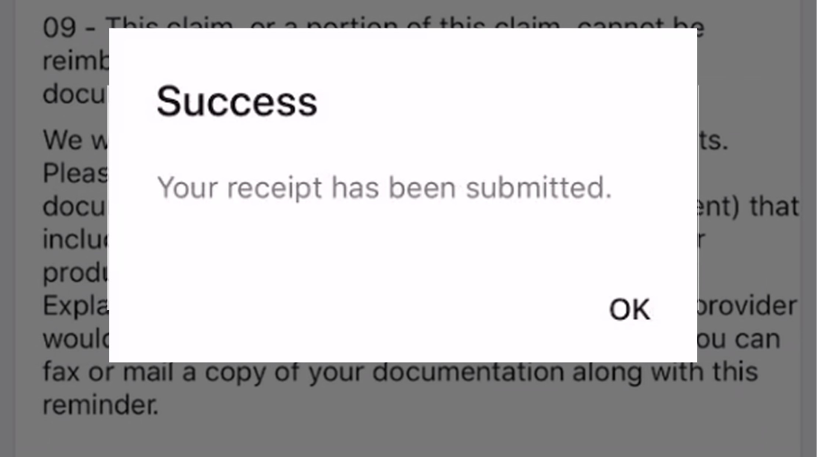
How to file a claim in the benefits mobile app
5
You’ll receive a confirmation message
Notes:
You’ll be shown a confirmation message once your documentation has been successfully submitted.

Slide 35

Eligible expenses for dependent care FSAs
Proprietary & Confidential
Notes:
Now what about the dependent care flexible spending account (or dependent care FSA)? The dependent care FSA is a benefits plan used to set aside a portion of your salary, before taxes, to pay for dependent care expenses.
Eligible expenses for dependent care FSAs must be incurred to allow you or your spouse to be gainfully employed, seeking employment, or a full-time student.

Slide 36

Eligible expenses
The list includes but is not limited to:
Summer day camps
Babysitters
Nannies
Care of a disabled spouse or dependent of any age
Notes:
Eligible expenses for dependent care FSAs are used to care for children ages 12 and younger who are claimed as qualifying dependents.
Eligible expenses include summer day camps, babysitters and nannies.
Dependent care FSAs also include eligible expenses for the care of a disabled spouse or dependent of any age, including custodial care of an adult dependent, as long as the following are true:
The elderly person is a qualifying individual
And the person still regularly spends at least eight hours each day in your household

Slide 37
Ineligible expenses
X
Medical expenses
Costs already claimed as a dependent care tax credit
Services provided by one of your dependents
Care at a nursing home, long-term care insurance premiums, respite care or other residential care center, and services such as housework
Expenses while on vacation
Notes:
Ineligible expenses for dependent care FSAs include:
Medical expenses
Costs already claimed as a dependent care tax credit on your tax return
Services provided by one of your dependents
Care at a nursing home, long-term care insurance premiums, respite care or other residential care center, and services such as housework
And expenses while on vacation

Slide 38

How to substantiate dependent care FSA purchases of eligible expenses
Proprietary & Confidential
Notes:
Now what about substantiating eligible expenses for the dependent care FSA?

Slide 39
Details needed to substantiate
  Name of the provider
  Date of the service received
  Description of the service received
  Dollar Amount of the expense
Notes:
The internal revenue service (or IRS) requires you to provide documentation to make sure the expenses are eligible for reimbursement from your dependent care FSA.
If a transaction made with your benefits debit card can’t be auto-substantiated, you’ll receive one or more receipt reminders letting you know that documentation is required.
Any documentation must include the:
The name of the provider
The date of the service
The description of the service received
And the dollar amount of the expense.

Slide 40
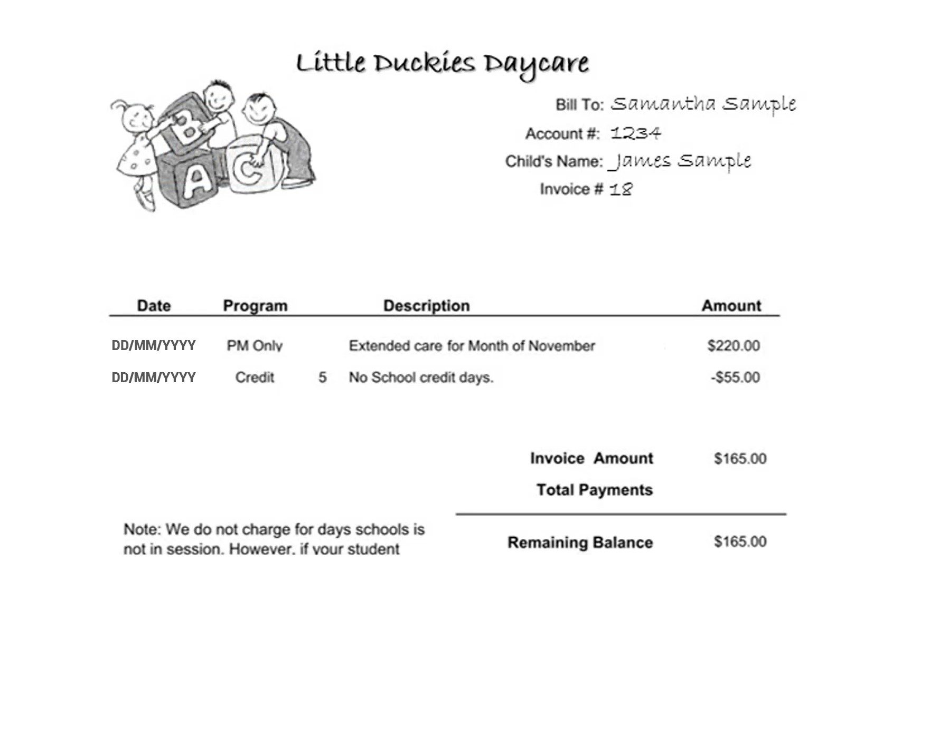
Details needed to substantiate
Notes:
Let’s take a look at a receipt to get more familiar with the information that the IRS requires.

Slide 41
Details needed to substantiate
Name of the provider
Notes:
The documentation needs the name of the provider.

Slide 42
Details needed to substantiate
Date of the service received
Notes:
The date of the service received.

Slide 43
Details needed to substantiate
Description of the service received
Notes:
A description of the service received.

Slide 44
Details needed to substantiate
Dollar Amount of the expense
Notes:
And the dollar amount of the expense.

Slide 45
How to set up recurring dependent care reimbursement
Proprietary & Confidential
Notes:
You can eliminate the need to file claims throughout the year for dependent care expenses by enrolling in recurring dependent care.

Slide 46
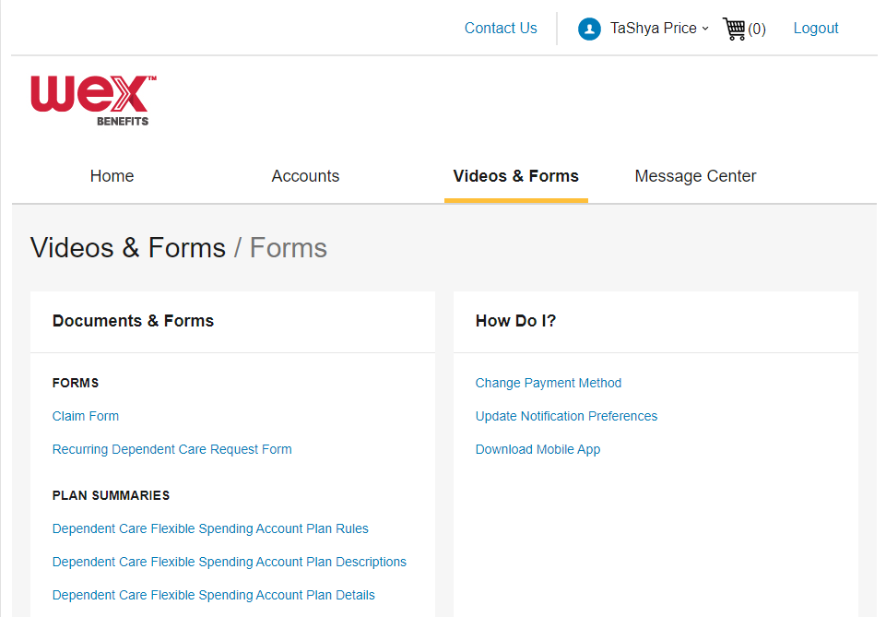
Recurring Dependent Care Request Form
Notes:
Using the Recurring Dependent Care Request form, which can be found in the Videos & Forms section of your online account, you are able to file for automatic recurring reimbursement for your eligible dependent care expenses.

Slide 47
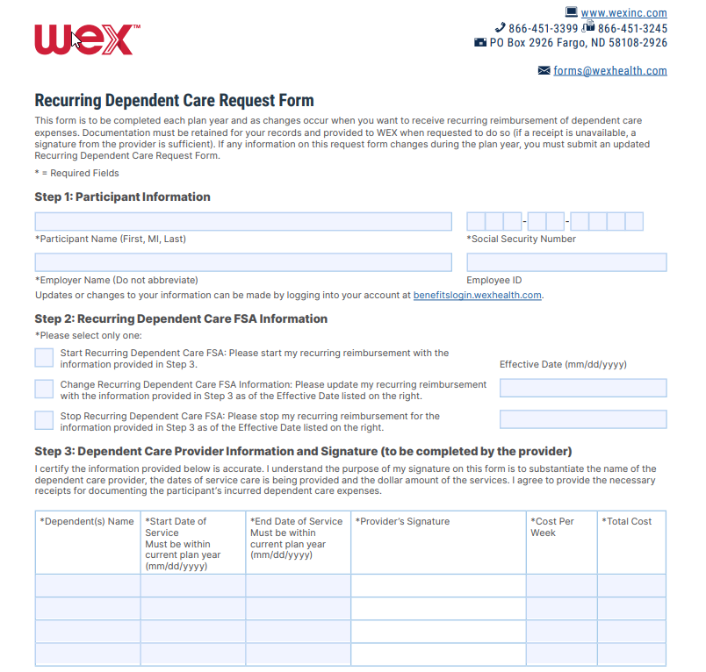
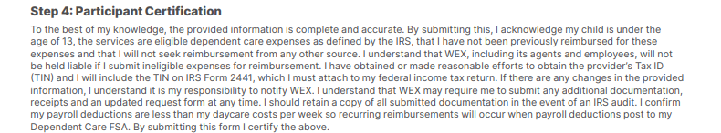
Recurring Dependent Care Request Form
Submit one form per year for automatic reimbursement
Mail
Fax
Online Account
Notes:
This process requires you to submit one form per year for each daycare provider you use. You and your daycare provider will complete the Recurring Dependent Care Request Form. You can submit the form by fax, mail, or upload directly through your online account. Once your form is processed, you will be automatically reimbursed throughout the plan year.

Slide 48

Contact Participant Services
Our Participant Services team is available Monday through Friday, from 6 a.m. to 9 p.m. CT, except holidays.
Website
––––
www.wexinc.com
Phone
––––
Current WEX participants:
866-451-3399
New to WEX:
844-561-1337
Notes:
For any questions or assistance you may need, our participant services team is available to you Monday through Friday from 6 am to 9 pm Central time.
You have a variety of options to contact us. You can get support on our website at www.wexinc.com or call to speak to a participant services representative.
If participates ask for instructions…
Support on Website: To access the form, follow the below steps:
Navigate to www.wexinc.com > Support > Contact customer service team > Contact WEX benefits.
Select the following:
a. Type of Inquiry: Customer Service
b. I am a: Employee/Participant
Select “WEX Benefits Support Center”.
Complete the form.
A successful submission message will appear indicating that we'll be in touch.
The employee/participant will receive an email response with additional details or resolution to their inquiry.
Form URL: https://wexhealthinc.my.site.com/WEXbenefitscontactus/s/

Slide 49
Notes:
I want to thank you for taking the time to be with me today and I hope you found this presentation both educational and enjoyable.
We’ve got some time to open up for questions now. As a reminder, please keep in mind this is live in a group setting, so in order to protect your privacy, it’s best to contact Participant Services directly for any specific individual situations.

