Slide 1
Read, then delete this slide
Add/remove slides as needed to tailor your presentation to your prospect
To share/email, click “File” in the top left of main menu above and then “Download.”
  Recommend downloading as a PDF for easy emailing and reading by the recipient
If are you looking for instructions or videos on the webinar subjects,
we have linked the participant articles and video of each topic.
Getting started with your online account Article | Video
How to set up the WEX benefits mobile app Article | Video
How to reset your password for your online account Article | Video
How to reset your username and password in the benefits mobile app Article | Video
How to access the knowledgebase from your mobile or online account Article | Video
How to set up direct deposit Article | Video

Slide 2
Client name
Getting started with your online account and mobile application
Notes:
Hello everyone, and welcome to your post-enrollment webinar, Getting started with your online account and mobile application, presented by WEX.
My name is ____________ and I am happy to be here with you today as we go through how to get started in your WEX benefits online account.
Before we begin, I’d like to quickly mention- as we ask you to participate throughout the presentation, please keep in mind this is a live webinar in a group setting so we are unable to answer any questions regarding specific individual situations to protect your privacy. We are happy to answer any general questions you may have, and will be sure to provide you with our Participant Services Team contact information as well, as they are able to dig in further and help you with any specific or more confidential questions you may have. With that - let’s get started!

Slide 3
Getting started with your online account
Set up your online account
Reset your password in your online account
Reset your username and password in the mobile app
Navigate your online account
Set up direct deposit
Set up your benefits mobile app
Reset your username and password in the mobile app
Access the Knowledgebase from your mobile or online account
Notes:
***If slides are removed from the deck, please remember to remove that task from this slide image and text***
During our time together, we will be covering how to:
Set up your online account
Reset your password in your online account
Navigate your online account
Set up direct deposit
Set up your benefits mobile app
Reset your username and password in the mobile app
And Access the Knowledgebase from your mobile or online account
As we go through, you may notice your online account or mobile app looks slightly different than those showing on the screen, depending on the plan or plan(s) you’re enrolled in, OR slight platform updates.

Slide 4

How to set up your online account
Proprietary & Confidential
Notes:
First things first, how to set up your online account.

Slide 5
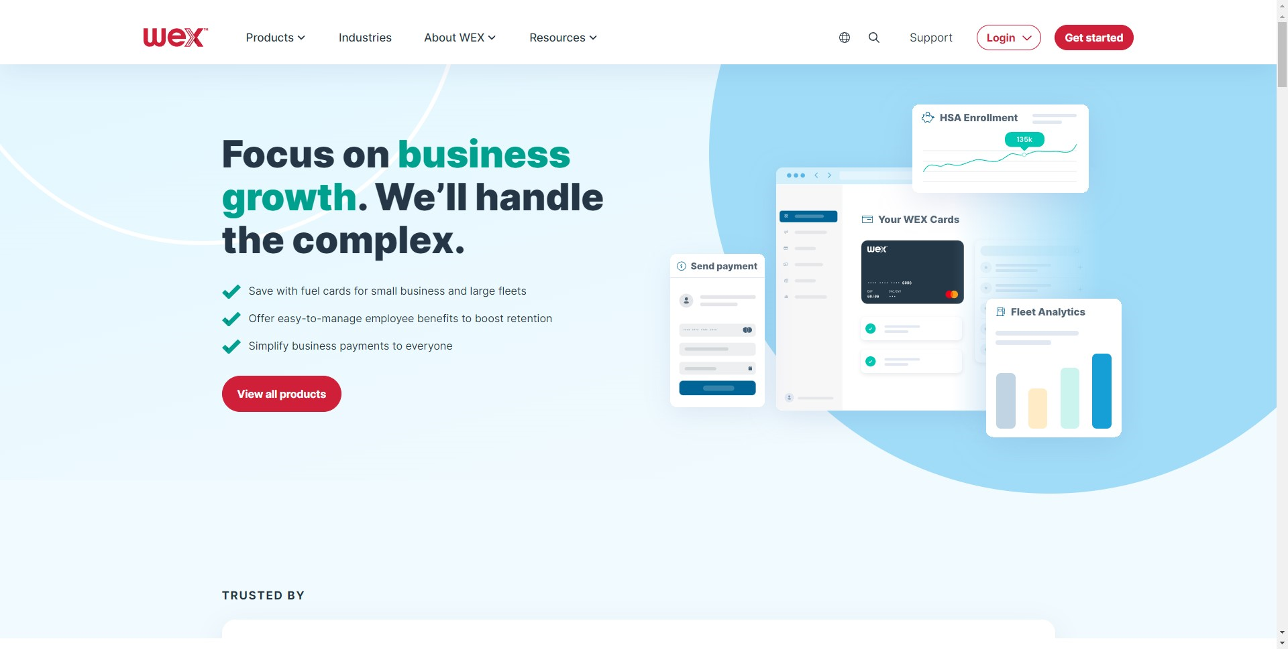
Set up your online account
Notes:
To set up your online account, you’ll first need to navigate to the login page. To do this, go to wexinc.com, then select “Login” at the top of the page, as shown here.

Slide 6
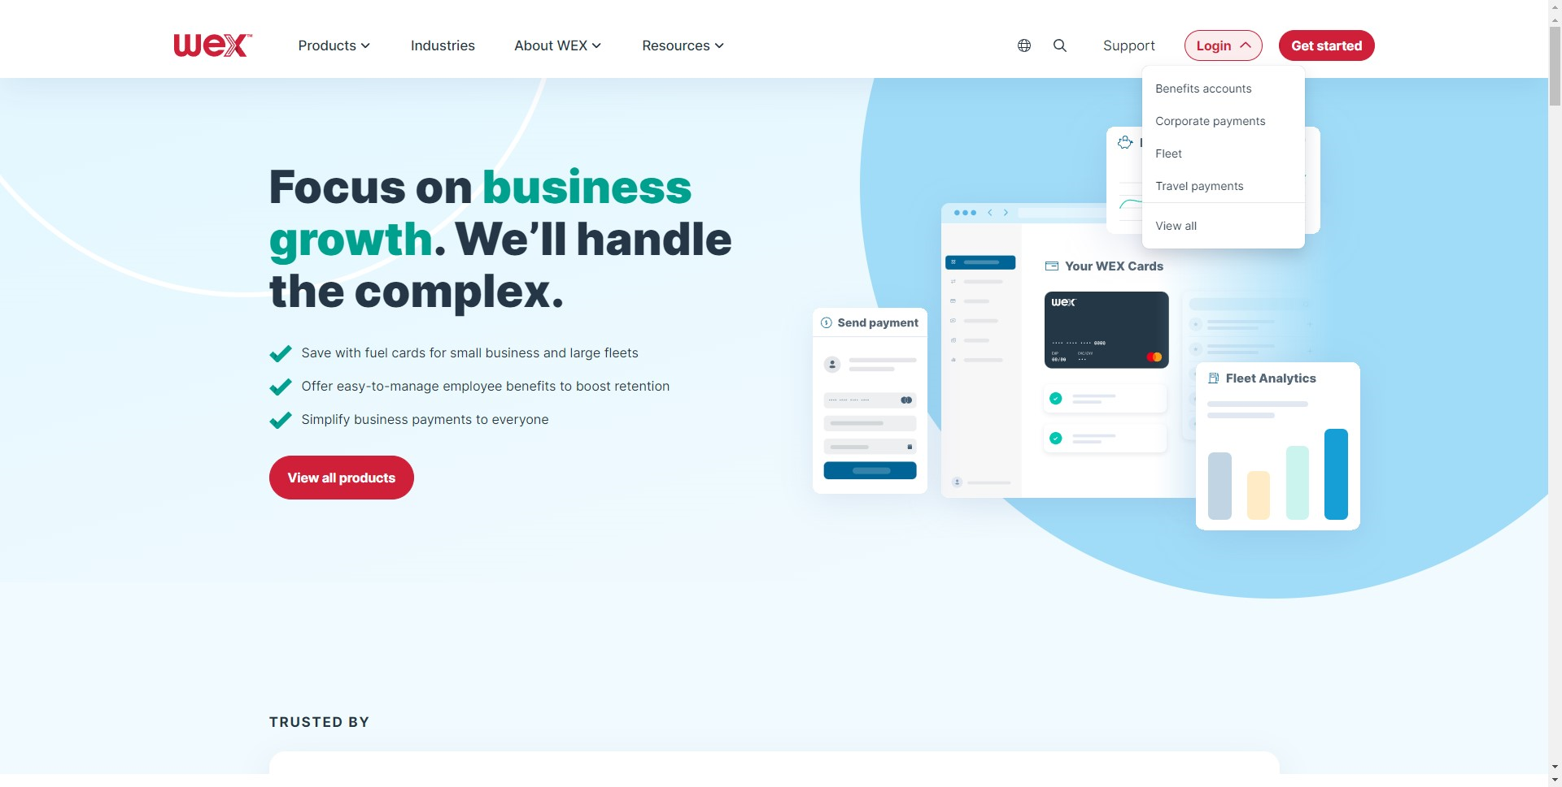
Set up your online account
Notes:
Then select, “Benefits accounts”

Slide 7
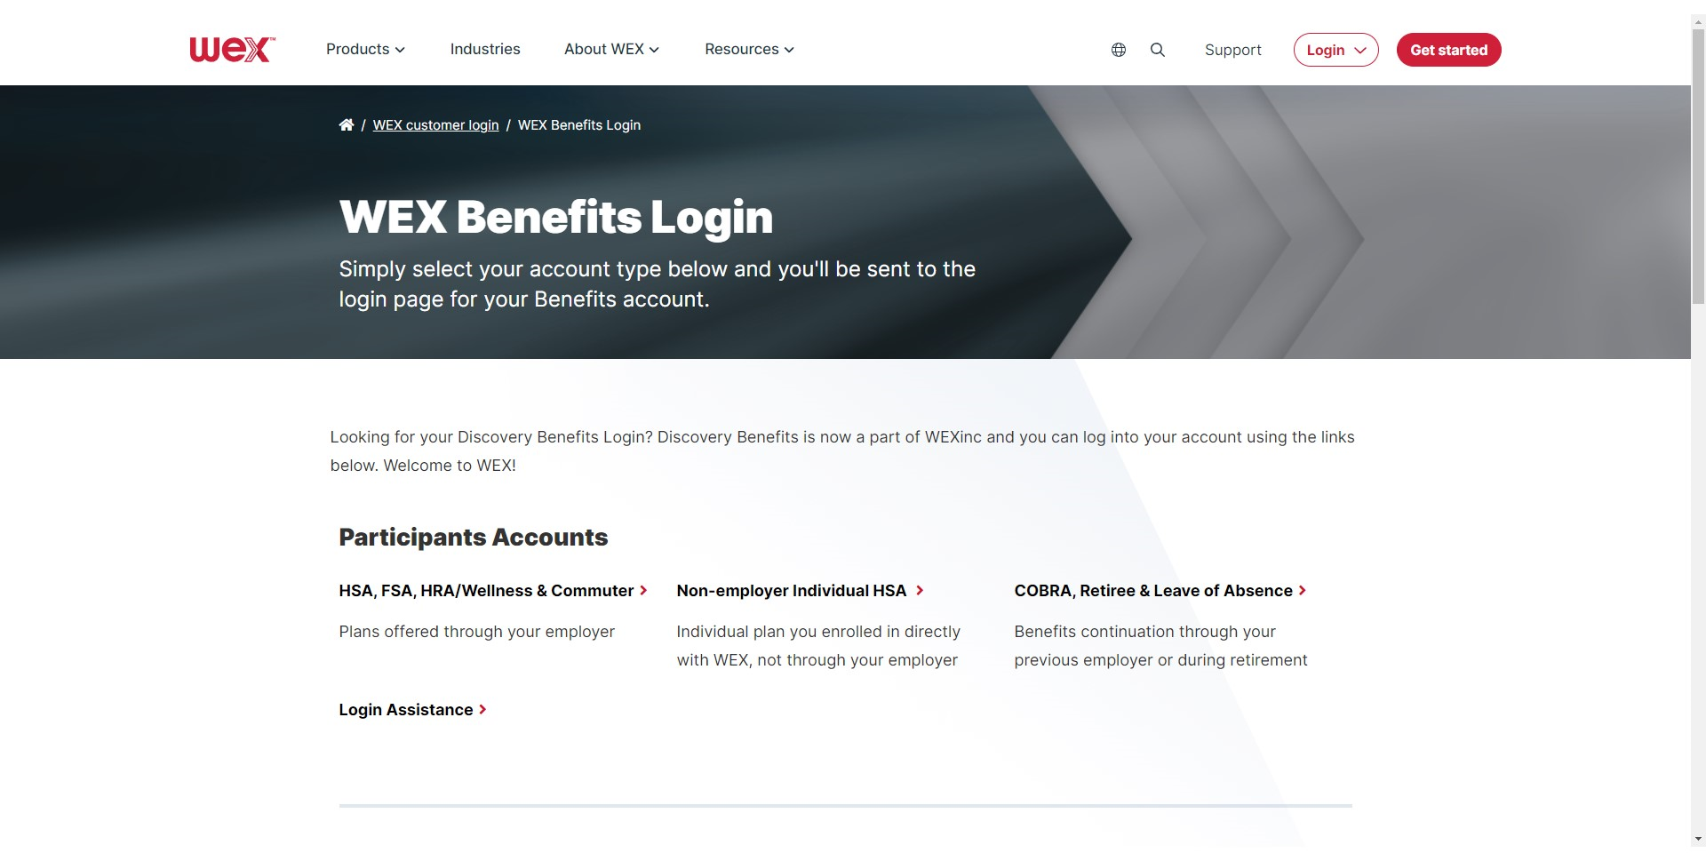
Set up your online account
Notes:
Under participant Accounts Select “HSA, FSA, HRA/Wellness & Commuter”.

Slide 8
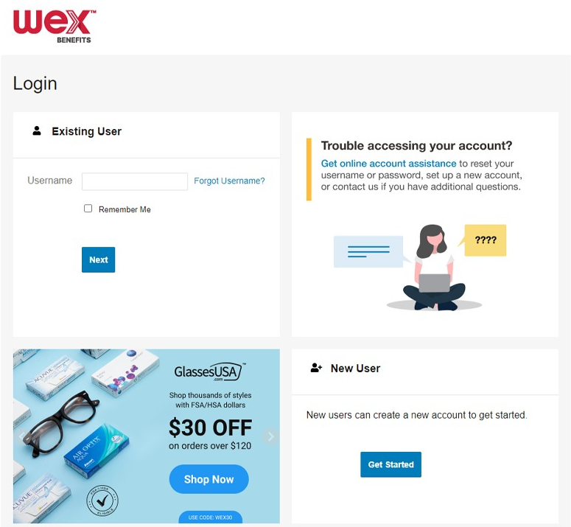
Set up your online account
Notes:
This will bring you to the login page.
Under new user, select get started to set up your online account.

Slide 9
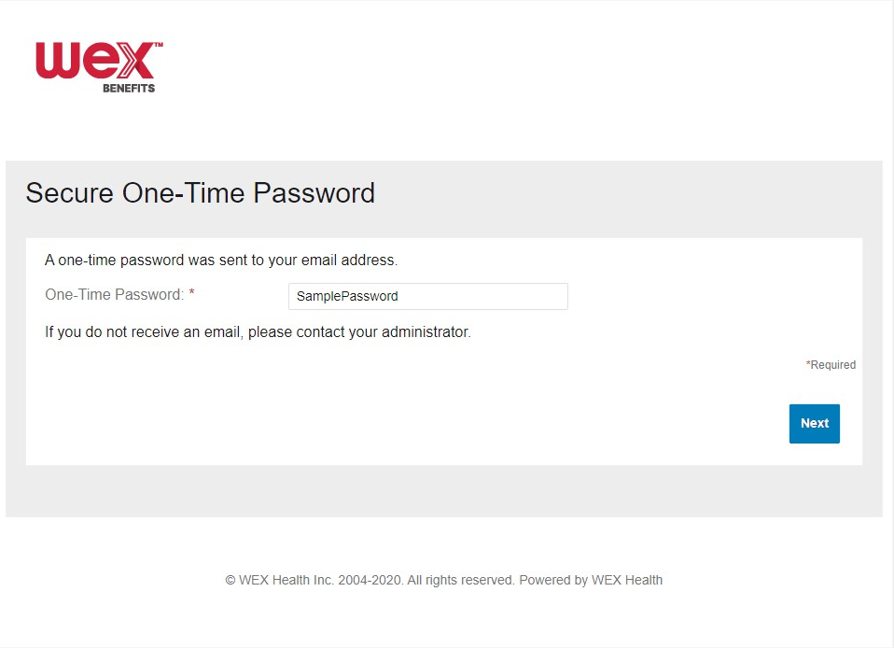
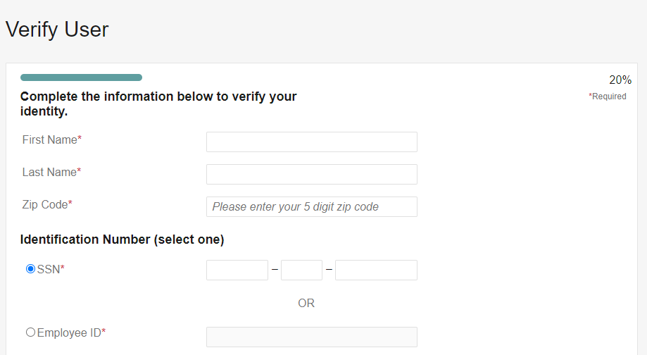
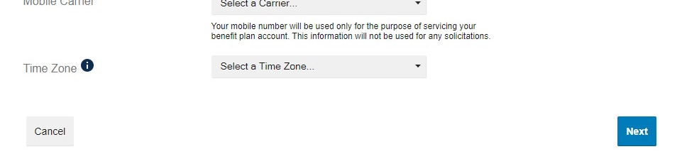
Set up your online account
Notes:
You’ll be asked to provide information to verify your identity. Complete the required fields.
Your information must match what your employer provided.
Then, select “Next”.

Slide 10
Set up your online account
Notes:
You will receive an email at the email address we have on file. Check your email and enter the one-time password sent to you.
Then, select “Next”.

Slide 11
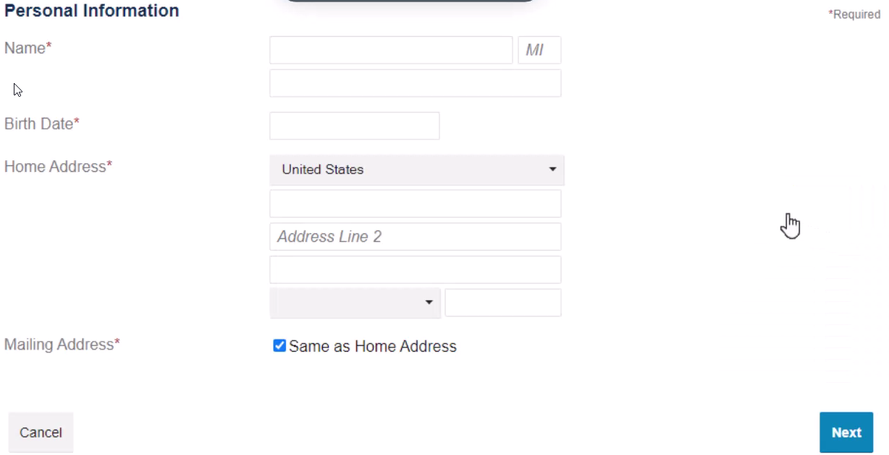
Set up your online account
Create Account
Notes:
Complete the required fields.
Then, select “Next”.

Slide 12
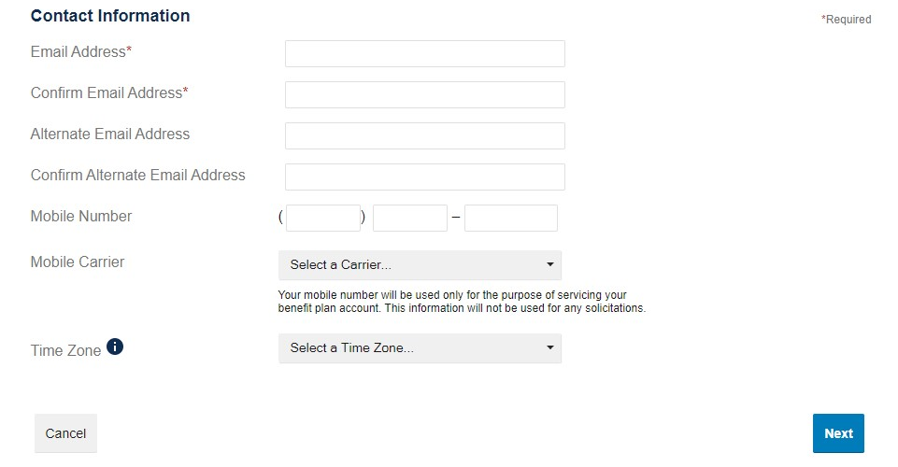
Set up your online account
Create Account
Notes:
Enter all applicable contact information. This will be used to recover your account if you forget your username or password.
Select “Next”.

Slide 13
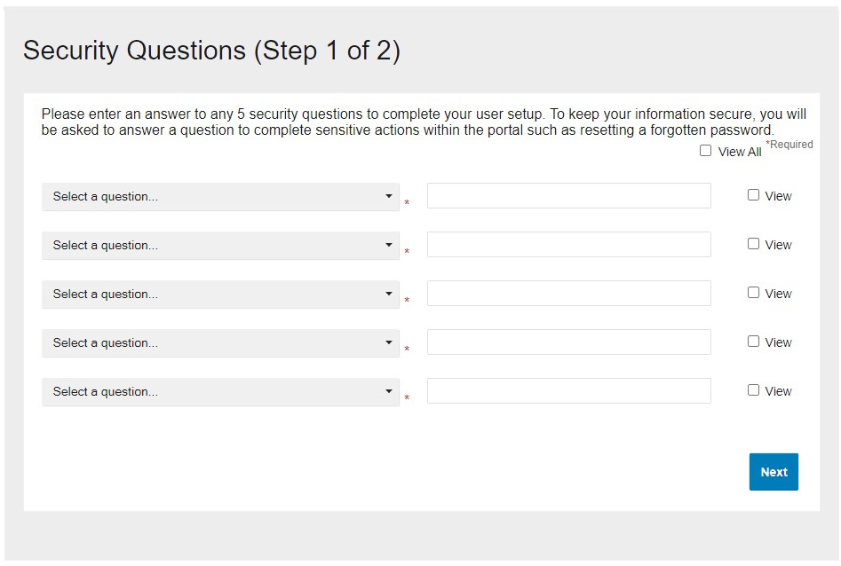
Set up your online account
Notes:
This will prompt you to complete a series of security questions. These questions will be used to assist with future security concerns, such as resetting a forgotten password.
Choose your preferred security questions, and fill in the corresponding fields. Once you have chosen 5 security questions, select “Next.”

Slide 14
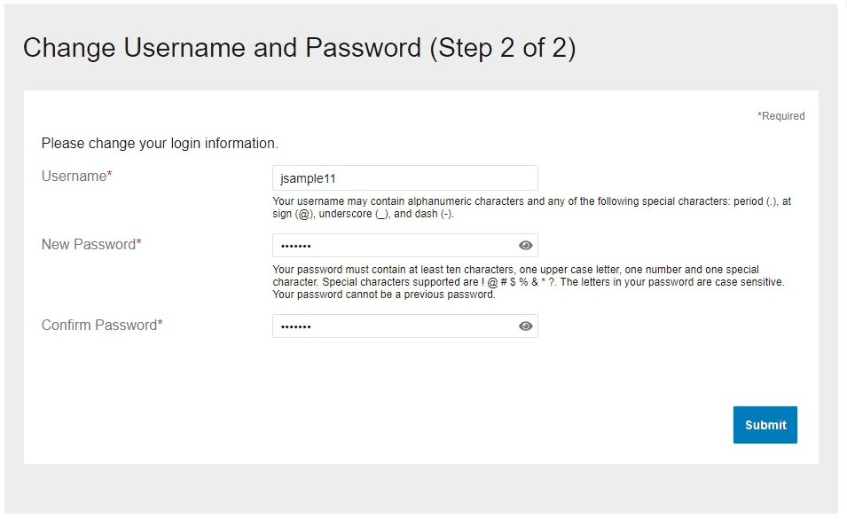
Set up your online account
This is a headline or statement about a feature or benefit
This is some body copy that supports the statement above. It should be typeset like this.
Notes:
On the next page, you’ll be asked to enter your login information. You may change the username to one of your choice. Then set up a new password.
Once you have entered your username and password, select “Submit”.

Slide 15
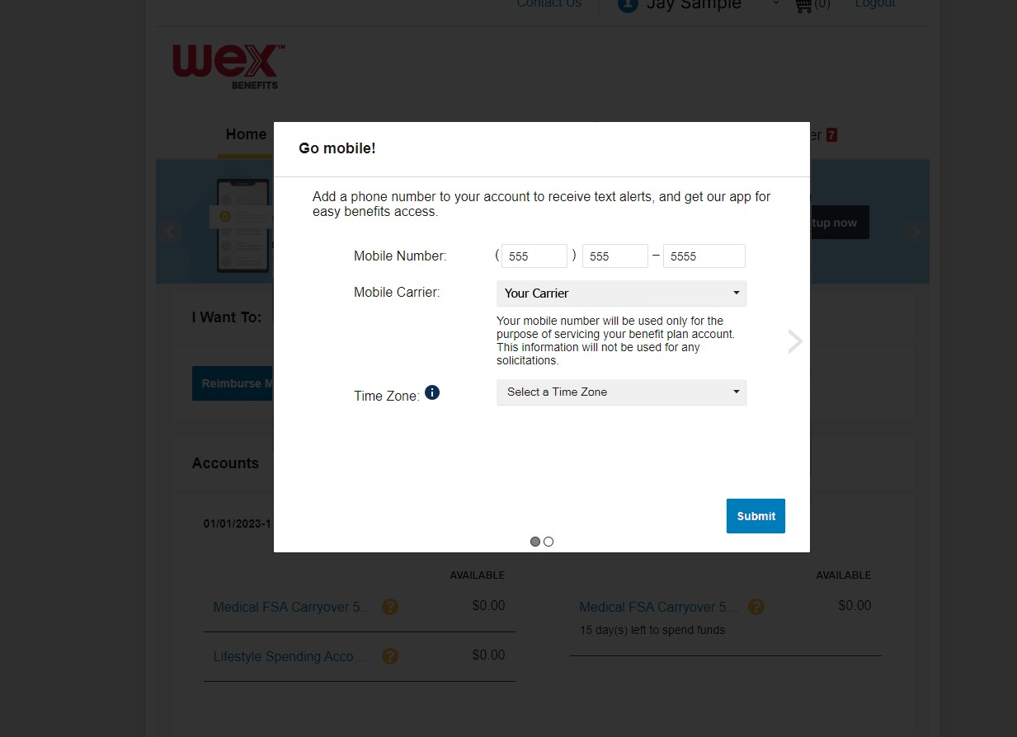
Set up your online account
This is a headline or statement about a feature or benefit
This is some body copy that supports the statement above. It should be typeset like this.
Notes:
You’ll be prompted to add a mobile number to your account. If you would like you may add a number here.
Then, select “Submit.”

Slide 16
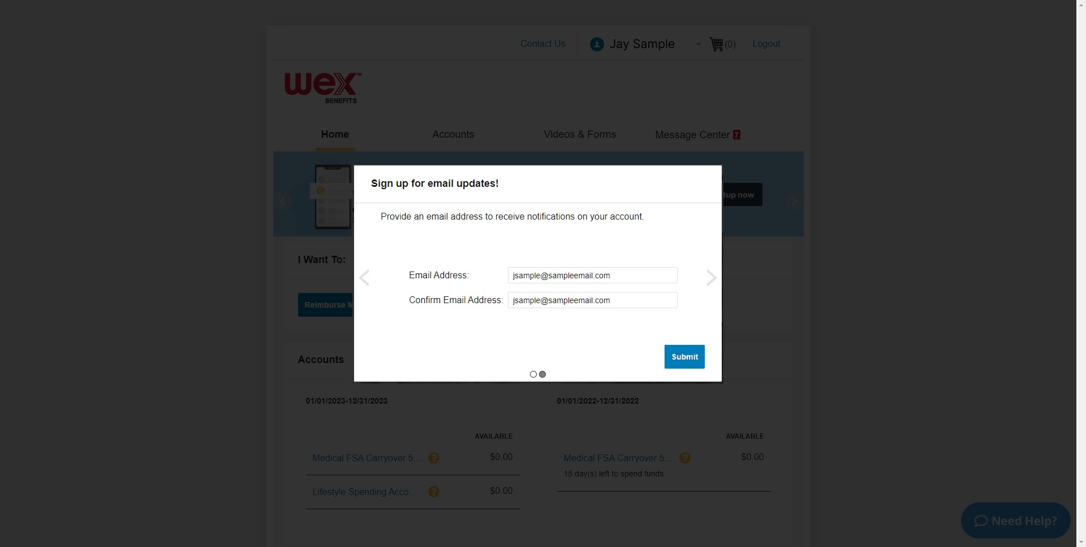
Set up your online account
This is a headline or statement about a feature or benefit
This is some body copy that supports the statement above. It should be typeset like this.
Notes:
Next, you’ll be prompted to add an email address to receive notifications on your account. If desired, enter your email address here.
Then, select “Submit” to finalize your account.

Slide 17

How to reset your password in your online account
Proprietary & Confidential
Notes:
Now what about if you forget your password and need to reset it in your online account.

Slide 18
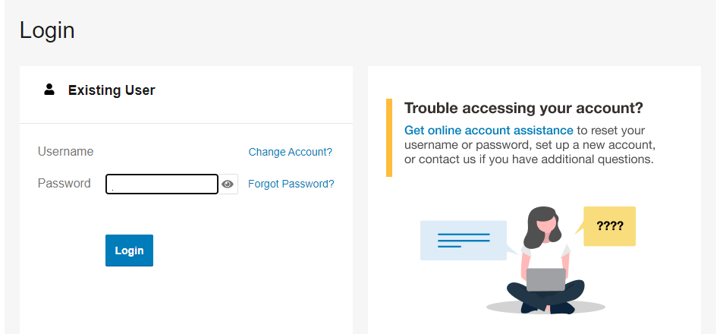
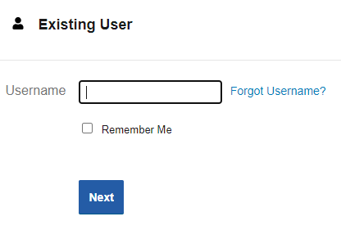
Password Reset
Notes:
To reset your password, navigate to the login page at wexinc.com and enter your username in the required field.
Then, select “Next.”

Slide 19
Password Reset
Notes:
On the next page, select “Forgot Password?”.

Slide 20
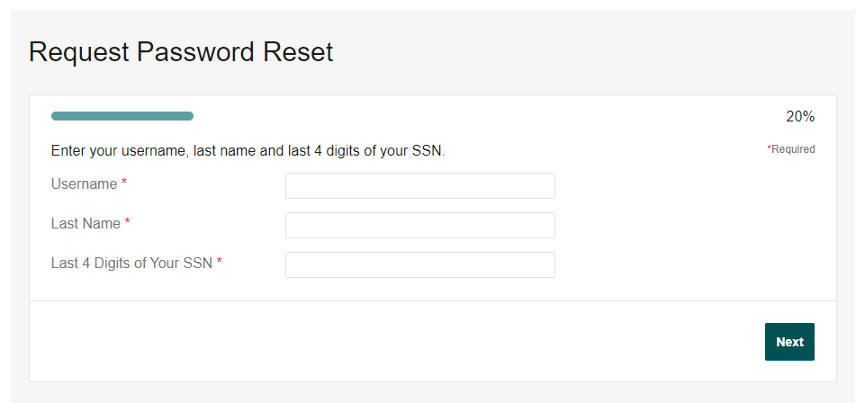
Password Reset
Notes:
Enter the appropriate information in the required fields.
Then, select “Next.”

Slide 21
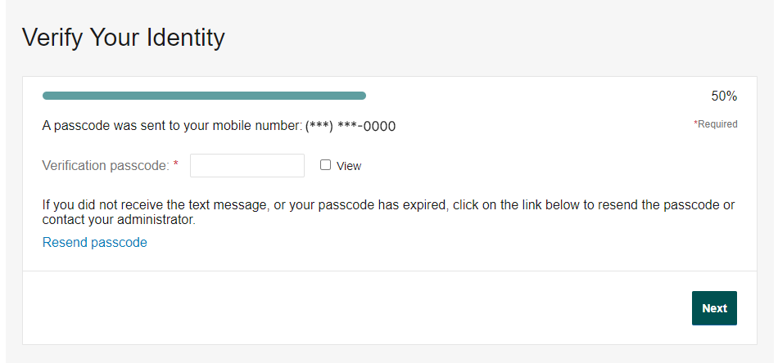
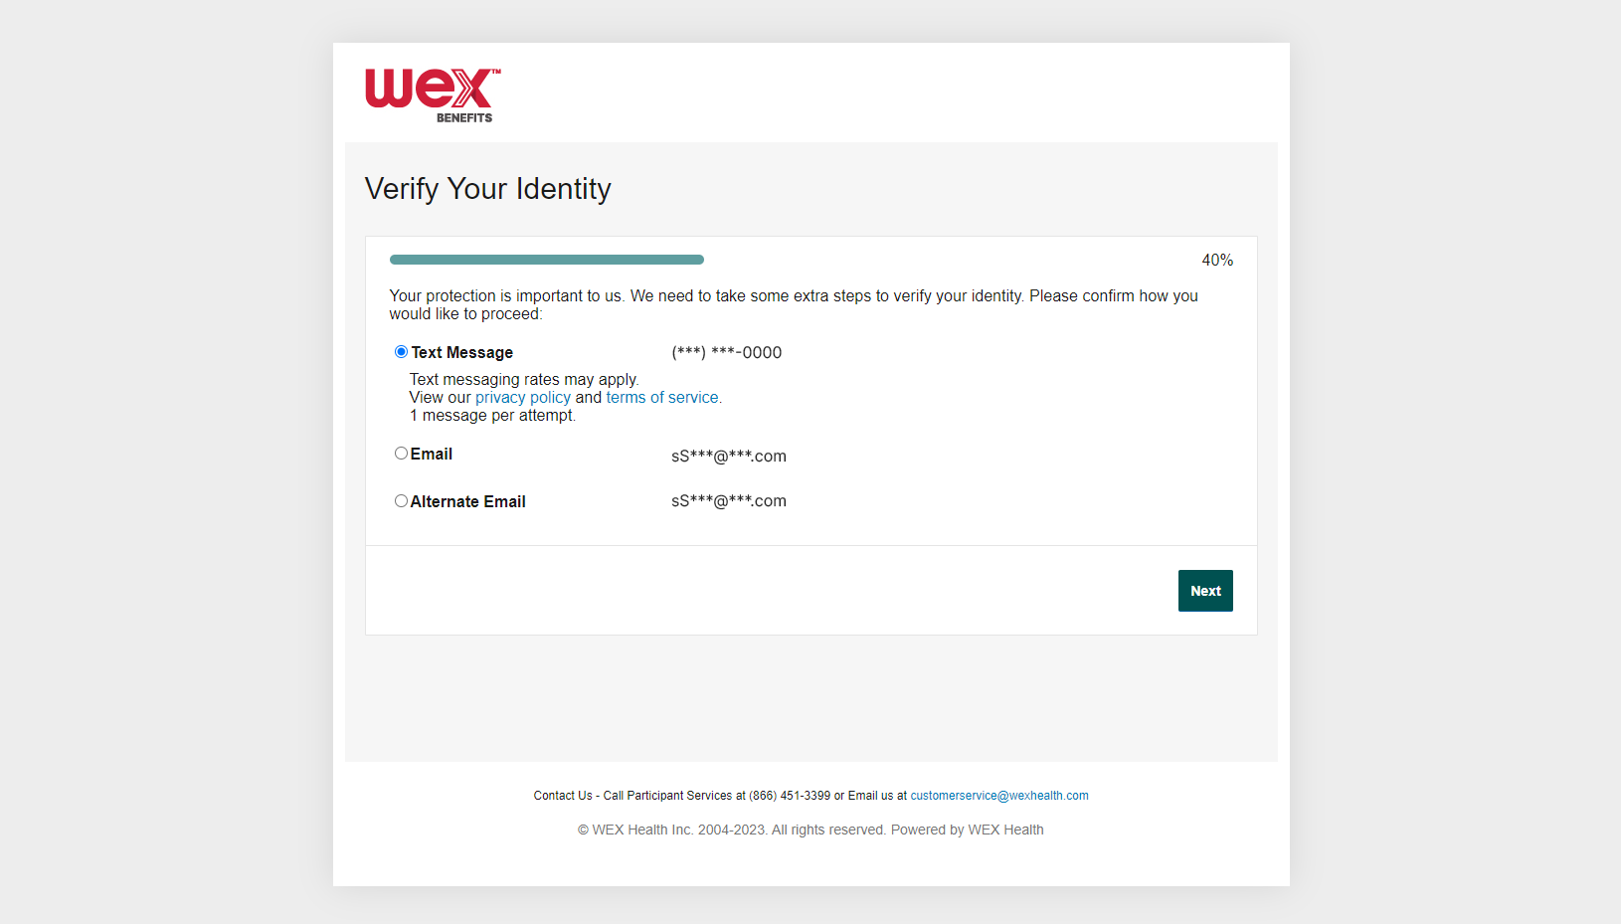
Password Reset
Notes:
Select the method you would prefer to receive your passcode, this could be text message or email.
It is important to know that in order to select either option, you must already have that information on file with WEX.

Slide 22
Password Reset
Notes:
Once you receive your verification passcode via text or email, enter the passcode and select “Next.”
This will route you to continue the password reset process.

Slide 23
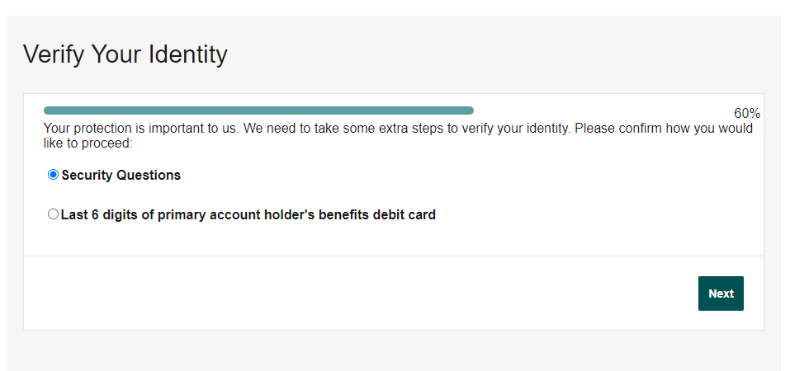
Password Reset
Notes:
You will be asked to answer a security question or provide the last six digits of your benefits debit card.

Slide 24
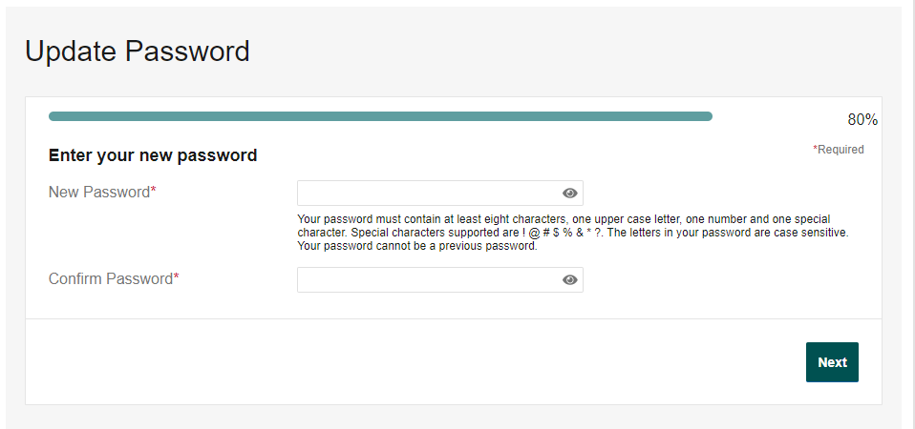
Password Reset
Notes:
On the next page, you’ll be asked to create a new password. Following the password guidelines, create a new password.
Then, select “Next.”

Slide 25
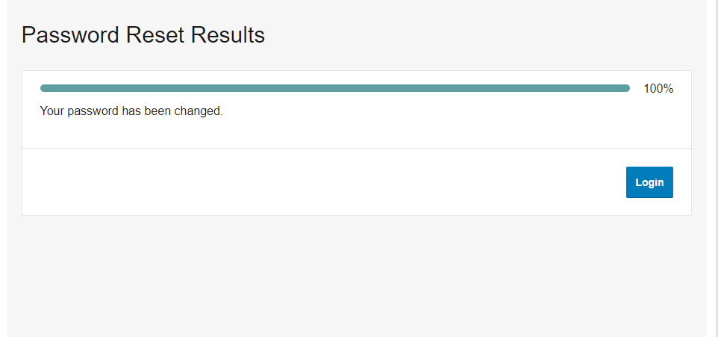
Password Reset
Notes:
You will receive a message confirming that your password has been changed.
Select “Login” to use your new password.

Slide 26
Password Reset
Notes:
You will now be able to log in using your new password.

Slide 27

Navigate your online account
Proprietary & Confidential
Notes:
Now I’d like us to discuss how to Navigate your online account.

Slide 28
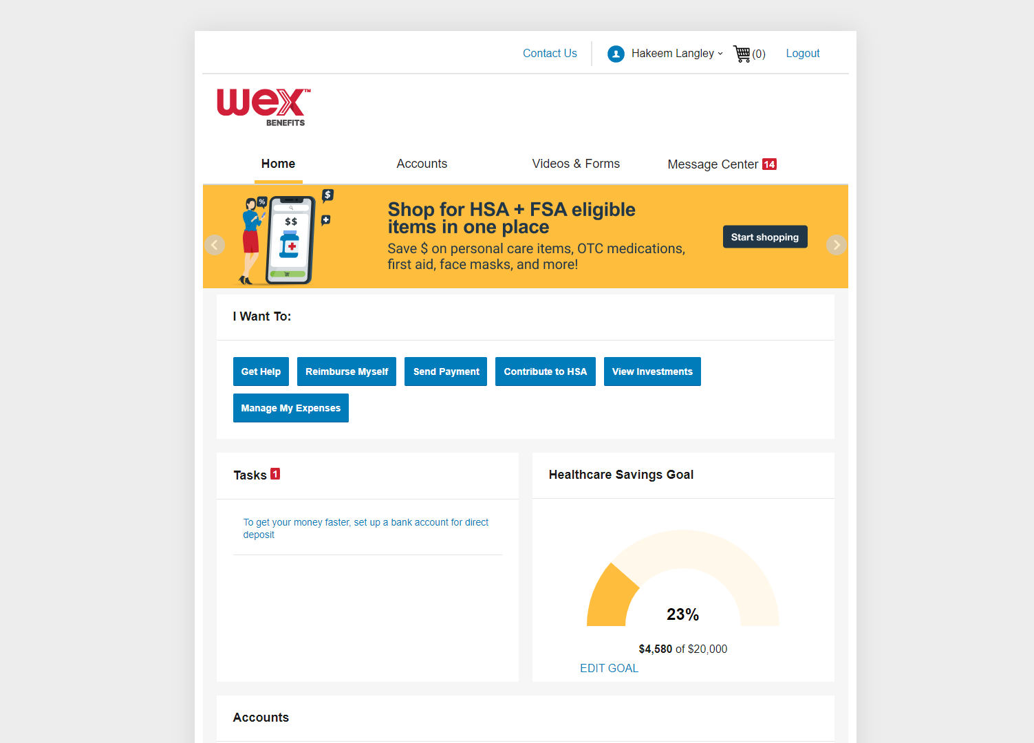
Navigate your online account
Select your name
along the bar at the top of the screen to open your profile menu
This is a headline or statement about a feature or benefit
This is some body copy that supports the statement above. It should be typeset like this.
This is a headline or statement about a feature or benefit
This is some body copy that supports the statement above. It should be typeset like this.
Notes:
To navigate your account, select your name along the bar at the top of the screen. This will open your profile menu.

Slide 29
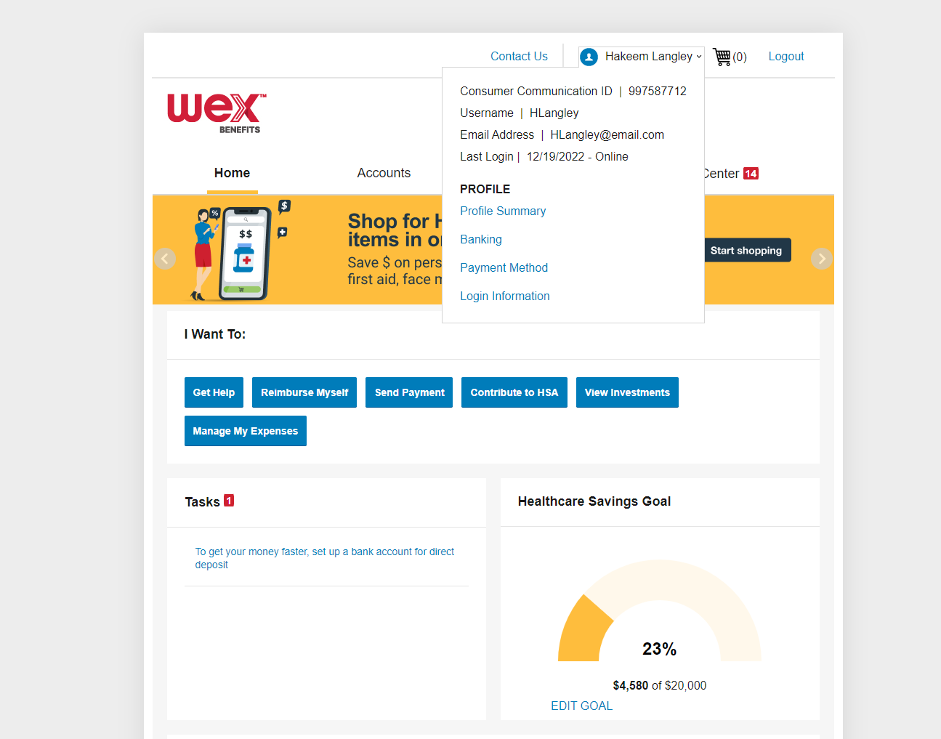
Profile Menu
Review personal information
Add dependents, authorized representatives, and direct deposit information
Order additional or replacement WEX benefits debit cards
Update login information
Notes:
Your profile menu allows you to: review personal demographic information, add dependents, authorized representatives and direct deposit information, order additional or replacement benefits debit cards, and update login information.

Slide 30
Home Page
This page shows highlights of all your recent activity. These include…
I want to shows possible actions
Tasks shows tasks that may need to be completed
Accounts shows plans and balances
Recent transactions shows recent account activity
Notes:
The “Home” tab contains lots of useful information.

Slide 31
Home Page
The “I Want To” section allows you to:
File a claim.
Manage expenses and investments.
Find answers to questions
This is a headline or statement about a feature or benefit
This is some body copy that supports the statement above. It should be typeset like this.
This is a headline or statement about a feature or benefit
This is some body copy that supports the statement above. It should be typeset like this.
Notes:
The “I Want To” menu, on the Home Tab, allows you to access quick buttons for common tasks such as filing a claim and managing HSA expenses and investments, if applicable, and get answers to your questions. You can access this menu from every tab in your online account.

Slide 32
Home Page
The “Tasks” section allows you to:
Review actions needed.
This is a headline or statement about a feature or benefit
This is some body copy that supports the statement above. It should be typeset like this.
This is a headline or statement about a feature or benefit
This is some body copy that supports the statement above. It should be typeset like this.
Notes:
You may also review any actions needed under the “Tasks” bar…

Slide 33
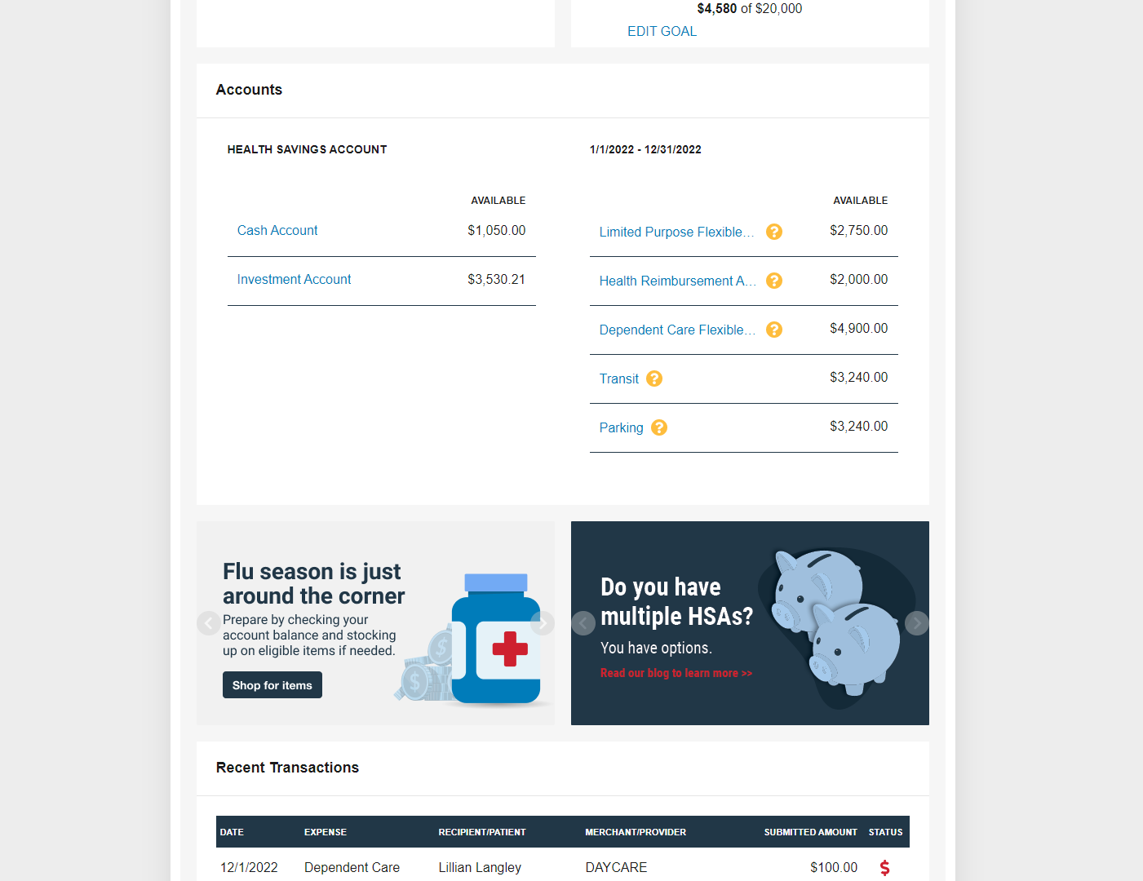
Home Page
The “Accounts” section allows you to:
View available balances.
Notes:
…view your available balance under the “Accounts” bar…

Slide 34
Home Page
The “Recent Transactions” section allows you to:
Check transaction history.
This is a headline or statement about a feature or benefit
This is some body copy that supports the statement above. It should be typeset like this.
This is a headline or statement about a feature or benefit
This is some body copy that supports the statement above. It should be typeset like this.
Notes:
… and check your transaction history under the “Recent Transactions” bar.

Slide 35
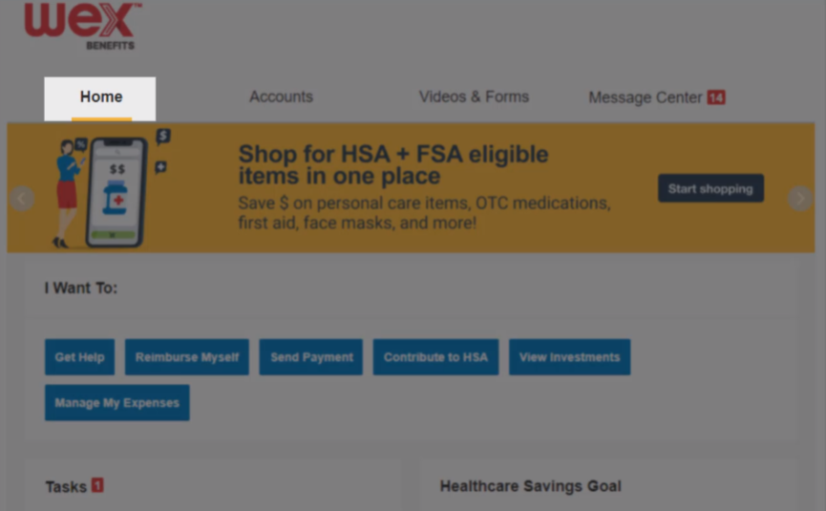
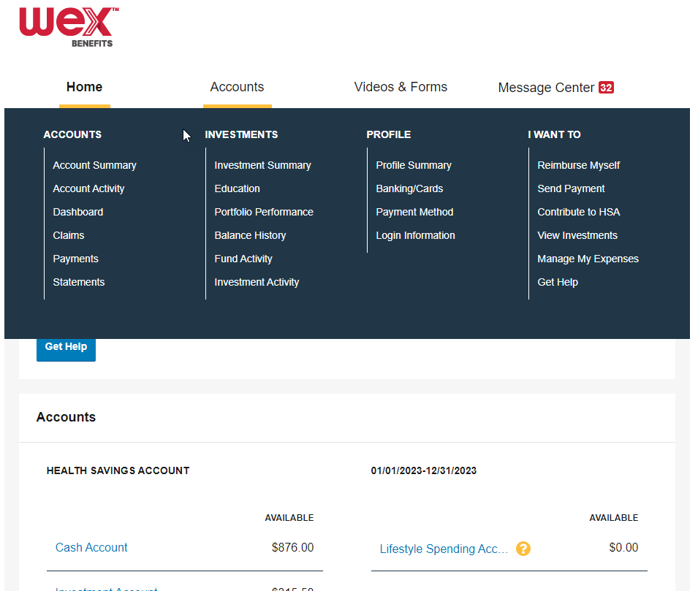
Accounts Page
This page shows highlights of all your recent activity. These include…
Account Summary
Claims details
Payments history
Dashboard
Notes:
The “Accounts” tab allows you to review your account summary and claim details as well as look at payment history information and election or plan description details.
In the “Dashboard” section, you can access real-time data about your recent healthcare expenses. If you’re enrolled in a health savings account, or HSA, you can also make investment selections here.

Slide 36
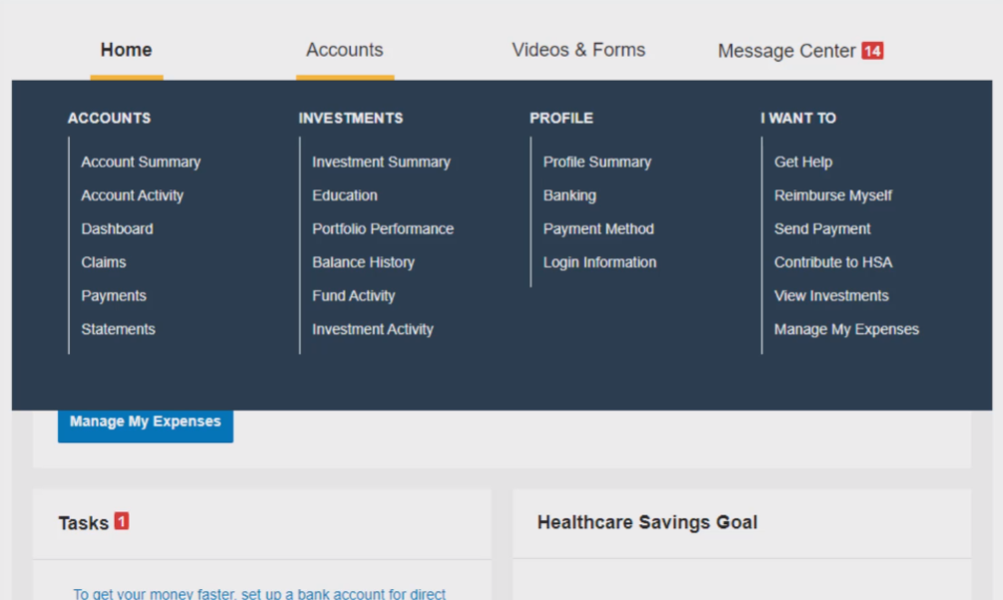
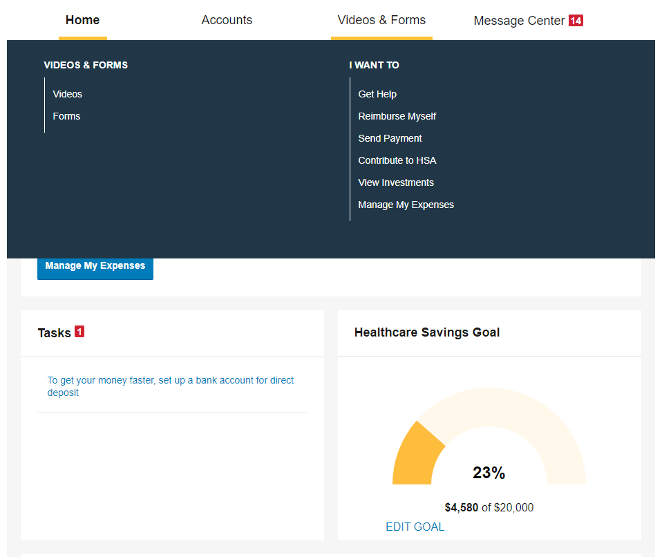
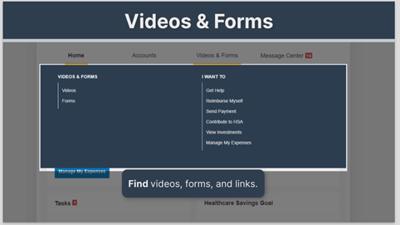
Videos & Forms Page
View videos, forms and links applicable to your account(s)
Notes:
The “Videos and Forms” tab will allow you to view videos, forms, and links applicable to your account.

Slide 37
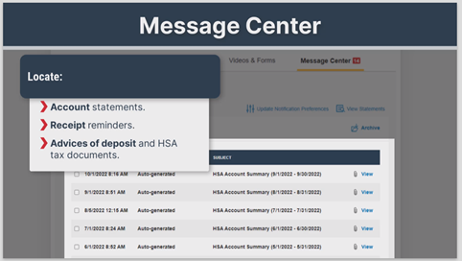
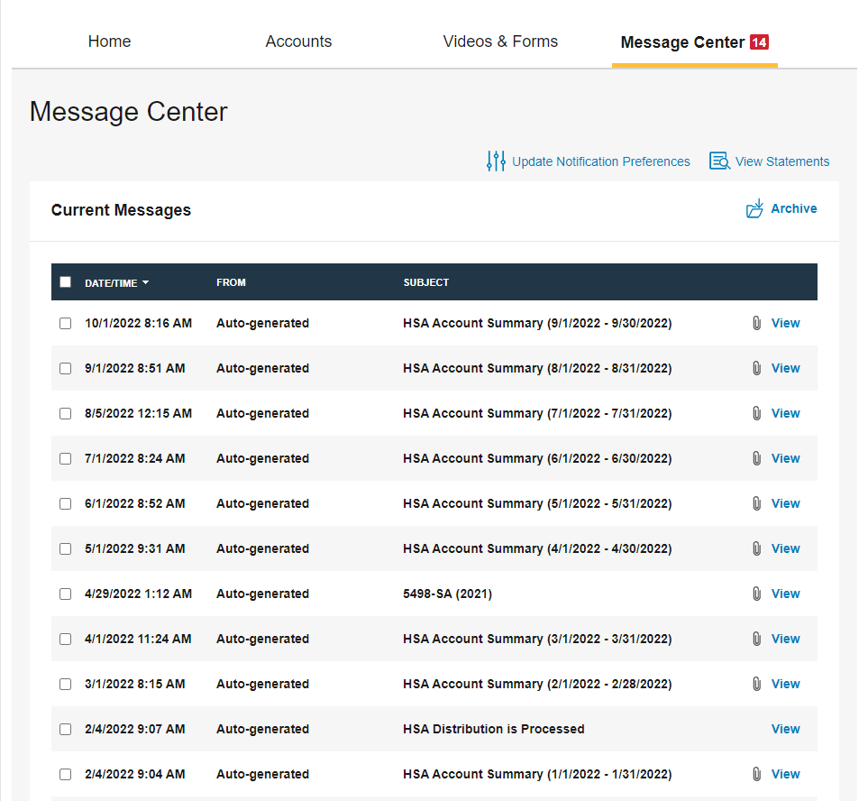
Message Center Page
Locate account statements, receipt reminders, advices of deposit and HSA tax documents, if applicable.
Notes:
The “Message Center” tab allows you to locate account statements, receipt reminders, and advice of deposit and HSA tax documents, if applicable.

Slide 38
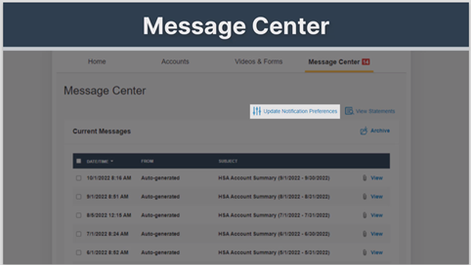
Message Center Page
Locate account statements, receipt reminders, advices of deposit and HSA tax documents, if applicable.
Update notification preferences to opt in or out of certain text and email alerts.
Notes:
You can also update your notification preferences to opt in or out of certain text and email alerts.

Slide 39
How to set up direct deposit
Notes:
Let’s now talk about how to set up direct deposit.

Slide 40
Direct Deposit
Notes:
To set up direct deposit, navigate to the “Accounts” tab in your online account.

Slide 41
Direct Deposit
Notes:
Select “Accounts” to open the menu. Under “Profile,” select “Banking/Cards.”

Slide 42
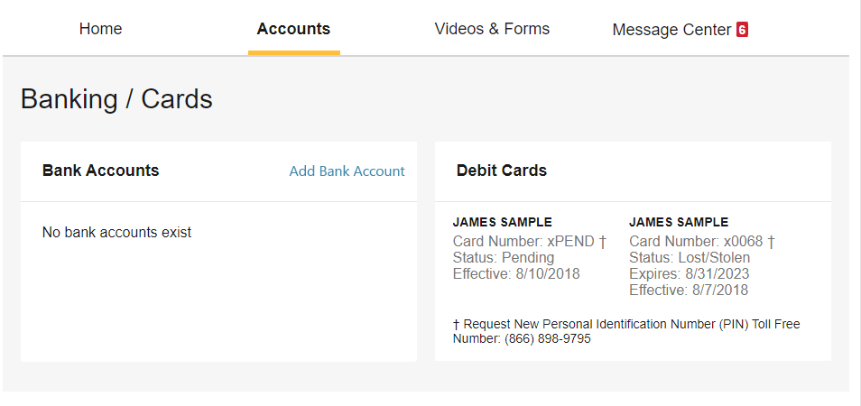
Direct Deposit
Notes:
This will route you to a page to view your banking and card information. Within the “Bank Accounts” bar, select “Add Bank Account.”

Slide 43
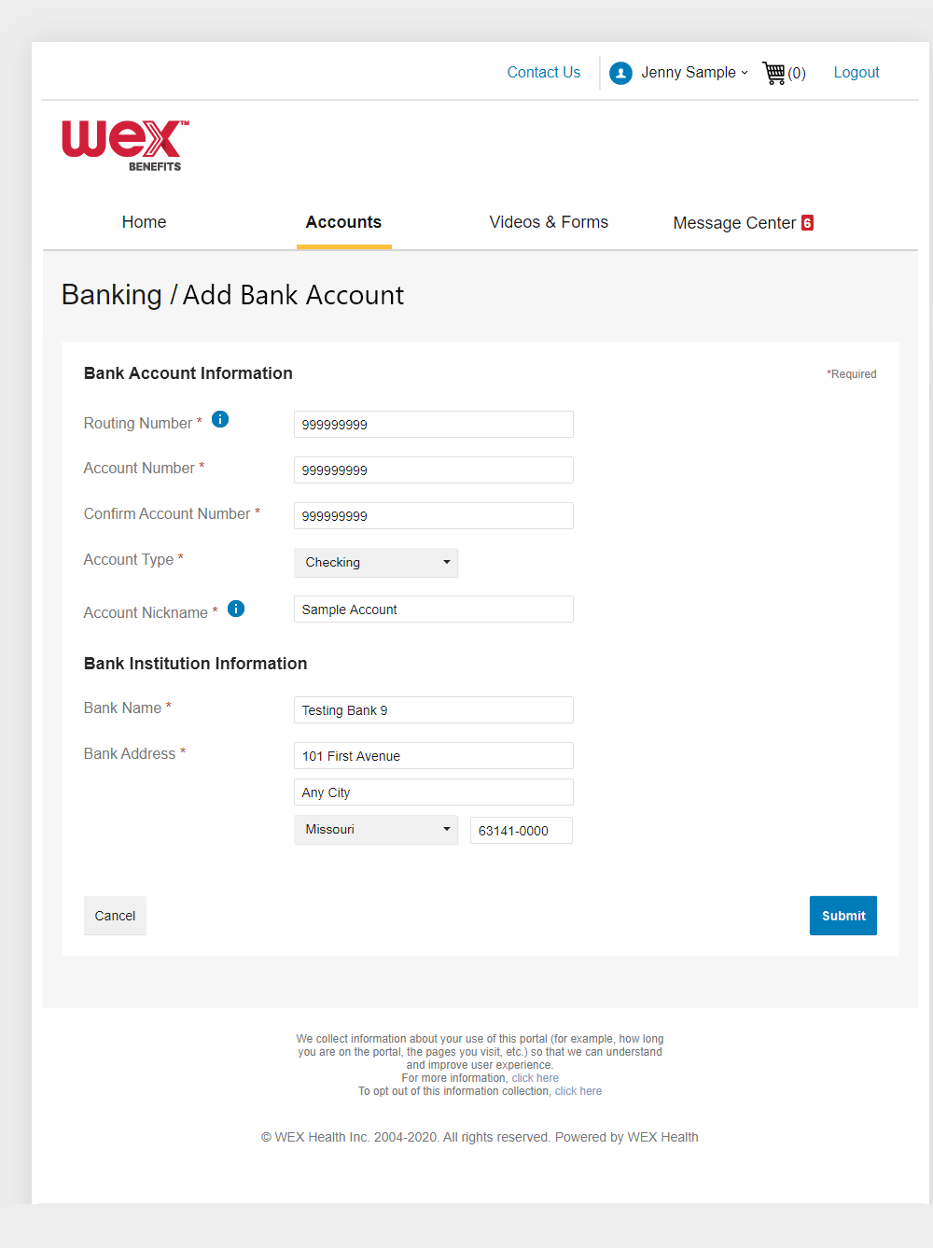
Direct Deposit
Notes:
You’ll be asked for your bank account information. Provide your information in the required fields.
Then, select “Submit.”

Slide 44
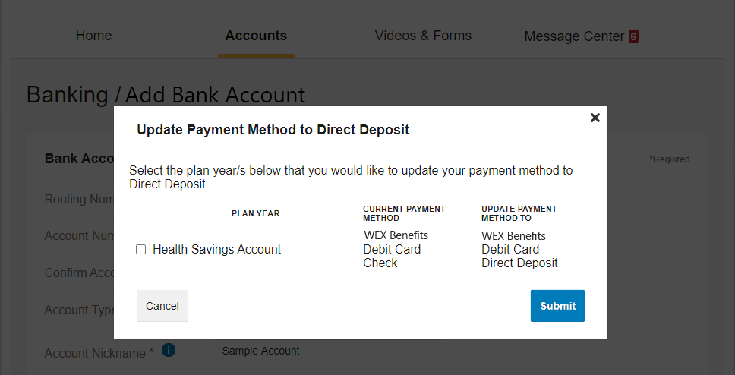
Direct Deposit
Notes:
In the following window, select the plan in which you’d like to update your payment method to direct deposit.
Then, select “Submit.”

Slide 45
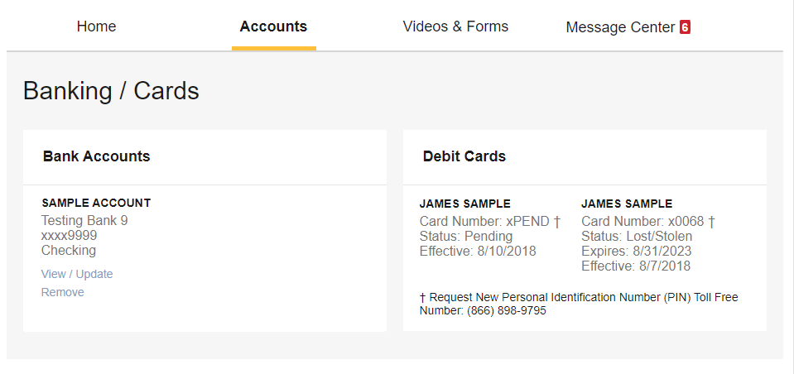
Direct Deposit
Notes:
Your bank account information will now reflect the bank account you added for direct deposit.

Slide 46

How to set up your benefits mobile app
Proprietary & Confidential
Notes:
Now for quick easy access to your online account, we have the WEX benefits mobile app, allowing you to view account information and complete tasks right from your phone.

Slide 47
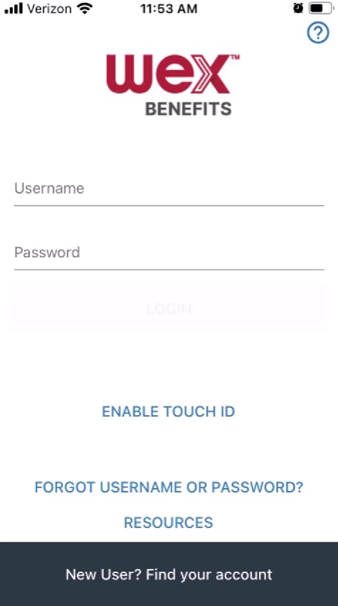
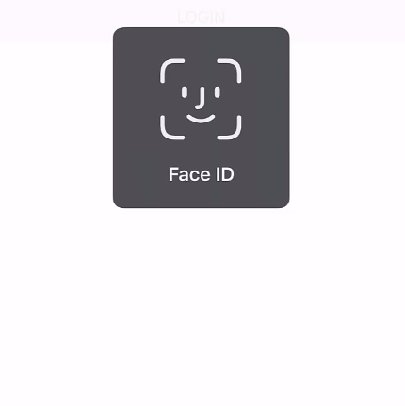
How to set up your WEX benefits mobile app
1
Download the app from your phone’s online store
Notes:
To set up the benefits mobile app, first download the Benefits by WEX app from your phone’s online store.
What happens next depends on if you’ve already set up your online account. If you have, when you open your app for the first time, you’ll need to provide your username and password previously set up for your online account. For subsequent logins, you can use your username and password, or fingerprint or face ID if available on your device.

Slide 48
How to set up your WEX benefits mobile app
2
Select “New User? Find your account”
Must have an email address on file
Notes:
If you have not already set up your online account, you’ll need to complete the following steps.
Open the app and select “New User? Find your account.” Please keep in mind that you must have an email address on file.

Slide 49
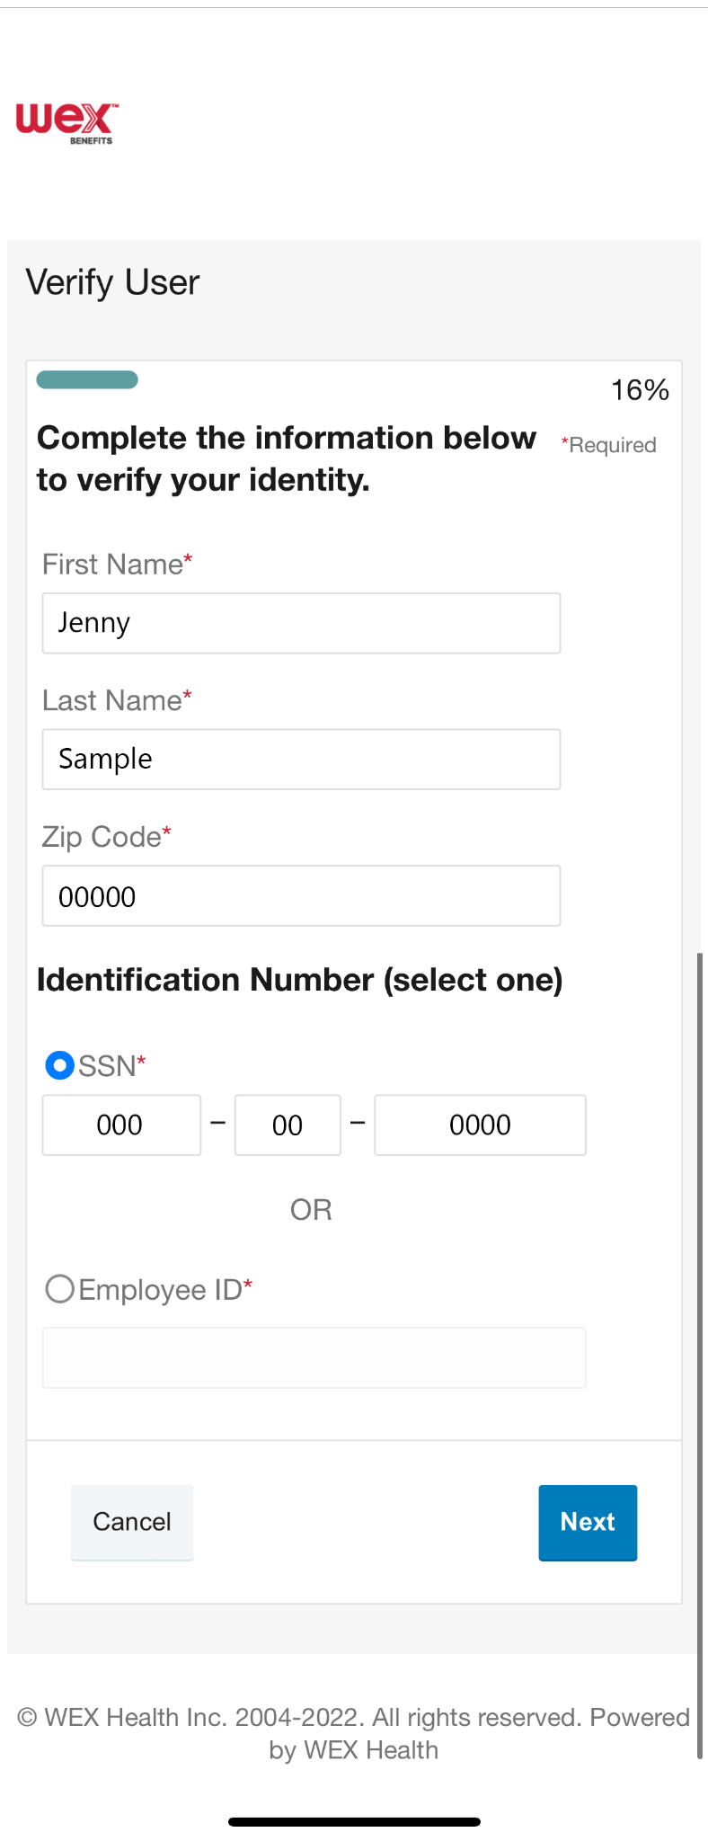
How to set up your WEX benefits mobile app
3
Complete required fields
Select “Next”
Notes:
You will be asked to provide information. Complete the required fields.
Then select, “Next.”

Slide 50
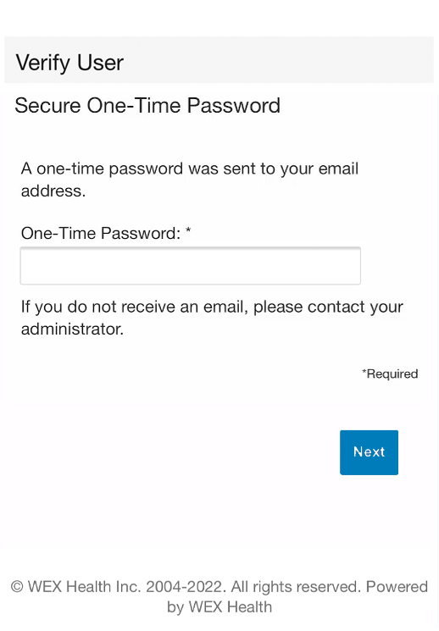
How to set up your WEX benefits mobile app
4
Enter the temporary password in the required field
Select “Next”
Notes:
A temporary password will be sent to your email. Enter the temporary password in the required field.
Then select, “Next.”

Slide 51
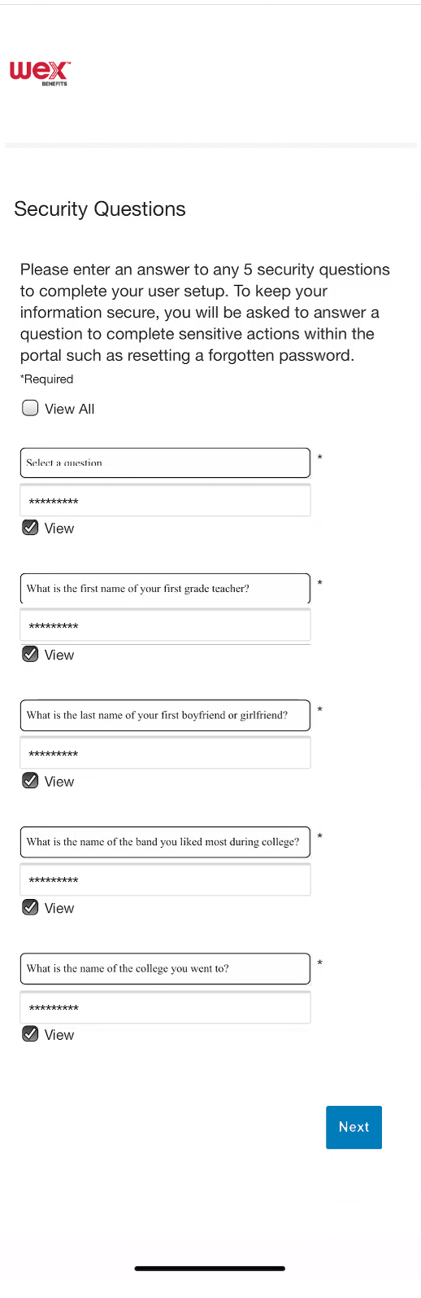
How to set up your WEX benefits mobile app
5
Set up security questions in the required fields
Select “Next”
Notes:
You will be asked to set up five security questions. Set up your security questions in the required fields.
Then select, “Next.”

Slide 52
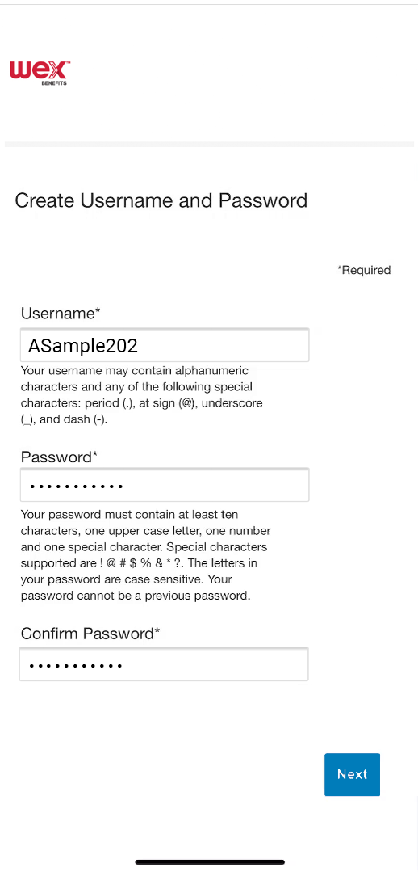
How to set up your WEX benefits mobile app
6
Enter desired username and password in the required fields
Select “Next”
Notes:
Lastly, you will need to set up your username and password. Enter your desired username and password in the required fields.
Then select, “Next.”

Slide 53
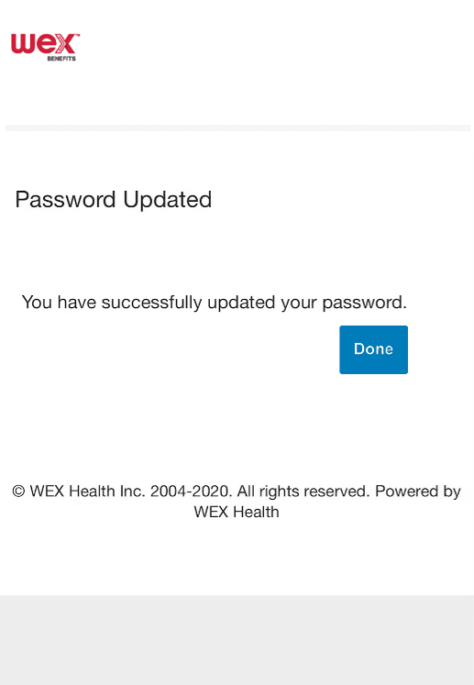
How to set up your WEX benefits mobile app
7
You’ll receive a confirmation message
Select “Done”
Notes:
You will receive a message confirming that your password has been successfully updated.
Select “Done” to begin using the benefits mobile app.

Slide 54

How to reset your username and password in the mobile app
Proprietary & Confidential
Notes:
Next, let’s look at how you can reset both your username and password in the WEX Benefits mobile app

Slide 55
How to reset your username in the WEX Benefits mobile app
1
Select “Forgot Username or Password?”
Notes:
To retrieve your username in the benefits mobile app, select “Forgot username or password?”

Slide 56
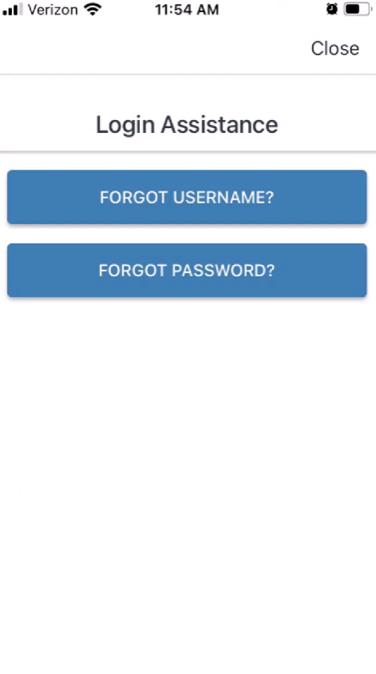
How to reset your username in the WEX Benefits mobile app
2
Select “Forgot Username?”
Notes:
On the next page, select “Forgot Username?”

Slide 57
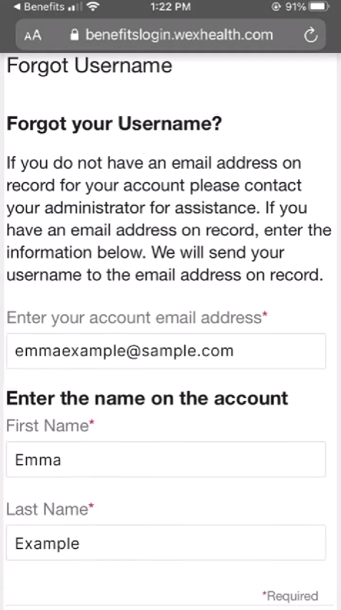

How to reset your username in the WEX Benefits mobile app
3
Provide email address and full name
Select “Next”
Notes:
Provide your email address and full name in the required fields.
Then select, “Next.”

Slide 58
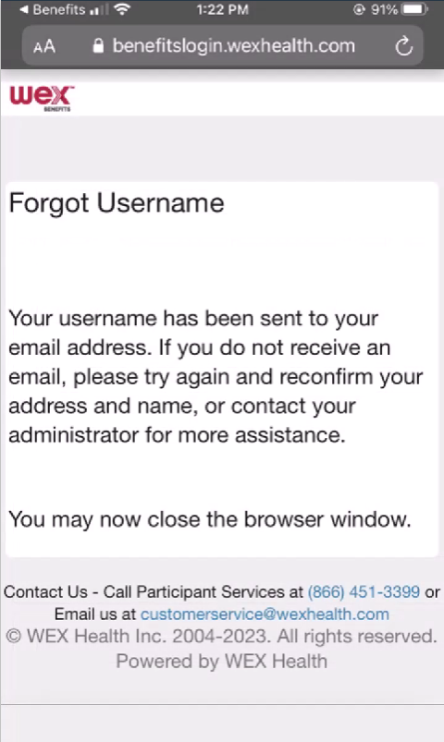
How to reset your username in the WEX Benefits mobile app
4
Retrieve your username from the email and reopen the app
Notes:
You’ll be sent an email with your username. Retrieve your username from the email and reopen the app.

Slide 59
How to reset your username in the WEX Benefits mobile app
5
Use the username retrieved from your email to log in
Notes:
Using the username you retrieved from your email, you’ll now be able to log in.

Slide 60
How to reset your username in the WEX Benefits mobile app
6
Select “Forgot Username or Password?”
Notes:
To reset your password in the benefits mobile app, select “Forgot username or password?”

Slide 61
How to reset your username in the WEX Benefits mobile app
7
Select “Forgot Password?”
Notes:
On the next page, select “Forgot password?”

Slide 62
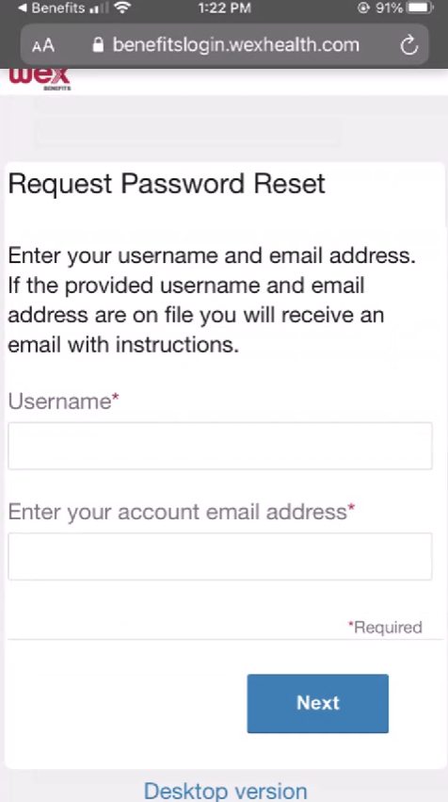
How to reset your username in the WEX Benefits mobile app
8
Provide username and email address
Select “Next”
Notes:
Provide your username and email in the required fields.
Then select, “Next.”

Slide 63
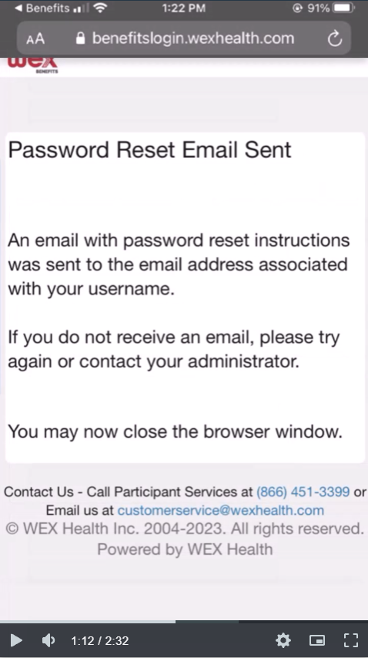
How to reset your username in the WEX Benefits mobile app
9
Check your email and select the password reset link
Notes:
A password reset link will be sent to your email. Check your email and select the password reset link.

Slide 64
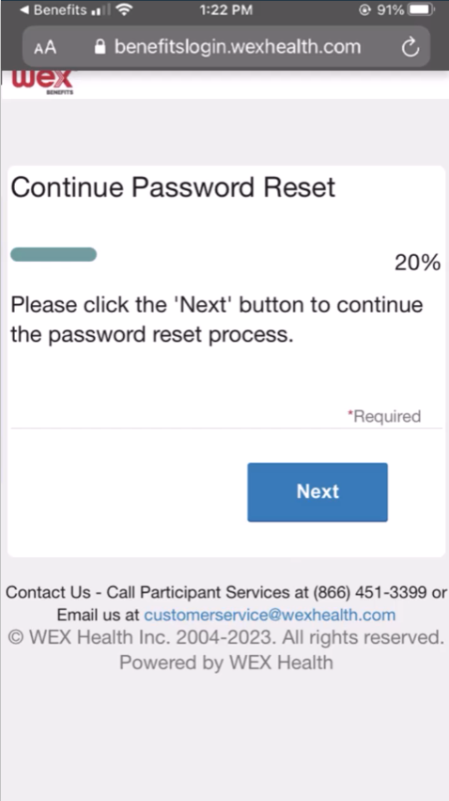
How to reset your username in the WEX Benefits mobile app
10
Follow the link to continue the reset
Select “Next”
Notes:
This link will route you to a page to continue your password reset.
Select, “Next.”

Slide 65
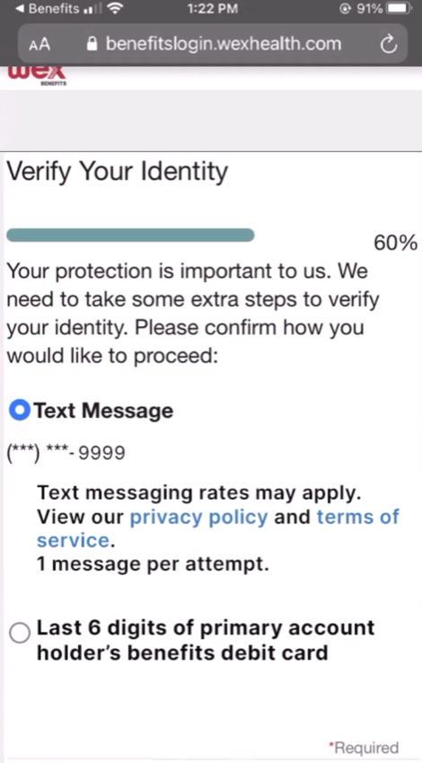
How to reset your username in the WEX Benefits mobile app
11
Verify your identity by text message or last
Select “Next”
Notes:
You’ll be asked to select a method to verify your identity. If there’s a cell phone number on file, you may choose to have a text message sent to verify your identity.
If there isn’t a cell phone number on file, or if you would prefer not to receive a text message, you may provide the last 6 digits of your benefits debit card instead.
After you’ve chosen your verification method, select “Next” to complete the verification process.

Slide 66

How to reset your username in the WEX Benefits mobile app
12
Enter the appropriate information
Select “Next”
Notes:
To complete the verification process, enter the appropriate information.
Then select, “Next.”

Slide 67

How to reset your username in the WEX Benefits mobile app
13
Enter and confirm your new password
Select “Next”
Notes:
Once you verify your identity, enter and confirm your new password in the required fields.
Then select, “Next.”

Slide 68

How to reset your username in the WEX Benefits mobile app
14
You’ll receive confirmation the password is updated
Notes:
You’ll receive a confirmation message once you’ve successfully updated your password.

Slide 69
How to reset your username in the WEX Benefits mobile app
15
Log in using your new password
Notes:
You’ll now be able to log in using your new password.

Slide 70
How to Access WEX Knowledgebase
from your mobile or online account
Notes:
If you have questions while navigating the WEX benefits platforms, the fastest and easiest way to get answers is to use WEX Knowledgebase.
WEX Knowledgebase is a place where you can search through a selection of articles and get the information you need, fast.

Slide 71

How to access the Knowledgebase in WEX benefits mobile app
1
Select “Eligible Expenses”
1
Notes:
To reach the knowledgebase while in the benefits mobile app, first navigate to the eligible expenses section.

Slide 72

How to access the Knowledgebase in WEX benefits mobile app
2
Select “Knowledgebase”
1
Notes:
Then, under helpful links, select “Knowledgebase.”

Slide 73

How to access the Knowledgebase in WEX benefits mobile app
3
Select “OK”
1
1
Notes:
A reminder prompt will appear to let you know you will be navigating away from the app. Be sure you’ve completed any business you have, as you may need to login again when you return.
Selecting OK will launch the knowledgebase in a web browser.

Slide 74

How to access the Knowledgebase in WEX benefits mobile app
4
Select “Menu” icon to browse
1
Notes:
Select the menu icon at the top to visit the homepage or browse articles by topic.

Slide 75
How to access Knowledgebase in your online account
Notes:
Next, how to access the knowledgebase in your online account.

Slide 76
How to access the Knowledgebase in your online account
Notes:
To reach the knowledgebase while in your online account, simply select the “Get Help” button.

Slide 77

How to access the Knowledgebase in your online account
Notes:
Accessing the knowledgebase while logged in to your online account unlocks some extra functionality.
You instantly get access to more articles ……

Slide 78


How to access the Knowledgebase in your online account
Notes:
….and can start a chat with a representative by selecting the “Start Chat” button.

Slide 79

How to access the Knowledgebase in your online account
Notes:
Select the menu icon on the homepage to view the knowledgebase options or to log out.

Slide 80

Contact Participant Services
Our Participant Services team is available Monday through Friday, from 6 a.m. to 9 p.m. CT, except holidays.
Website
––––
www.wexinc.com
Phone
––––
Current WEX participants:
866-451-3399
New to WEX:
844-561-1337
Notes:
For any questions or assistance you may need, our participant services team is available to you Monday through Friday from 6 am to 9 pm Central time.
You have a variety of options to contact us. You can get support on our website at www.wexinc.com or call to speak to a participant services representative.
If participates ask for instructions…
Support on Website: To access the form, follow the below steps:
Navigate to www.wexinc.com > Support > Contact customer service team > Contact WEX benefits.
Select the following:
a. Type of Inquiry: Customer Service
b. I am a: Employee/Participant
Select “WEX Benefits Support Center”.
Complete the form.
A successful submission message will appear indicating that we'll be in touch.
The employee/participant will receive an email response with additional details or resolution to their inquiry.
Form URL: https://wexhealthinc.my.site.com/WEXbenefitscontactus/s/

Slide 81
Notes:
I want to thank you for taking the time to be with me today and I hope you found this presentation both educational and enjoyable.
We’ve got some time to open up for questions now. As a reminder, please keep in mind this is live in a group setting, so in order to protect your privacy, it’s best to contact Participant Services directly for any specific individual situations.

