Slide 1


Client Name
OPEN ENROLLMENT WEBINAR
Notes:
Thank you for joining us as we cover your company’s Commuter Benefits.
This presentation is being presented by WEX. My name is ____________ and I am happy to be here with you today!

Slide 2
Client Name
OPEN ENROLLMENT PRESENTATION
Notes:
Thank you for joining us as we cover your company’s Commuter Benefits.
This presentation is being presented by WEX. My name is ____________ and I am happy to be here with you today!

Slide 3
Commuter benefits
Notes:
Thank you for joining us today to cover your company’s sponsored Commuter plan.

Slide 4

Transit benefits
Pay for transportation to and from work – tax-free
Contribute pre-tax, up to the IRS monthly maximum
Make post-tax contributions at any time
Public transportation such as train, bus, subway, vanpool (vehicle that seats six or more adults, excluding the driver), ferry, etc.
Notes:
Why should you choose commuter benefits?
Commuter benefits allow you to put money from your paycheck aside each month, before taxes are taken out, for qualified mass transit and parking expenses.
You will experience fast savings, you can save 40% or more on your costs commuting to and from work.
You will also get hours back in your day, the average one way commute to work is nearly 30 minutes! By using public transit, you can use that time to read news, text friends or family, or simply get a start on your day.
Studies have also shown that people who commute to and from work in a method other than a private vehicle are less stressed.
Enrolling in the commuter plan also makes an impact on the environment, doing your part to reduce traffic congestion and air pollution.

Slide 5


What does the plan cover?
Eligible modes of transportation include but are not limited to:
Train
Bus
Subway
Ferry
Vanpool (must seat at least six adults)
Parking or parking meter near your place of employment
Notes:
Commuter funds can be used on a variety of transportation and parking expenses that allow you to travel to and from work.
Eligible modes of transportation include but aren’t limited to:
Train
Bus
Subway
Ferry
Vanpool (must seat at least 6 adults)
Parking or parking meter near your place of employment

Slide 6

Annual contribution limit
2026 commuter benefit maximum per month
$340
transit
$340
parking
Any money contributed to your transit or parking benefit rolls over every month until it is used or you are no longer eligible.
Notes:
The IRS sets the maximum dollar amount you can elect and contribute to the commuter and parking plan.
The 2026 limit is $340 per month for both transit and parking.
We recommend reviewing how much you spend on eligible expenses every year to determine how much to elect.

Slide 7
Accessing your funds
WEX benefits card
Cash reimbursement available for parking
Processed within two business days
File parking claims through your online account or mobile app
No documentation required
Page 7
Notes:
You can access your commuter funds by using the WEX benefits card or by filing a claim for reimbursement through your mobile app.

Slide 8
Smart commute

Slide 9
Smart commute
For those in Chicago, San Francisco, and Washington D.C.
Step 1
Enroll in a mass
transit plan.
Step 2
Purchase a smart card from your transit authority in Chicago, San Francisco, or Washington D.C.
Step 3
Log in to your WEX online account, go to the commuter page, and load your pre-tax dollars onto your smart card by clicking “New Order.” Orders must be placed at least one month in advance.
Step 4
Pre-tax dollars are available on the smart card on the first day of the benefit month. You can begin spending!
Page 9
Notes:
Those eligible for Smart commute can load commuter funds onto transit cards through a commuter page in their WEX online account each month. It’s easy! Just click the “Place Commuter Order” button to access Smart commute, click the “New Order” button and follow a few simple steps.
Smart commute orders must be placed by 11:59 p.m. Eastern time on the 10th of the month prior to the balance being used for commuter funds to be accessible on your transit cards. If this deadline isn’t met, funds won’t be loaded onto transit cards.

Slide 10
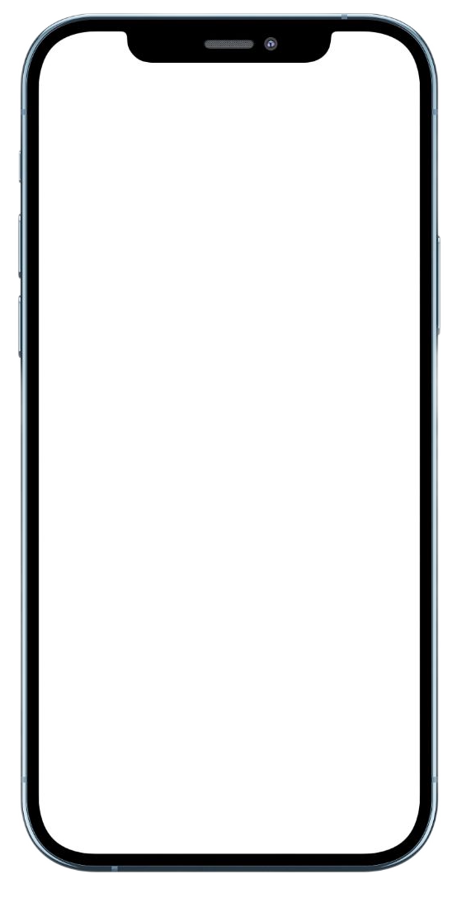
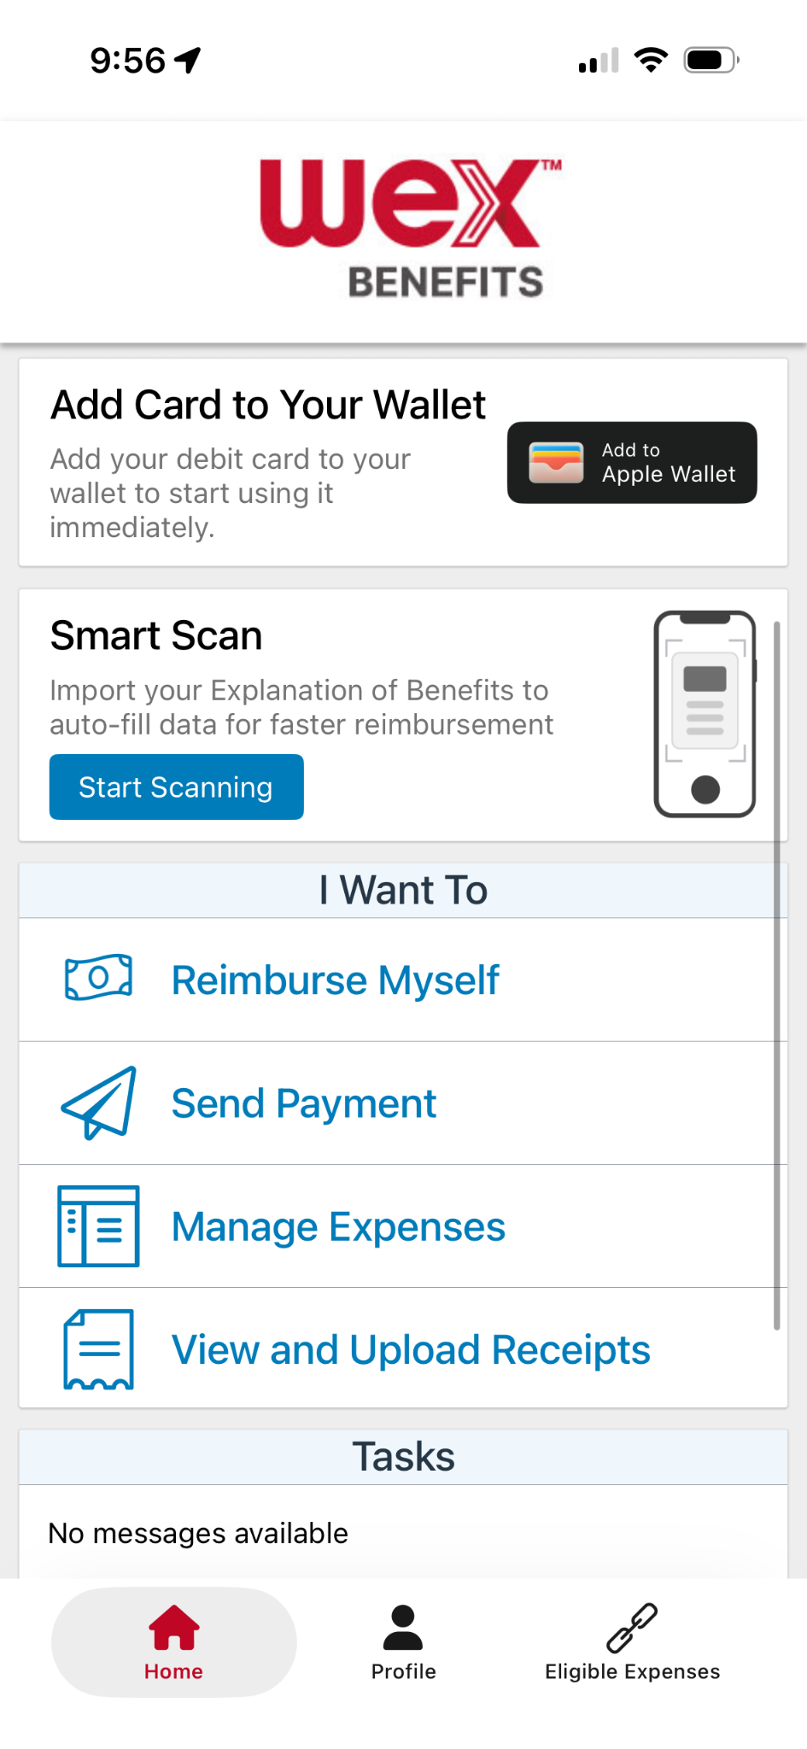
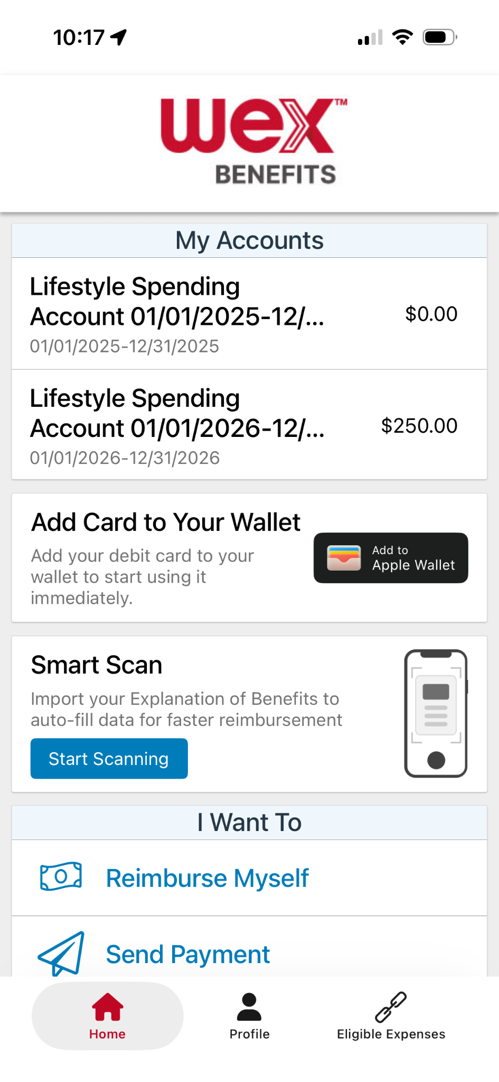
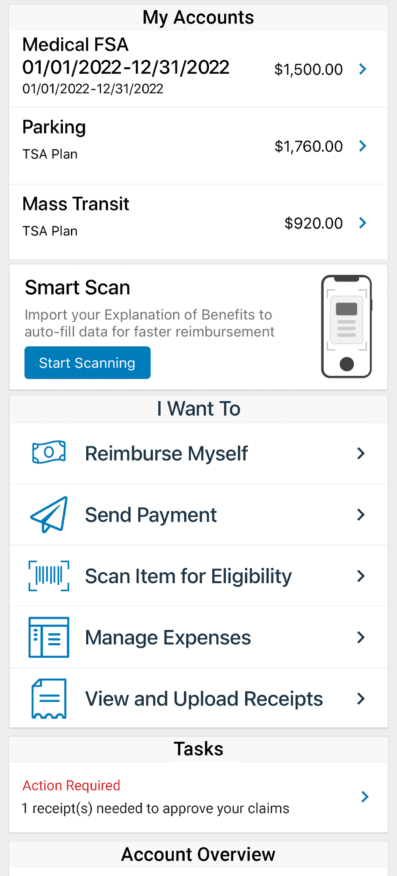
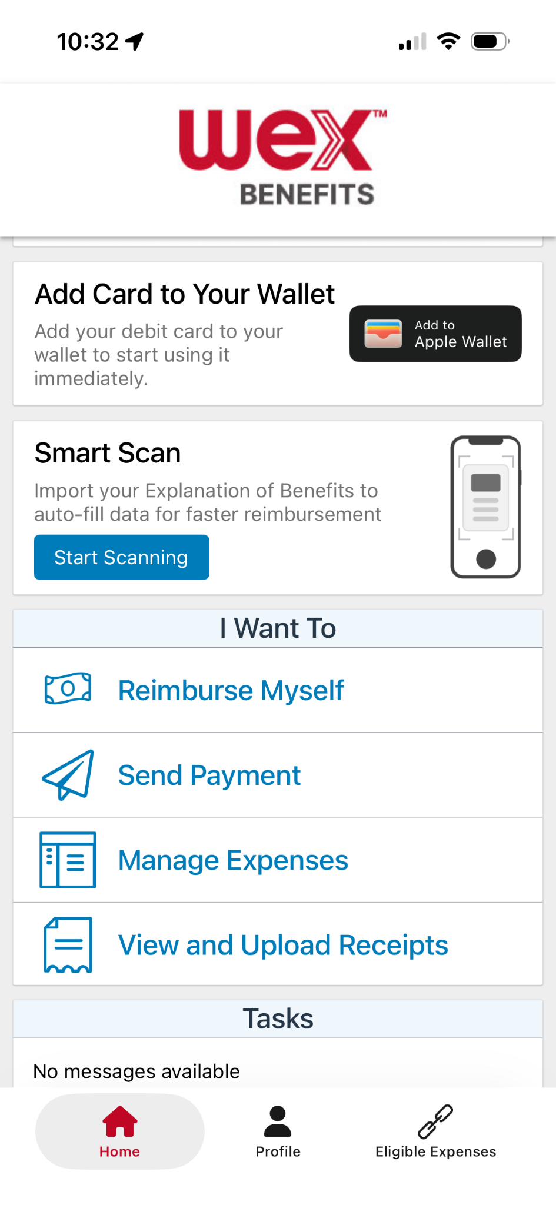

With our mobile app you can
Check your balance and view your activity.
Security on the go
Get instant notifications on the status of your claims.
01/01/2026-12/31/2026
01/01/2026 - 12/31/2026
Easily move funds from your HSA into your bank account to cover eligible expenses.
Our mobile app uses secure encryption and won’t store pictures on your phone, keeping your documentation safe and secure. Login is protected by a four digit passcode of your choosing. You can also log in with your thumbprint on Apple devices.
File a claim and upload documentation in seconds using your phone’s camera.
View current HSA investments balance, recent activity, and rate of return.
Scan an item’s barcode with your phone’s camera to determine if it is an IRS code 213(d) eligible expense.
Download the app for free on Apple and Android smartphones and tablets.
Scan Item for Eligibility
Reset login credentials.
Login with your Face ID.
Report a card as lost or stolen.
Page 10
Notes:
The WEX mobile app provides you with quick easy access to your online account. After logging in the first time, you can set up face ID access right from your phone, allowing you to quickly check your account balance or file claims right from the palm of your hand.

Slide 11


Contact Participant Services
Our Participant Services team is available Monday through Friday, from 6 a.m. to 9 p.m. CT, except holidays.
Website
www.wexinc.com
Current WEX participants
866-451-3399
New to WEX
844-561-1337
Page 11
Notes:
For any questions or assistance you may need, our participant services team is available to you Monday through Friday from 6 am to 9 pm Central time.
You have a variety of options to contact us. You can get support on our website at www.wexinc.com or call to speak to a participant services representative.
If participates ask for instructions…
Support on Website: To access the form, follow the below steps:
Navigate to www.wexinc.com > Support > Contact customer service team > Contact WEX benefits.
Select the following:
a. Type of Inquiry: Customer Service
b. I am a: Employee/Participant
Select “WEX Benefits Support Center”.
Complete the form.
A successful submission message will appear indicating that we'll be in touch.
The employee/participant will receive an email response with additional details or resolution to their inquiry.
Form URL: https://wexhealthinc.my.site.com/WEXbenefitscontactus/s/

Slide 12
Thank you!
Notes:
Notes

