Slide 1


Client Name
OPEN ENROLLMENT WEBINAR
Notes:
Thank you for joining us as we cover your company’s Health Savings Account.
This presentation is being presented by WEX. My name is ____________ and I am happy to be here with you today!

Slide 2
Client Name
OPEN ENROLLMENT PRESENTATION
Notes:
Thank you for joining us as we cover your company’s Health Savings Account.
This presentation is being presented by WEX. My name is ____________ and I am happy to be here with you today!

Slide 3
Health savings account
HSA
Notes:
During our presentation today, I will be reviewing what a health savings account, or HSA, is and why you should consider enrolling in an HSA.

Slide 4
What is a health savings account (HSA)?
Individually owned account
Funds roll over every year
Grow account through investments
Page 4
Notes:
A health savings account is a benefit that allows you to choose how much of your paycheck you’d like to set aside, before taxes are taken out, for eligible healthcare expenses that we’ll look at in just a moment, or use as a retirement savings tool.
Just some of the benefits are that it is YOURS and an individually owned account. Think of your HSA as a personal savings account. Any unspent money in your HSA remains yours and rolls over year after year, allowing you to grow your balance over time.
You also have investment options, You can invest your HSA funds in an interest-bearing account or our standard mutual fund lineup. Savvy investors may opt for a health savings brokerage account powered by Charles Schwab, giving you access to more than 8,500 mutual funds, stocks and bonds.
It is flexible and helps you save for a rainy day, Invest for your future retirement, Or simply spend your funds on qualified expenses, tax free.

Slide 5
Eligibility
You must be enrolled in a high-deductible health plan (HDHP)
Cannot be enrolled in a PPO or HMO health plan
Can be enrolled/covered by:
Limited FSA or combination FSA
Dependent care FSA
Page 5
Notes:
In order to be eligible for an HSA you must be enrolled in a high-deductible health plan (HDHP).
This means you cannot be covered by a PPO or HMO health plan regardless if you are enrolled in the plan or you are covered by your spouse’s or guardian’s PPO or HMO health plan.
For reference a PPO or HMO plan would have co-pays, and a HDHP would not. In order to qualify as a HDHP (in 2026), the health plan must have a deductible of at least $1700 for individual coverage and $3400 for family coverage.
Did you know you can enroll in an HSA and still enroll in a Limited or Combination FSA, and Dependent care FSA? —(Remove or edit SCRIPT and SLIDE if not applicable)

Slide 6
Tax advantages
Since 2003…
Tax-deductible contributions
Tax-free accumulation of interest & dividends
Tax-free distributions for qualified medical expenses
Page 6
Notes:
Health Savings Accounts offer a unique, triple-tax savings. This means that the money you contribute, earnings from investments and withdrawals for eligible expenses are all tax-free, offering more tax savings than a traditional Roth 401(k) and IRA, making it a powerful savings and retirement tool.

Slide 7

What does an HSA cover?
Eligible expenses include but are not limited to:
Copays, coinsurance, insurance premiums
Doctor visits and surgeries
Over-the-counter medications (first-aid, allergy, asthma, cold/flu, heartburn, etc.)
Prescription drugs
Birthing and Lamaze classes
Dental and orthodontia
Vision expenses, such as frames, contacts, prescription sunglasses, etc.
Notes:
Now what is eligible under an HSA? There are thousands of eligible items including but not limited to:
Copays, coinsurance, insurance premiums
Doctor visits and surgeries
Over-the-counter medications (first-aid, allergy, asthma, cold/flu, heartburn, etc.)
Prescription drugs
Birthing and lamaze classes
Dental and orthodontia
Vision expenses, such as frames, contacts, prescription sunglasses, etc

Slide 8

Benefits after age 65
You are eligible to contribute to an HSA after you turn 65 if you meet the following criteria:
You remain enrolled in a qualified high-deductible health plan (HDHP)
You do not enroll in Medicare
Note: If you sign up for Social Security, you are automatically enrolled in Medicare Part A.
Notes:
When you reach age 65, you can withdraw money (without penalty) and use it for anything, including non-healthcare expenses. You are eligible to contribute to an HSA after you turn 65 if you meet the following criteria:
You remain enrolled in a qualified high-deductible health plan (HDHP).
You do not enroll in Medicare.
Note: If you sign up for Social Security, you are automatically enrolled in Medicare Part A.
If you are enrolled in Medicare, you are not eligible to contribute to your HSA. However, you may continue to withdraw funds from your HSA without penalty. Distributions remain tax deductible if they are used to pay for qualified medical expenses.
Your spouse’s enrollment in Medicare doesn’t provide coverage for you, so you remain eligible to contribute to your HSA as long as you are not covered by a non-high-deductible health plan (non-HDHP). Your spouse’s qualified medical expenses are still eligible for reimbursement from your HSA even though your spouse is enrolled in Medicare.

Slide 9
Annual contribution limit
$4,400
Individual maximum contribution limit
Contributions
Pre-tax employer contributions
Pre-tax employee payroll contributions
Post-tax employee contributions outside of payroll deductions
$8,750
Family maximum contribution limit
$1,000
Catch-up contribution for age 55+
Page 9
Notes:
This slide represents the 2026 HSA annual contribution limits which ar $4400 for individual and $8750 family.
Your employer is contributing, $X,XXX for Individual plans and $X,XXX for family plans —(Remove or edit SCRIPT and SLIDE if not applicable)
You can contribute pre-tax via payroll contributions as well as post tax contributions, and contributions can be changed at any time throughout the year.
Your annual contributions should not exceed the annual limits or you may be fined by the IRS, and WEX will alert you via email if you contribute more than the IRS maximum with us. You can also set up text alerts so you receive a notification once you meet an established contribution threshold.
Any individual age 55 or older, who is currently enrolled and eligible for the HSA may contribute an additional $1000 (above and beyond the IRS maximum) annually to their account.
Studies are showing that Americans appreciate their benefits even more now and are in fact contributing more. Encourage you to sit down and run your numbers. Set savings goals. If you are just starting off, some will contribute just enough to cover their deductible. Then, if a healthcare expense comes out of left-field, it does not weigh you down. You can use your HSA. Then, save whenever you can. Some of those smaller items can be paid for out-of-pocket so that you can save your HSA instead. Down the road, you could always pull the HSA funds out if you really need them. Remember it is a health savings account, not a health spending account.

Slide 10


Meet Angela
Angela is a 38 year old mother of three with a full-time career
Without HSA
––––
With HSA
––––
GROSS ANNUAL PAY ……………….……. $60,000
TAX RATE (18%) …………………………..…. -$10,800
NET ANNUAL PAY ……………………....….. $49,200
HEALTHCARE EXPENSES ………….….… -$8,750
FINAL TAKE-HOME PAY …………….….. $40,450
GROSS ANNUAL PAY ……………….……. $60,000
ANNUAL HSA CONTRIBUTION ….… -$8,750
ADJUSTED GROSS PAY ……….….….... $51,250
TAX RATE (18%) …………………………....…. -$9,225
FINAL TAKE-HOME PAY …………….….. $42,025
Take home this much more with a health savings account.
$1,575
All figures in this table are estimates and based on an annual salary of $60,000 and maximum contribution limits to the benefit account. Your salary, tax rate, healthcare expenses and tax savings may be different.
Page 10
Notes:
Let us review a real life example of how having an HSA can save you money.
Meet Angela. Angela is a 38 year old mother of 3 kids and has a full time career.
She is enrolled in an HSA and makes an annual contribution of $8,750
Since her HSA contributions are taken out pre-tax her actual taxable income is lowered which means she has more take-home pay then if she didn’t have an HSA.
For Angela this means an additional $1,575 dollars to use for expenses or maybe even for a fun trip with her family.

Slide 11
FSA
HSA
Control | Owned by the employer | Owned by the employee
Funding | Employer and/or employee funded | Employer and/or employee funded
Health plan eligibility | Must be offered a group health plan by employer | Must be enrolled in a high deductible health plan
Can participants invest funds? | No | Yes
Can participants roll over funds? | No | Yes
Page 11
Notes:
To help demonstrate what an HSA is, let us compare it to a standard flexible spending account.
FSA – an FSA is employer owned and you forfeit any unused money back at the end of a plan year vs. an HSA – that is employee owned and you can take all money in the account with you even if you leave the company.
Both can receive Employer and Employee contributions.
To be eligible for the FSA –a group health plan must be offered by the Employer.
Where as with the HSA – an individual must be enrolled in a high deductible health plan to be considered eligible.
And, only the HSA provides participants with investment options.

Slide 12
Investment
options
Interest earned on all funds
Low threshold to access investment options
Approx. 30 different mutual funds
Health Savings Brokerage Account for expanded investment opportunities
Easily view and manage investments through online account and mobile app
Automated money movement between cash and investments (excluding brokerage account)
Page 12
Notes:
So let us talk a little more about investment options.
After you have met your minimum cash balance you can start investing your HSA funds.
You can invest your HSA funds in an interest-bearing account or our standard mutual fund lineup. Savvy investors may opt for a health savings brokerage account powered by Charles Schwab, giving you access to more than 8,500 mutual funds, stocks and bonds.
You can even keep track of your HSA portfolio right from your benefits mobile app!

Slide 13
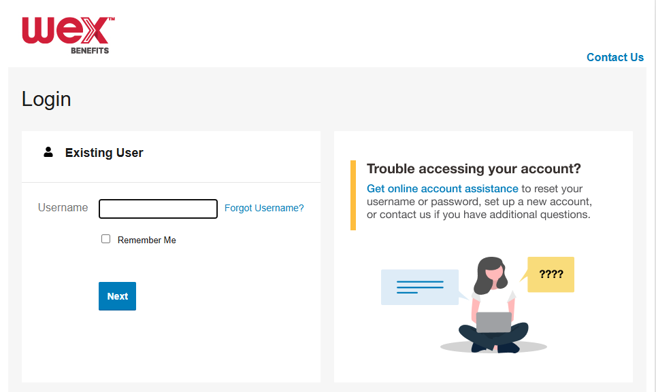
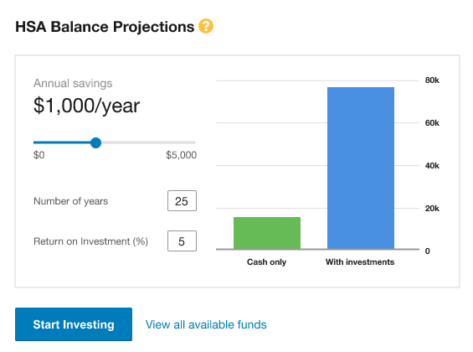
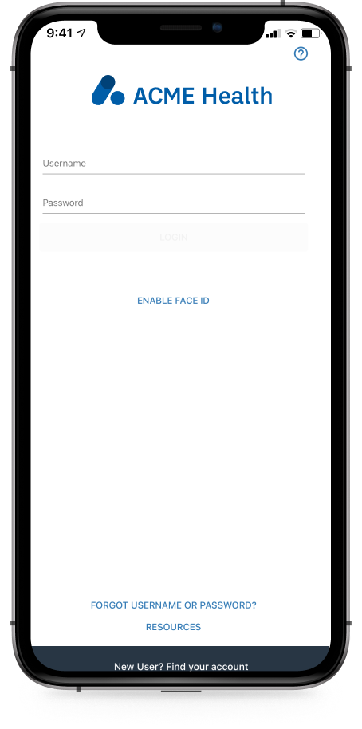

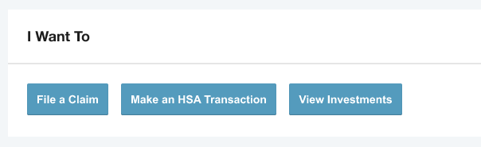
Investing with your HSA
HSAs are a powerful investment and retirement tool. Getting started is simple. You can begin investing in just 3 easy steps.
1
2
3
Log in to your WEX online account or mobile app.
From the homepage,
click “View Investments.”
Click “Start Investing” to choose your investments
or use our guidance tool.
Page 13
Notes:
If you’re ready to start investing, it’s easy. Just log in to your account, open your HSA investment account, and click “Start Investing.”
You’ll have the choice to pick your own funds, or you can use our guidance tool if you’d like help deciding.

Slide 14

Your role
Ensure funds are used for eligible health care expenses
No documentation required for the HSA
Recommend saving contributions and distributions for tax purposes – your account’s expense tracker makes it easy to store receipts in one place
WEX will provide HSA participants with the necessary tax forms, it will remain your responsibility to report these contributions on your taxes
Notes:
So what do you need to do when it comes to your HSA?
WEX will make it easy for you to manage your HSA with an online account, free benefits mobile app as well as text and email alerts.
All you have to do is make sure you use your HSA for eligible health care expenses.
We recommend saving your documentation such as itemized receipts and EOBs for tax purposes. You can use the expense tracker in your account to store everything in one place.
Then at the end of the year we will provide you with the necessary tax forms for you to file your taxes. But it is still your responsibility to report your HSA contributions and distributions at tax time.

Slide 15
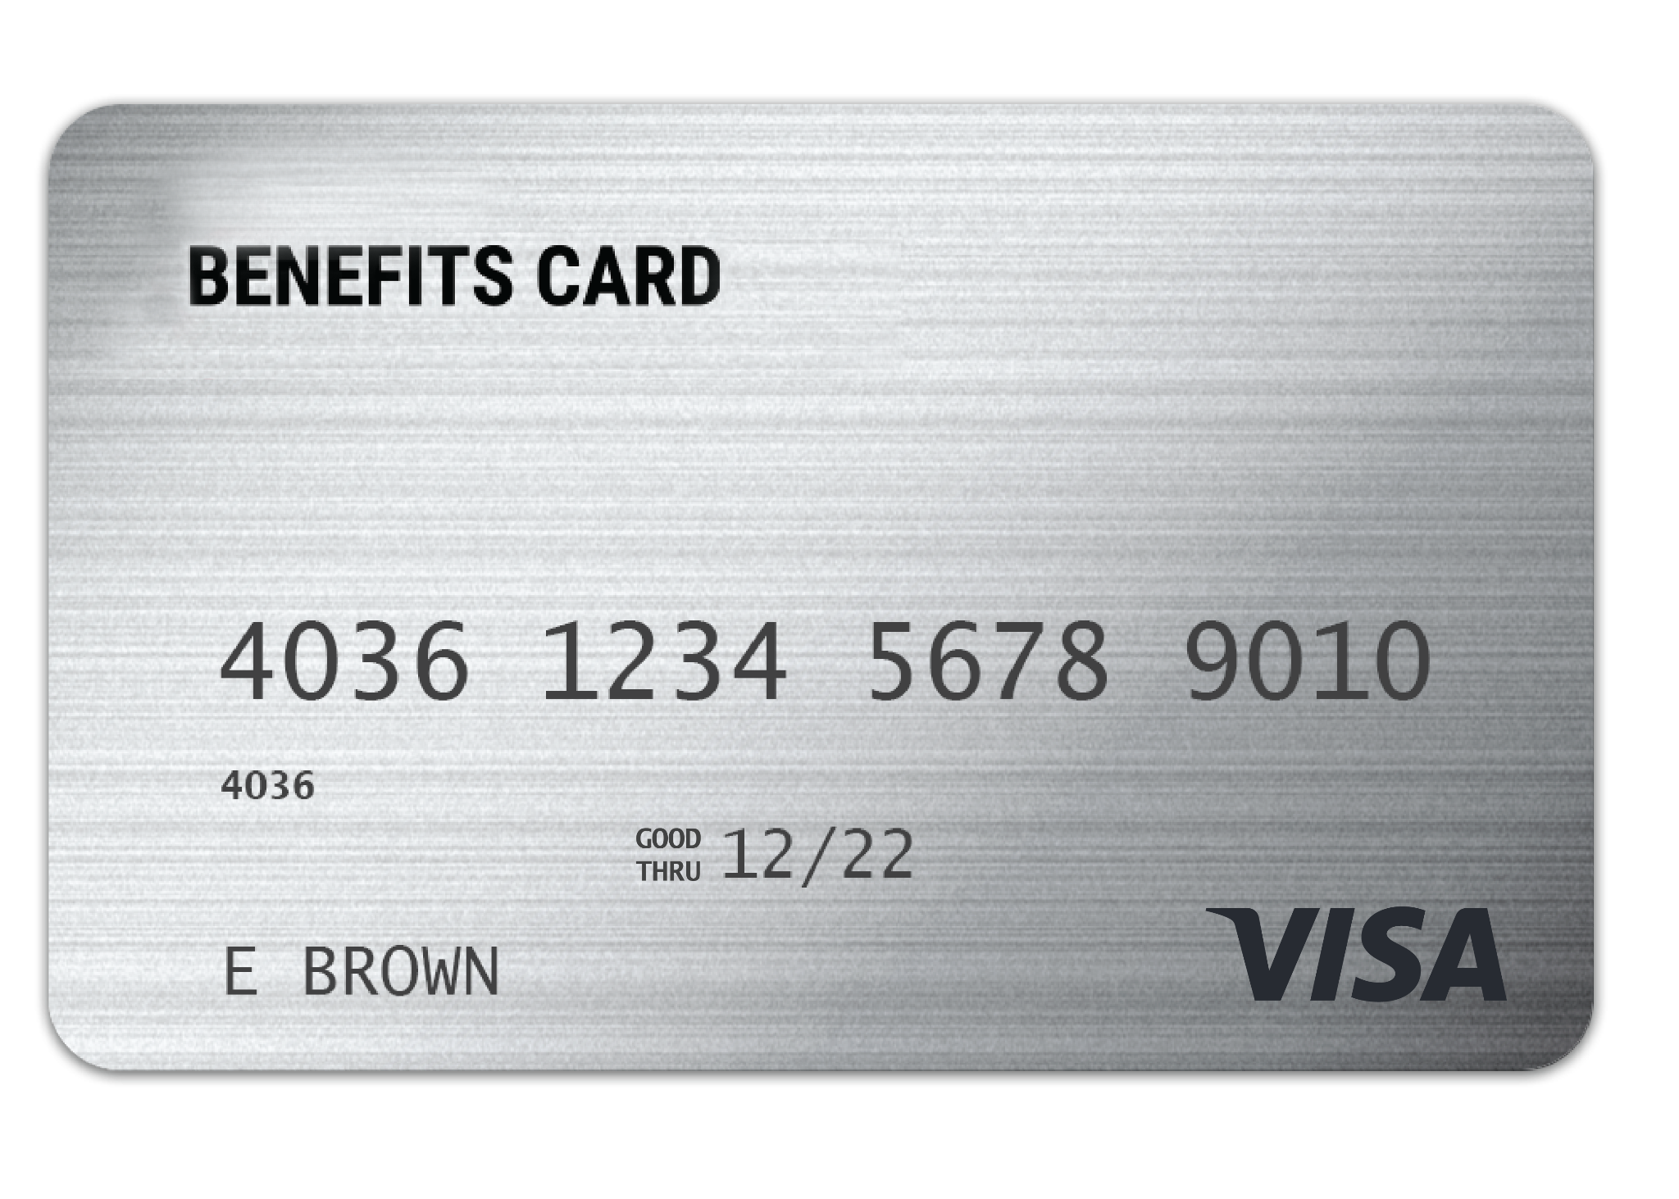
WEX
benefits card
One card to easily access your funds and pay for eligible expenses.
Free benefits card
Add to your mobile wallet for easy access on the go
Minimize the amount of out-of-pocket spending
Valid for three years
Instant access to plan funds
Page 15
Notes:
Your enrollment in an HSA includes our free benefits debit card. This allows you to easily access your HSA funds right from your wallet to help you minimize the amount of out of pocket spending.
You also have the option to add your benefits debit card to your mobile wallet, giving you convenient access on the go.
If you already have our debit card, they are good for three years, so if you received one within the last two years you will not get a new one again next year. We will mail you a new debit card 90 days before the expiration date of your current debit card. All new cards will be good for 4 years.
Regardless if you are enrolled in an HSA or other WEX benefits you will use the same card.
If your card is lost or stolen, you can order a new card free of charge from the benefits mobile app or by going through your online account.
The WEX Benefits Debit Card is the most common way that distributions are made from your HSA.

Slide 16
Accessing your HSA funds
Mobile app or online
account
Distribution request
Pay your provider from your online account or mobile app – check issued from your HSA to your provider
Distribution request to you via free direct deposit or paper check
Page 16
Notes:
In addition to using your debit card you can also submit a distribution request from your HSA at anytime.
You can login to your online account or use your mobile app to request a payment to be sent directly to your provider or request a distribution directly to yourself for an expense you paid out of pocket.
And do not forget about direct deposit! You can set up direct deposit directly from your online account allowing us to automatically distribute funds directly to your bank account.

Slide 17

Financial wellness through your HSA
Investment guidance tool
My HSA planner
Page 17
Notes:
WEX also provides you with a variety of tools to help you manage your health care expenses including:
Your online account has an investment guidance tool – just follow the series of questions about your HSA goals and we will provide you with recommendations.
We also have an HSA calculator to help you estimate how much to contribute into your HSA each year.

Slide 18
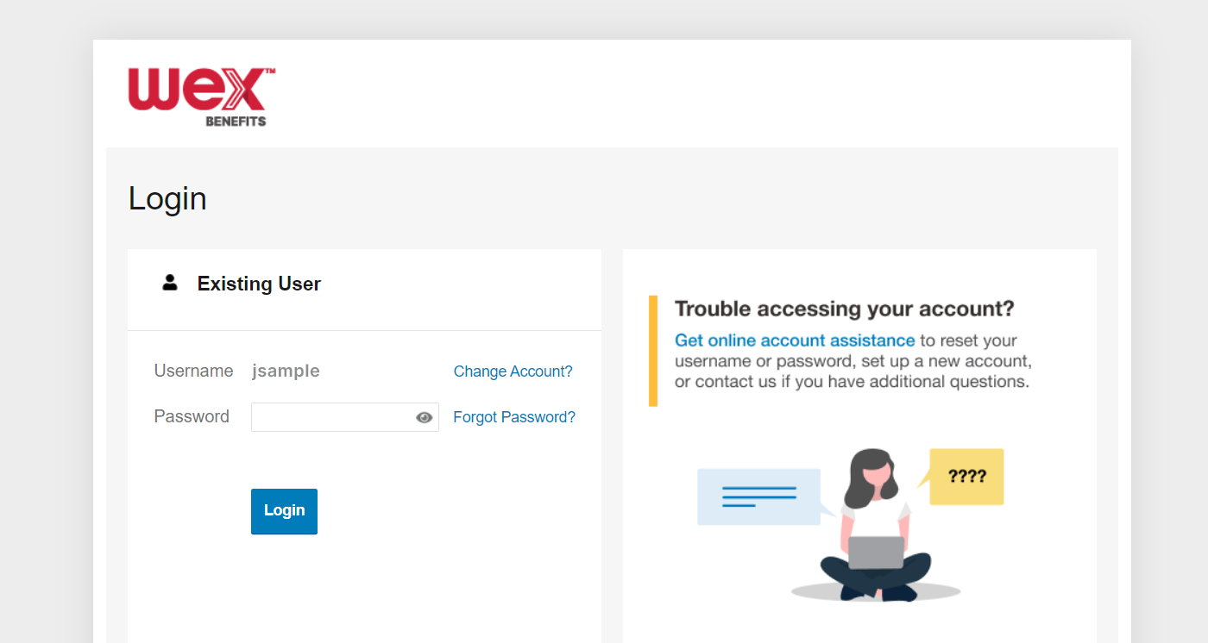

Account access
Online account
Mobile app
Page 18
Notes:
Now let’s end with a highlight of how you can access all of your accounts with us.
You can get access your account information by logging into your online account. Here you see details and balances of any accounts with us, transactions, and complete any tasks you’d like or need to take on your account. We also have the free WEX benefits mobile app.

Slide 19

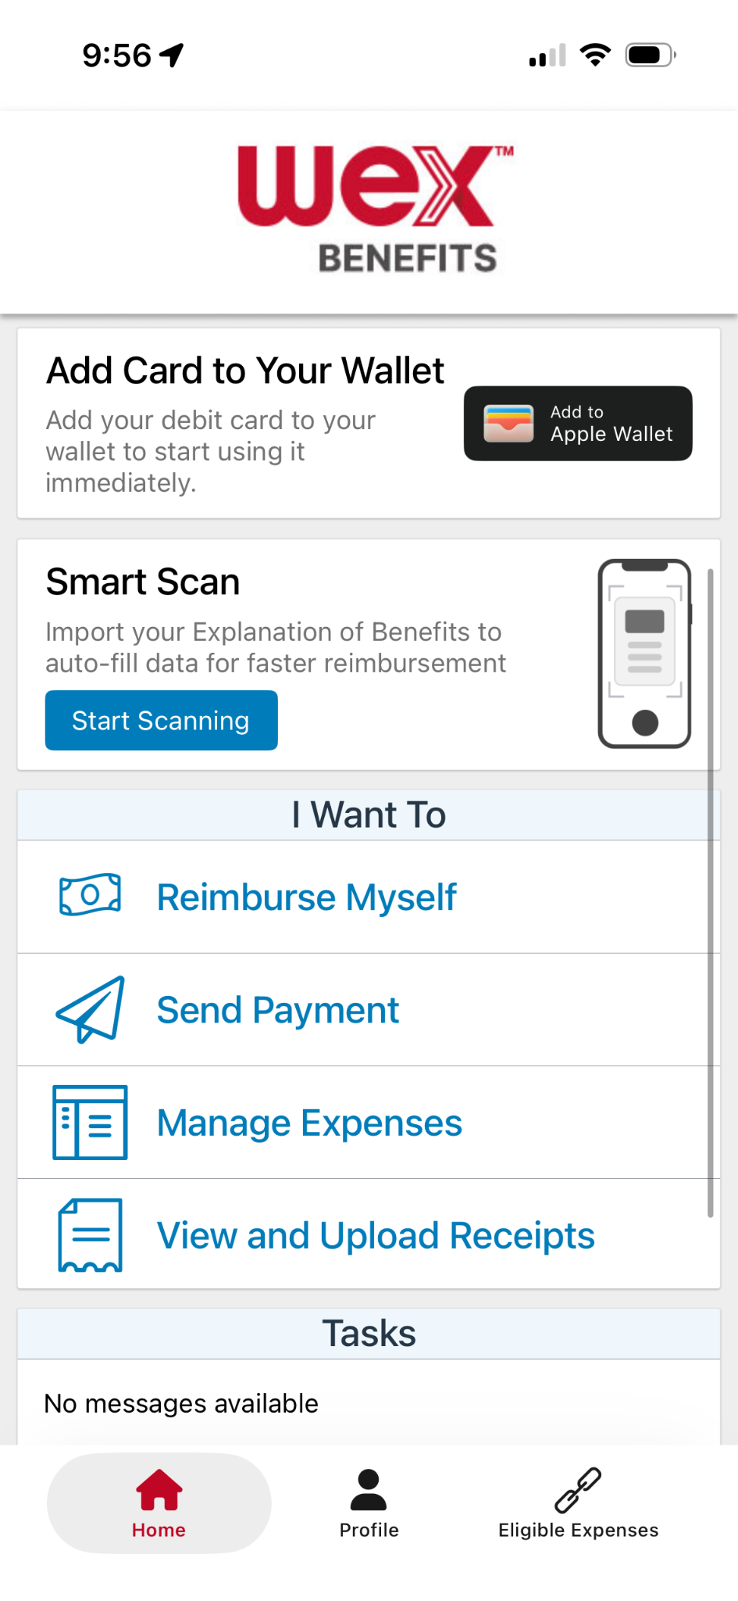
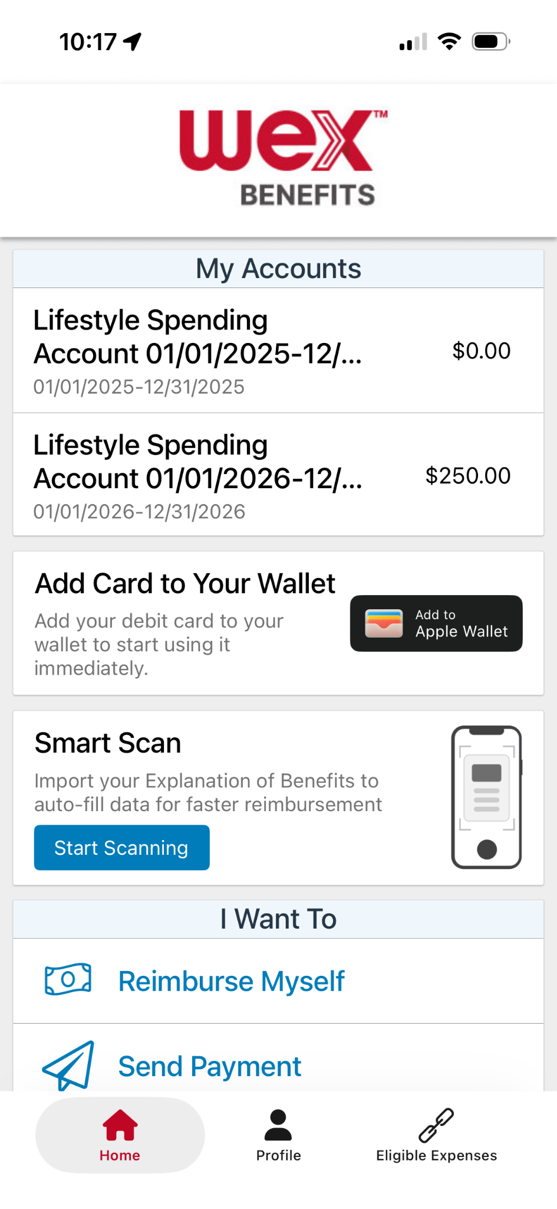
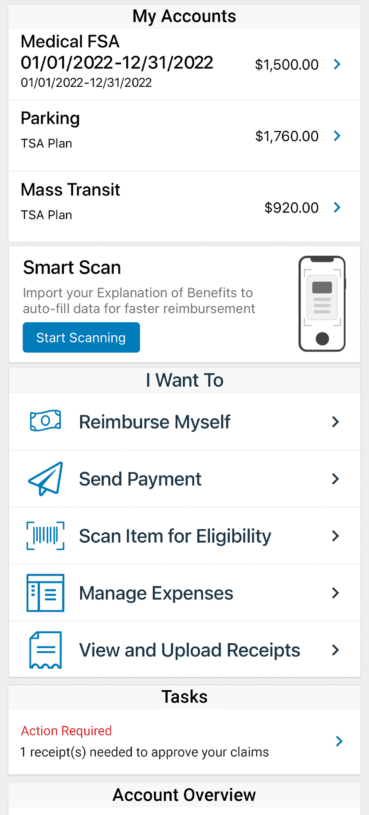
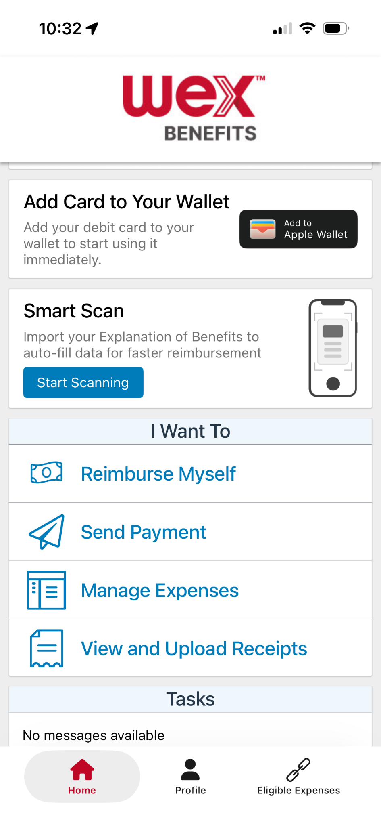

With our mobile app you can
Check your balance and view your activity.
Security on the go
Get instant notifications on the status of your claims.
01/01/2026-12/31/2026
01/01/2026 - 12/31/2026
Easily move funds from your HSA into your bank account to cover eligible expenses.
Our mobile app uses secure encryption and won’t store pictures on your phone, keeping your documentation safe and secure. Login is protected by a four digit passcode of your choosing. You can also log in with your thumbprint on Apple devices.
File a claim and upload documentation in seconds using your phone’s camera.
View current HSA investments balance, recent activity, and rate of return.
Scan an item’s barcode with your phone’s camera to determine if it is an IRS code 213(d) eligible expense.
Download the app for free on Apple and Android smartphones and tablets.
Scan Item for Eligibility
Reset login credentials.
Login with your Face ID.
Report a card as lost or stolen.
Page 19
Notes:
The WEX mobile app provides you with quick easy access to your online account. After logging in the first time, you can set up face ID access right from your phone.
Other great features include:
An eligible expense scanner – scan barcodes of items to see if they qualify as an eligible expense. — (Remove if not applicable)
Take a photo of your explanation of benefits or itemized receipt in order to submit documentation for any outstanding claims. This saves a ton of time since you don’t have to scan an email receipt and upload it manually.
Easily check your account balance while standing in line at the store, making it easy to decide if you want to use your HSA dollars to cover a purchase.

Slide 20


Contact Participant Services
Our Participant Services team is available Monday through Friday, from 6 a.m. to 9 p.m. CT, except holidays.
Website
www.wexinc.com
Current WEX participants
866-451-3399
New to WEX
844-561-1337
Page 20
Notes:
For any questions or assistance you may need, our participant services team is available to you Monday through Friday from 6 am to 9 pm Central time.
You have a variety of options to contact us. You can get support on our website at www.wexinc.com or call to speak to a participant services representative.
If participates ask for instructions…
Support on Website: To access the form, follow the below steps:
Navigate to www.wexinc.com > Support > Contact customer service team > Contact WEX benefits.
Select the following:
a. Type of Inquiry: Customer Service
b. I am a: Employee/Participant
Select “WEX Benefits Support Center”.
Complete the form.
A successful submission message will appear indicating that we'll be in touch.
The employee/participant will receive an email response with additional details or resolution to their inquiry.
Form URL: https://wexhealthinc.my.site.com/WEXbenefitscontactus/s/

Slide 21
Thank you!

