Slide 1


Client Name
OPEN ENROLLMENT WEBINAR
Notes:
Thank you for joining us as we cover your company’s Lifestyle Spending Account.
This presentation is being presented by WEX. My name is ____________ and I am happy to be here with you today!

Slide 2
Client Name
OPEN ENROLLMENT PRESENTATION
Notes:
Thank you for joining us as we cover your company’s Lifestyle Spending Account.
This presentation is being presented by WEX. My name is ____________ and I am happy to be here with you today!

Slide 3
Lifestyle spending account
LSA
Notes:
During our presentation today, I will be reviewing what a lifestyle spending account, or LSA, is and why you should consider enrolling in an LSA.

Slide 4
What is a lifestyle spending account?
Designed and funded by your employer – post tax
Funds for a positive lifestyle
Can be paired with other benefit plans
Page 4
Notes:
A lifestyle spending account, or LSA, is a benefits account funded by your employer. With those funds, an LSA is used for qualified expenses that promote a happy and healthy lifestyle by reimbursing you for eligible physical, emotional, and financial wellness expenses.
The LSA is funded by post-tax employer contributions which means distributions from the LSA will be treated as taxable income. If there are any funds left over at the end of the year, they cannot be cashed out.
If you have a flexible spending account, also known as an FSA, or a health savings account, also called an HSA, they can be paired with an LSA to manage the long-term and short-term expenses that are a part of life.

Slide 5
Eligibility
LSA eligibility is determined by your employer
Be sure to reach out to a representative from your human resources team for more information
Page 5
Notes:
Your employer has control over how much can be contributed to the plan, and whether funds carry over to the next plan year.
Your employer also determines when contributions become available. This could be 100% at the beginning of the plan year, scheduled throughout the year, or activity based. For example: upon successful completion of certain health-related tasks.
Your employer also determines who is eligible to participate in an LSA. Be sure to reach out to your human resources representative for the specifics of your LSA plan!

Slide 6


What does an LSA cover?
Eligible expenses are determined by your employer but may include expenses such as:
Gym memberships
Pet care
Fitness trackers
Financial advisors
Personal development classes
Notes:
Your employer also determines what expenses are eligible for reimbursement. These can vary quite a bit from student loan payments, to gym memberships and much more.

Slide 7
FSA
LSA
Control | Owned by the employer | Owned by the employer
Funding | Employer and/or employee funded | Employer funded
Contribution limits | Set by the IRS | Set by the employer
Eligible expenses | Medical, dental, vision, and preventive | Physical, emotional, and financial wellness expenses - determined by employer
Are distributions taxable? | No | Yes
Can participants roll over funds? | No | Determined by employer
Notes:
To help demonstrate what an LSA is, we are going to compare it to a standard flexible spending account.
FSA – an FSA is employer owned and you forfeit any unused money back at the end of a plan year an LSA works the same way.
An FSA can be funded by either the employer OR the employee. An LSA is strictly funded by the employer.
An FSA can be used to reimburse expenses for medical, dental, vision, and preventive goods or services. LSA eligible expenses are medical, emotional, and/or financial expenses that are determined by your employer.
Reimbursements from your FSA are pre-tax dollars, and you do not pay taxes on the amount you are reimbursed. LSA reimbursements are post-tax funds that will be counted towards your taxable income.
FSA funds are considered use-it-or-lose-it. With an LSA, your employer will determine whether or not you can roll unused funds into the next plan year.

Slide 8
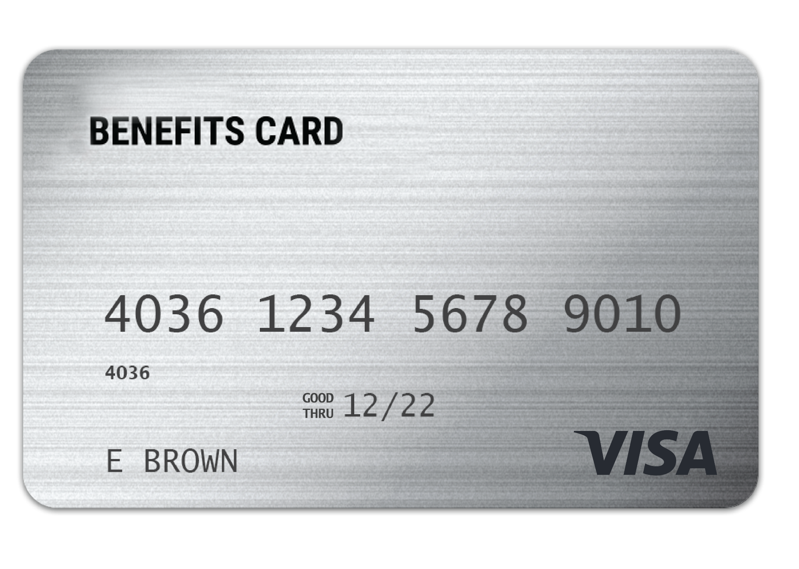
WEX
benefits card
One card to easily access your funds and pay for eligible expenses.
Free benefits card
Add to your mobile wallet for easy access on the go
Minimize the amount of out-of-pocket spending
Valid for three years
Instant access to plan funds
Page 8
Notes:
Your enrollment in any of our plans includes our free benefits debit card. This allows you to easily access your funds right from your wallet to help you minimize the amount of out of pocket spending.
You also have the option to add your benefits debit card to your mobile wallet, giving you convenient access on the go.
If you already have our debit card, they are good for 3 years, so if you received one within the last 2 years you will not get a new one again next year. We will mail you a new debit card 90 days before the expiration date of your current debit card. All new cards will be good for 4 years.
Regardless if you are enrolled in an LSA or other WEX benefits you will use the same card.
If your card is lost or stolen, you can order a new card free of charge from the benefits mobile app or by going through your online account.

Slide 9
Any documentation provided must contain the following information:
When the expense was incurred
Where the expense was incurred
What the expense was
The amount/cost of the expense incurred
Claim filing
The best form of documentation when submitting a claim is an itemized receipt from your provider.
Page 9
Notes:
Let us talk a bit about documentation! (say jokingly) Everyone loves providing documentation, right?
For anything you paid out of pocket, you can submit a reimbursement request with documentation showing the following information:
When the expense was incurred
Where the expense was incurred
What the expense was
The amount/cost of the expense incurred

Slide 10
Accessing your LSA funds
Mobile app or online
account
Claim request
Pay your provider from your online account or mobile app – check issued from your LSA to your provider
Accepted claims sent via free direct deposit or paper check
Page 10
Notes:
Depending on your plan design you can file a claim in your online account or mobile app, or may be able to submit a Claim Form as well.
Once approved, you’ll either receive a check reimbursement, OR you can set up direct deposit. This can be done easily through your online account and allows us to add funds directly to your bank account!

Slide 11
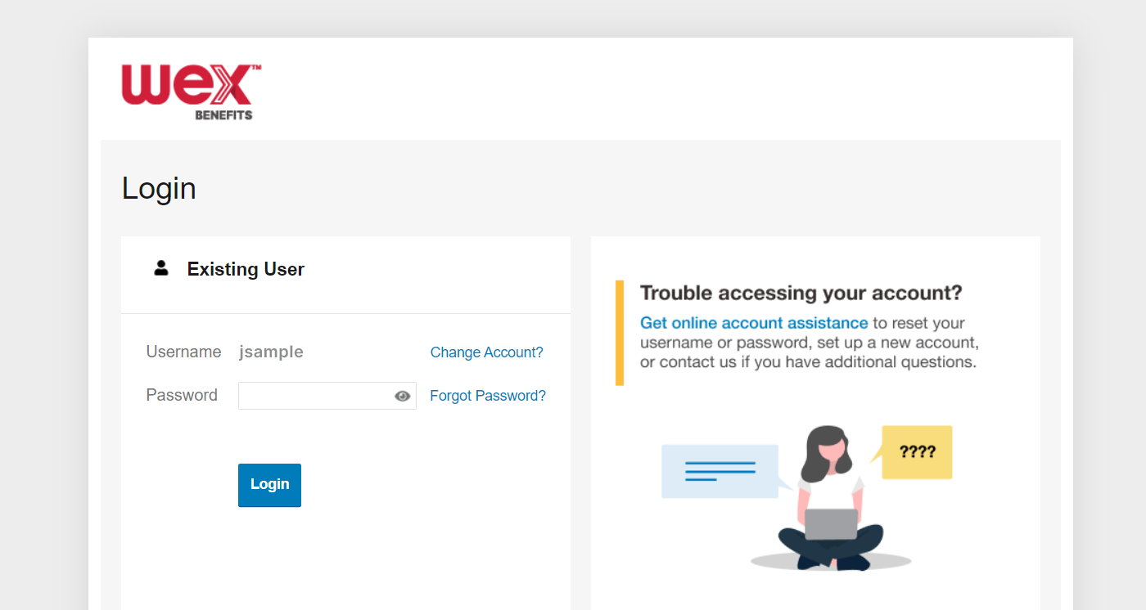

Account access
Online account
Mobile app
Page 11
Notes:
Now let’s end with a highlight of how you can access all of your accounts with us.
You can get access your account information by logging into your online account. Here you see details and balances of any accounts with us, transactions, and complete any tasks you’d like or need to take on your account. We also have the free WEX benefits mobile app.

Slide 12
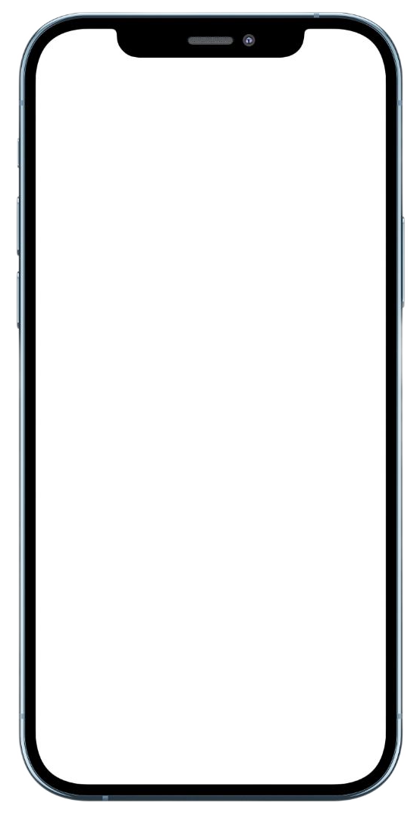
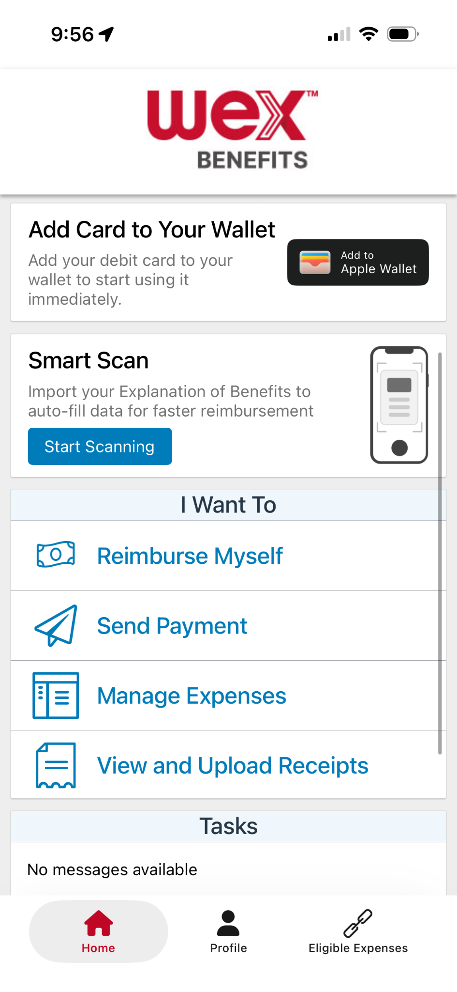
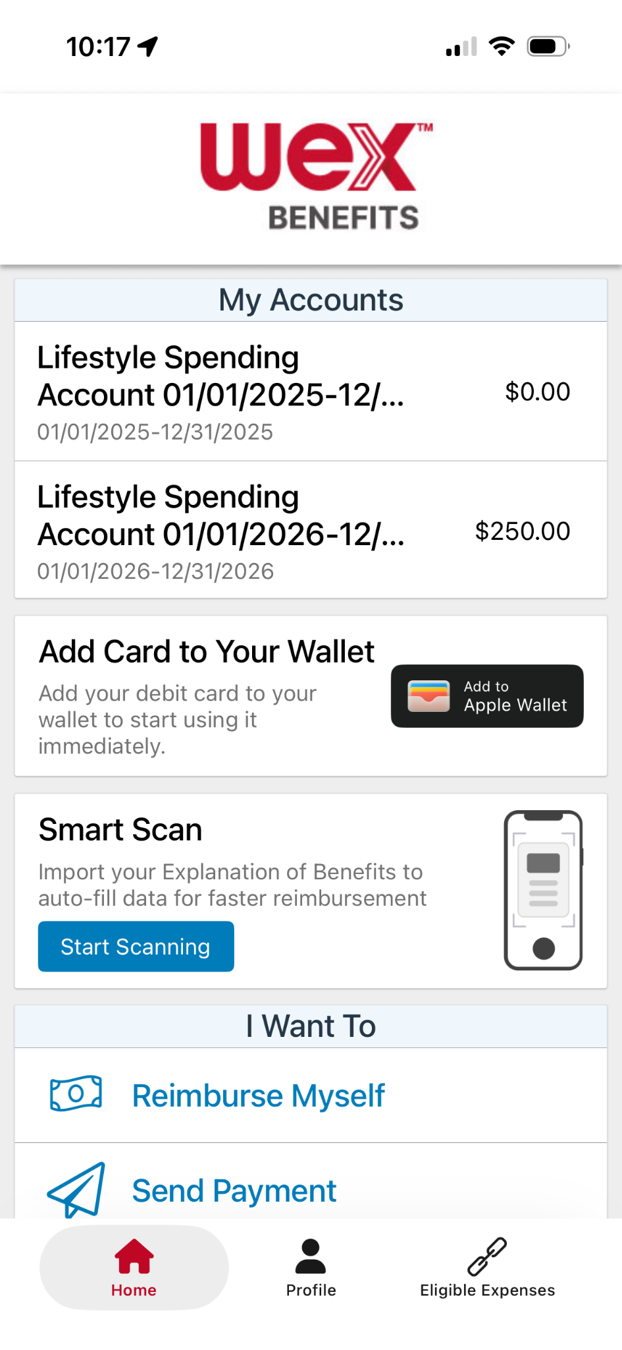
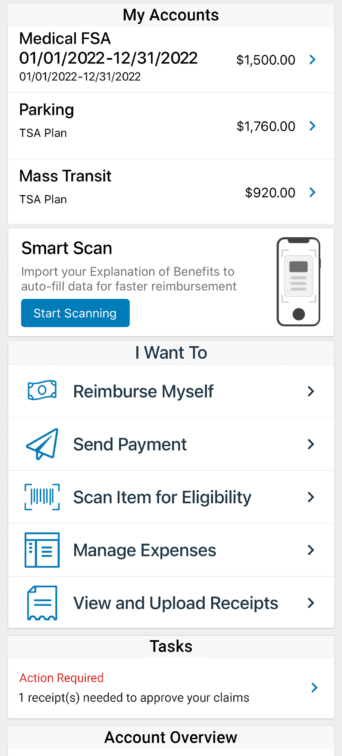
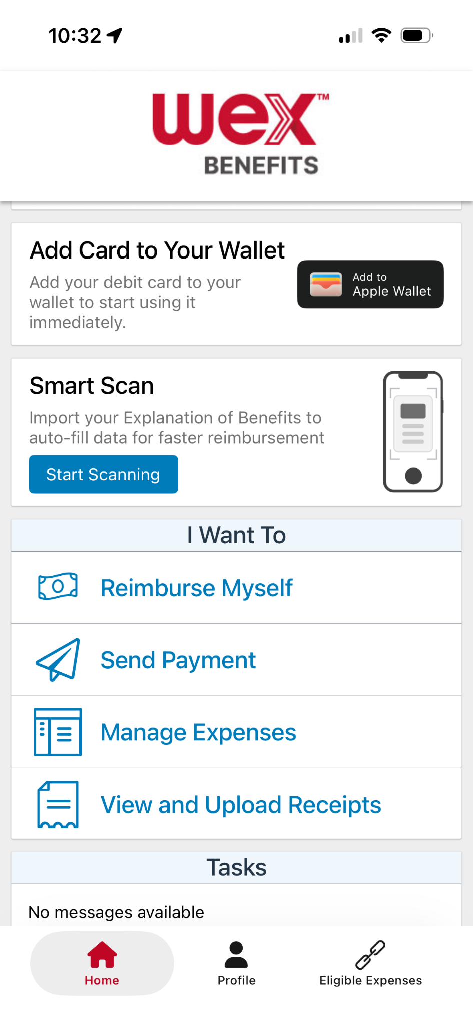

With our mobile app you can
Check your balance and view your activity.
Security on the go
Get instant notifications on the status of your claims.
01/01/2026-12/31/2026
01/01/2026 - 12/31/2026
Easily move funds from your HSA into your bank account to cover eligible expenses.
Our mobile app uses secure encryption and won’t store pictures on your phone, keeping your documentation safe and secure. Login is protected by a four digit passcode of your choosing. You can also log in with your thumbprint on Apple devices.
File a claim and upload documentation in seconds using your phone’s camera.
View current HSA investments balance, recent activity, and rate of return.
Scan an item’s barcode with your phone’s camera to determine if it is an IRS code 213(d) eligible expense.
Download the app for free on Apple and Android smartphones and tablets.
Scan Item for Eligibility
Reset login credentials.
Login with your Face ID.
Report a card as lost or stolen.
Page 12
Notes:
The WEX mobile app provides you with quick easy access to your online account. After logging in the first time, you can set up face ID access right from your phone.
Other great features include:
An eligible expense scanner – scan barcodes of items to see if they qualify as an eligible expense. — (Remove if not applicable)
Take a photo of your explanation of benefits or itemized receipt in order to submit documentation for any outstanding claims. This saves a ton of time since you don’t have to scan an email receipt and upload it manually.
Easily check your account balance while standing in line at the store, making it easy to decide if you want to use your plan dollars to cover a purchase.

Slide 13


Contact Participant Services
Our Participant Services team is available Monday through Friday, from 6 a.m. to 9 p.m. CT, except holidays.
Website
www.wexinc.com
Current WEX participants
866-451-3399
New to WEX
844-561-1337
Page 13
Notes:
For any questions or assistance you may need, our participant services team is available to you Monday through Friday from 6 am to 9 pm Central time.
You have a variety of options to contact us. You can get support on our website at www.wexinc.com or call to speak to a participant services representative.
If participates ask for instructions…
Support on Website: To access the form, follow the below steps:
Navigate to www.wexinc.com > Support > Contact customer service team > Contact WEX benefits.
Select the following:
a. Type of Inquiry: Customer Service
b. I am a: Employee/Participant
Select “WEX Benefits Support Center”.
Complete the form.
A successful submission message will appear indicating that we'll be in touch.
The employee/participant will receive an email response with additional details or resolution to their inquiry.
Form URL: https://wexhealthinc.my.site.com/WEXbenefitscontactus/s/

Slide 14
Thank you!

